Slide 1
Why Do People Buy Luxury Products?
YinYi Huang, Queenty
Institute for Tourism Studies, Macau, China

Slide 2
Agenda
Theoretical Background
Literature review
Results and discussion
Limitations and Further Research
Methodology

Slide 3
Theoretical Background
Literature review
Results and discussion
Limitations and Further Research
Methodology

Slide 4
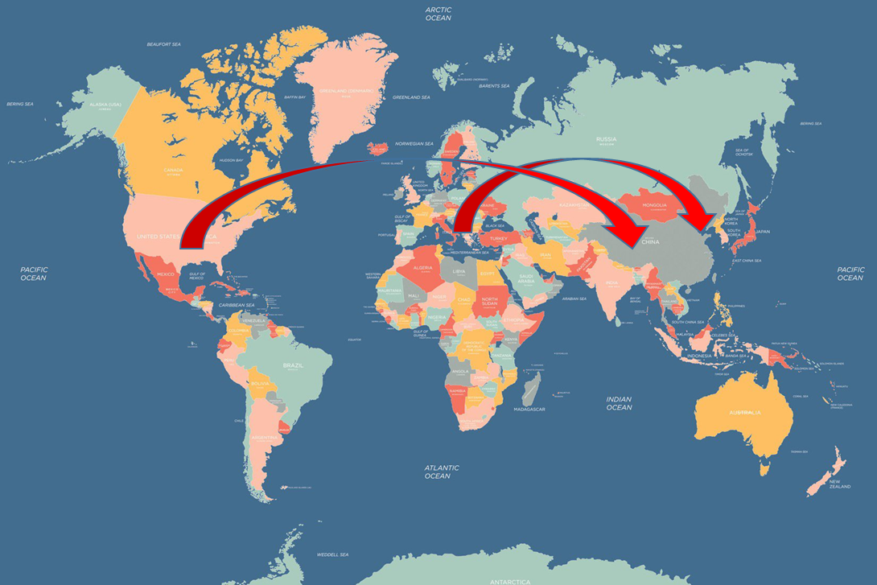
Luxury industries
Luxury industries are booming in new rich markets in Asia (Park & Reisinger, 2009).
Luxury companies started to develop their business to satisfy the increasing demand from Asian markets because of the recent economic recession in Europe (Park et al., 2008).

Slide 5
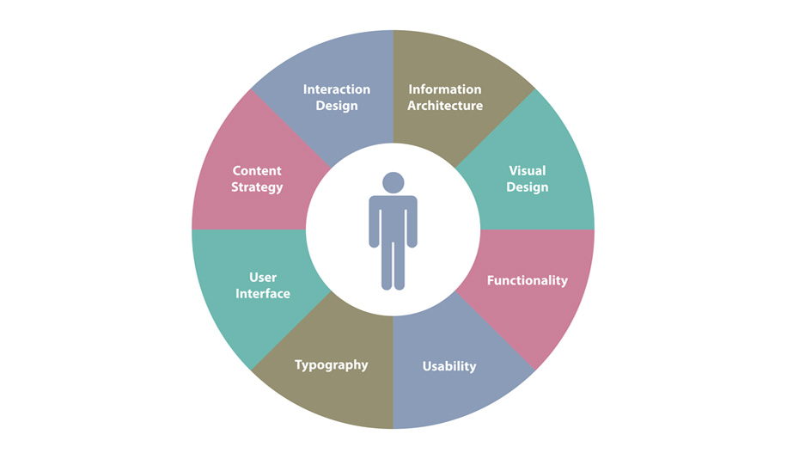
Importance of this study
Customers have desire to be different and impress others by owning luxury or unique goods (Naz & Lohdi, 2016).
It is critical to understand the changing perceptions and preferences of customers (Zhang & Kim, 2013).

Slide 6
Research gap
Customers’ needs for higher social status and better appearances (Park & Reisinger, 2009)
Personal feelings and emotions (Vigneron & Johnson, 2004)
Demographic characteristics (Hauck & Stanforth, 2007)
Luxury perceptions of Chinese customers in Macao
The impact of marital status on luxury perceptions

Slide 7
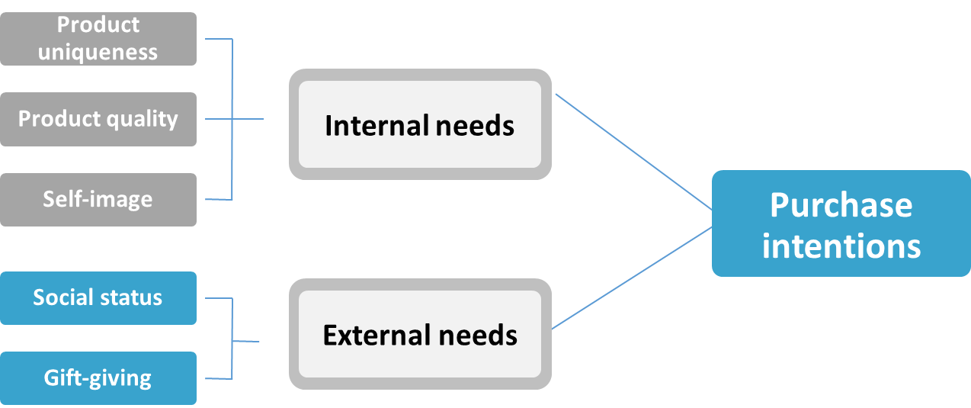
Research objectives & Hypothesis
The influence of luxury perceptions of Chinese customers in Macao on luxury purchase intentions

Slide 8
Research objectives & Hypothesis
The influence of marital status of Chinese customers in Macao on luxury purchase intentions.
Single
In a relationship
Marital status
Purchase intentions
Married

Slide 9
Theoretical Background
Literature review
Results and discussion
Limitations and Further Research
Methodology

Slide 10
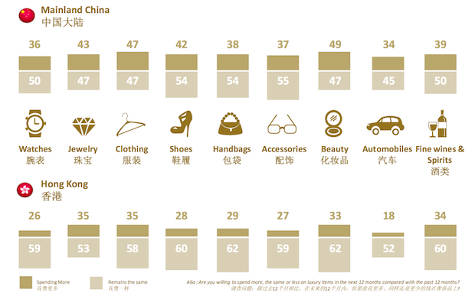
Concept of luxury
Products with particular brands which can bring prestige and reputation to owners
Provide emotional benefits to the users (Sheth, Newman & Gross, 1991).

Slide 11
Perceptions of luxury
Different use of a product could generate opposite opinions on consumers’ perceptions and buying behaviors (Godey et al., 2012).
Internal needs
External needs

Slide 12
Internal needs
Product uniqueness
  The degree to which customers believe that a brand or a product is different from other brands or products in the same level (Wiedman et al., 2007)
Product quality
  A brand name could reflect and offer a guaranteed quality and design (Prendergast & Wong, 2003).
Self-image
  Self-image is very important for Brazilian teens’ consumer buying preference (Gil et al., 2012)

Slide 13


External needs
Social status
  Social comparison theory (Festinger, 1954)
Gift-giving
  Gift-giving with luxury products (Park & Reisinger, 2009)

Slide 14
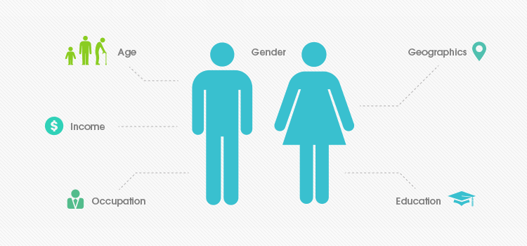
Demographic factors
Age (Hauck & Stanforth, 2007)
Economic condition (Dubois & Duquesne, 1993)
Gender (Stokburger-Sauer & Teichmann, 2013)
Marital status (Bhanot et al., 2015)

Slide 15
Theoretical Background
Literature review
Results and discussion
Limitations and Further Research
Methodology

Slide 16
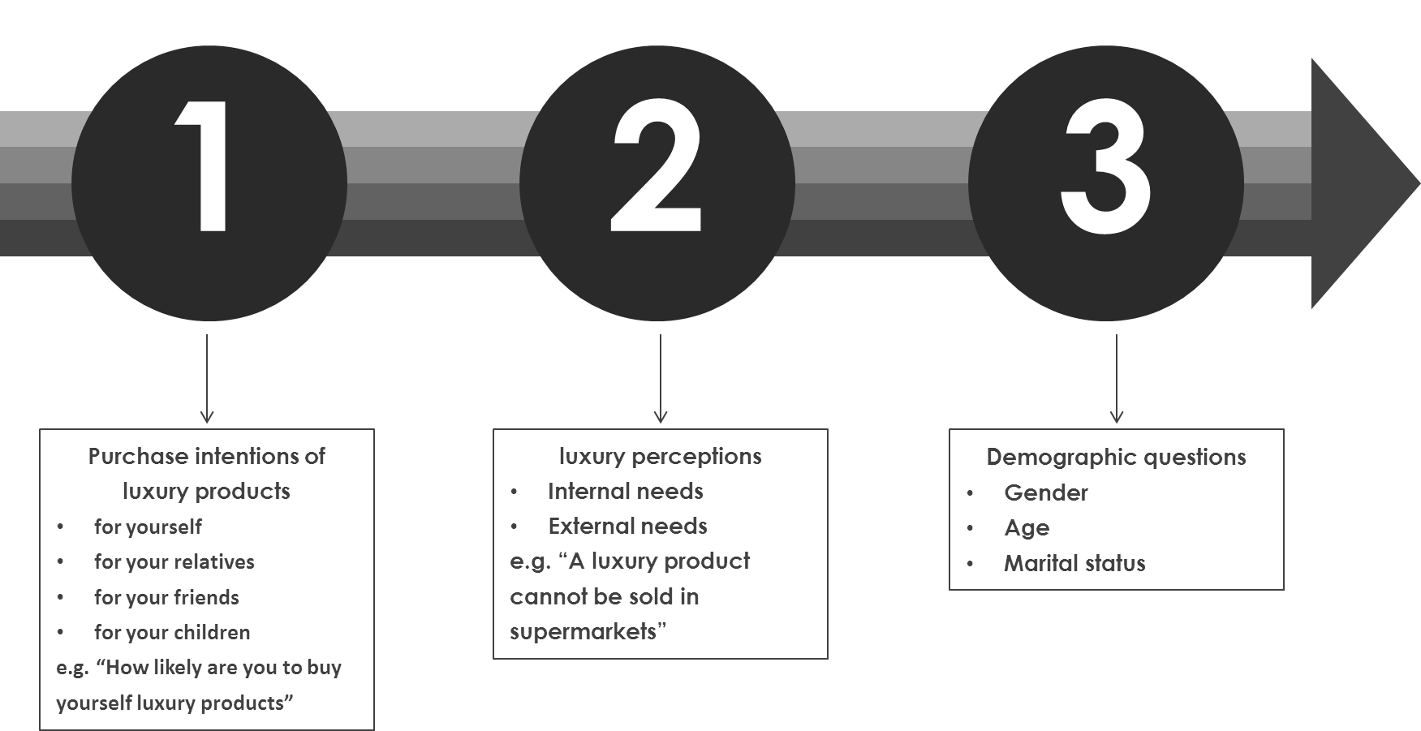
Methodology
Quantitative research

Slide 17
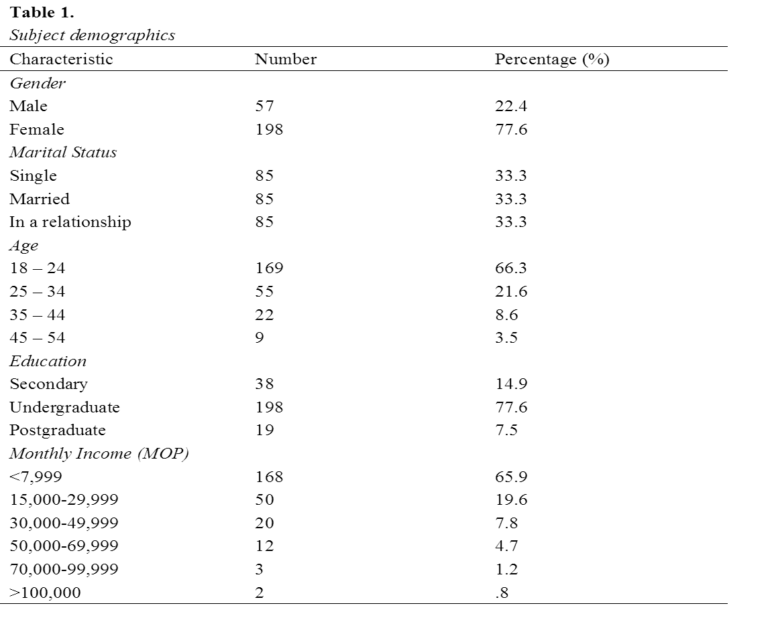
Data collection

Slide 18
Theoretical Background
Literature review
Results and discussion
Limitations and Further Research
Methodology

Slide 19
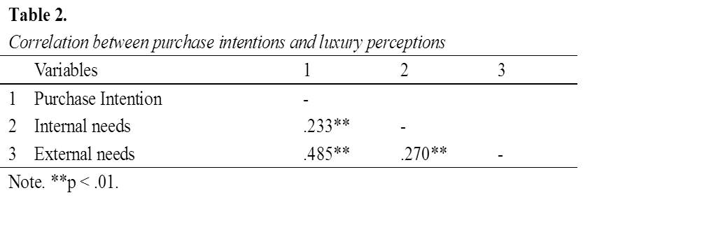
Results
Both internal needs and external needs are positively related to purchase intentions of luxury products

Slide 20
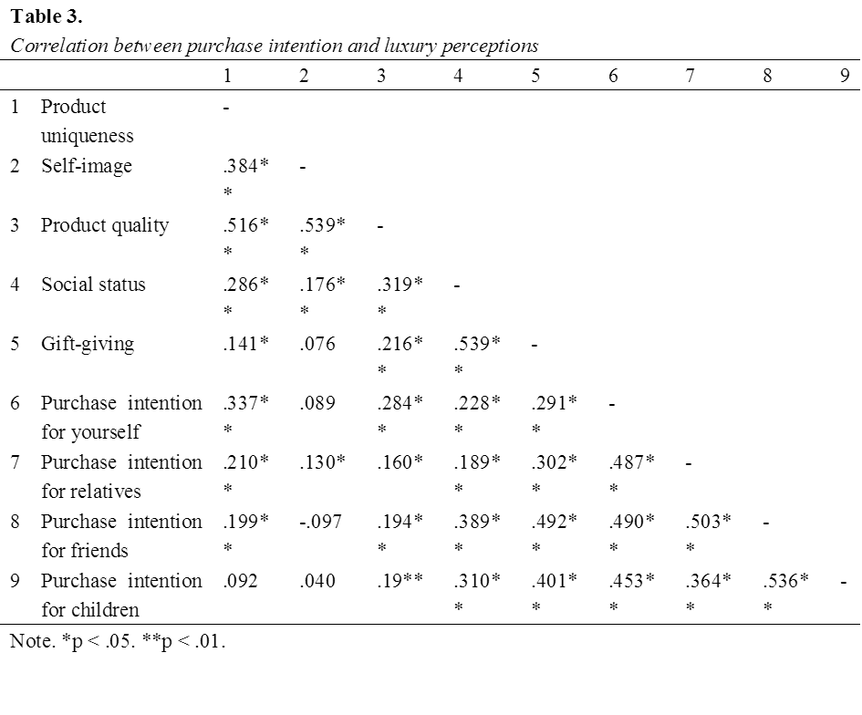
Results
Except the self-image and product uniqueness, all the factors are significantly correlated to the four aspects of purchase intentions.

Slide 21
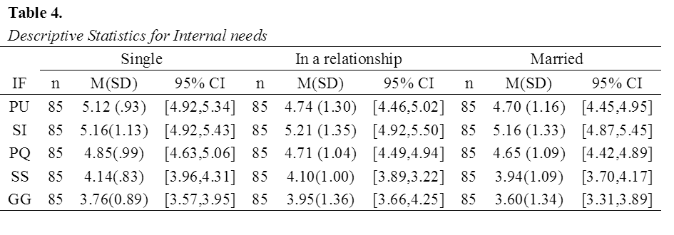
Results
Marital status do not have significant influence on purchase intention of luxury products
The effect of marital status on perception of luxury products is not significant
Only the difference between product uniqueness and marital status is positively significant.

Slide 22
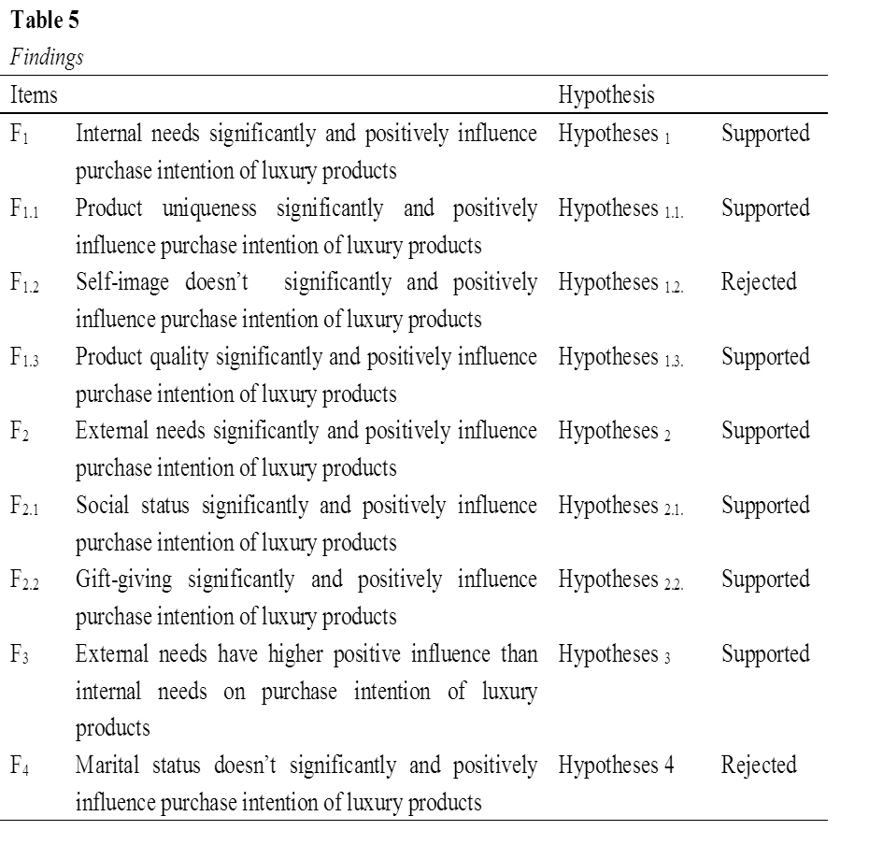
Discussion

Slide 23
Implications
Focus on external needs
Unique experience
Highlighting product uniqueness

Slide 24
Theoretical Background
Literature review
Results and discussion
Limitations and Further Research
Methodology

Slide 25
Limitations and future research
Sample size
self-image
Marital status
Brand image
insufficient time
Manpower
affordances
divorce

Slide 26
Reference
Amatulli, C., & Guido, G. (2011). Determinants of purchasing intention for fashion luxury goods in the Italian market: A laddering approach. Journal of Fashion Marketing and Management: An International Journal, 15(1), 123-136.
Bakker, M. (2005). Luxury and tailor-made Holidays, travel and tourism analyst. Chicago: Mintel International Group Ltd.
Bhanot, S., Srinivasan, R., & Srivastava, R. K. (2014). Influence of ethnicity on uniqueness & snob value in purchase behaviour of luxury brands. Journal of Research in Marketing, 2(3), 172-186.
Bian, Q., & Forsythe, S. (2012). Purchase intention for luxury brands: A cross cultural comparison. Journal of Business Research, 65(10), 1443-1451.
Boguslaw, S. (2015). Predicting consumers´ purchase intention toward luxury fashion brands by applying several personality traits.
Cavender, B., & Rein, S. (2009). LUXURY GOODS-Still Strong Sellers-China's luxury goods sales may perform well despite bear-market conditions. China business review, 36(2), 36.
Chen, C. Y., Chao, C. H., & Lee, Y. J. (2012). Exploration of the differences in Taiwanese women's purchasing decisions towards luxury goods and general products. African Journal of Business Management, 6(2), 548.
Dubois, B., & Duquesne, P. (1993). The market for luxury goods: Income versus culture. European Journal of Marketing, 27(1), 35-44.
Gao, L., Norton, M. J., Zhang, Z. M., & Kin-man To, C. (2009). Potential niche markets for luxury fashion goods in China. Journal of Fashion Marketing and Management: An International Journal, 13(4), 514-526.
Gentry, J. W., Putrevu, S., II, C. S., & Commuri, S. (2001). How now Ralph Lauren? The separation of brand and product in a counterfeit culture. NA-Advances in Consumer Research Volume 28.
Gil, L. A., Kwon, K. N., Good, L. K., & Johnson, L. W. (2012). Impact of self on attitudes toward luxury brands among teens. Journal of Business Research, 65(10), 1425-1433.
Hauck, W. E., & Stanforth, N. (2007). Cohort perception of luxury goods and services. Journal of Fashion Marketing and Management: An International Journal, 11(2), 175-188.

Slide 27
Reference
Heinemann, G. (2008). Motivations for Chinese and Indian consumers to buy luxury brands (Doctoral dissertation, Auckland University of Technology).
Jamal, A., & Goode, M. M. (2001). Consumers and brands: a study of the impact of self-image congruence on brand preference and satisfaction. Marketing Intelligence & Planning, 19(7), 482-492.
Jansen-Verbeke, M. (1994). Synergy between shopping and tourism: The Japanese experience. In W. Theobald (Ed.), Global tourism: The next decade (pp. 347-362). Oxford, UK: Butterworth Heinemann
Jia, C. (2012). Gifts or self-use? Chinese consumers’ values, attitudes and purchase intention toward luxury fashion brands (Master dissertation).
Love, D. A. (2010). The effects of marital status and children on savings and portfolio choice. Review of Financial Studies, 23(1), 385-432.
Lukkarinen, S., & Xing, W. (2012). Luxury consumer behaviour-a comparative case study of emerging luxury markets in China and Finland.
Naz, U., & Lohdi, S. (2016) Impact of Customer Self Concept and Life Style on Luxury Goods Purchases: A Case of Females of Karachi. Arab J Bus Manage Rev, 6: 192
Niehm, L. S., Fiore, A. M., Jeong, M., & Kim, H. J. (2006). Pop-up retail’s acceptability as an innovative business strategy and enhancer of the consumer shopping experience. Journal of Shopping Center Research, 13(2), 1-30.
Nueno, J. L., & Quelch, J. A. (1998). The mass marketing of luxury. Business Horizons, 41(6), 61-68.
Nwankwo, S., Hamelin, N., & Khaled, M. (2014). Consumer values, motivation and purchase intention for luxury goods. Journal of retailing and consumer services, 21(5), 735-744.
O'Cass, A., & Frost, H. (2002). Status brands: examining the effects of non-product-related brand associations on status and conspicuous consumption. Journal of product & brand management, 11(2), 67-88.
O'Cass, A., & McEwen, H. (2004). Exploring consumer status and conspicuous consumption. Journal of Consumer Behaviour, 4(1), 25-39.
Park, K. S., & Reisinger, Y. (2009). Cultural differences in shopping for luxury goods: Western, Asian, and Hispanic tourists. Journal of Travel & Tourism Marketing, 26(8), 762-777.
Park, H. J., Rabolt, N. J., & Sook, J. K. (2008). Purchasing global luxury brands among young Korean consumers. Journal of Fashion Marketing and Management: An International Journal, 12(2), 244-259.

Slide 28
Reference
Prendergast, G., & Wong, C. (2003). Parental influence on the purchase of luxury brands of infant apparel: an exploratory study in Hong Kong. Journal of Consumer Marketing, 20(2), 157-169.
Richins, M. L., & Dawson, S. (1992). A consumer values orientation for materialism and its measurement: Scale development and validation. Journal of consumer research, 19(3), 303-316.
Roux, E. (1995, May). Consumer evaluation of luxury brand extensions. InEMAC Conference, May, ESSEC, Paris (pp. 1971-1980).
Shermach, K. (1997). What consumers wish brand managers knew. Marketing News, 31(12), 9-17.
Sheth, J. N., Newman, B. I., & Gross, B. L. (1991). Consumption values and market choices: Theory and applications (pp. 16-74). Cincinnati, OH: South-Western Publishing Company.
Solomon, M. R. (1983). The role of products as social stimuli: A symbolic interactionism perspective. Journal of Consumer research, 10(3), 319-329.
Stokburger-Sauer, N. E., & Teichmann, K. (2013). Is luxury just a female thing? The role of gender in luxury brand consumption. Journal of Business Research, 66(7), 889-896.
Tsai, S. P. (2005). Impact of personal orientation on luxury-brand purchase value. International Journal of Market Research, 47(4), 429-454.
Vigneron, F. and Johnson, L.W. (2004), “Measuring perceptions of brand luxury”, Journal of Brand Management, Vol. 11 No. 6, pp. 484-506.
Wang, J., & Foosiri, P. Factors Related to Consumer Behavior on Luxury Goods Purchasing in China.
Wiedmann, K. P., Hennigs, N., & Siebels, A. (2007). Measuring consumers’ luxury value perception: A cross-cultural framework. Academy of Marketing Science Review, 7(7), 333-361.
Wiedmann, K. P., Hennigs, N., & Siebels, A. (2009). Value‐based segmentation of luxury consumption behavior. Psychology & Marketing, 26(7), 625-651.
Wilcox, K., Kim, H. M., & Sen, S. (2009). Why do consumers buy counterfeit luxury brands? Journal of Marketing Research, 46(2), 247-259.
Workman, J. E., & Kidd, L. K. (2000). Use of the need for uniqueness scale to characterize fashion consumer groups. Clothing and Textiles Research Journal, 18(4), 227-236.
Zhan, L., & He, Y. (2012). Understanding luxury consumption in China: Consumer perceptions of best-known brands. Journal of Business Research, 65(10), 1452-1460.
Zhang, B., & Kim, J. H. (2013). Luxury fashion consumption in China: Factors affecting attitude and purchase intent. Journal of Retailing and Consumer Services, 20(1), 68-79.

Slide 29
Thank you
YinYi Huang, Queenty
Institute for Tourism Studies
Macau, China
Email:
s136313@ift.edu.mo
queentyhuang@hotmail.com

