Slide 1
Virtual Reality as a tool to trigger emotions in tourism marketing
Subjective and objective measurements to investigate the impact of VR
Julia Beck
Salzburg University of Applied Sciences
Austria

Slide 2

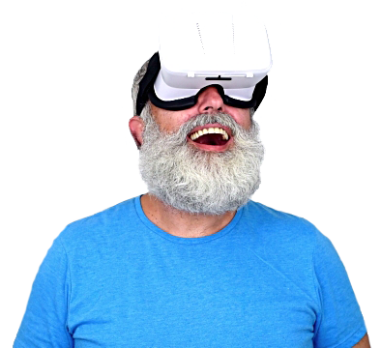
VR in tourism marketing
Motivation &
Purpose
Tool to emotionalise the customer
‘Try before you buy’ experience
Positive influence on buying decision

Slide 3

Virtual Reality
(VR)

Slide 4
VR in tourism marketing
Virtual Reality
(VR)
Synthetic vs. captured content
Systems: fully | semi | non-immersive
Hitherto in tourism marketing:
synthetic & captured, non-immersive

Slide 5
VR in tourism marketing
Approach

Slide 6
VR in tourism marketing
Research
Questions
Does the technology of VR intensify triggered emotions in tourism marketing?
RQ1: Does a tourism marketing video representation with a HMD lead to greater emotional reactions than a desktop-based representation?
RQ2: Does a tourism marketing video representation with a HMD lead to greater impact on the decision-making than a desktop-based representation?
RQ3: To what extent do the intensity of experienced emotions and decision making show a correlation?

Slide 7
VR in tourism marketing
Emotions
in Marketing
Buying decisions: not on daily basis
Intensity positive emotions triggered
Enjoyment & engagement: user satisfaction, purchase intention
(Sigg 2009; Häusel 2012; Papagiannidies et al 2014; Stürmer and Schmidt 2014)

Slide 8



VR in tourism marketing
Measurement
of Emotions

Slide 9
Research Design
360° destination marketing video: “The Winter Within”, by Destination BC

Slide 10
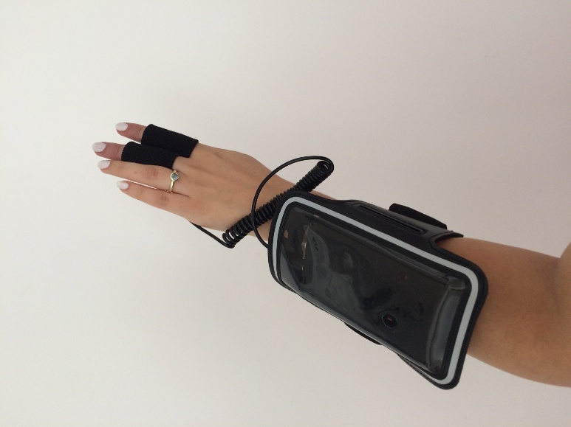
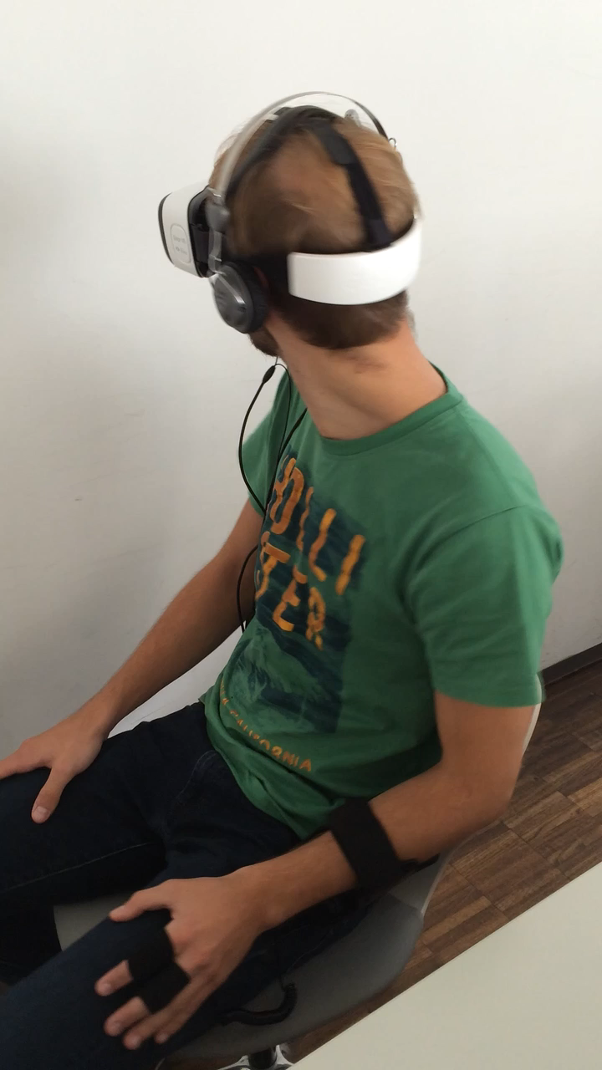
Experiment

Slide 11

VR in tourism marketing
Results
t-Test/U-Test
Parameter | Results (n=101)
Heart rate | Significant
Electrodermal activity | Significant
Self-reported emotions | Not significant
Decision response | Not significant
Product interest | Not significant
Purchase immediacy | Not significant

Slide 12
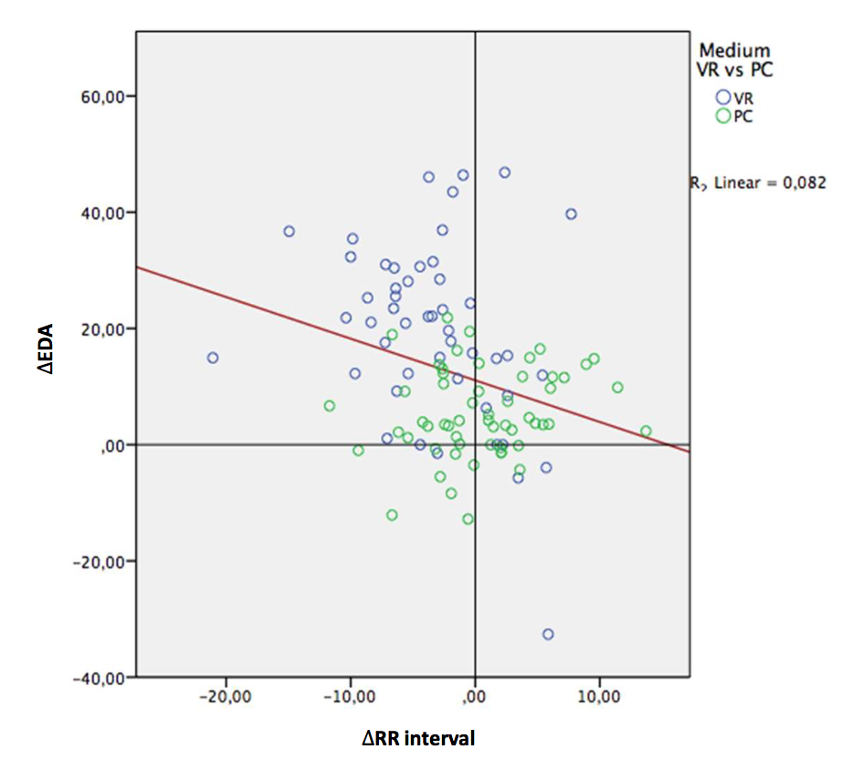
VR in tourism marketing
Results
Correlation

Slide 13
VR in tourism marketing
Results
Correlation
Per Group

Slide 14
VR in tourism marketing
Results
Pearson’s r
Per group
Heart rate & electrodermal activity
Physiological emotions & self-reported emotions
Physiological emotions & decision making
Self-reported emotions & decision making

Slide 15
VR in tourism marketing
Results
Pearson’s r
Per group
Type of stimulus:
Interest in winter sports & self-reported emotions
Interest in winter sports & decision making
ONLY for VR GROUP!

Slide 16
VR in tourism marketing
Conclusion I
Managerial implications:
Physiological arousal & subjective excitement
Target group tailored content
Future of tourism marketing

Slide 17
VR in tourism marketing
Conclusion II
Tourism research:
Complexity of measurement & interpretation of emotions
Starting point for further research

Slide 18
Thank you

