Slide 1
THE OVERSEAS SUMMER INTERNSHIP BY CHINESE STUDENTS
--- Motivations and perceived value
Student’s name:
Xiao Hu
Plymouth University, UK
Supervisor's name:
Dr. Rong Huang
Plymouth University, UK

Slide 2
Outline
Introduction
Theoretical Background
Methodology
Results
Conclusion
Contributions of the research
Suggestions and limitations

Slide 3



Introduction
America Summer Work and Travel Programme
Programme Introduction
My gains and inspirations
Why did I choose this as my research topic?

Slide 4
Introduction
It is clear that internships provide a professional aspect to the benefits gained by students, as well as institutions, and companies.
However, researchers have not paid enough attention to the effects that internships have on the students’ social experiences and social values during the internship programs.
The aim of this research is to investigate the value of overseas summer internship for Chinese students in China. More specifically, three research objectives are:
  To examine student motivations for undertaking the overseas summer internships;
  To evaluate the students’ perceived values of such internships;
  To provide recommendations to improve the promotion of such internships amongst Chinese students.

Slide 5
Theoretical Background
Defining internships
Internships are one source of work experience which can be classified into apprenticeships, cooperative education, and so on (Anderson and Gerbing ,1998; Auburn, 2007; Auburn et al.,1993; Chang et al., 2009; Leslie, 1991).
For students in China, internships were also described as a necessary educational model to enhance students’ ability both in studying and working ( Chen, 2011; Jia and Yin, 2010).
For this research, an internship is a direct process for students to explore and gain global value and social experience which could be engaged in the real life for students.

Slide 6
Theoretical Background
Why choose internships?
finding proposed by Richard, et al. (2007) that internships provided win-win-win opportunities for students, employers (host organizations) and schools (institutions) were the essential reason why internship programs were prevalent.
Students benefited from overseas internships in different facets.
  Foreign language skills enhancement (Stronkhorst, 2005)
  Intercultural competencies(Stronkhorst, 2005)
  Exotic tourist experience achievement(Toncar and Cudmore, 2000)
  Enhanced ability to critically reflect on their business workplace(Gerber, 2001; Tribe, 2001)

Slide 7
Theoretical Background
The value of Internship in tourism and hospitality
the tangible and tight link between university education and the expectations that industry(Domask, 2007; Singh, 2010; Solnet, et al., 2009).
a crucial element for hospitality and tourism graduates to gain related work experience, skills and help place students in their early careers (Breiter, 1993)
an experiential studying and teaching tool and an essential part of major education (Barrows,1999; Busby and Gibson, 2010).

Slide 8
Methodology
The data was collected with the help of an instrument - a structured, straightforward questionnaire.
Questionnaires were used in a range of internships researches (e.g. Gabris and Mitchell, 1989; Ruth and Wolff, 2015; Brown-Liburd and Porco, 2011).
A range of previous literature sources and the research objectives informed the design of different questions.
An online questionnaire was designed and snowball sampling was adopted.
In total 400 usable questionnaires were collected.
SPSS was adopted to analyse the collected data.

Slide 9
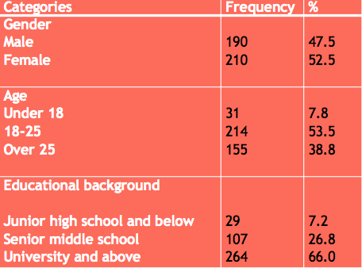
Results
Profile of the respondents
All the respondents are chosen from China, a large percentage
Of them are from Chongqing.

Slide 10
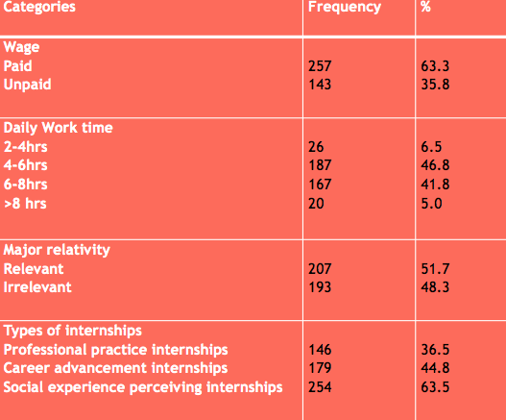
Results
Previous Internship Experience

Slide 11
Results
Motivations to student (overseas) summer internship programs
The motivations of the respondents to student (overseas) summer internship programs were presented by using different question types, one is ranked question, and another one is 1-5 Likert scale question.
Earning social skills (communication, cooperation, and environmental adaption) was the main reason why respondents were attracted to participate in relevant internship programs
The results showed that ‘the opportunities to participate in social activities’, ‘Internship location (whether it is overseas)’ and ‘Internship contents (meets your professional needs)’ were treated as the top three factors which influenced students to choose internship programs.
The Salary ranked one of the weakest factors that influenced students. Both of them had a high ranking in others’ researches.

Slide 12
Results
Values perceived by Chinese students
Students obtained social values much more than working aspects. It is clear that social skills were the most important factor towards internship programs (3.87). Following this was social experience (3.79).
more researches and studies found that professional and major outcomes should not be neglected during internship programs.
The reason why the results are different
Minority of scholars pay attention to social values in their studies. S
Perceived social values are not easy to be identified by students in a short term.

Slide 13
Results
Recommendations for such internship program
university department is the most important way for internship organizations to carry on promotion (38.5%)
‘have more opportunities to practical operation' is significant for students to participate in internship programs

Slide 14
Results
Study of Chi-Square Tests and Cross tabulation
Influential factors and gender
Find that more males (48.9%) thought salary level was very important than females (27.6%), they paid attention to internship location than females did (44.8 %).
More females tended to overtake internships when they were university students (75.2%). Instead, more males (44.2%) chose to attend internships before engaged in university
Influential factors and educational background
Respondents who had a high educational background (33.7%) were less caring about salary level in the internship
More females (94.8%) than males (84.2%) received social value during their internship programs because they worked less hours than males.

Slide 15
Results
Value satisfactions
Females have much more positive comments towards social experience (72.4%) and social skills (79.0%) than males (58.9%, 56.8% respectively)
Respondents who attended internship when they were university students could feel less satisfied with their wage (29.3%), but feel more satisfied with social experience (20.5%) and social skills (66.0%) after the internship programs.
It is possible that female respondents with high educational background have more opportunities to receive social values when participating in the internship

Slide 16
Conclusion
This research revealed that social factor was a strong motivator for Chinese students to participate in the overseas summer internship programs.
Chinese students obtain more social values and social experience than work values and work experience.
Some important relationships are:
Male students in china care more about internship wage than female students.
Well educated Chinese students pay less attention to internship wage.
More female students prefer attending such internships when they engaged in higher educational institutions.

Slide 17
Contributions of the research
This research verified and expanded some literature in terms of motivation, satisfaction, and recommendations in the internship.
It had a constructive contribution to studies on investigating social values for Chinese students to attend overseas summer internship programs.
This research addressed the gap that exists within literature relating to student internships, especially concerning the values and experience received in internships.

Slide 18
Suggestions and limitations
Some suggestions also should be given to relevant organizations
Educational institutions are the first one to consider as the location to find proper targets
Students have highest demand on upon intangible ‘social’ factors, they also should pay attention to the tangible factors (e.g. location, practical operation) of internships.
Limitations of the research
The majority of respondents were living in Chongqing
The number of people for each age group or educational background was not equalled
It is impossible to consider all the respects in each question.

