Slide 1
Effects of Online Customers’ Reviews on Tourists’ Attitudes and Intentions of Festival: The Case of Lusofonia Festival in Macau
ChiIan Ma (Doris)
Institute for Tourism Studies, Macao, China
S134456@ift.edu.mo

Slide 2
Content
Introduction of topic
Background of Macau and Lusofonia Festival
Online Customer Reviews (OCRs)
Attitudes and intention towards festivals and OCRs
Objective
Methodology
Results
Conclusion

Slide 3
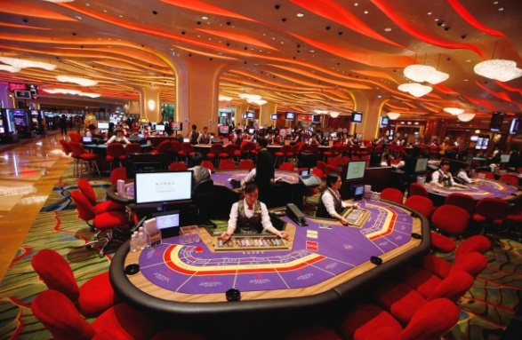
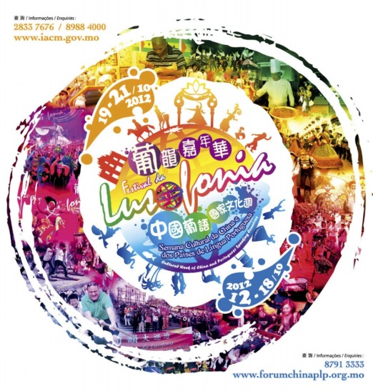
Background of Macau and Lusofonia Festival
Over reliance on ☹
Macao SAR
(one country, two systems)
Gaming liberalization in 2002
An urban cultural festival since 1998
Hold in October annually
Featured foods, handicrafts, games, music and dance performance offer by Portuguese- speaking countries around the world
Aims to promote Portuguese cultures

Slide 4
Would you spend sometime to browse reviews online before you join any of event, try a new restaurant, watch a movie?
Online Customer Reviews (OCRs)

Slide 5
Online Customer Reviews (OCRs)
Did those comments/reviews affect you buying purchasing?

Slide 6
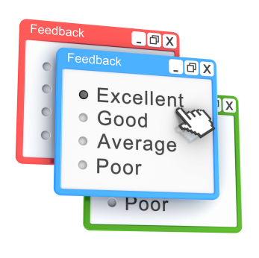
What is Online Customer Reviews (OCRs)?
Users’ opinions, recommendations, feedbacks, complaints of the products, the brands, the services or the experiences they had involved that write on the online-review platform which includes social platform, blogs, review channels, website pages etc.
(Chen & Xie, 2008)
The online consumer review known as a type of electronic-word-of-mouth (eWOM) communication
(Chatterjee, 2001)

Slide 7
Attitudes and intention towards festivals and OCRs
OCRs divided in positive comment or the negative opinion
(Sen & Lerman, 2007; Sparks & Browning, 2011)
Receiver’s attitudes and intention would be affected by both positive and negative OCRs
(Elseidi & El-Baz, 2016)

Slide 8
Objective
Positive OCRs | Negative OCRs
H1: Tourists’ attitudes ↑ | H3: Tourists’ attitudes↓
H2:Tourists’ visiting intention↑ | H4: Tourists’ visiting intention↓
H5: Trust positive OCRs> Festival organizers’ created information. | H6: Trust negative OCRs > Festival organizers’ created information
H7: Trust negative OCRs > positive OCRs
H8: Negative OCRs influences tourists’ attitudes towards the festival > the positive OCRs
H9: Negative OCRs influences tourists’ visiting intentions towards the Festival >the positive OCRs

Slide 9
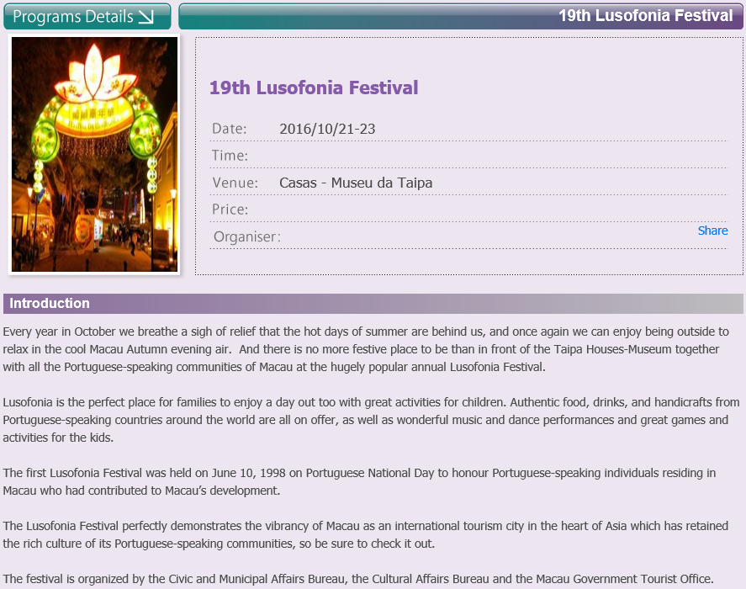
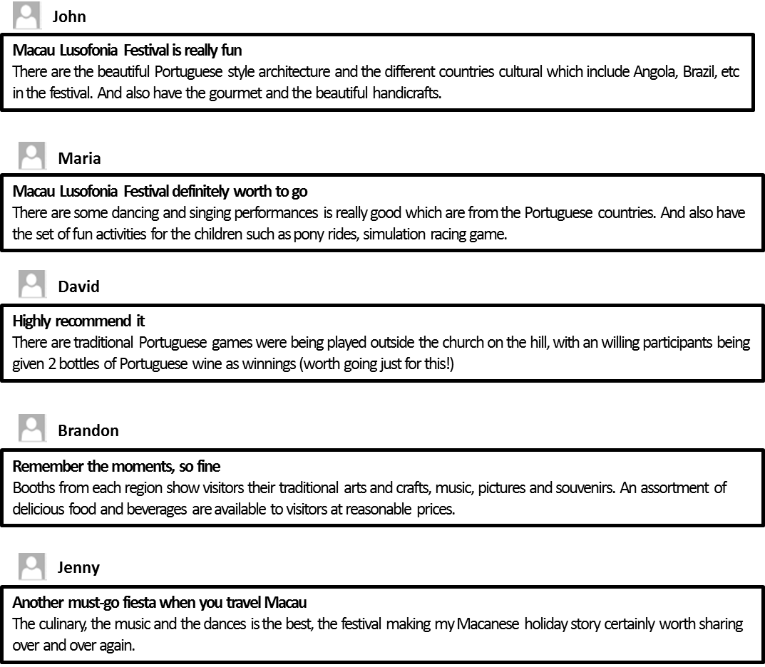
Methodology

Slide 10
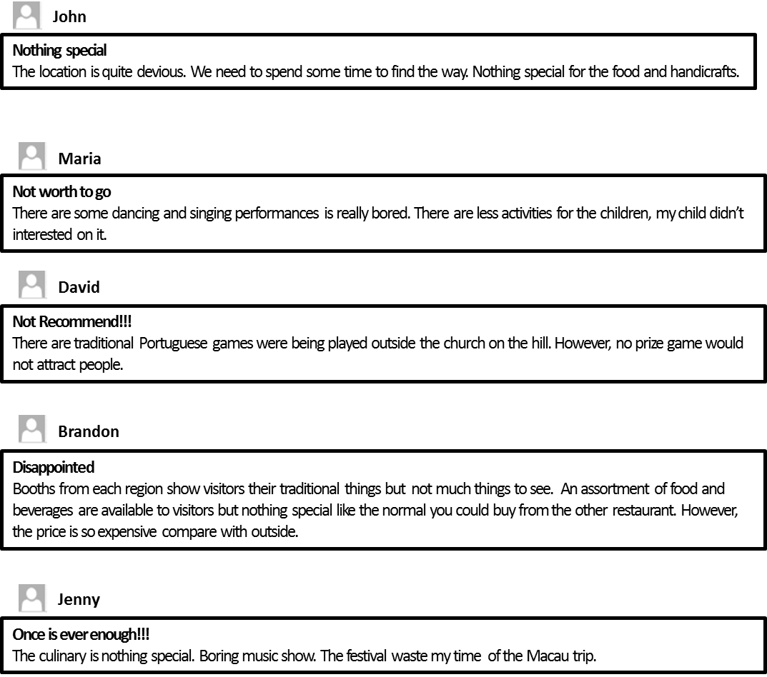
Methodology

Slide 11
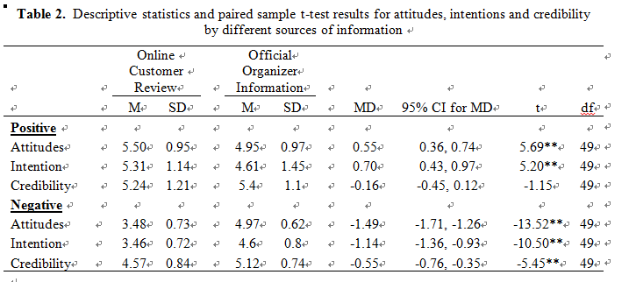
Result

Slide 12
Result
Positive OCRs | Negative OCRs
H1: Tourists’ attitudes ↑ | H3: Tourists’ attitudes↓
H2:Tourists’ visiting intention↑ | H4: Tourists’ visiting intention↓
H5: Trust positive OCRs> Festival organizers’ created information. | H6: Trust negative OCRs > Festival organizers’ created information
H7: Trust negative OCRs > positive OCRs
H8: Negative OCRs influences tourists’ attitudes towards the festival > the positive OCRs
H9: Negative OCRs influences tourists’ visiting intentions towards the Festival >the positive OCRs

Slide 13
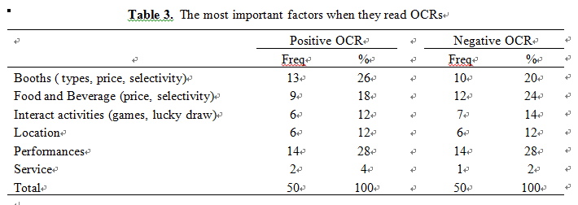
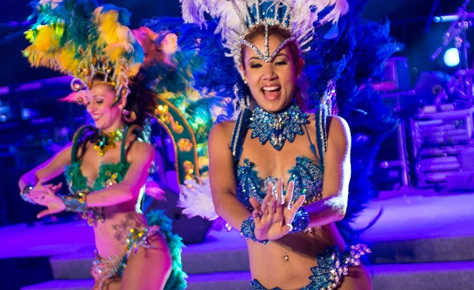
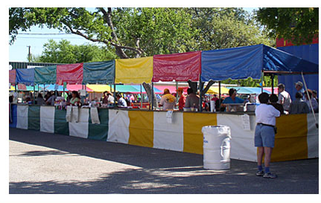
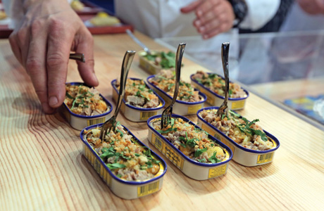
Result

Slide 14
Conclusion
Implication
Know the effectiveness of OCRs to event
Give marketers event promotion ideas
Highlight the positive OCRs
Manage negative OCRs
Complaint handling procedure

Slide 15
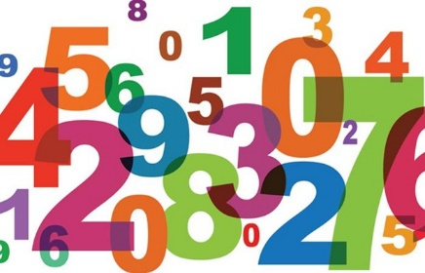
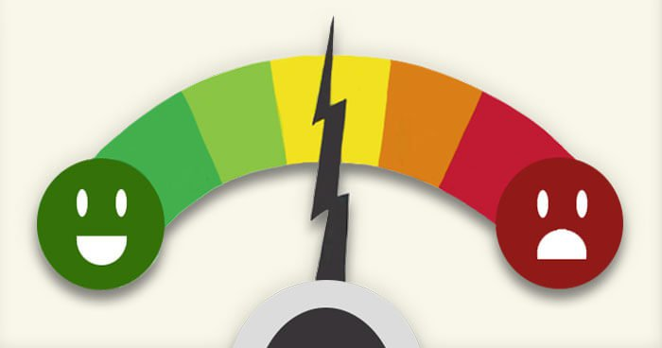
Conclusion
Limitations
Only test one type of event
Covers the fully positive and negative OCR conditions
Number and length of OCRs not cover
Reasons of tourists believe OCRs before experiencing the festival
Good ☺and bad☹
Trust

Slide 16
Conclusion
Future research
Test different kind of event (Sport event, music event..)
Provide mixed conditions and context
Add more information on OCRs. For example, stars and picture
Ask reasons of tourists trust OCRs
Good ☺and bad☹

Slide 17
References
Ajzen, I. (2001). Nature and Operation of Attitudes. Annual review of Psychology, 52(1), pp. 27-58
Ajzen, I. (2002). Perceived Behavioural Control, Self-Efficacy, Locus of Control, and the Theory of Planned Behaviour. Journal of Applied Social Psychology, 32, pp. 665-683.
Ao, R. H. T., Choi, S. H. (2015). Visitors’ Satisfaction with the Macao Lusofonia Festival: An Importance-Performance Analysis.
Bohner, G., & Dickel, N. (2011). Attitudes and Attitude Change. Annu. Rev. Psychol, 62, pp. 391-417. Doi: 10.1146/annurev.psych.121208.131609
Chang, W., & Yuan, J. J. (2011). A taste of tourism: Visitors' motivations to attend a food festival. Event Management, 15(1), pp. 13-23.
Chatterjee, P. (2001) Online reviews: Do consumers use them? Advances in Consumer Research, 28, pp. 129-133.
Chen, S. C. (2011). Residents’ Perceptions of the Impact of Major Annual Tourism Events in Macao: Cluster Analysis, Journal of Convention & Event Tourism, 12(2), pp. 106-128, DOI: 10.1080/15470148.2011.569877
Chen, Y., & Xie, J. (2008). Online Consumer Review: Word-of-Mouth as a New Element of Marketing Communication Mix. Management Science, 54(3), pp. 477-491. doi: 10.1287/mnsc.1070.0810

Slide 18
References
Cheng, S., Lam, T., & Hsu, C. H. C. (2005). Testing the sufficiency of the theory of planned behaviour: A case of customer dissatisfaction responses in restaurants. International Journal of Hospitality Management, 24(4), pp. 475-492
Cheung, C. M., Sia, C., & Kuan, K. K. Y. (2012). Is this review believable? A study of factors affecting the credibility of online consumer reviews from an ELM perspective. Journal of the Association for Information Systems, 13(8), pp. 618-635
Chevalier, J. A., & Mayzlin, D. (2006). The effect of word of mouth on sales: Online book reviews. Journal of marketing research, 43(3), pp. 345-354. Doi: http://dx.doi.org/10.1509/jmkr.43.3.345
Eagly, A. H., & Chaiken, S. (1993). The psychology of attitudes. Fort Worth, TX: Harcourt Brace.
Elseidi, R. I., & El-Baz, D. (2016). Electronic word of mouth effects on consumers’ brand attitudes, brand image and purchase intention: an empirical study in Egypt. The Business and Management Review, 7(5), pp. 268-276
Gursoy, D., Spangenberg, E. R., & Rutherford, D. G. (2006). The hedonic and utilitarian dimensions of attendees' attitudes toward festivals. Journal of Hospitality & Tourism Research, 30(3), pp. 279-294.
Harris, A. D., McGregor, J. C., Perencevich, E. N., Furuno, J. P., Zhu, J., Peterson, D. E., & Finkelstein, J. (2006). The Use and Interpretation of Quasi-Experimental Studies in Medical Informatics. Journal of the American Medical Informatics Association : JAMIA, 13(1), pp. 16–23. http://doi.org/10.1197/jamia.M1749

Slide 19
References
Ho-Dac, N. N., Carson, S. J., & Moore, W. L. (2013). The effects of positive and negative online customer reviews: do brand strength and category maturity matter?. Journal of Marketing, 77(6), pp. 37-53.
Hosein, N. (2012). Measuring the Purchase Intention of Visitors to the Auto Show. Journal of Management & Marketing Research, 9, pp.1-17.
Jalilvand, M. R., Esfahani, S. S., & Samiei, N. (2011). Electronic word-of-mouth: Challenges and opportunities. Procedia Computer Science, 3, pp.42-46.
Jurriens, L. (2014). Facebook Event Pages for Music Festivals: The Influence of Attendance and Comments on Attitude towards the Festival and Ticket Purchase Intention. (Master’s thesis, Universities van Amsterdam) [Online] Available at: http://dare.uva.nl/cgi/arno/show.cgi?fid=530286 [Accessed 10 October 2016].
Lam, T., & Hsu, C. H. C. (2004). Theory of planned behaviour: Potential travellers from China. Journal of Hospitality and Tourism Research, 28(4), pp. 463-482.
Macao Government Tourism Office. (2016, August 29). Event and Festival. [Online] Available at: http://en.macaotourism.gov.mo/events/calendar.php [Accessed 10 September 2016]
McQuail, D. (2010). Mass communication theory. London: Sage Publications
Park, C., Wang, Y., Yao, Y., & Kang, Y. R. (2011). Factors influencing eWOM effects: Using experience, credibility, and susceptibility. International Journal of Social Science and Humanity, 1(1), pp.74-79.
Petty, R. E., Wegener, D. T., & Fabrigar, L. R. (1997). Attitudes and attitude change. Annual review of psychology, 48(1), pp. 609-647.

Slide 20
References
Rijneveld. E. (2008). Success Factors of Music Festivals in the Netherlands. (Master’s thesis, Universities van Amsterdam). [Online] Available at: http://dare.uva.nl/cgi/arno/show.cgi?fid=118884. [Accessed 10 September 2016]
Sen, S., & Lerman, D. (2007). Why are you telling me this? An examination into negative consumer reviews on the web. Journal of interactive marketing, 21(4), pp. 76-94.
Smith, D., Menon, S. and Sivakumar, K. (2005). Online Peer and Editorial Recommendations, Trust, and Choice in Virtual Markets. Journal of Interactive Marketing, 19(3), pp.15-37.
Song, H., You, G.-J., Reisinger, Y., Lee, C.-K., & Lee, S.-K. (2014). Behavioural intention of visitors to an oriental medicine festival: an extended model of goal directed behaviour. Tourism Management, 42, pp. 101-113.
Sparks, B. A. & Browning, V. (2011). The impact of online reviews on hotel booking intentions and perception of trust. Tourism Management, 32, pp. 1310-1323.
Sparks, B. A., Perkins, H. E., & Buckley, R. (2013). Online travel reviews as persuasive communication: The effects of content type, source, and certification logos on consumer behaviour. Tourism Management, 39, pp. 1–9.
Vermeulen, I. E., & Seegers, D. (2009). Tried and tested: The impact of online hotel reviews on consumer consideration. Tourism management, 30(1), pp. 123-127.

