Slide 1
The Design Factors Influencing the Perceived Quality of Hotel Website
WengLam Sin (Winnie)
Institute for Tourism Studies,
Macao, China

Slide 2
Content
Background
Objective
Website Design
Methodology
Result
Conclusion
  Suggestion
  Limitations & Future research

Slide 3
Background
Hospitality industry is considered as one of the major industries in Macau.
Most tourists have made reservations via the hotel websites.
(Qi, Law and Buhalis, 2013)
Usage of hotel websites is rising rapidly.
(Macau Business, 2017)
A hotel website which has a superior quality of design is the key reason for consumers stickiness (A website can retain its visitors to stay longer while browsing and to induce repeat visits).
(Liang and Lai, 2002)

Slide 4



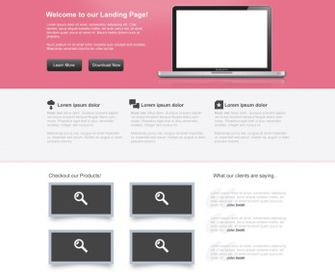
Objective
Customers’ navigation
&
repeat visit
Suggestions
Notes:
Examines whether the factors, which include visual attractiveness (colour scheme & font type) and website layout, can contribute to perceived quality of website or not.
Find out which type of colour scheme, font type and website layout are presented as the most pleasing as well as the most favourable website design.
Discuss the contributions of design factors on customers’navigation and repeat visit.
Provide suggestions for websites designers on how to design a high-quality website

Slide 5
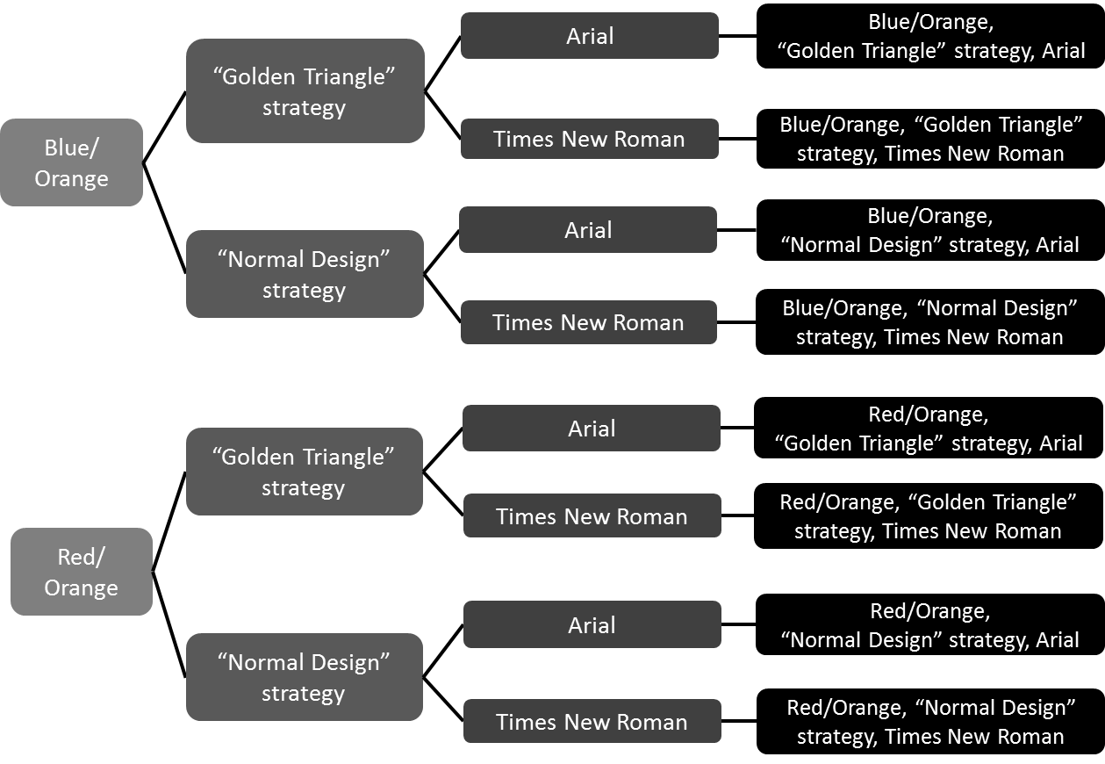
Website Design
2 colour combinations (Cool and Warm, Warm and Warm) x 2 font types (Arial and Times New Roman) x 2 website layout (‘Golden Triangle’ and ‘Normal Design’)

Slide 6
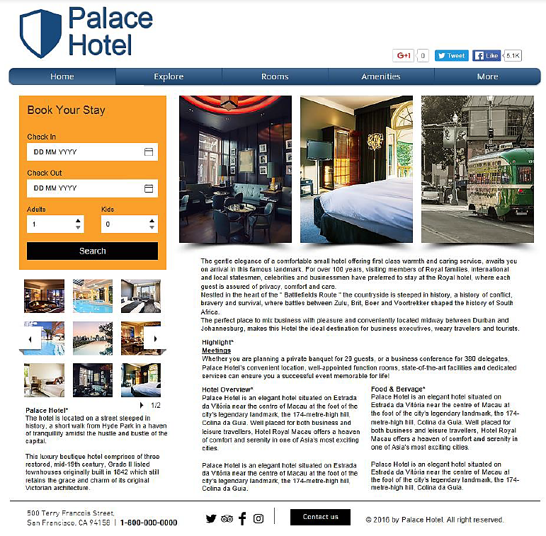
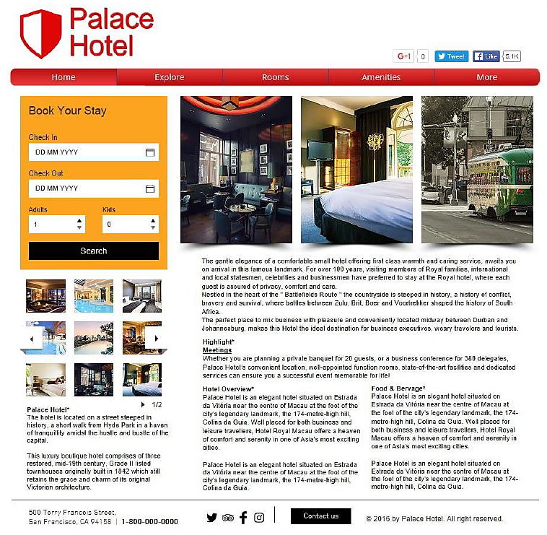
Website Design
Website 5
Website 1
Website 5: Cool and Warm colour combinations, “Golden Triangle” strategy, Arial
Website 1: Warm and Warm colour combinations, “Golden Triangle” strategy, Arial

Slide 7
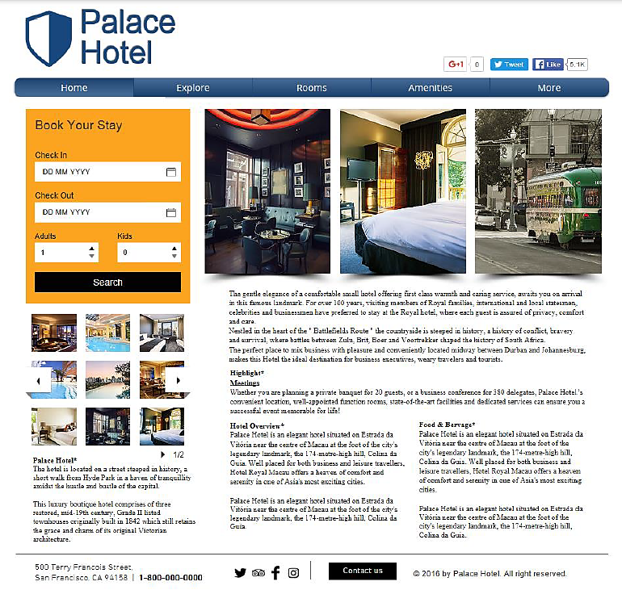
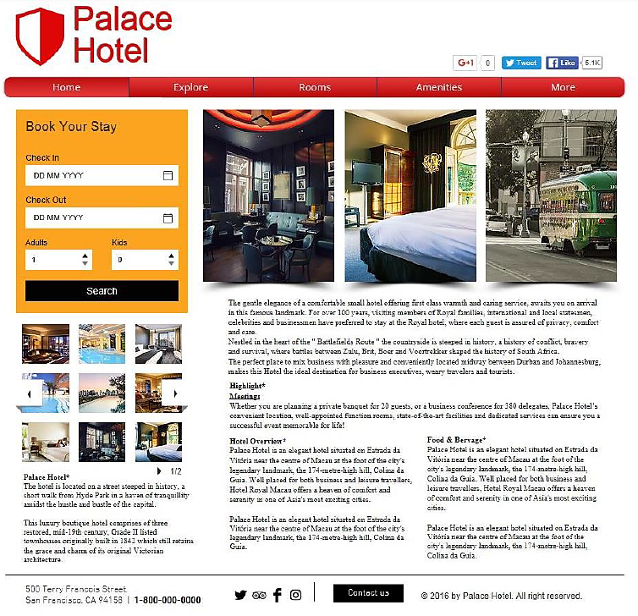
Website Design
Website 7
Website 3
Website 7: Cool and Warm colour combinations, “Golden Triangle” strategy, Times New Roman
Website 3: Warm and Warm colour combinations, “Golden Triangle” strategy, Times New Roman

Slide 8
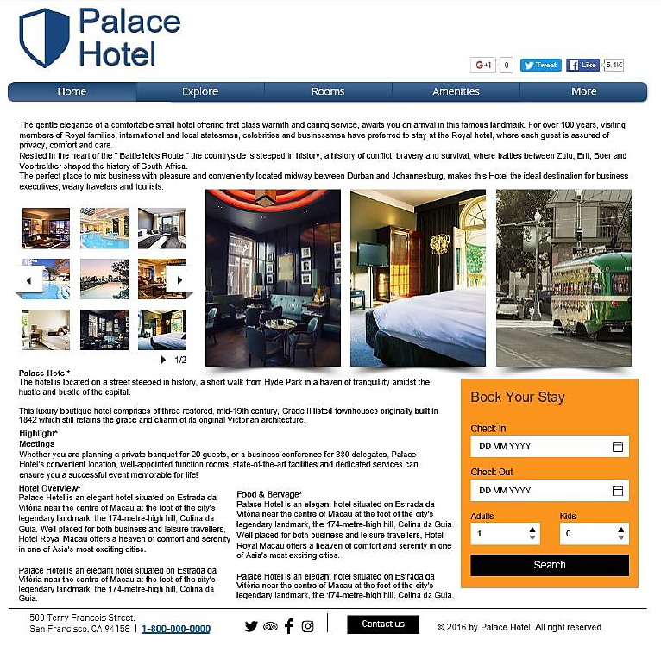
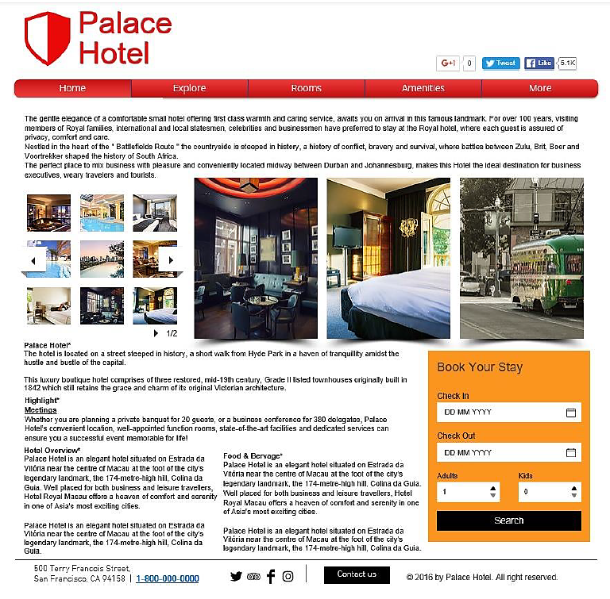
Website Design
Website 6
Website 2
Website 6: Cool and Warm colour combinations, “Normal Design” strategy, Arial
Website 2: Warm and Warm colour combinations, “Normal Design” strategy, Arial

Slide 9
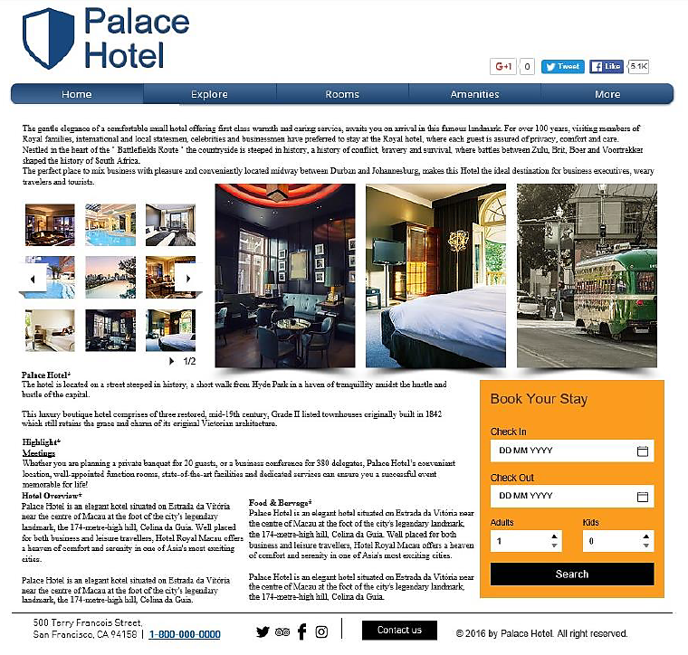
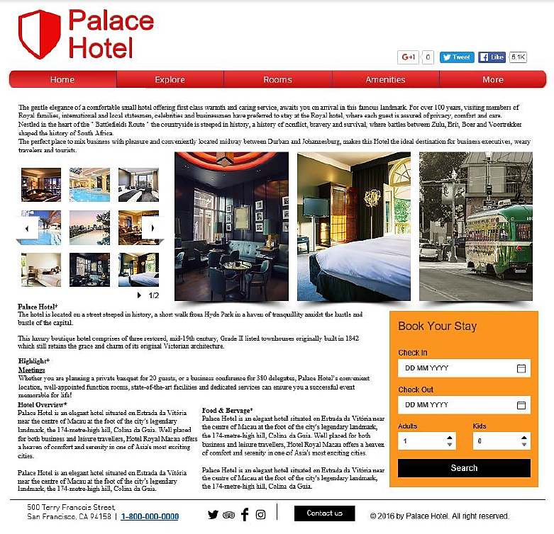
Website Design
Website 8
Website 4
Website 8: Cool and Warm colour combinations, “Normal Design” strategy, Times New Roman
Website 4: Warm and Warm colour combinations, “Normal Design” strategy, Times New Roman

Slide 10

Methodology
Research Method: Survey with tested websites
Sample Size: ‘Rules of Thumb’ concept → ‘Cell size of 30
(VanVoorhis & Morgan, 2007)
Formula: 30 participants X 8 tested websites = 240 respondents

Slide 11
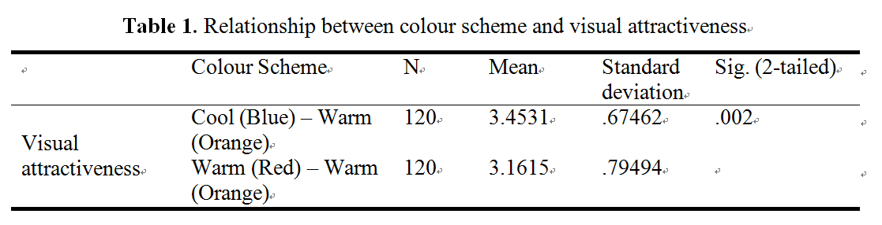
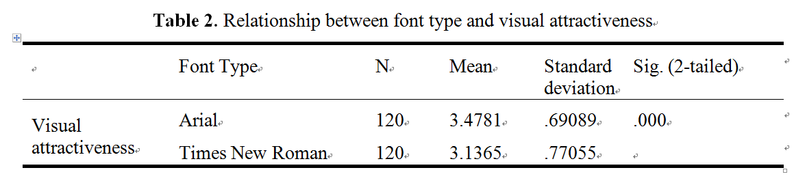
Result
Notes:
Table 1: The respondents are more satisfied with tested websites which were designed with Cool and Warm colour combination than the one designed with Warm and Warm colour combination.
Table 2: The respondents had a better understanding of words in Arial font type than Times New Roman. From this study, it was discovered that the websites devised in Arial font type with size 12 has a greater satisfaction than the website which adopted the Times New Roman font type with the same font size.

Slide 12
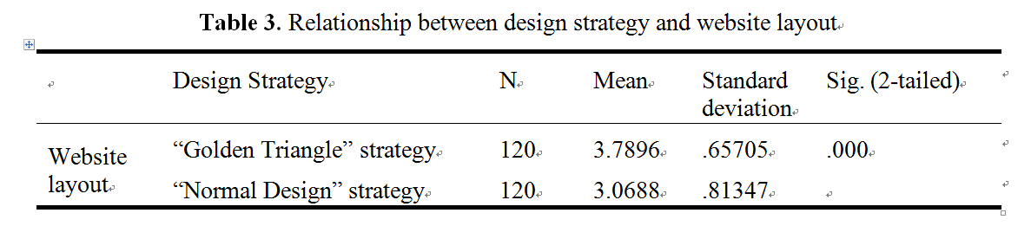
Result
Notes:
Table 3: The respondents evaluated websites designed with ‘Golden Triangle’ strategy more highly than websites devised with ‘Normal Design’ strategy.

Slide 13
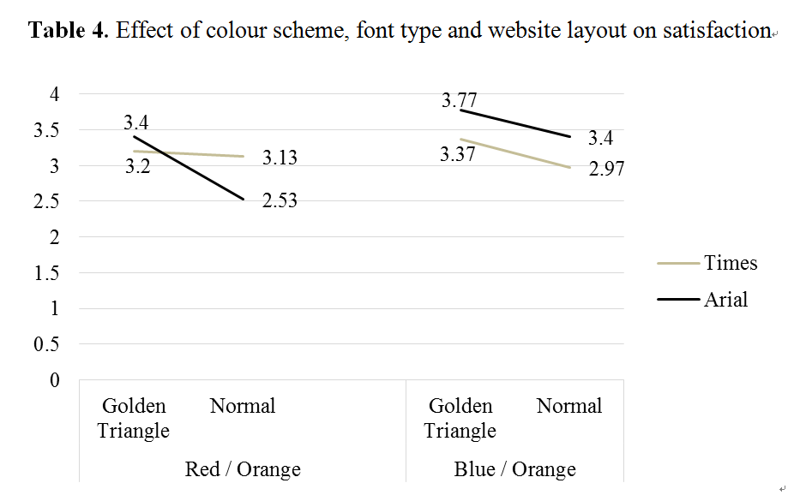
Result
Notes:
A three – way ANOVA analysis was used to assess the effect of colour scheme, font type and website layout on perceived quality of website. As results shown in Table 6, there was a difference between two colour combinations. The overall satisfaction in Blue and Orange combination were higher than in Red and Orange combination. Moreover, the satisfaction of Arial font type was higher than Times New Roman excluding the score in ‘Normal Design’ with Red and Orange combination. In addition, the overall satisfaction in ‘Golden Triangle’ were higher than in ‘Normal Design’. Accordingly, hypothesis 4 ‘Perceived visual attractiveness and perceived quality of website design have an effect on perceived overall quality of website.’ was supported.

Slide 14
Result
Table 5. Mean of the eight tested websites on satisfaction

Slide 15

Conclusion
Suggestion
Provide a suggestion to hotel website designer
→ On selecting: Colour scheme, font type and website layout
      Cool and Warm Colour Combinations
      “Golden Triangle” Strategy
      Arial font type
Notes:
According to the results, the visual attractiveness and website layout can actually contribute to the perceived quality of website as well as the website design with Cool and Warm colour combinations, “Golden Triangle” strategy, Arial has the highest satisfaction of the customers.
Meanwhile, if website designers apply these kinds of elements for websites design, it can encourage the customers to stay longer while they visiting the websites and repeat visit.
Thus, the idea is suggested to help website designers in retaining existing customers by encouraging loyalty such as website designers should carefully pay attention when selecting the most suitable elements to devise the websites since the design factors have a significant effect on the perceived quality of websites.

Slide 16

Conclusion
Limitations & Future research
Limited font type
  Future research: Contain other font types
Technical skill
  Future research: Conduct real websites
Notes:
Firstly, font type is considered as one of the limitations. This study is only studied the impact of two font types (Arial and Times New Roman) on perceived quality of websites. Therefore, it may have different influence on perceived quality of websites that if the future study contains other font types.
Secondly, technical skill is another limitation. Since the researcher had only basic website design skills, in this study, the respondents could only be presented with screenshots instead of real websites. Therefore, the real websites may be used to conduct in future studies. Actual websites may have another impact on the perceived quality of websites since the information displayed on the websites may present a better representation when people surf the website.
Finally, apart from the suggestions mentioned above, future studies may focus on identifying other factors which also influence the perceived quality of websites. Only a few of factors were discussed in this study. There may be other factors of influencing the perceived quality of websites that have not discussed in this study which means that there may have other findings if the future study discusses how navigations or functions of the websites influence the perceived quality of websites.
In addition, the factors may include cultural differences or individual preferences which may be the important contingencies in future studies. Moreover, the website genres or the recent design trends may be considered as design factors for measurement in future studies.

Slide 17
Conclusion
Limitations & Future research
Few factors were discussed
  Future research: Identify other factors
  Factors:
  Cultural differences
  Individual preferences
  Website genres or recent design trends
Notes:
Finally, apart from the suggestions mentioned above, future studies may focus on identifying other factors which also influence the perceived quality of websites. Only a few of factors were discussed in this study. There may be other factors of influencing the perceived quality of websites that have not discussed in this study which means that there may have other findings if the future study discusses how navigations or functions of the websites influence the perceived quality of websites.
In addition, the factors may include cultural differences or individual preferences which may be the important contingencies in future studies. Moreover, the website genres or the recent design trends may be considered as design factors for measurement in future studies.

Slide 18

That’s all!
Thank you for your attention!

