Slide 1
Service With a Smile: Enhancement on Customer Satisfaction
Chan Ka Po
Institute for Tourism Studies
Macao, China
Notes:
Which is Service with a smile. I believe most of you here are professional of tourism or hotel industry, you won’t doubt the importance of presenting smile to customers. If you do, please clip your hand, very good, excellent. So all of you agree with that right?

Slide 2
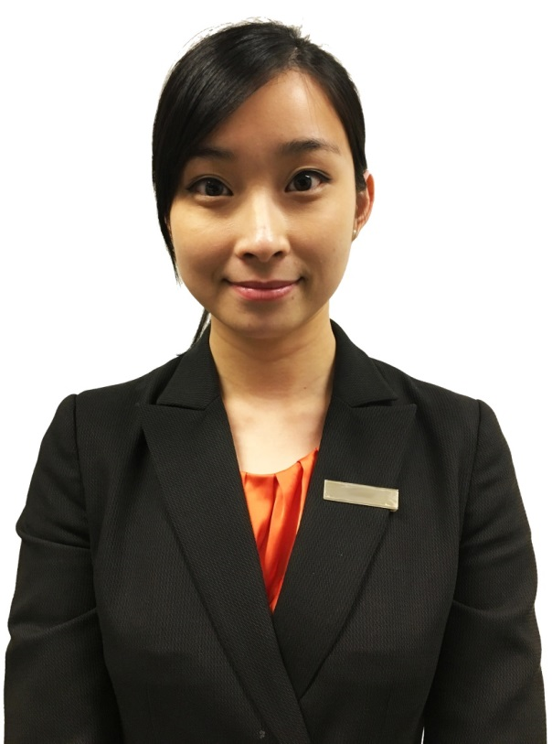
Authentic Smile

Slide 3
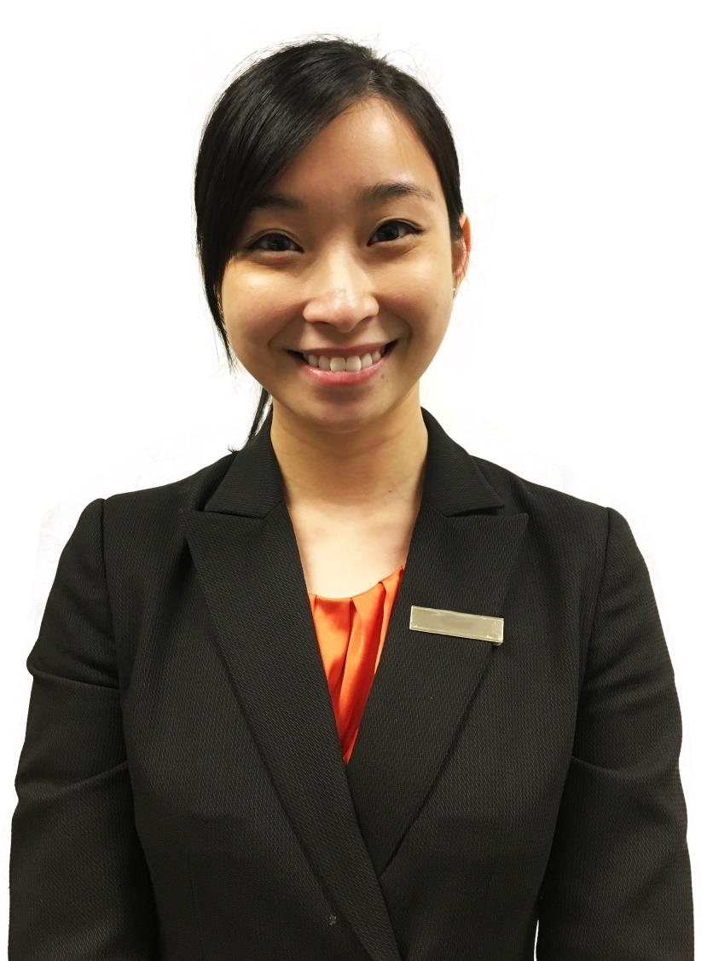
Authentic Smile
Do you know how to present it?
?
?
?
Notes:
But do you really know how to present a authentic smile? As we all know our work sometimes make us frustrated, losing our patient and even get angry. How could you present a smile with such negative emotion and customer still think your smile is sincere? Is there any standard or clear guideline for presenting a authentic smile? I doubt it. And it inspiring me to study this topic.
Actually there are lots of research studying in this topic and found various factors that can identify or enhance the authenticity of a smile. But few of them combine the factors into different types of smile and test their impact on hotel service quality.

Slide 4
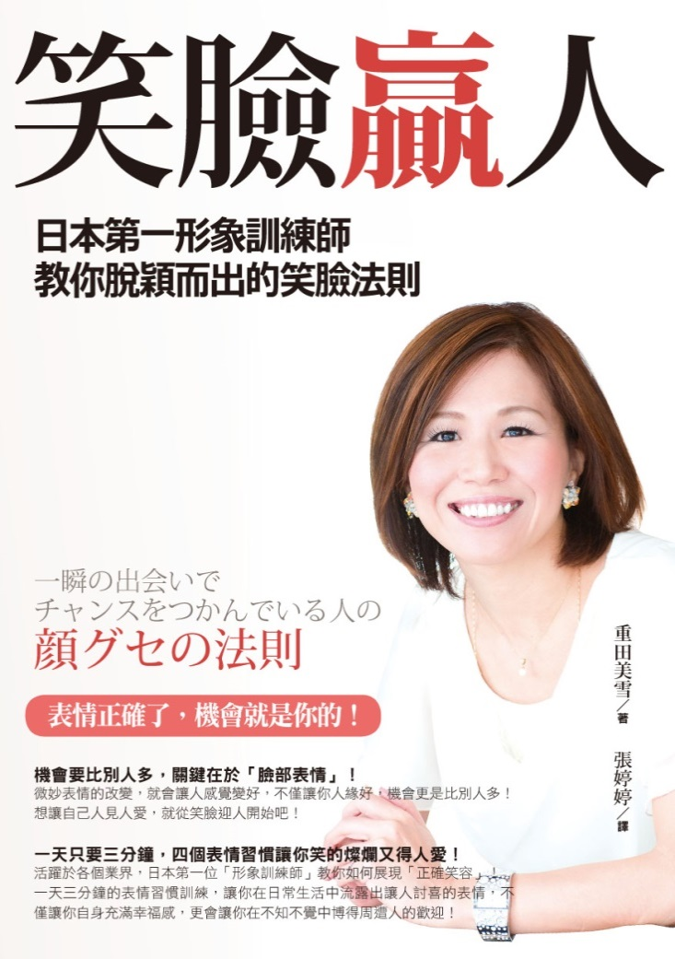
Authentic Smile
Notes:
NIKKEI--日本經濟新聞中文版. (n.d.). Retrieved January 08, 2017, from https://zh.cn.nikkei.com/
日本微笑产业一年创收千亿日元. (n.d.). Retrieved January 08, 2017, from http://news.sina.com.cn/w/2007-10-23/082314145018.shtml
笑臉贏人──日本第一形象訓練師教你脫穎而出的笑臉法則. (n.d.). Retrieved January 08, 2017, from http://anycult.com/popup_image.php?pID=1482

Slide 5
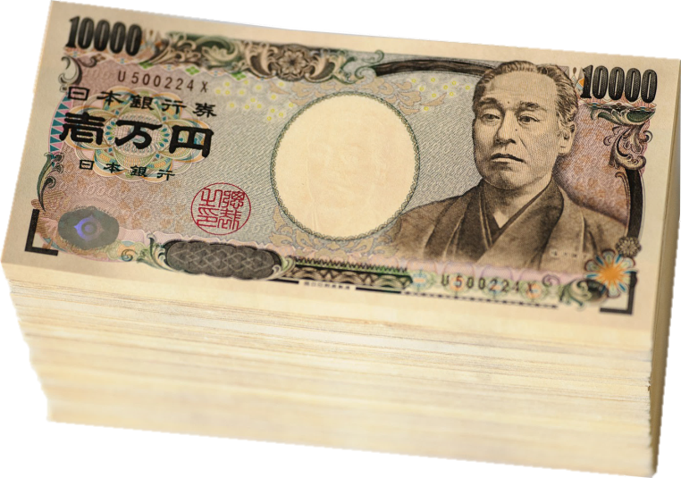
Authentic Smile

Slide 6

Authentic Smile

Slide 7

Authentic Smile

Slide 8
Smile Authenticity
Appearance changes by muscles around eyes (Duchenne smile (Ekman, Davidson, & Friesen, 1990)
Teeth showing
Minimal smile & maximal smile (Tidd and Lockard, 1978)
Head canting
Enhancement on trustworthiness and attractiveness (Otta et al., 1994; Costa and Bitti, 2000)

Slide 9
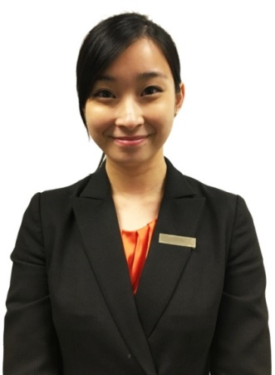

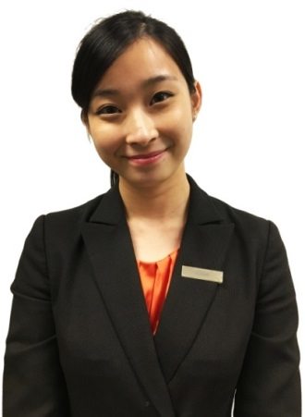
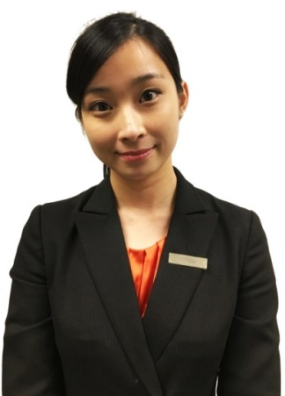
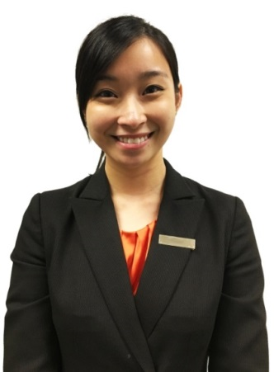
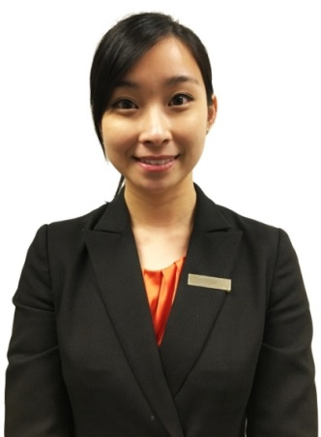
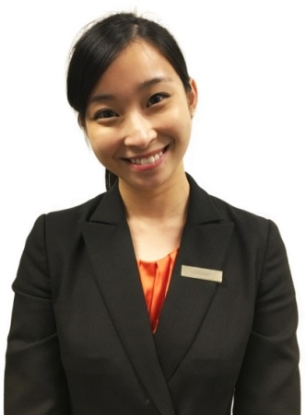
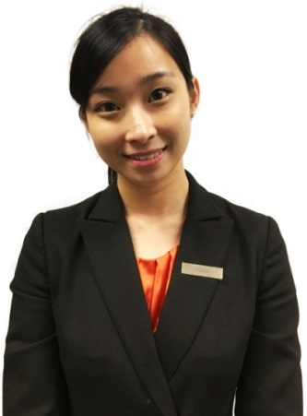
Smile Authenticity
E
None
EH
H
ET
T
ETH
TH
Notes:
So we applied a modified unweighted SERVPERF scales and these 8 types of smile to indicate the relationship between customer perception on hotel service quality and the authenticity of service smiles.

Slide 10
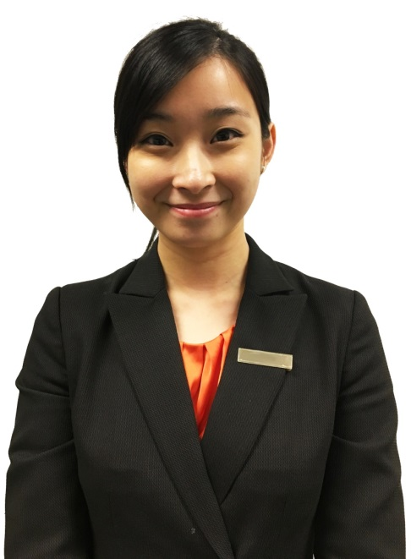

Smile Authenticity
“E”
Appearance changes by muscles around eyes
Duchenne smile (Ekman, Davidson, & Friesen, 1990)
Notes:
People are more likely to smile with the appearance changes by muscles around the eyes when they are experiencing happiness and enjoyment

Slide 11

Smile Authenticity
“T”
Teeth showing
Minimal smile & maximal smile (Tidd and Lockard, 1978)

Slide 12
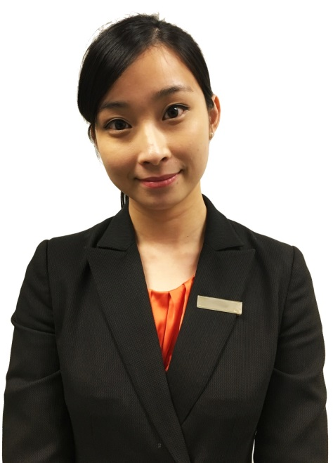
Smile Authenticity
“H”
Head canting
Enhancement on trustworthiness and attractiveness (Otta et al., 1994; Costa and Bitti, 2000)

Slide 13
Smile Authenticity
E
None
EH
H
ET
T
ETH
TH

Slide 14
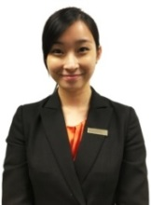
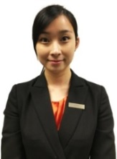
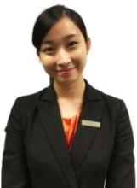

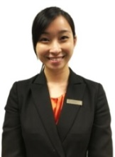

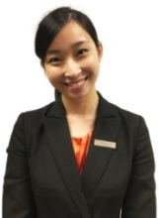

Result

Slide 15
Result
ET
ETH
E
EH
T
NONE
TH
H

Slide 16
Result

Slide 17
Result
The most authentic & preferred smile
“ET”

Slide 18
Customer Satisfaction
Customer value
Service quality
(Cronin, Brady, & Hult 2000; Kim, Park, & Jeong 2004; Oh, 1999; Oliver, 1981)

Slide 19
Customer Satisfaction
Service quality
(Cronin, Brady, & Hult 2000; Kim, Park, & Jeong 2004; Oh, 1999; Oliver, 1981)
SERVQUAL
(Parasuraman, Zeithaml and Berry, 1985)
SERVPERF
(Cronin and Taylor, 1992)

Slide 20
Customer Satisfaction
Service quality
(Cronin, Brady, & Hult 2000; Kim, Park, & Jeong 2004; Oh, 1999; Oliver, 1981)
SERVQUAL
(Parasuraman, Zeithaml and Berry, 1985)
SERVPERF
(Cronin and Taylor, 1992)

Slide 21
Result
(p < 0.001***)
(p < 0.001***)
(p = 0.055)
Notes:
So we applied a modified unweighted SERVPERF scales and these 8 types of smile to indicate the relationship between customer perception on hotel service quality and the authenticity of service smiles.

Slide 22
Result
Positive
“E” (p < 0.001***)
“T” (p < 0.001***)
Negative
“H” (p = 0.055)
Notes:
And we found that smiles with factor E and T have significant positive impact on both authenticity of smile and service quality but factor H make a negative impact on it.
It is not difficult to explain the positive impact of E and T but negative impact of H is a null hypothesis in our study.

Slide 23
Result
Female smile with heat canting
lower reliability
(Otta et al., 1994)
SERVPERF
(Cronin and Taylor, 1992)

Slide 24
Intention To Return
Smiles with factors
Smiles without factors
Notes:
In fact, the effect of the modified SERVPERF scale didn’t proven by past studies and we are concern about the values of smile ET in hotel service encounter.
Therefore, we also ask respondents to rate for their intention to return base on different types of smile.

Slide 25
Intention To Return
The most suggested smile to improve customer intention to return
“ET”

Slide 26
Demographic Background
Age
People tend to be more sensitive to the authenticity of smile by their age growing.
(Calder et al., 2003; Slessor, Miles, Bull and Phillips, 2010; Williams et al., 2006)
Female
Female customer is easier to be satisfied by smile with teeth showing.
(Calder et al., 2003; Slessor, Miles, Bull and Phillips, 2010; Williams et al., 2006)
Notes:
Average mean is sig higher in “18-24” (n = 83, M = 2.81, SD = 0.69) than “25-34” (n = 80, M = 2.53, SD = 0.61) and “35-44” (n = 41, M = 2.47, SD = 0.68) in terms on the smile without “E”

Slide 27
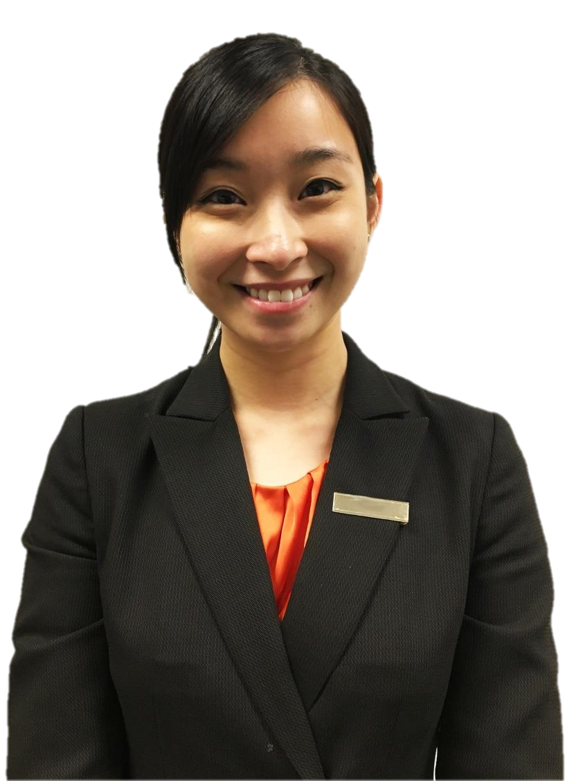
Discussion
The best?
experiential knowledge
conceptual knowledge
(Robinson and Clore, 2002)
Notes:
Robinson and Clore (2002) have mentioned an Accessibility Model of Emotion Self-report that studying people’s judgement on whether a smile is presented by genuine emotion. They found two different sources of information humans use to identify the correlation of a presented smile and the true emotion, one is experiential knowledge and the other one is conceptual knowledge. They also found that people are more likely to use conceptual knowledge to judge the emotion if they are not able to apply their experiential knowledge.
Therefore, a smile with factor “ET” is possibly the most successful expression of smile to match with the most authentic and preferable smile according to customer experience or the best smile they have imagined by using their conceptual knowledge.

Slide 28
Discussion
The best?
halo effect
(Nisbett & Wilson, 1977; Thorndike, 1920)
Notes:
the smiles with factor “E” and “T” possibly emphasize the positive impressions of service providers to customer, and then enhance customer satisfaction
It is suggested that hotel service providers should be trained to present the smile type 5: “ET”
surface acting presentation: not really require consistent emotion → easy to learn and apply, at the same time, making the most sig positive impact on customer satisfaction and intention to return.
Problem and solving problem: job labour → employee can smile well even suffering from negative emotional issues
#job burnout #employee personality #unsatisfying working environment.

Slide 29
Thank You

Slide 30
References
Calder, A. J., Keane, J., Manly, T., Sprengelmeyer, R., Scott, S., Nimmo-Smith, I., & Young, A. W. (2003). Facial expression recognition across the adult life span. Neuropsychologia, 41(2), 195-202.
Costa, M., & Bitti, P. E. R. (2000). Face-ism effect and head canting in one's own and others' photographs. European Psychologist, 5(4), 293.
Cronin Jr, J. J., & Taylor, S. A. (1992). Measuring service quality: a reexamination and extension. The journal of marketing, 55-68.
Cronin, J. J., Brady, M. K., & Hult, G. T. M. (2000). Assessing the effects of quality, value, and customer satisfaction on consumer behavioral intentions in service environments. Journal of retailing, 76(2), 193-218.
Ekman, P., Davidson, R. J., & Friesen, W. V. (1990). The Duchenne smile: Emotional expression and brain physiology: II. Journal of personality and social psychology, 58(2), 342.
Grandey, A. A., Fisk, G. M., Mattila, A. S., Jansen, K. J., & Sideman, L. A. (2005). Is “service with a smile” enough? Authenticity of positive displays during service encounters. Organizational Behavior and Human Decision Processes, 96(1), 38-55.
Kim, M. K., Park, M. C., & Jeong, D. H. (2004). The effects of customer satisfaction and switching barrier on customer loyalty in Korean mobile telecommunication services. Telecommunications policy, 28(2), 145-159.
Krys, K., Hansen, K., Xing, C., Espinosa, A. D., Szarota, P., & Morales, M. F. (2015). It is better to smile to women: Gender modifies perception of honesty of smiling individuals across cultures. International Journal of Psychology, 50(2), 150-154.

Slide 31
References
Otta, E., Lira, B. B. P., Delevati, N. M., Cesar, O. P., & Pires, C. S. G. (1994). The effect of smiling and of head tilting on person perception. The Journal of psychology, 128(3), 323-331.
Nisbett, R. E., & Wilson, T. D. (1977). The halo effect: Evidence for unconscious alteration of judgments. Journal of personality and social psychology, 35(4), 250.
Oh, H. (1999). Service quality, customer satisfaction, and customer value: A holistic perspective. International Journal of Hospitality Management, 18(1), 67-82.
Oliver, R. L. (2014). Satisfaction: A behavioral perspective on the consumer. Routledge.
Parasuraman, A., Zeithaml, V. A., & Berry, L. L. (1985). A conceptual model of service quality and its implications for future research. the Journal of Marketing, 41-50.
Robinson, M. D., & Clore, G. L. (2002). Belief and feeling: evidence for an accessibility model of emotional self-report. Psychological bulletin, 128(6), 934.
Slessor, G., Miles, L. K., Bull, R., & Phillips, L. H. (2010). Age-related changes in detecting happiness: discriminating between enjoyment and nonenjoyment smiles. Psychology and aging, 25(1), 246.
Söderlund, M., & Rosengren, S. (2010). The happy versus unhappy service worker in the service encounter: Assessing the impact on customer satisfaction. Journal of Retailing and Consumer Services, 17(2), 161-169.

Slide 32
References
Thorndike, E. L. (1920). A constant error in psychological ratings. Journal of Applied Psychology, 4, 25-29.
Tidd, K. L., & Lockard, J. S. (1978). Monetary significance of the affiliative smile: A case for reciprocal altruism. Bulletin of the Psychonomic Society, 11(6), 344-346.
Williams, L. M., Brown, K. J., Palmer, D., Liddell, B. J., Kemp, A. H., Olivieri, G., ... & Gordon, E. (2006). The mellow years?: neural basis of improving emotional stability over age. The journal of Neuroscience, 26(24), 6422-6430.
日本微笑产业一年创收千亿日元. (n.d.). Retrieved January 08, 2017, from http://news.sina.com.cn/w/2007-10-23/082314145018.shtml

