Slide 1
Pictures with a new meaning -
How photography affects the travel experience
Sandra HETTEGGER, Magdalena PATZ, Elisabeth PUSCHAN, Johanna RÖCK,
Sabine SARLAY
FHS Salzburg - University of Applied Sciences
AUSTRIA

Slide 2
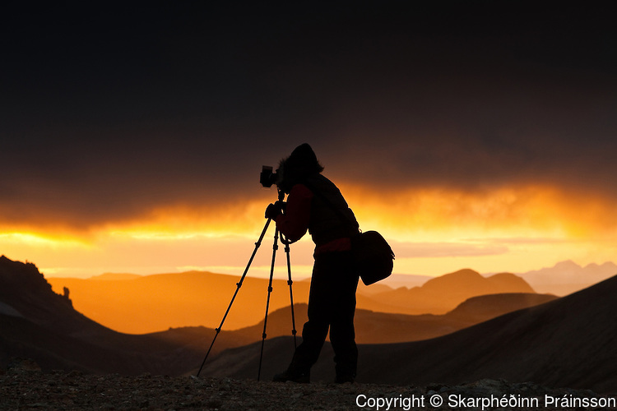
How does the motivation whether tourists take photos to capture the experience for themselves versus to share them with others affect the travel experience of generation Y?
Notes:
Question

Slide 3
Hypotheses
H1: Tourists who take photographs to capture the experience for themselves are more engaged in the activity.
→ Attributes of engagement to measure engagement in the photo-taking activity
H2: Remembering the experience is of higher importance for tourists who take photographs for themselves.
→ Attributes of memory were transferred to tourism photography
H3: Self-staging is of greater importance to tourists who take photographs to capture the experience for others.
→ Sample items were transferred to self-presentation within tourists’ photography behavior

Slide 4
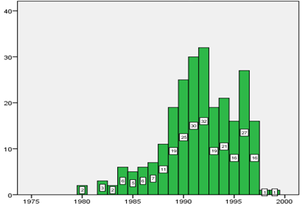
Methodology
Online questionnaire
249 valid respondents
70.3% female vs. 29.7% male
generation Y (1980-1999)
61.1% Austrians
69.9% students
Notes:
Methodology (Quantitative Research, Survey- Online Questionnaire, Generation Y)

Slide 5

Results
46.3% use a phone camera for taking pictures during a holiday
majority takes 21-50 photographs a day
majority needs 11-60 seconds to get to the perfect picture
usage of travel photographs:
  private photo album (19.4%), sharing with friends/family digitally (19.3%), storing digitally (17.2%) and sharing them on social media (18.8%)
favorite photo subject > landscape
Photography Behavior

Slide 6
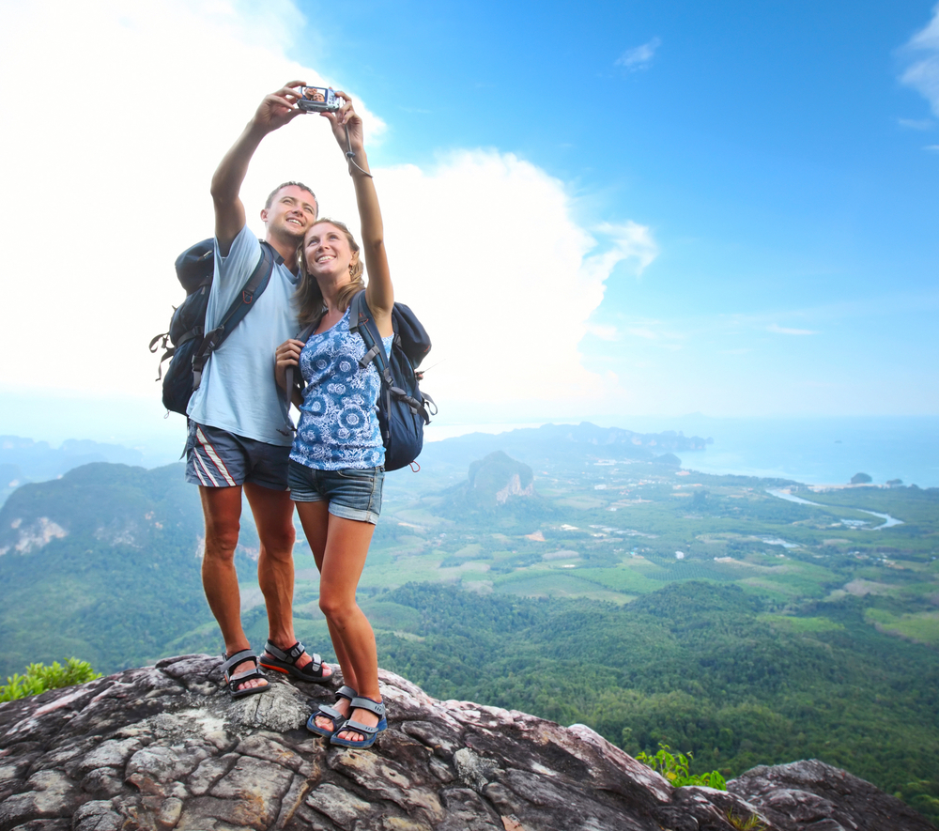
Results
more pictures > more engagement
more time for the perfect picture > more engagement
people who primarily use their travel photographs for sharing, spend more time to get to the perfect picture
people who make pictures for others have a higher level of engagement
travelers who use their travel photos for others, are more engaged in the activity
Engagement

Slide 7
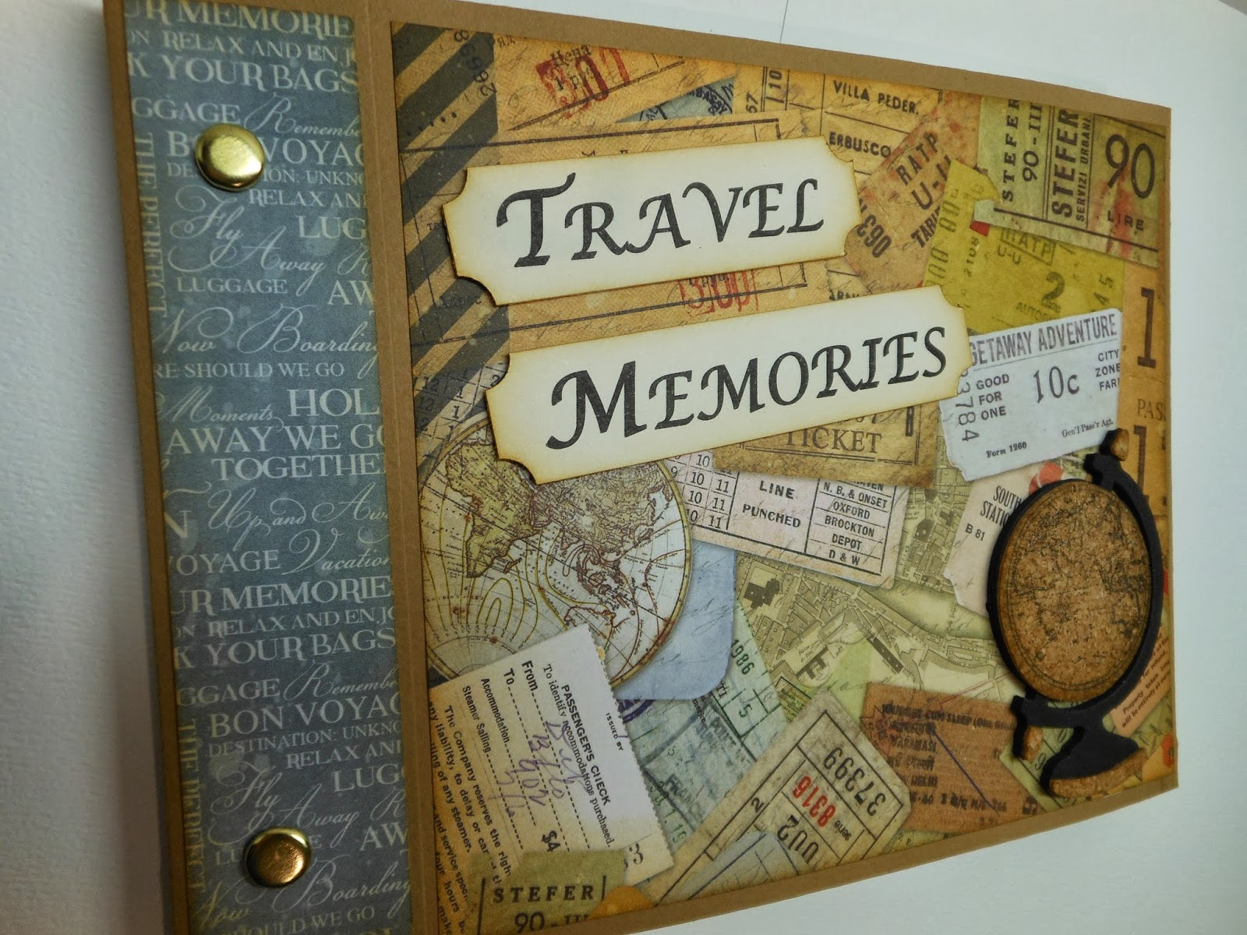
Results
Results
no participant has an excellent memory concerning his/her last holiday
more than half have a poor memory
  56% of the people who took photographs for themselves
  52% of those who took them to share them with others
Memory

Slide 8
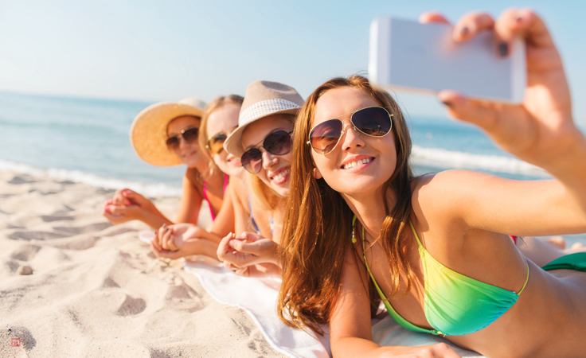
Results
people who pay higher importance to self-staging, dedicate more time to get to their perfect picture
travelers who took photographs for sharing, have proportionally a higher level of self-staging
tourists who take pictures for others, proportionally post photographs more often
Self staging

Slide 9
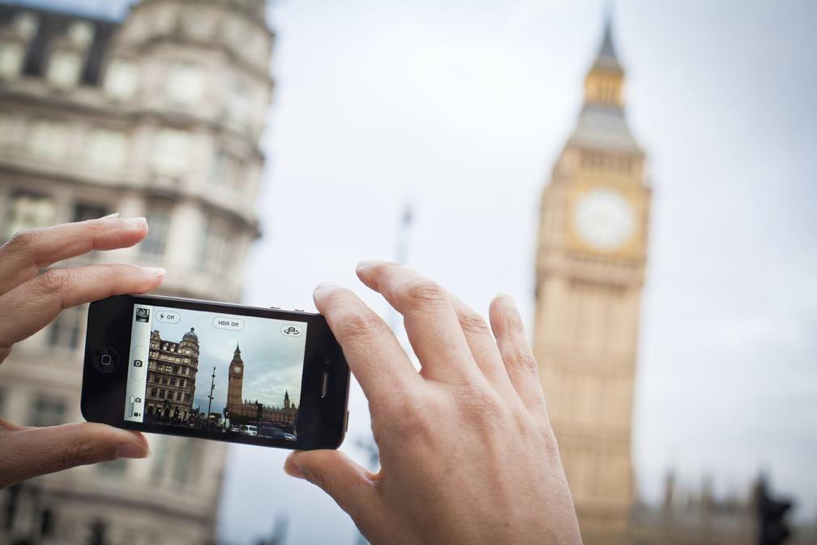
Discussion
For others
Higher level of self-staging
More engaged in travel experience & activities
Staging self- representation
Experience a journey differently
Future research: categorize respondents through an experiment
importance of the ‘self’
Most captured subject: landscapes
Take more time
Travel memory
Rather poor results
Limitations
Geographical locations
Different cultures
Widen to other generations

Slide 10
