Slide 1
Exploring Green Hotel's Communication and Environmental Education Methods and Guest-Involvement in Macau
Jing Li
Institute for Tourism Studies, Macau

Slide 2
Contents
Research Purpose
Introduction of Macau Green Hotels
Hotel-initiated and Guest-involved Green Practices
Green Communication and Environmental Education
Research Questions and Methodology
Results and Findings
Conclusions and References

Slide 3
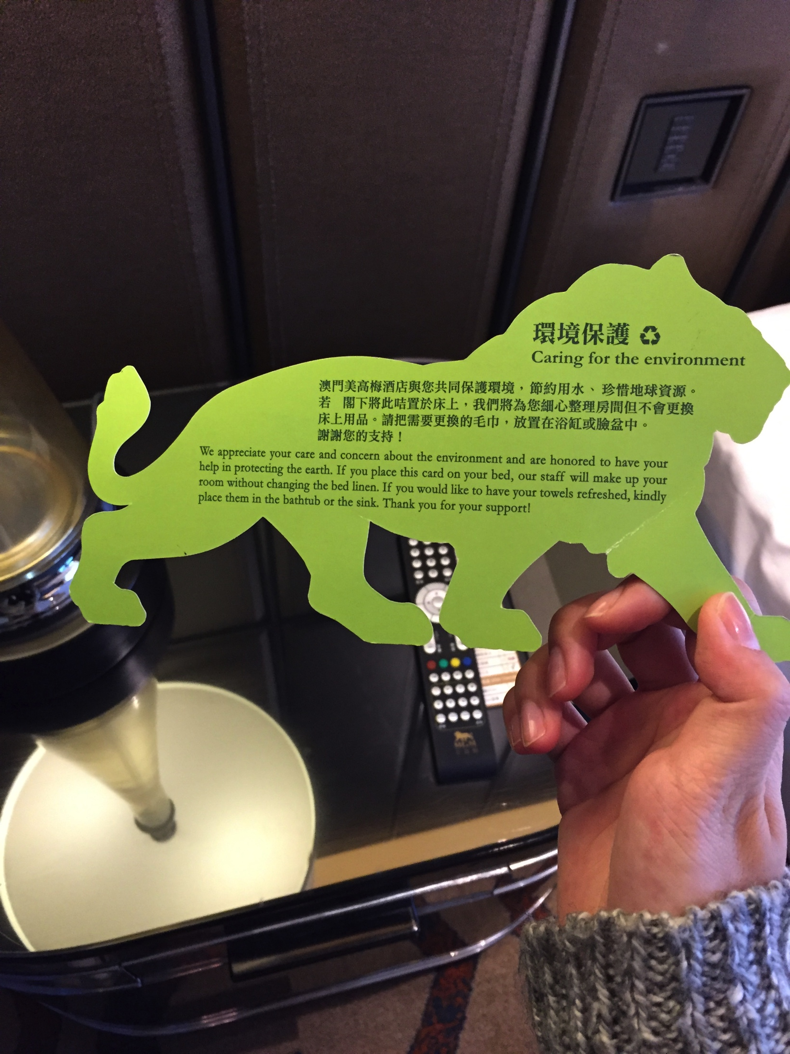
Research Purposes
Current Literature
Reasons to go green
Necessity
Benefits (PEST)
Green Communication
Environmental Education
Mediums
Personal Interest
How about Macau?

Slide 4
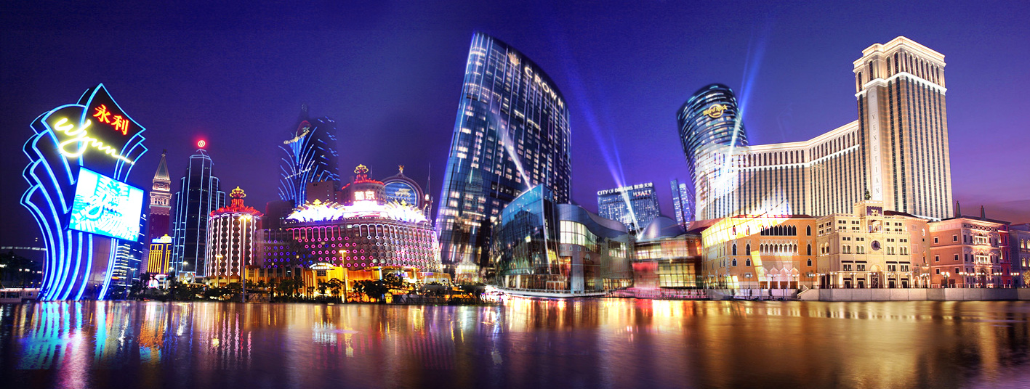
Introduction of Macau Green Hotels
by the end of 2015,
106 hotels and serviced apartments with over 32,000 rooms in total
Electricity Cost: MOP 1.56 billion (€179 million)
Utilities Cost: MOP 923 million (€ 106 million)
(Macau Statistics and Census Service [DSEC], 2015)
by the end of March of 2015,
32 green hotels, one third of all the hotels in Macau,
17,300 rooms, 60% of the total hotel rooms in Macau
(Macau SAR Portal, 2015)

Slide 5
Hotel-initiated and Guest-involved Green Practices
Hierarchy of Effects
Awareness
Knowledge
Different in high and low-involvement settings
Different routes of persuasion
Liking
Preference
Conviction
Hotel-initiated Green Practices
Guest-involved Green Practices
Purchase
(Lavidge & Steiner, 1961, as cited in Levy and Duverger, 2010)

Slide 6
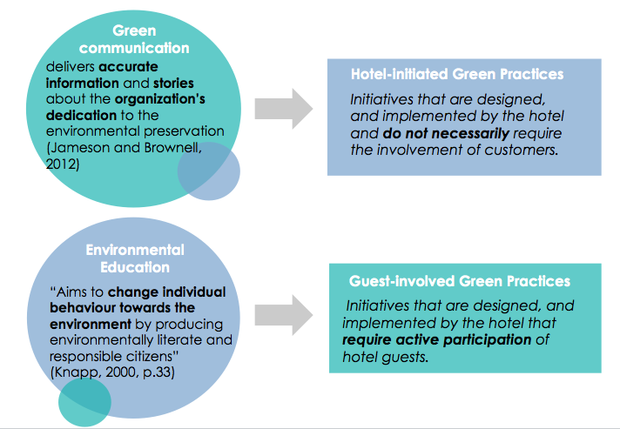
Green Communication and Environmental Education

Slide 7
Research Questions
1. What mediums are currently used by hotels in Macau to communicate with and educate their guests about the hotel-initiated and guest-involved green practices?
2. How do hotel guests perceive the effectiveness of these green communication and environmental education methods?
3. Are hotel guests more motivated to engage in environmentally responsible behaviors when the relevant communication and education by the hotel management is effective?
4. What green communication and environmental education tools are the most preferred by hotel guests in terms of hotel-initiated and guest-involved green practices?

Slide 8
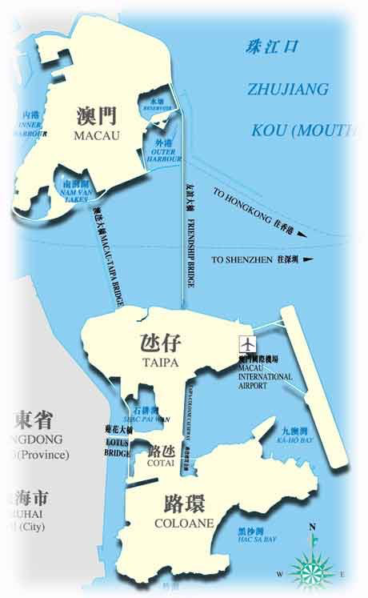
Methodology
Data Collection
Target Population -Macau green hotels’ guests
Convenience Sampling & Snowball Sampling
Quantitative Research - Questionnaires distributed by using electronic devices and
through the Internet
Data Collection Locations:
The Cotai Strip in Taipa, the Border Gate,
the Senado Square and the A-Ma Temple
109 respondents with 100 usable for analysis (Response Rate: 91.7%)
Data Analysis by SPSS PC
Descriptive Analysis
Independent Sample T-test
Open-ended question – coded and thematically analysed

Slide 9
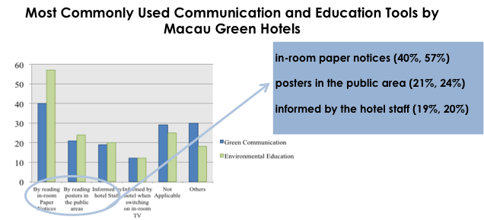
Results and Findings
Demographic Figures
51%
51%

Slide 10
Results and Findings
Most Preferred Green Communication Tools by the Hotel Guests
Same as the most commonly used tools
Different order of
preference

Slide 11
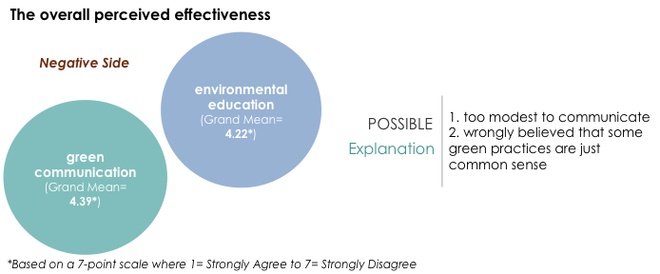
Results and Findings
Guests’ Perceived Effectiveness of Green Communication and Environmental Education
70% of the respondents were not informed or not sure whether they were informed that their hotel was a green hotel.
In accordance with North America (nearly 75%) and Accra, Ghana (74% )
(Mensah, 2015)

Slide 12
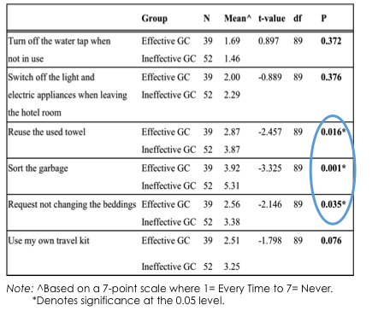
Results and Findings
Independent Sample T-test Results:
Green Communication and Guests’ Involvement in ERB

Slide 13
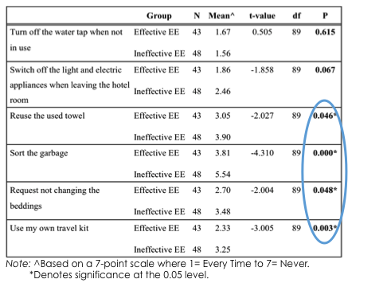
Results and Findings
Independent Sample T-test Results:
Environmental Education and Guests’ Involvement in ERB

Slide 14
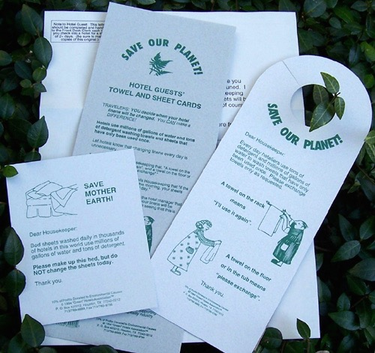
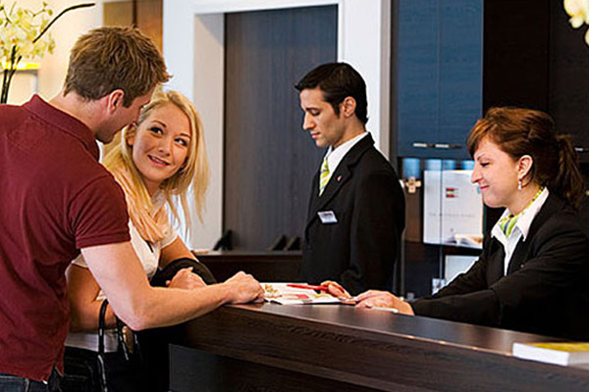
Conclusion
Most of the green hotels in Macau missed the opportunity to gain their guests’ awareness of the hotels’ green nature
Overall perceived effectiveness of green communication and education was not satisfying
Most commonly used and most preferred Tools of Communication and Education
No.1
No.2
No.3
in-room paper notices
posters
Informed by hotel staff
No.2
No.3
No.1

Slide 15
Conclusion
Hotel guests are more motivated to engage in ERBs when the relevant communication and education by the hotel management is effective.
Stop being modest !
Limitations
Small sample size
Other factors like gender, education and age may affect the results
Respondents recalled memories - inaccurate and made-up answers
Low generalizability

Slide 16
References
Levy, S. E., & Duverger, P. (2010). Consumer perceptions of sustainability in the lodging industry: examination of sustainable tourism criteria. Paper presented at the International Council on Hotel, Restaurant and Institutional Education [ICHRIE] Conference, San Juan, Puerto Rico, USA. Retrieved from: http://scholarworks.umass.edu/cgi/viewcontent.cgi?article=1555&context=refereed
Macau Census and Statistics Sevices [DSEC] (2014). Hotels and Similar Establishments Survey, Retrieved from: http://www.dsec.gov.mo/Statistic.aspx?NodeGuid=8fc36a27-54c5-4a12-bf32-2365dfa1ba02
Macau Census and Statistics Sevices [DSEC] (2015). Package Tours and Hotel Occupancy Rate, Retrieved from: http://www.dsec.gov.mo/Statistic.aspx?NodeGuid=f22bc742-c891-4988-9b6e-3952db8000e9
Mensah, I. (2012). Environmental Education and Environmentally Responsible Behavior: The Case of International Tourists in Accra Hotels. International Journal of Tourism Sciences, 12(3), 69-89.
Jameson, D., & Brownell, J. (2012). Telling your hotel’s “green” story: Developing an effective communication strategy to convey environmental values. Retrieved from: http://scholarship.sha.cornell.edu/cgi/viewcontent.cgi?article=1011&context=chrtools
Knapp, D. (2000). The Thessaloniki Declaration: A wake-up call for environmental education? The Journal of Environmental Education, 31(3), 32-39.

