Slide 1
Experiential Marketing in Services – Designing Multisensory Customer Experiences
Svenja König, Kempten University Of Applied Sciences, Germany

Slide 2
Structure
Relevance and Characteristics of Experiences
Experiential Marketing
    as conceptual response to the experience orientation of todays society
Design Parameters
    for Customer Experiences
Multisensory Conveyance
    of Customer Experience
Digital Transformation
    Chances for the Design of Multisensory Customer Experiences

Slide 3
CHARACTERISTICS AND RELEVANCE OF EXPERIENCES
Relevance of Experiences:
Societal Change
Increasing Prosperity
Increase in Life Expectancy
Commodi-
tization
of Services
Economic Significance

Slide 4
Definition of Experiences:
„Private events that occur in response to some stimulation“
Schmitt 1999, p. 60

Slide 5
Characteristics of Experiences:
Experiences constitute an emotional value
Experiences are unique
Experiences require to actively involve and integrate the customer
Experiences are holistic
Experiences are particularly memorable

Slide 6
Experiential Marketing as conceptual response to the experience orientation of todays society
Definition:
„Experiential Marketing focuses
on the usage and the consumption situation (instead of products),
on types of experiences (instead of product features),
and on bringing together and integrating the stimuli that customers
receive at all touchpoints.”
Schmitt 2003, p. 218

Slide 7
Tenets:
Focus on customers’ experiences
Customers are emotionally driven
Design of the consumption situation
Methods and tools are eclectic
Aim:
Creation of holistic customer experiences
anchoring a company’s offer in the customer’s mind

Slide 8
Strategic Experiential Modules & Experience Providers:
SEMs (Strategic Experiential Modules) | ExPros (Experience Providers)
Five types of experiences: Affective experiences Creative-cognitive experiences Physical experiences Social experiences Sensory experiences | Communications Visual and verbal identity Product presence Cobranding Spatial environments Electronic media People

Slide 9
Design Parameters for the Customer Experience
Memorable and Compelling Customer Experiences …
… require the compliance of immaterial and material elements of the
experience setting
… appeal to the customers’ lifestyles and take their particular needs into
account
… are inherently personal and at the same time appeal to a multitude of
customers
… include elements of novelty and surprise

Slide 10
… actively involve the customer
… provide an educational benefit
… encompass both episodic memory contents and semantic memory
contents

Slide 11
Multisensory Conveyance of Customer Experience
Communication Channels:

Slide 12

Practical Implementation of a Multisensory Sales Approach:
Visual Impressions
Tactile
Impressions
Olfactory
Impressions
Gustatory
Impressions
Acoustic
Impressions
Singapore Girl
Asian appearing music
Hot Towels
SINGAPORE AIRLINES
International Culinary Panel
Smell Stefan Floridian Waters

Slide 13
Digital Transformation
Chances for the Design of Multisensory Customer Experiences:
Visual Impressions
Tactile
Impressions
Olfactory
Impressions
Gustatory
Impressions
Acoustic
Impressions
Use of virtual reality classes
Phantom Omni © Haptic Device
Data Glove
Use of auditory signals
Drops with a supplementary smell
iAroma
Ophone

Slide 14
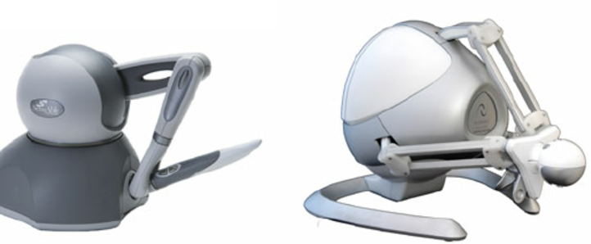
Phantom Omni Haptic © Device:
Source: https://www.researchgate.net/profile/Christoph_Fuenfzig2/publication/221231970/figure/fig1/AS:305632910561285@1449879972632/Figure-1-Haptic-Devices-the-SensAble-PHANTOM-Omni-R-is-a-serial-6DOF-input-3DOF-output.png

Slide 15

iAroma:
Source: http://www.designboom.com/cms/images/-Z85/ia2.jpg

Slide 16
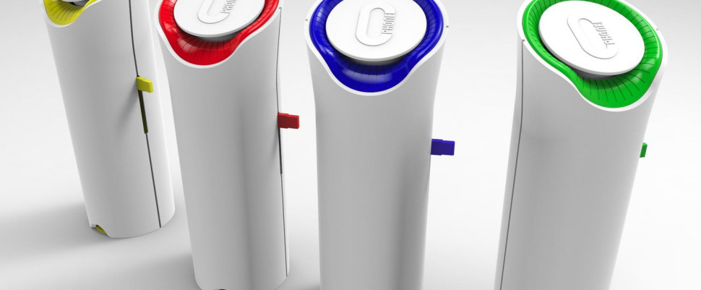
Ophone:
Source: http://icdn6.digitaltrends.com/image/ophone-vapor-communication-1-970x647-c.jpg

Slide 17
THANK YOU VERY MUCH FOR YOUR ATTENTION!
Are there any questions?

Slide 18
Discussion
„Blasting all senses at the same time will only result in over stimulation and confusion. Sometimes using only one sense may give a larger experience than „diluting“ it with multiple sensations.“
(Gelter 2007, S.42)

Slide 19
Bibliography
Text sources:
Carù, A. & Cova, B., 2007. Consuming experiences - an introduction. In: A. Carù & B. Cova, Eds. Consuming Experience. London i.a.: Routledge, pp. 3-16
Hultén, B., Broweus, N., Dijk, v. & Markus, 2009. Sensory Marketing. Basingstoke: palgrave macmillan
Kilian, K., 2009. Experiential Marketing and Brand Experiences: A Conceptual Framework. In: A. Lindgreen, J. Vanhamme & M. B. Beverland, Eds. Memorable Customer Experiences - A Research Anthology. Surrey i.a.: Gower Publishing Limited, pp. 25-44
Kilian, K. & Brexendorf, T. O., 2005. Multisensuale Markenführung als Differenzierungs- und Erfolgsgröße. [Online] Available at: http://www.markenlexikon.com/d_texte/campus_kilian_brexendorf_multisensuale_markenfuehrung_2005.pdf [Accessed 16 December 2016]
Lindstrom, M., 2005. Broad sensory branding. Journal of Product & Brand Management, No. 2, Vol. 14, pp. 84-87
Linxweiler, R. & Siegle, A., 2008. Markenplattformen - Erlebnis für alle Sinne. In: N. O. Herbrand, Eds. Schauplätze dreidimensionaler Markeninszenierung - Innovative Strategien und Erfolgsmodelle erlebnisorientierter Begegnungskommunikation. Stuttgart: Edition Neues Fachwissen, pp. 97-118
Gelter, H., 2007. Towards an Understanding of Experience Production. In: M. Kylänen, Ed. Articles on Experiences 4 - Digital Media & Games. Rovaniemi : Lapland Centre of Expertise for the Experience Industry (LCEEI), pp. 28-51

Slide 20
Poulsson, S. H. & Kale, S. H., 2004. The Experience Economy and Commercial Experiences. The Marketing Review, No. 3, Vol. 4, pp. 267-277
Salzmann, R., 2007. Multimodale Erlebnisvermittlung am Point of Sale. Wiesbaden: Deutscher Universitäts-Verlag.
Schmitt, B. H., 1999. EXPERIENTIAL MARKETING - How to Get Customers to SENSE, FEEL, THINK, ACT, and RELATE to Your Company and Brands. New York: THE FREE PRESS
Schmitt, B. H., 2003. Customer Experience Management- A revolutionary approach to connecting with your customers. Hoboken: Wiley
Schmitt, B. H. & Mangold, M., 2004. Kundenerlebnis als Wettbewerbsvorteil - Mit Customer Experience Management Marken und Märkte Gewinn bringend gestalten 1st ed. Wiesbaden: Gabler.
Schüller, A. M., 2016. TOUCH. POINT. SIEG. - Kommunikation in Zeiten der digitalen Transformation. 2nd ed. Offenbach: GABAL
Scott, N., Laws, E. & Boksberger, P., 2009. The Marketing of Hospitality and Leisure Experiences. Journal of Hospitality Marketing & Management, Vol. 18, pp. 99-110
Smith, K. & Hanover, D., 2016. Experiential Marketing: secrets, strategies, and success stories from the world´s greatest brands. Hoboken: Wiley
Steiner, P., 2011. Sensory Branding - Grundlagen multisensualer Markenführung. Wiesbaden: Gabler

Slide 21
Photo credits:
Logo Singapore Airlines:
http://images.google.de/imgres?imgurl=http%3A%2F%2Flogok.org%2Fwp-content%2Fuploads%2F2014%2F08%2FSingapore-Airlines-logo.png&imgrefurl=http%3A%2F%2Flogok.org%2Fsingapore-airlines-logo%2F&h=1200&w=1600&tbnid=RNYIZp6f6BU7OM%3A&vet=1&docid=MrAng_HljWtovM&ei=5NyFWK6lJuP36ASC_7XoCg&tbm=isch&iact=rc&uact=3&dur=1929&page=0&start=0&ndsp=26&ved=0ahUKEwiup76uidjRAhXjO5oKHYJ_Da0QMwg1KAYwBg&bih=913&biw=1280
Phantom Omni © Haptic Device:
https://www.researchgate.net/profile/Christoph_Fuenfzig2/publication/221231970/figure/fig1/AS:305632910561285@1449879972632/Figure-1-Haptic-Devices-the-SensAble-PHANTOM-Omni-R-is-a-serial-6DOF-input-3DOF-output.png
iAroma:
http://www.designboom.com/cms/images/-Z85/ia2.jpg
Ophone:
http://icdn6.digitaltrends.com/image/ophone-vapor-communication-1-970x647-c.jpg

