Slide 1
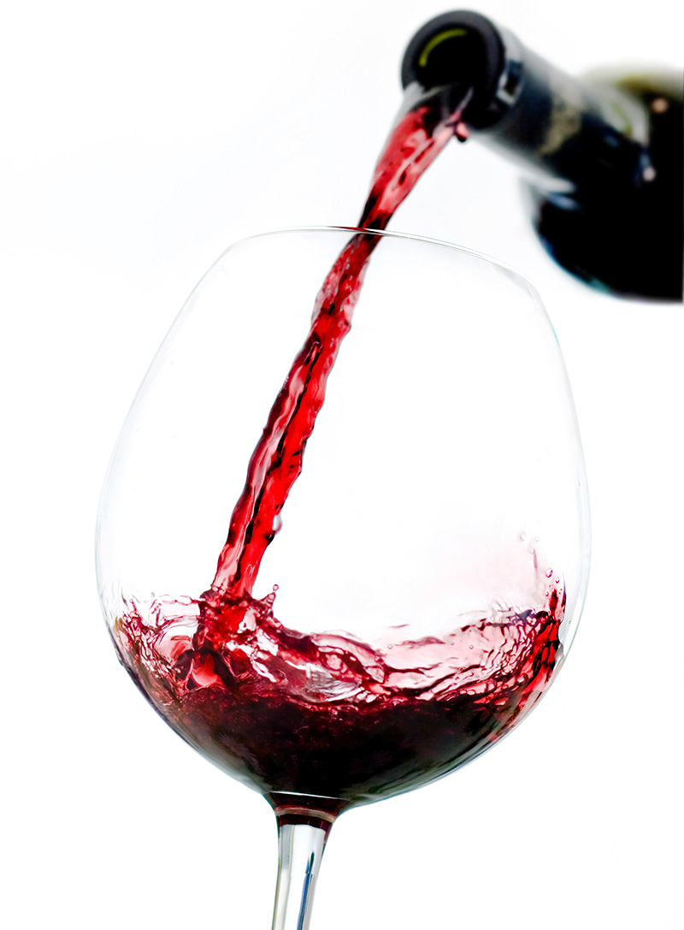
INFLUENCE OF EXTRINSIC CUES ON WINE PERCEPTION AND CONSUMER BEHAVIORS
SHI YUE
Institute for Tourism Studies,
Macao, China

Slide 2
WHAT ARE CUES?

Slide 3
EXTRINSIC
INTRINSIC
can be altered without changing the product,
directly related to the product
e.g. suggestions, price & glassware
e.g. grape varieties & color of the wine
(Aqueveque, 2006)

Slide 4
GLASSWARE EFFECT
Perception of odor intensity
(Pierce & Halpern, 1996)
Increase sales of alcohol
(Ford et al., 2013; Frewin, 2011)

Slide 5
INFLUENCE OF PRICE
Price-quality relationship
(Plassmann, O’Doherty, Shiv & Rangel A, 2008)
Decrease purchase intention
(Dodds & Monroe, 1985)

Slide 6
POWER OF EXPERT
Change in attitude under the influence of an authority
(Hughson & Boakes, 2002)
Increase wine sales
(Manske & Cordua 2005)

Slide 7
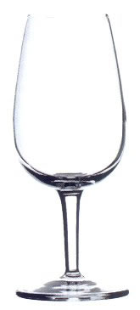
GLASS TYPE
ISO
225 ml
Chardonnay
350 ml
Riesling
395 ml

Slide 8
WINE QUALITY
DIMENSIONS
CONSUMER BEHAVIOR
Aroma intensity
Purchase intention
Aroma types
Perceived value
Flavor length
Willingness to recommend
Overall quality
(Aqueveque, 2006)
(WSET, 2014)

Slide 9
WINE QUALITY
DIMENSIONS
CONSUMER BEHAVIOR
Aroma intensity
Purchase intention
Aroma types
Perceived value
Flavor length
Willingness to recommend
Overall quality
(Aqueveque, 2006)
(WSET, 2014)

Slide 10
RESEARCH DESIGN
CONTROL
EXPERIMENTAL
EXPERIMENTAL
GROUP
GROUP 1
GROUP 2
N=25
N=24
N=25
Price influence
Wine expert
MOP 800

Slide 11
WINE QUALITY
EXPERT OPINIONS
Appearance
Aroma
Flavor
Overall quality

Slide 12
Aroma types
EXPERT OPINIONS
Oak Aroma

Slide 13
RESULTS

Slide 14
AROMA INTENSITY
F (2, 44) = 12.45, p = .000
Experimental group 2
Glassware
Experimental group 1
Control Group
3.25
2.75
2.25
2.04
1.75
1.52
1.57
ISO
Chardonnay
Riesling

Slide 15
GLASS TYPE
Highest air-to-liquid ratio
Shortest distance
ISO glass
225 ml

Slide 16
AROMA INTENSITY
Experimental group 2
PRICE
Experimental group 1
Control Group
3.25
2.75
p > .05
2.25
1.75
ISO
Chardonnay
Riesling

Slide 17
AROMA INTENSITY
Experimental group 2
EXPERT
Experimental group 1
Control Group
3.25
p < .005
2.75
2.25
1.75
ISO
Chardonnay
Riesling

Slide 18
AROMA TYPES
7
2

Slide 19
AROMA TYPES
16

Slide 20
FLAVOR LENGTH
Experimental group 2
PRICE
Experimental group 1
Control Group
2.75
2.5
p > .05
2.25
2
1.75
ISO
Chardonnay
Riesling

Slide 21
FLAVOR LENGTH
Experimental group 2
EXPERT
Experimental group 1
Control Group
2.75
p < .005
2.5
2.25
2
1.75
ISO
Chardonnay
Riesling

Slide 22
OVERALL QUALITY
Experimental group 2
PRICE
Experimental group 1
Control Group
4
3.75
p < .05
3.5
3.25
3
2.75
ISO
Chardonnay
Riesling

Slide 23
OVERALL QUALITY
Experimental group 2
EXPERT
Experimental group 1
Control Group
p < .005
4
3.75
3.5
3.25
3
2.75
ISO
Chardonnay
Riesling

Slide 24
PURCHASE INTENTION
Experimental group 2
Glassware
Experimental group 1
Control Group
4.5
4
3.8
3.72
3.5
3.2
3
ISO
Chardonnay
Riesling

Slide 25
GLASS TYPE
ISO
225 ml
Chardonnay
350 ml
Riesling
395 ml

Slide 26
PURCHASE INTENTION
Experimental group 2
PRICE
Experimental group 1
Control Group
4.5
4
p > . 05
3.5
3
ISO
Chardonnay
Riesling

Slide 27
PURCHASE INTENTION
Experimental group 2
EXPERT
Experimental group 1
Control Group
p < .005
4.5
4
3.5
3
ISO
Chardonnay
Riesling

Slide 28
PERCEIVED VALUE
Experimental group 2
PRICE
Experimental group 1
Control Group
p < .005
475
350
225
100
ISO
Chardonnay
Riesling

Slide 29
PERCEIVED VALUE
Experimental group 2
EXPERT
Experimental group 1
Control Group
475
p < .005
350
225
100
ISO
Chardonnay
Riesling

Slide 30
WILLINGNESS TO RECOMMEND
Experimental group 2
EXPERT
Experimental group 1
Control Group
4.8
p < .005
4.4
4
3.6
3.2
ISO
Chardonnay
Riesling

Slide 31
LIMITATIONS
Only white wine and white wine glasses were used.

Slide 32
LIMITATIONS
Small sample size
(n=74)

Slide 33
CONCLUSION & IMPLICATIONS
Large-bodied glassware
Purchase intention.

Slide 34
CONCLUSION & IMPLICATIONS
Price
Wine quality perception
Purchase intention.

Slide 35
CONCLUSION & IMPLICATIONS
Slightly mark up the price.

Slide 36
CONCLUSION & IMPLICATIONS
Expert
Wine quality perception
Purchase intention

Slide 37
CONCLUSION & IMPLICATIONS
In-house sommelier
On-site wine promoter

Slide 38
CONCLUSION & IMPLICATIONS
Consult but don’t blind trust experts.

Slide 40
REFERENCES
Aqueveque, C. (2006). Extrinsic cues and perceived risk: the influence of consumption situation. Journal of Consumer Marketing, 23(5), 237-247.
Dodds, W. B., & Monroe, K. B. (1985). The effect of brand and price information on subjective product evaluations. NA-Advances in Consumer Research Volume 12.
Ford A, Moodie C, MacKintosh AM et al. (2013) Adolescent perceptions of cigarette appearance. Eur J Public Health, online 23rd October.
Frewin A. (2011) Libbey two-third pint beer schooner glasses from John Artis. Caterer and Hotelkeeper. 25th November. http://www.catererandhotelkeeper.co.uk/printer-friendly/341297
Hughson, A. L., & Boakes, R. A. (2002). The knowing nose: the role of knowledge in wine expertise. Food quality and preference, 13(7), 463- 472.
Manske, M., & Cordua, G. (2005). Understanding the sommelier effect. International journal of contemporary hospitality management, 17(7), 569-576.
Pierce, J., & Halpern, B. P. (1996). Orthonasal and retronasal odorant identification based upon vapor phase input from common substances. Chemical Senses, 21(5), 529-543.
Plassmann H, O’Doherty J, Shiv B, Rangel A. (2008). Marketing actions can modulate neural representations of experienced pleasantness. Proc. Natl. Acad. Sci. USA 105:1050–54

