Slide 1
Difference of comments
perception between men and
women on destination pictures
promoted on Facebook
Ou Jing
Irina Dygruber-Pak
Damyan Kanchev

Slide 2


Why did we choose this topic?
• Social Media
• Destinations
• Pictures and comments
• Gender Differences in
perception of comments

Slide 3
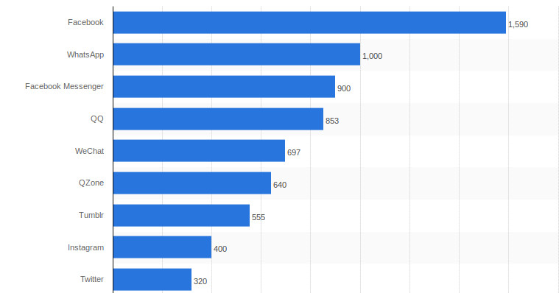
Facebook/ User Generated Content
1.59 billion monthly active users
1.09 billion daily active users on average for March 2016
989 million mobile daily active users on average for March 2016
1.65 billion monthly active users as of March 31, 2016
1.51 billion mobile monthly active users as of March 31, 2016
350 million photos are averagely uploaded daily

Slide 4
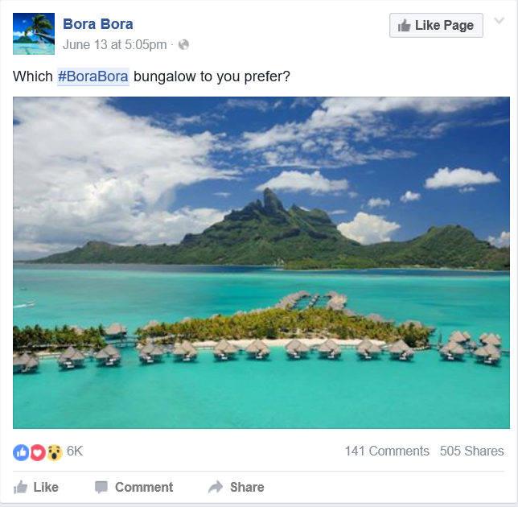
Pictures/Destination images
Power of pictures
Get attention
Arouse emotions
Create interest
Reduce intangibility
Work faster as text

Slide 5

Comments/User Generated Content
Reason for the influence of comments:
Intangible tourism products

Slide 6

Why women?
Women are the main decision maker for holidays.
Women are more active in social media and dominating Facebook.
Women are more influenced by comments.

Slide 7
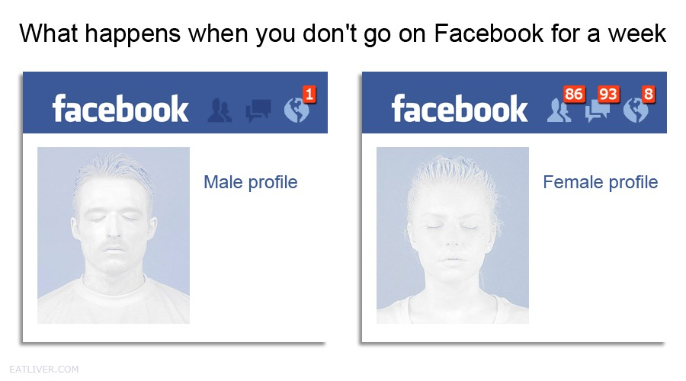
Why women?
Men Are From Foursquare, Women Are From Facebook

Slide 8
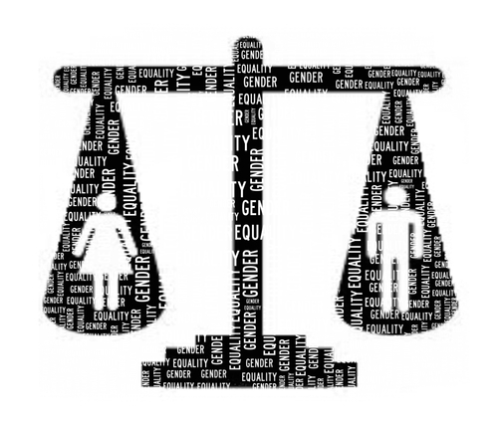
Well, are man and woman really different in terms of their behaviour in social media?
Gender difference
Gender differences do exist (e.g. Okazaki, 2007)
No gender differences exist (e.g. Schubert, Brown, Gysler, & Brachinger, 1999)
Biological factors (Derry, 2006), sexual identity (Thompson & Morgan, 2008), gender role attitudes (Stickney & Konrad, 2007), and consumer values (Mitchell & Walsh, 2004).
culture, knowledge, affection, cognition, ethical values and perceptual processes (Feisal, Jancovicova, Panayeva, & Vasic, 2015)

Slide 9
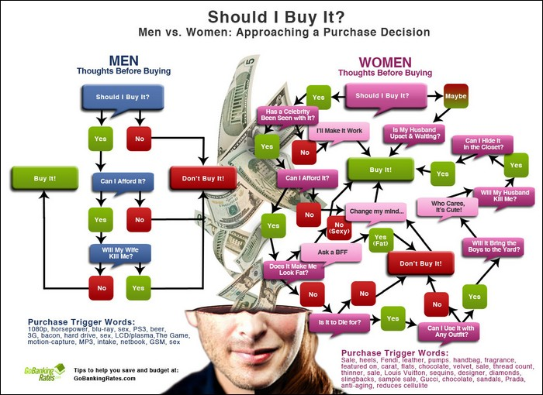
Gender difference - information searching and collecting
Information
Females processed information in a more exhaustive and interpretive way, relying on a broad variety of information. Females processed information resorting more to sources in the external world rather than to their own judgments (Meyers, 1988).
Comments
Females are more likely to rely on a recommendation from others, and word-of-mouth communication has a stronger effect on females than males and consumer reviews can play an important role as electronic word-of-mouth by offering females credible product information and recommendations (Bae & Lee, 2010).

Slide 10

What do we want to find out?

Slide 11
Hypothesis
1) Comments have a greater influence on perception of destination pictures promoted on Facebook for female than male.
2) Negative comments of destination picture on Facebook have greater value than positive comments

Slide 12
Empirical part
Methodology: Quantitative approach

Slide 13
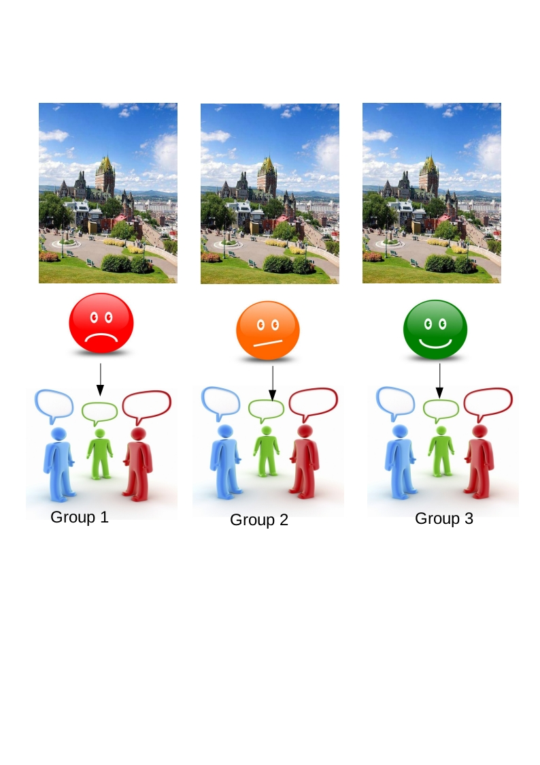
Questionnaire design
3 Questionnaire/3 groups
Facebook post (picture+comments)
Explicit checking
Demographic questions (age, gender, marital status, education etc.)
Likert scale statements of destination picture & comments to evaluate (strongly agree to strongly disagree), ex: “The comments on this posting raise my inspiration to visit the destination”

Slide 14
SPSS
Tools to analyze

Slide 15
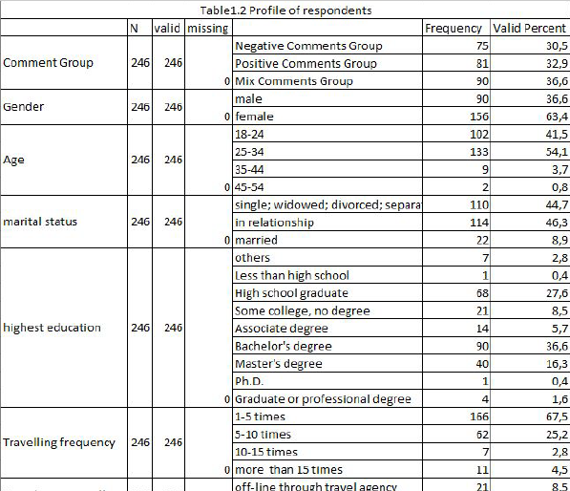
Demographic characteristics of participants:
Total number of participants - 246
Total number of male respondents - 90
Total number of female respondents - 156
Respondents between 18-24 and 25-34 - 95.6 % from the whole sample size
Highest number of participants with Bachelor”s degree - 36.6 %

Slide 16
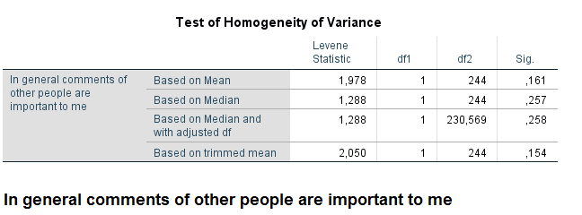
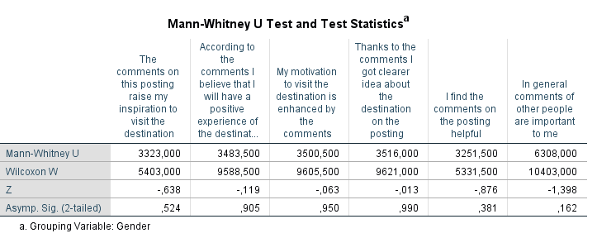
Non-parametric tool
H1:Comments have a greater influence on perception of destination pictures promoted on Facebook for female than male.

Slide 17
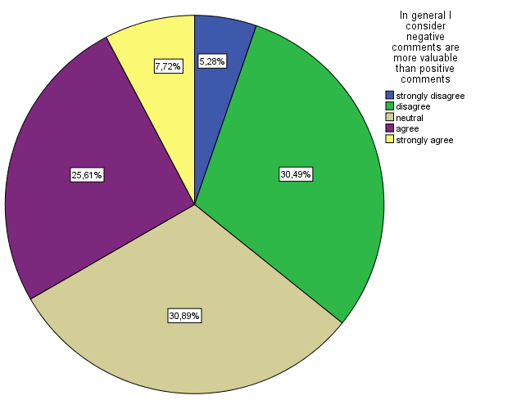
H2: Negative comments of destination picture on Facebook have greater value than positive comments
Univariate analysis
The whole sample size was measured
33,33% negative comments < 35,77% positive comments

Slide 18
Non-parametric tool
H1:Comments have a greater influence on perception of destination pictures promoted on Facebook for female than male.

Slide 19
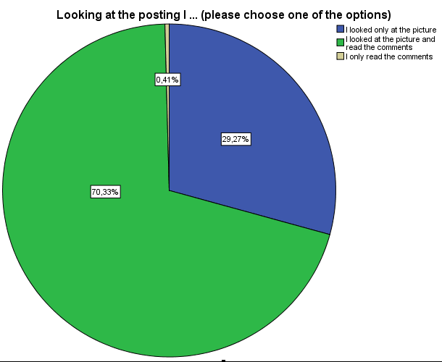
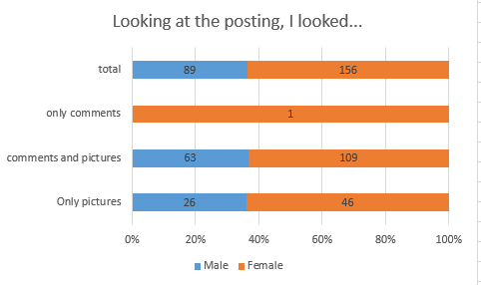
Comments preference

Slide 20
LIMITATIONS AND FUTURE RESEARCH
Samplings
Statistical tests
Authenticity of conducting scene

Slide 21
DISCUSSION AND CONCLUSION
Mann-Whitney U test, Cross Table test and T-Test suggested there were no significant differences
Mean calculation with excel showed the opposite outcome and the percentage analysis of Cross Table test favored this result
Evaluation label “Neutral” makes use only in cases if respondents really don’t know what to answer

Slide 22

Thank you for your attention!
Any comments or are you focused
on the Smile picture?

