Slide 1
Boiling Summers – a Threat for Alpine Regions?
Marcella Manzl
University of Applied Sciences Krems
Austria

Slide 2

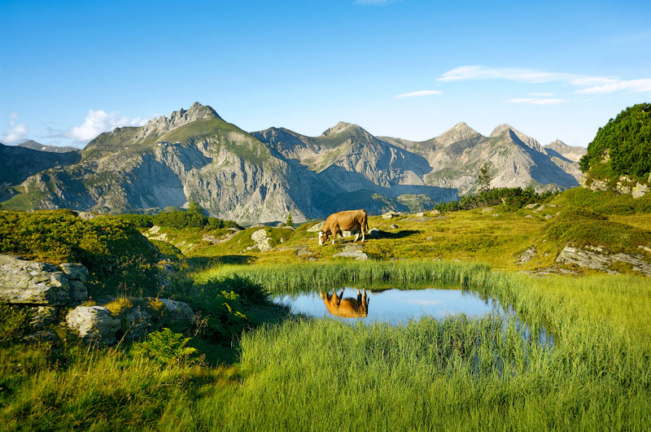
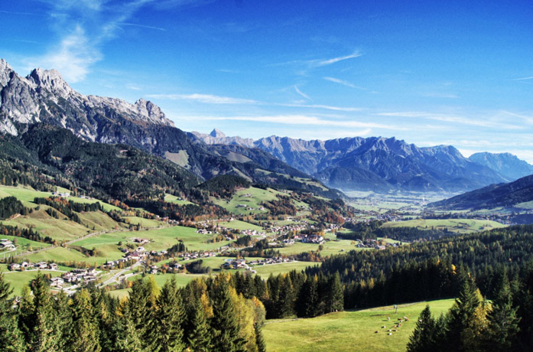
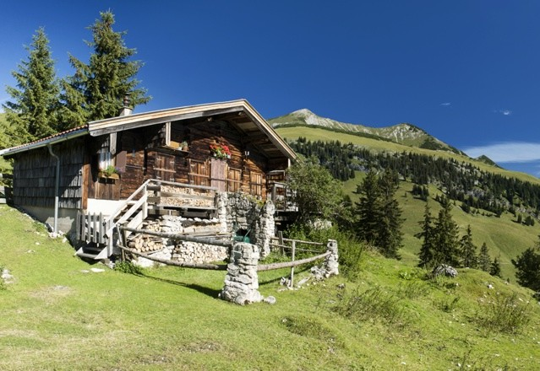
Notes:
http://img.welt.de/img/vermischtes/crop144755153/1499737752-ci3x2l-w540/Children-splashing-in-lake.jpg
http://www.lilies-diary.com/ein-wochenende-in-osterreich-leogang-und-saalfelden/
http://www.diewaldversicherung.at/fragen-antworten.html

Slide 3
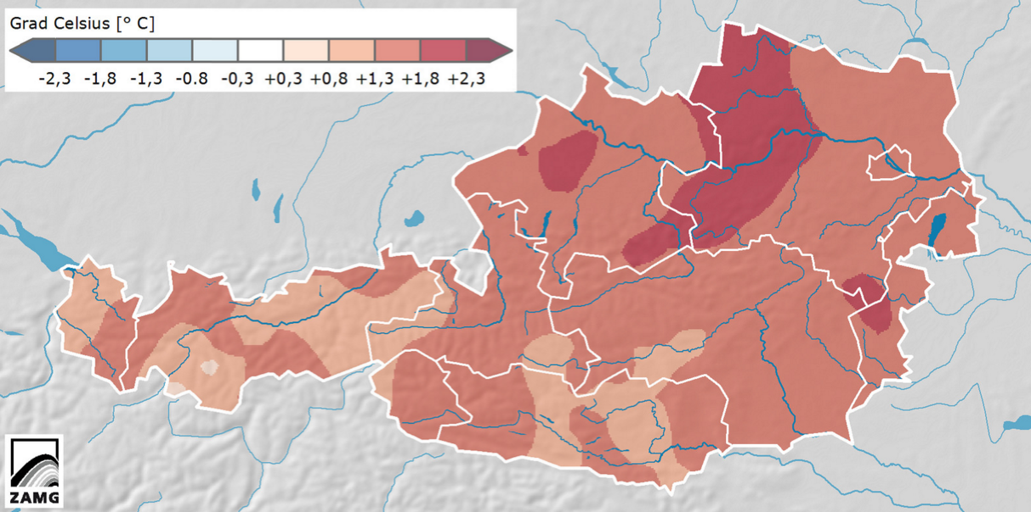
Research Problem
Temperatures in Austria 2015
Source: Zentralanstalt für Meteorologie und Geodynamik (2016)

Slide 4
Aim & Research Questions
What are the influences of increasing temperatures on the tourists‘ behaviour while on holiday?
How are the impacts of climate change affecting the personal level of comfort of the tourists?
What are the influences of recurring hot temperatures on the future tourists‘ behaviour?
In which respect will climate change influence core aspects of the holiday decision, such as:
- practiced activities
- time of travel
- the choice of the destination?
In which respect will the impacts of climate change influence the overall perception of the visited destination?
What are the effects of the rising temperatures on the practiced activities during the holiday?

Slide 5
Methodology
Literature Review
Online Questionnaire Survey
Climate Change and Tourism
Tourists‘ Behaviour
Leisure Activities
Literature-based
Question Items
Holiday Criteria
Leisure Activities
Weather Conditions
Level of Comfort

Slide 6
Sample Overview
Total number of responses | 118 completed questionnaires | Profession | Employee: 42.4 % Self-employed: 15.3 % Retiree: 12.7 % Student: 12.7 % Worker: 7.6 % Unemployed/Maternity leave: 5 % Public servant: 3.4 % Apprentice: 0.8 %
Gender | Female: 66 % Male : 44 % | Travel Company | Partner: 45.9 % Family and/or Friends: 23.6 % Child(ren): 16.9 % Alone: 8.8 % Travel Group: 4.7 %
Nationality | Austria: 56.8 % Germany: 31.4 % Other Country: 5.1 % Netherlands: 2.5 % Italy: 2.5 % Switzerland: 1.7 %

Slide 7
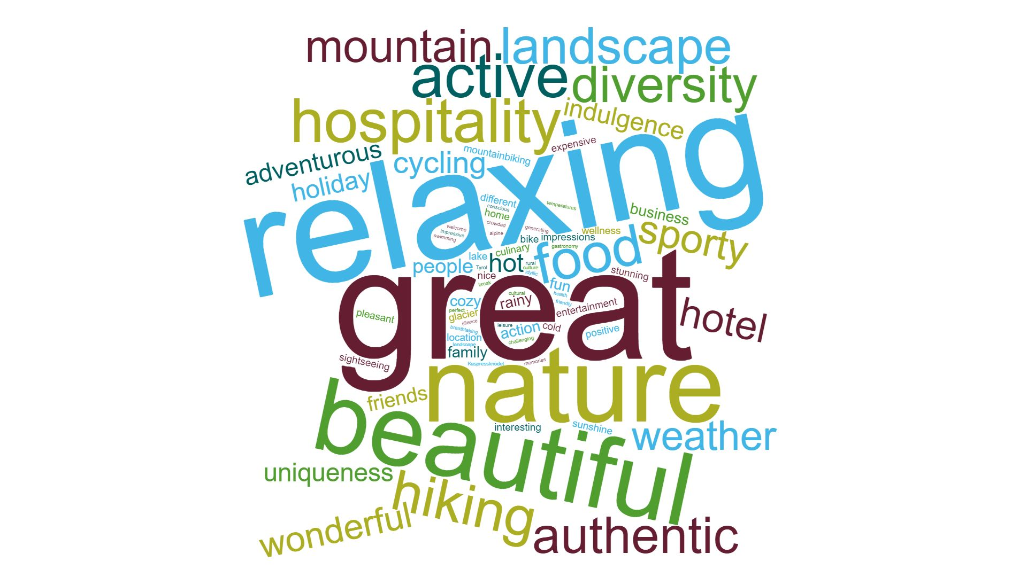
Findings

Slide 8
Findings
Influence of Temperatures on Level of Comfort
Basis: total (n=118) in %
Source: by the author
Notes:
Amelung, et al. (2007, p. 291):
different people experience temperatures differently
changes in the global climate will have implications for tourists’ behaviour
shifting level of comfort = other shifting criteria and dimensions
McKercher, et al.(2015, p. 453):
Tourists adaptable to climatic circumstances
level of comfort easily adjusts to given situation.

Slide 9
Findings
Basis: tourists who experienced hotter temperatures compared to previous visits (n=38) in %
Adaption to higher Temperatures
Source: by the author

Slide 10
Findings
Importance / Unimportance of Offers at the Destination
Basis: total (n=118) in mean values
Source: by the author
very
unimportant
rather
unimportant
neither nor
rather
important
very
important
Notes:
Goh (2012, p. 1868):
information on the climate can be used to further develop offer at destinations
missing offer or unfulfilled needs of tourists needs to be gathered → minimize the gap between the expectation and the experience
Petrick and Huether (2013, p. 705):
travel is beneficial for the tourist and the receiving destination
effort needs to be placed on development of touristic offer or on desired offer of the target customers
by listening to tourists and their needs → quality of destination improves immediately
Gössling, et al. (2012, p. 39):
alpine regions are an epitome to tourists → they perceive this area as a place with great quality of living

Slide 11
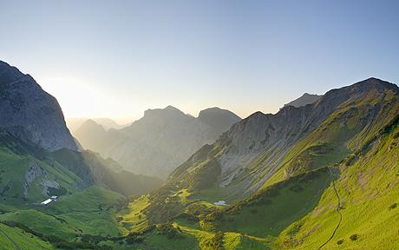
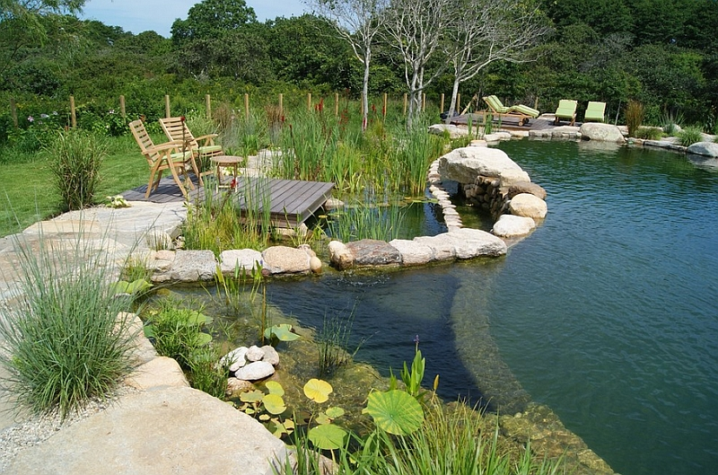

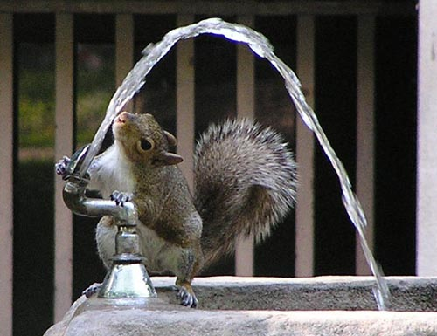
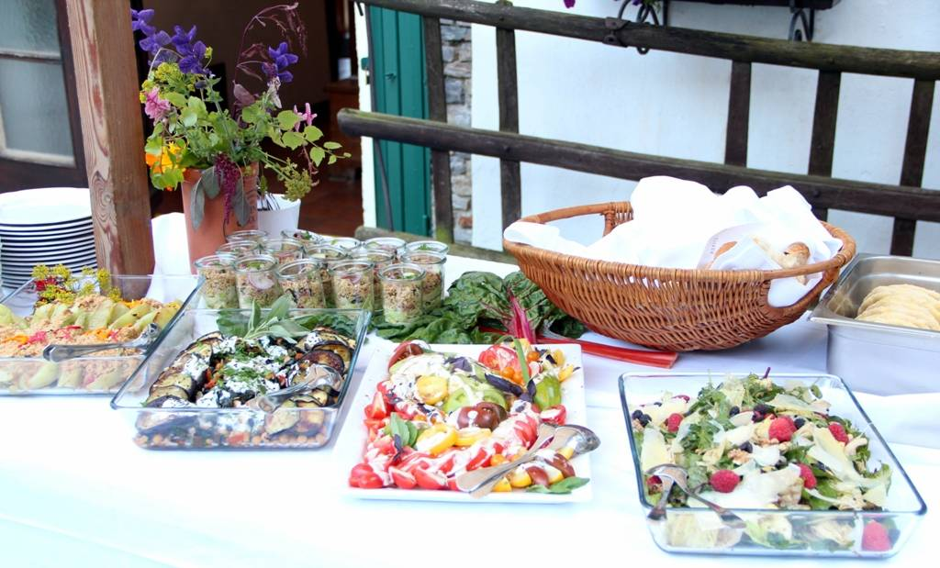
Conclusion & Recommendations
Alpine Escape
New Elements of Experience
Longitudinal
Study
Public Drinking Fountains
Newly-interpreted Nutrition

Slide 12

„We are the first generation that can end poverty,
but the last that can end climate change!“
Ban Ki-moon
Fomer United Nations Secretary-General
Notes:
http://www.benjerry.com/values/issues-we-care-about/climate-justice/its-everything-change

Slide 13
Alternative Findings
Temperatures compared to previous visits (n=76)
  50:50
Revisiting the destination
  Majority would like to revisit
Change in behaviour due to increasing temperatures (n=95)
  Leisure Activities and Time of Travel very unlikely to change
General change of holiday behaviour (n=11)
  Type of Holiday, Climate Zone and Time of Travel unlikely to change

Slide 14
Literature
Slide 9:
  Amelung, et al. (2007, p. 291):
    different people experience temperatures differently
    changes in the global climate will have implications for tourists’ behaviour
    shifting level of comfort = other shifting criteria and dimensions
  McKercher, et al.(2015, p. 453):
    Tourists adaptable to climatic circumstances
    level of comfort easily adjusts to given situation.
Slide 11:
  Goh (2012, p. 1868):
    information on the climate can be used to further develop offer at destinations
    missing offer or unfulfilled needs of tourists needs to be gathered → minimize the gap between the expectation and the experience
  Petrick and Huether (2013, p. 705):
    travel is beneficial for the tourist and the receiving destination
    effort needs to be placed on development of touristic offer or on desired offer of the target customers
    by listening to tourists and their needs → quality of destination improves immediately
  Gössling, et al. (2012, p. 39):
    alpine regions are an epitome to tourists → they perceive this area as a place with great quality of living

Slide 15
Image Credits
Slide 3:
  http://img.welt.de/img/vermischtes/crop144755153/1499737752-ci3x2l-w540/Children-splashing-in-lake.jpg
  http://www.lilies-diary.com/ein-wochenende-in-osterreich-leogang-und-saalfelden/
  http://www.diewaldversicherung.at/fragen-antworten.html
Slide 12:
  http://www.telegraph.co.uk/travel/activityandadventure/walkingholidays/5231562/Walking-holiday-in-the-Austrian-Alps.html
  http://www.decoist.com/2014-07-09/natural-swimming-pools/enjoy-a-serene-evening-on-the-edge-of-the-beautiful-natural-pool/
  https://www.holidaycheck.at/m/buffet-mit-gemueseraritaeten/df65a0bc-66c3-3c54-a15d-23908aa0381
  http://bakingwithdynamite.blogspot.co.at/2008/11/fitness-fun-fridays-17.html
  http://ctsi.psu.edu/
Slide 13:
  http://www.benjerry.com/values/issues-we-care-about/climate-justice/its-everything-change

