Slide 1



Generation Y‘s perception of destination websites: The example of Visit London by means of eye tracking
Rebecca Wahler, MA
MCI – Management Center Innsbruck
Austria
www.tourism-student-conference.com

Slide 2
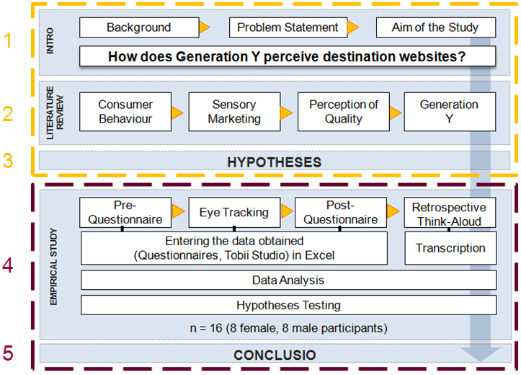
ISCONTOUR 2016

Slide 3
ISCONTOUR 2016

Slide 4
1 INTRODUCTION
Background
Technological developments change the way tourists gather information. An appealing website is one approach of tourism organizations to attract potential customers’ attention and turn them into repeat website visitors. Thus, choosing proper website elements addressing expectations and emotions alike is a key challenge to gain behavioural intentions (Xiang et al., 2015).
ISCONTOUR 2016

Slide 5
1 INTRODUCTION
Problem Statement
Due to Generation Y's strong online purchasing power, many enterprises focus on this target group → strong technological know-how sets high standards regarding a website being perceived as appealing.
Based on a deficit literature (retail websites) concerning Generation Y's preferences regarding website design, businesses are struggling to find the best, and most successful, approach (Djamasbi et al., 2010).
ISCONTOUR 2016

Slide 6
1 INTRODUCTION
Aim of the Study
Conduct a behavioural study in order to examine Generation Y's perception of destination website elements with the objective to develop recommendations.
ISCONTOUR 2016

Slide 7
1 INTRODUCTION
Reserach Question
How does Generation Y perceive destination websites?
ISCONTOUR 2016

Slide 8
2 LITERATURE REVIEW
Consumer Behaviour
Overall, content is rated as most important website dimension → first impression: aesthetics is rated most important (Thielsch, 2008).
Tourists prefer to obtain their information online, nevertheless prefer to book their holiday offline via travel agencies (VIR, 2014).
ISCONTOUR 2016

Slide 9
2 LITERATURE REVIEW
Sensory Marketing
When aiming for an attractive website, the focus lies on visual web marketing (as a sub-part of sensory marketing) in order to stimulate the visual sense of a visitor.
Giving virtual representations (text, graphics) a certain “virtual hierarchy” can influence a visitor’s perception and exploration behaviour. (Djamasbi et al., 2010)
ISCONTOUR 2016

Slide 10
2 LITERATURE REVIEW
Percpetion of Quality
Every customer perceives quality in an individual and different way.
It is impossible to develop a standardized catalogue of criteria in order to evaluate the efficiency of a website in terms of one size fits all.
Quality indicators are rated differently depending on the sector or industry (Woodside et al., 2011)
ISCONTOUR 2016

Slide 11
2 LITERATURE REVIEW
Generation Y
Owing to its broad technological know-how Generation Y has high expectations towards websites (Tractinsky, 2015; Djamasbi et al., 2010).
ISCONTOUR 2016

Slide 12
3 HYPOTHESES
Pictures score the highest fixation count
Pictures of famous people receive the highest attention
Social Media is perceived as an important element within the first impression
Destination websites are rather seen as a platform for information than for booking intentions
During the phase of first impression website elements embedded in lower parts of a website are not perceived
Differences in the perception of destination websites exist between men and women within the first impressions
ISCONTOUR 2016

Slide 13
ISCONTOUR 2016

Slide 14
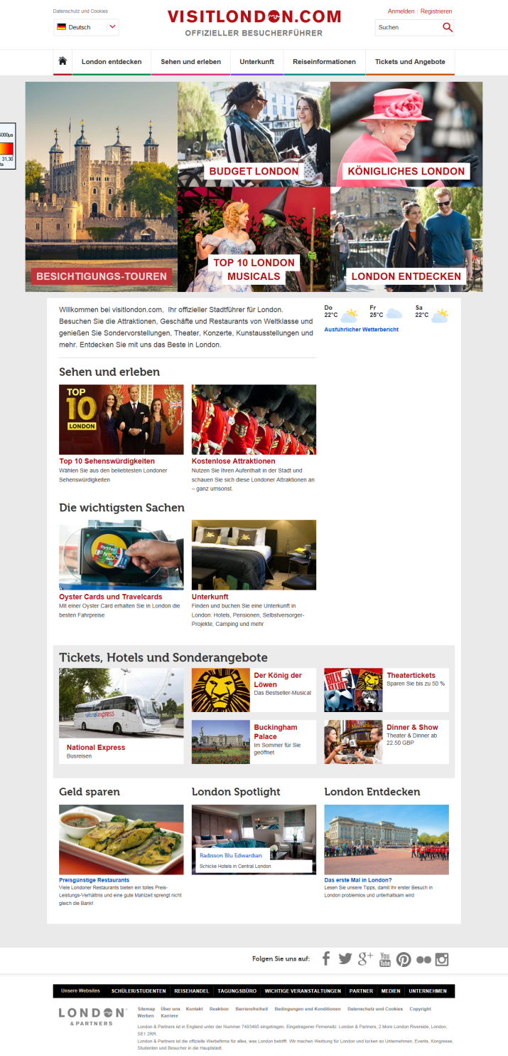
ISCONTOUR 2016

Slide 15
4 EMPIRICAL STUDY
Pre-Questionnaire
Description:
Composed of closed questions (7-point Likert scale).
Ten stage ranking system for different website elements.
Short scenario description of an upcoming holiday in London was presented (→expectations).
Objectives:
Get to know the subjects and their interests better.
Collect demographic information as well as data regarding past behaviour .
Find out which website elements are expected.
ISCONTOUR 2016

Slide 16
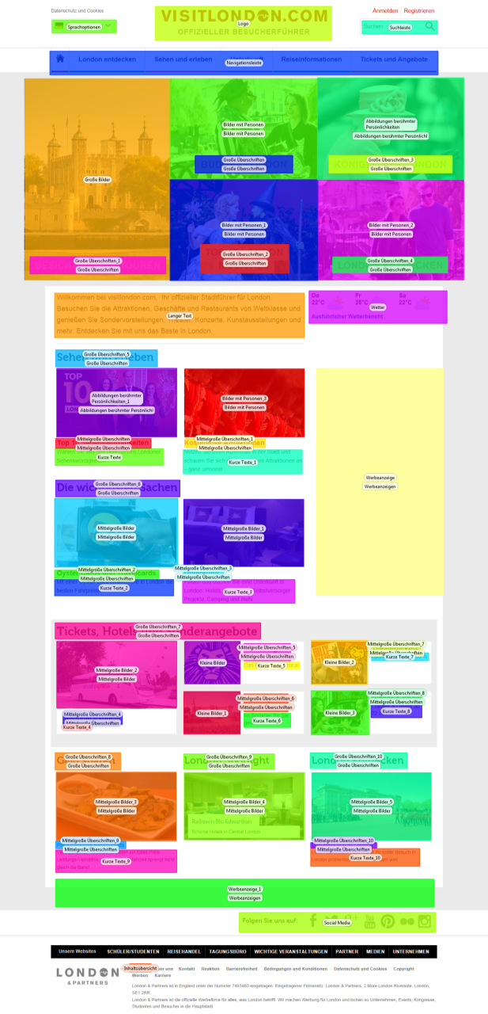
4 EMPIRICAL STUDY
Eye Tracking
Description:
A non-portable eye tracking device (Tobii T60) has been used to track an individual’s eye movements by means of the reflected infrared lights of the participant’s pupils.
17 Areas of Interest (AOIs) across the entire website were defined.
Objectives:
Make conclusions about the cognitive processes of the participants.
Visualize the eye movements (heat maps; gaze plots).
Detect which elements of a website are perceived most frequently during the time of first impression (20 seconds).
ISCONTOUR 2016

Slide 17
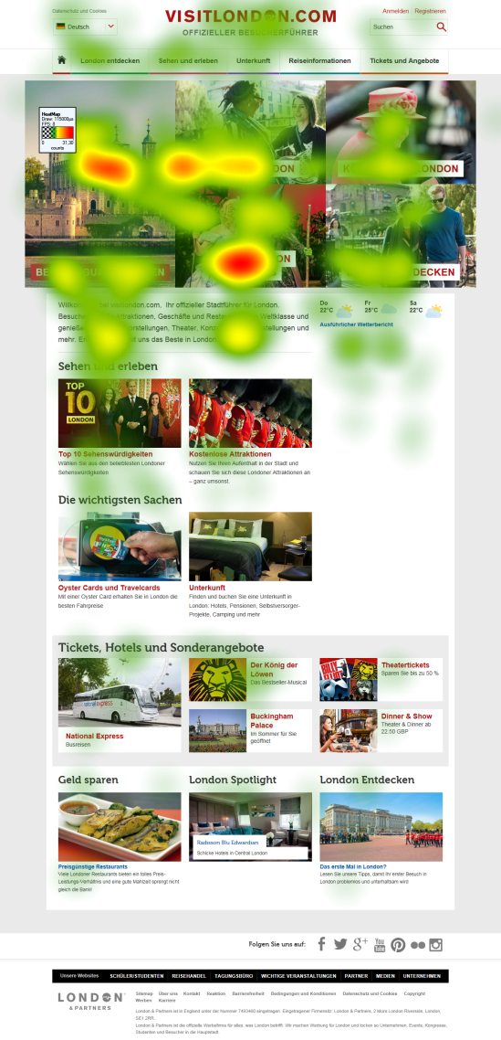
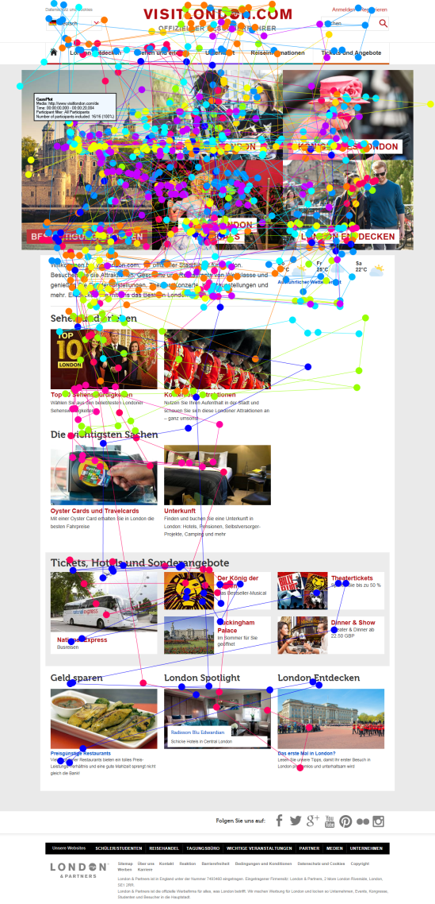
4 EMPIRICAL STUDY
Eye Tracking
Description:
A non-portable eye tracking device (Tobii T60) has been used to track an individual’s eye movements by means of the reflected infrared lights of the participant’s pupils.
17 Areas of Interest (AOIs) across the entire website were defined.
Objectives:
Make conclusions about the cognitive processes of the participants.
Visualize the eye movements (heat maps; gaze plots).
Detect which elements of a website are perceived most frequently during the time of first impression (20 seconds).
ISCONTOUR 2016

Slide 18
4 EMPIRICAL STUDY
Eye Tracking
Description:
A non-portable eye tracking device (Tobii T60) has been used to track an individual’s eye movements by means of the reflected infrared lights of the participant’s pupils.
17 Areas of Interest (AOIs) across the entire website were defined.
Objectives:
Make conclusions about the cognitive processes of the participants.
Visualize the eye movements (heat maps; gaze plots).
Detect which elements of a website are perceived most frequently during the time of first impression (20 seconds).
ISCONTOUR 2016

Slide 19
4 EMPIRICAL STUDY
Post-Questionnaire
Description:
Composed of open questions (7-point Likert scale).
Net Promoter Score (NPS).
Objectives:
Find out more about the participant’s satisfaction, the perceived quality and the response to certain elements of the website.
How likely would the participants recommend the website to others.
ISCONTOUR 2016

Slide 20
4 EMPIRICAL STUDY
Retrospective Think-Aloud
Description:
Eye movement video (RTA gaze video) was shown to the individual subject at the end of the experiment.
Participants had to think aloud and comment on their individual eye movements (→ comments were recorded).
Objectives:
Gather more valuable subjective interpretations of the recorded eye movements from the participants.
Complement eye tracking results with further data and giving it consequently more significance.
ISCONTOUR 2016

Slide 21
ISCONTOUR 2016

Slide 22

5 CONCLUSIO
Findings
Pictures score the highest fixation count
Pictures of famous people do not receive the highest attention
Social Media is not perceived as an important element within the first impression
Destination websites are rather seen as a platform for information than for booking intentions
During the phase of first impression website elements embedded in lower parts of a website are not perceived
Differences in the perception of destination websites exist between men and women within the first impressions
ISCONTOUR 2016

Slide 23
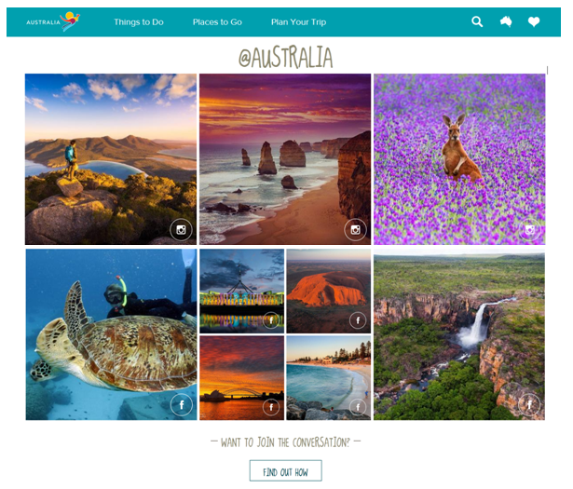


5 CONCLUSIO
Recommendations
First screen:
should contain a clearly visible
section with offers and activities “free of charge”
constant replacement of the images of famous sights
random people should be present on the pictures
Second screen:
should be entirely devoted to user-generated content from social media sources e.g. Instagram
→ recommendations from previous visitors (higher credibility!)
ISCONTOUR 2016

Slide 24
5 CONCLUSIO
Limitations
Sense of hearing was neglected in this study
Convenience sampling
Cultural differences were disregarded
Choosing exclusively only one website for this study
ISCONTOUR 2016

Slide 25
THANK YOU FOR YOUR ATTENTION!
ISCONTOUR 2016

Slide 26
Bibliography
Djamasbi, S., Siegel, M., & Tullis, T. (2010). Generation Y, web design, and eye tracking. Int. Journal of Human Computer Studies, 68(5), S. 307-323.
Thielsch, M. (2008). Inhalt, Usability und Ästhetik in der Bewertung durch Webnutzer. In M. Herczeg, & M. Kindsmüller, Mensch & Computer 2008: Viel mehr Interaktion (S. 441-444). München: Oldenbourg.
Tractinsky, N. (2015). Aesthetics in information technology. In Y. Zhang, & D. Galletta, Human-computer Interaction and Management Information Systems: Foundations (S. 330-347). New York: Routledge.
Woodside, A., Vicente, R., & Duque, M. (2011). Tourism's destination dominance & marketing website usefulness. Int. Journal of Contemporary Hospitality Management, 23(4), S. 552-564.
VIR. (2014). Daten & Fakten zum Online-Reisemarkt 2014. Oberhaching: Verband Internet Reisevertrieb e.V.
Xiang, Z., Magnini, V. P., & Fesenmaier, D. R. (2015). Information technology and consumer behavior in travel and tourism: Insight from travel planning using the internet. Journal of Retailing and Consumer Services, 22, S. 244-249.
ISCONTOUR 2016

Slide 27
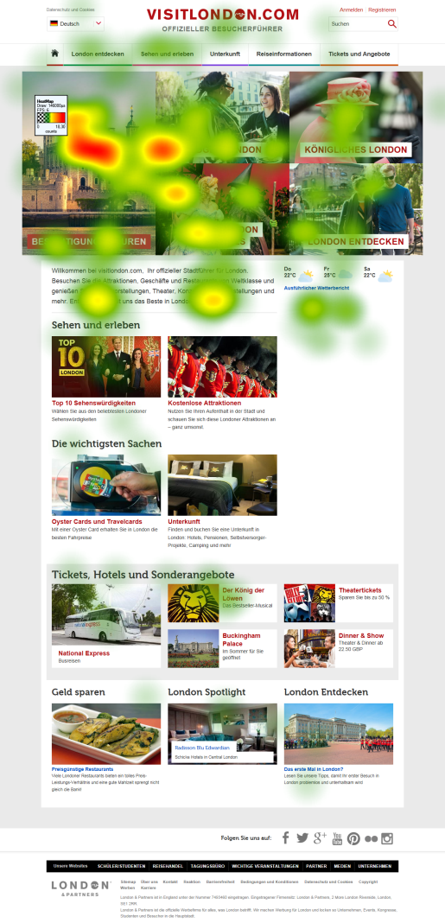
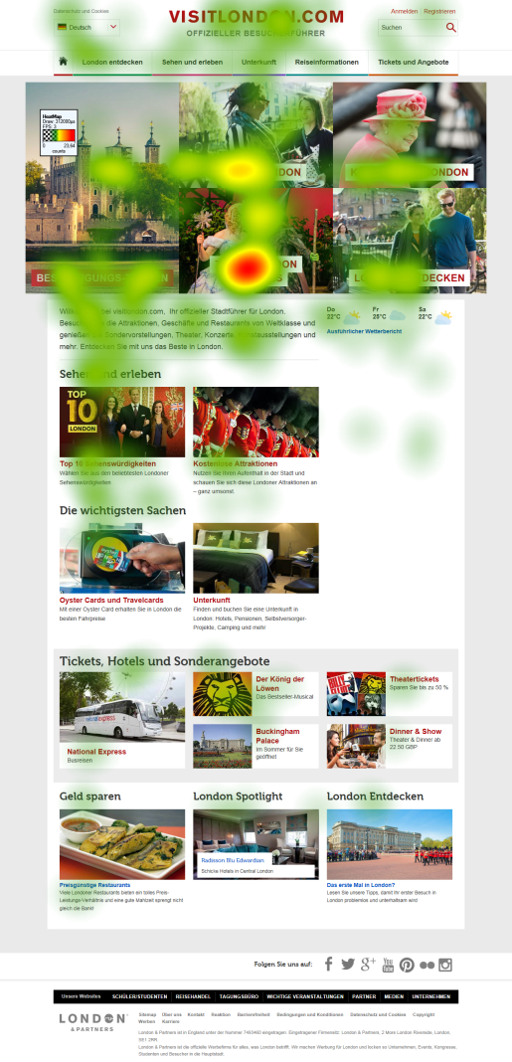
Heat Map differences between men and women
men
women
ISCONTOUR 2016

