Slide 1
Influencing the touristic experience?
Vivien Verb (Hungary), Fachhochschule Salzburg
Gloria Karlein (Germany), Fachhochschule Salzburg
Fadja Gross (Austria), Fachhochschule Salzburg
Akanksha Varma (India), Fachhochschule Salzburg
www.tourism-student-conference.com

Slide 2
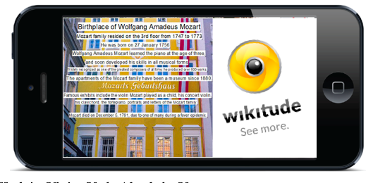
Influencing the touristic experience? A study of tourists’ perception of authenticity through Augmented Reality at Mozart’s Birthplace
ISCONTOUR 2016

Slide 3
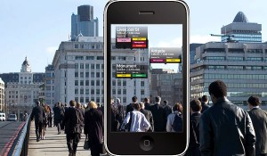
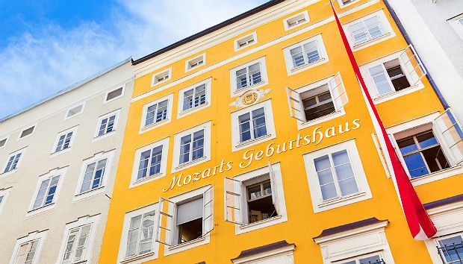
Purpose of this Study
Explore possible link between Augmented Reality (AR) & Authenticity
Underlying theories prominent in literature
Discover the relation among AR, authenticity & tourism
Shedding more light - influence of technology usage (AR in this case) on the consequential alteration of touristic perceptions at historical sights
Keywords: tourism experience, objective authenticity, existential authenticity, constructive authenticity, augmented reality
ISCONTOUR 2016

Slide 4
Authenticity & Tourism
360 degree of Authenticity Model used in this study.
ISCONTOUR 2016

Slide 5
The following statements were formed (according to the model)
Ob
1. Objective Authenticity: “When visiting a place, it is important to me that the site has the characteristics it claims to have”
2. Commercial Authenticity: “It is important to me that the experience of the site is true and real.”
3. Constructive Authenticity: “It is important to me to experience a place within a suitable environment.”
ISCONTOUR 2016

Slide 6
Research Question?
ISCONTOUR 2016

Slide 7
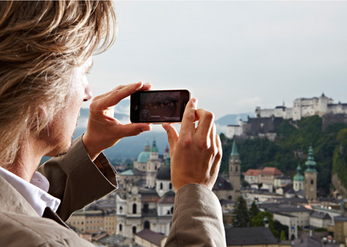
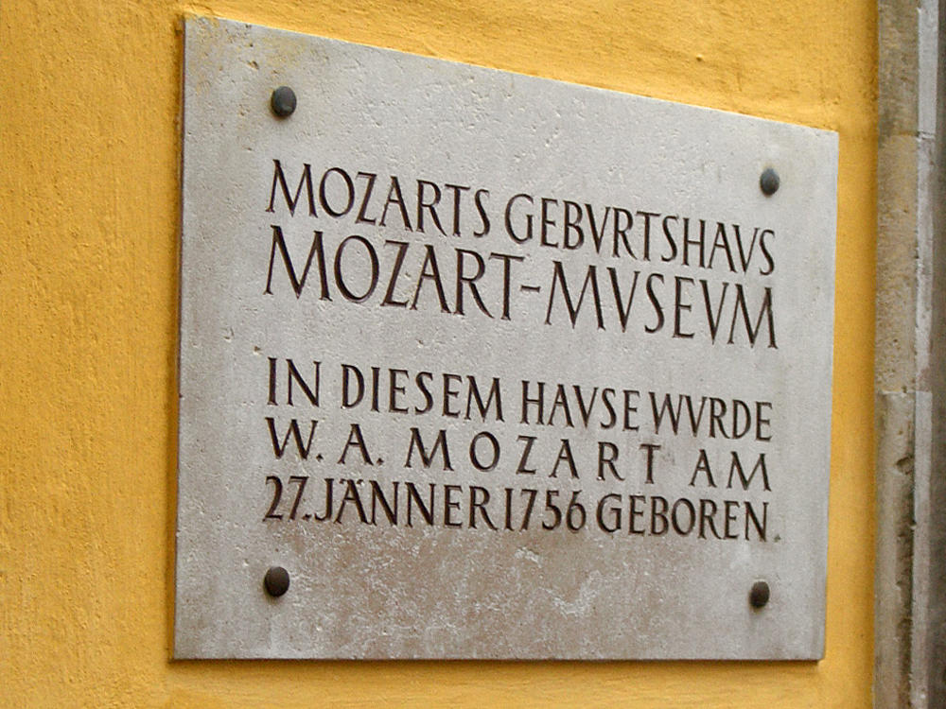
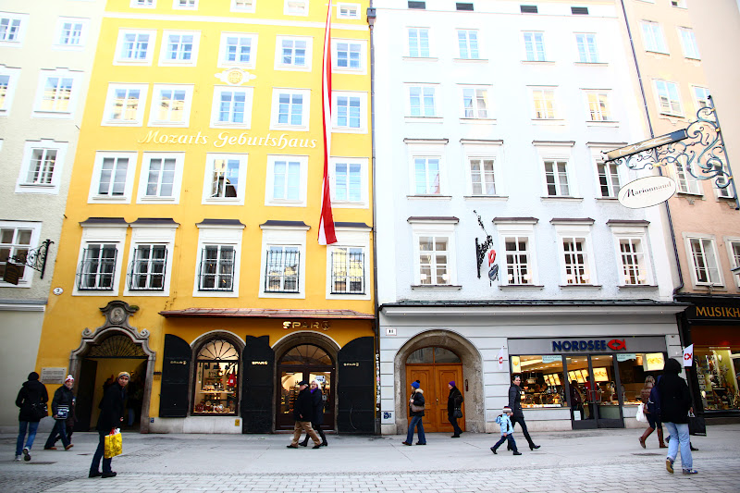
“To what extent does augmented reality influence the tourist experience in regards to authenticity at the Mozart birthplace? ”
Are there differences in the kind of authenticity tourists perceive when it comes to using Augmented reality in comparison to not using it?
ISCONTOUR 2016

Slide 8
Hypotheses
H1: Using the App will decrease the perception of objective authenticity.
H2: Using the App increases the perception of constructive authenticity.
H3: The App encourages individuals to visit the inside of the building.
H4: The origin of the individuals influences their perception of authenticity.
ISCONTOUR 2016

Slide 9
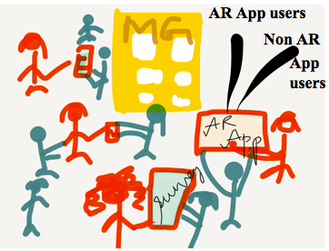
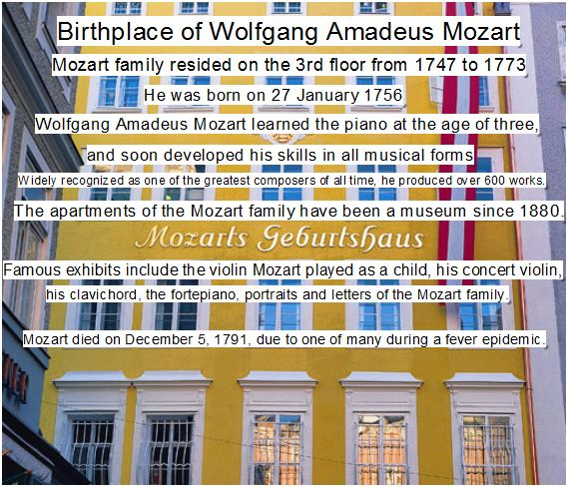
Tools used to answer Research Question(s) & prove the hypotheses – Augmented reality
Literature Review
Day 1: Quite the scene at Mozart Birthplace while conducting the surveys
ISCONTOUR 2016

Slide 10
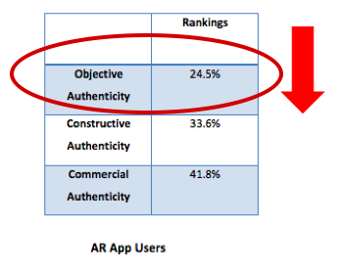
Findings
H1: Using the App will decrease the perception of objective authenticity “When visiting a tourist attraction, it is important for the visitor that the site has the characteristics it claims to have.”
ISCONTOUR 2016

Slide 11
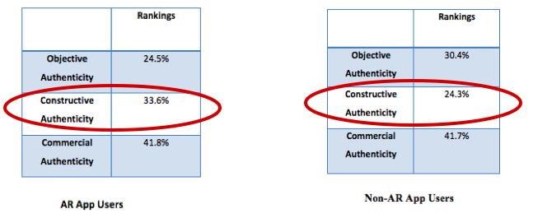
H2: Using the App increases the perception of constructive authenticity. “It is important to the visitors to experience a place within a suitable environment”
ISCONTOUR 2016

Slide 12
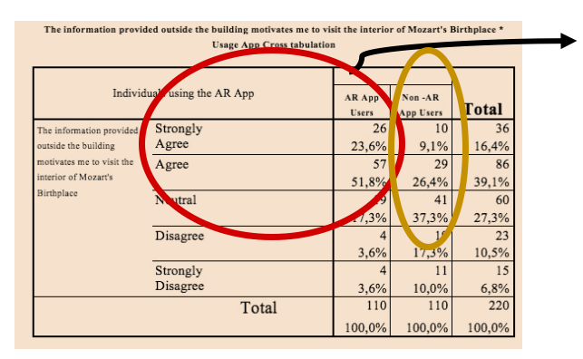
H3: The (AR) App encourages individuals to visit the inside of the building.
The AR App users are more likely to visit the interior of the building after being provided information outside (75.4%) in comparison to the non-AR App users.
ISCONTOUR 2016

Slide 13
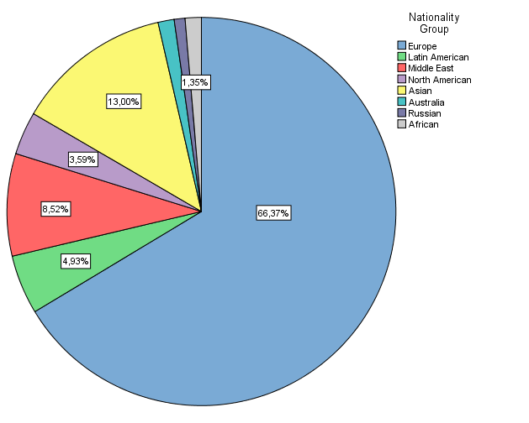
H4: The origin of the individuals influences their perception of authenticity.
ISCONTOUR 2016

Slide 14
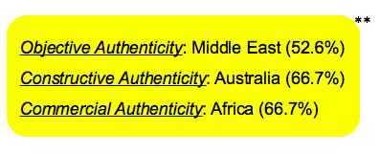
** indicates limitations because of small number of participants among other Nationality groups (except Europe), so the results cannot be generalized.
ISCONTOUR 2016

Slide 15
Contribution of this Study
AR (app) - seen as an influential factor - perception of authenticity (objective, constructive & commercial authenticities)
AR app – explore the site (tourist attraction) more deeply; a better understanding & enhanced tourist experience(s)
Origin of the tourists - definitely influence their preference of specific type of authenticity to an extent
This study: most participants chose Commercial Authenticity (41.8% & 41.7%)
ISCONTOUR 2016

Slide 16
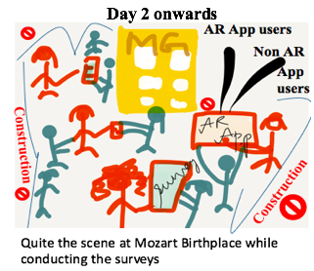
Limitations
Age Group (elders- not very tech savvy/ ready to fill the survey).
Most inconvenient situation – on-site construction; didn’t spend more time on site.
Weather conditions in Salzburg – unpredictable
Time constraints
ISCONTOUR 2016

