Slide 1
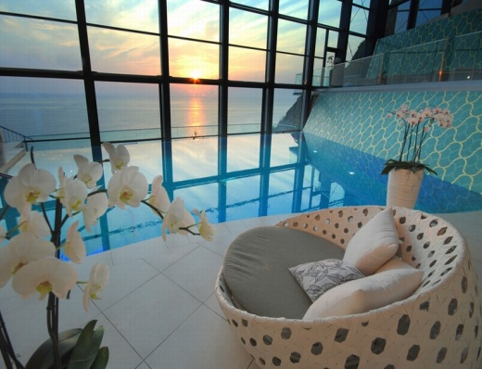
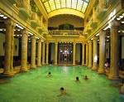
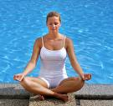
Overwhelmed by Wellness?
Time to put the Health back into
Health Tourism!
Dr Melanie Smith
Budapest Metropolitan University Hungary
Email: msmith@metropolitan.hu

Slide 2

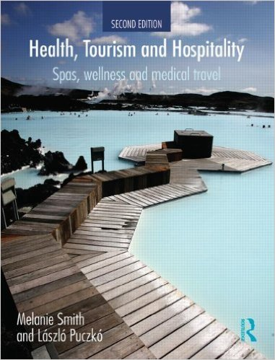
A Bit About Me....
I began research on holistic and retreat tourism 10 years ago.
I also started training as a yoga teacher and did a Thai massage course in Thailand!
In 2005 I moved to Hungary and began my research on spas and thermal baths with Dr László Puczkó, a spa consultant.
In 2009 we published the book Health and Wellness Tourism and in 2013 we published the book Health, Tourism and Hospitality: Spas, Wellness and Medical Travel .
I have also published several papers and chapters on health wellness, spas and retreat tourism.
I have recently been working on Baltic Health Tourism and Balkan Wellbeing research, as well as an EU COST project on Tourism, Wellbeing and Ecosystem Services.
I helped to develop and teach on Pärnu College, Estonia’s Wellness and Spa Service Design and Management.
I run a new MA Programme on Thermal Spa and Resort Management in Budapest.
I have done consultancy work for UNWTO, ETC and the Global Spa and Wellness Summit.
I am have just finished editing a Routledge Handbook of Health Tourism.

Slide 3
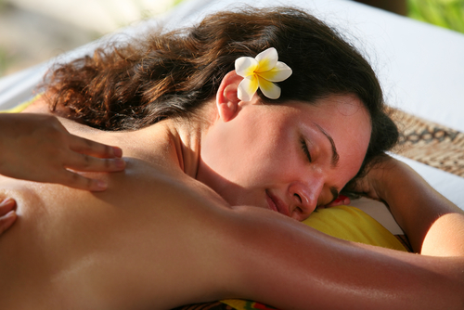
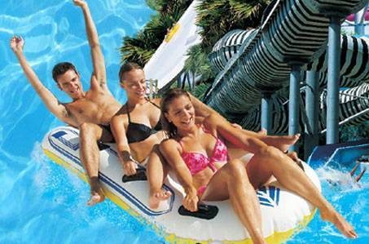
Fun?
Relaxation?

Slide 4
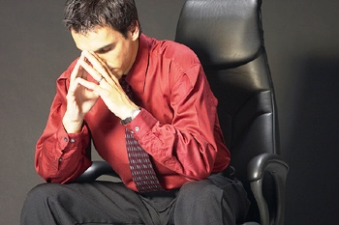
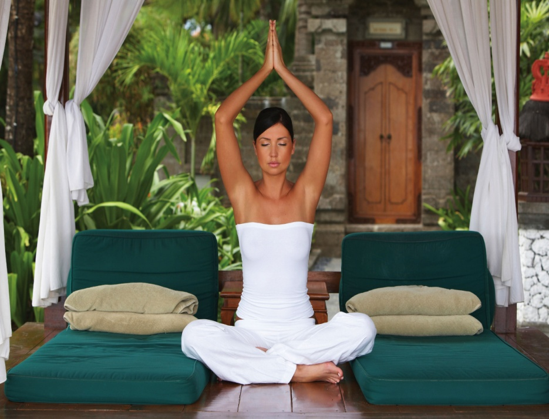
Spiritual Development?
Stress Management?

Slide 5
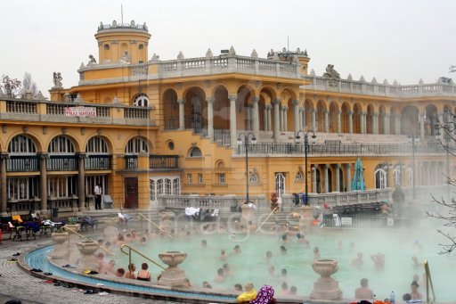
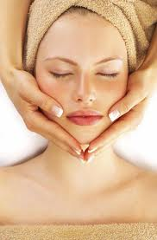
Beauty?
Healing?

Slide 6
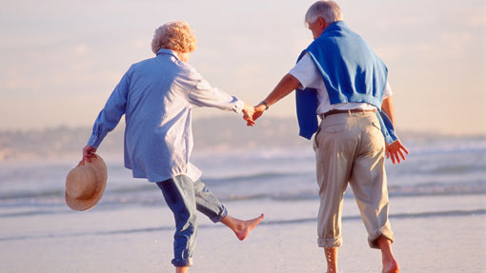
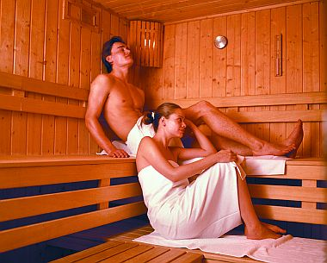
Everyday Wellbeing?
Longevity?

Slide 7
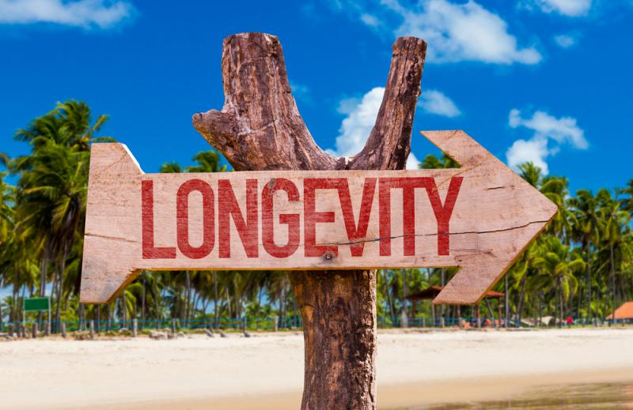
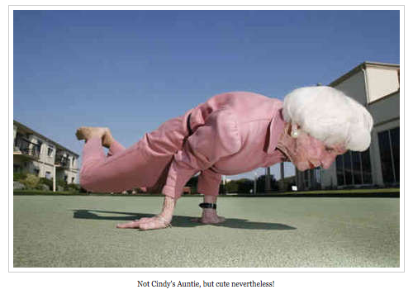
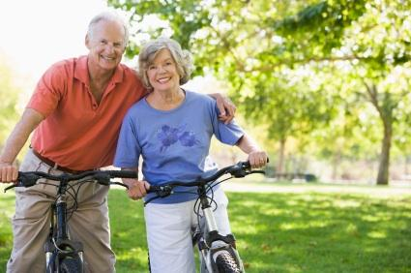
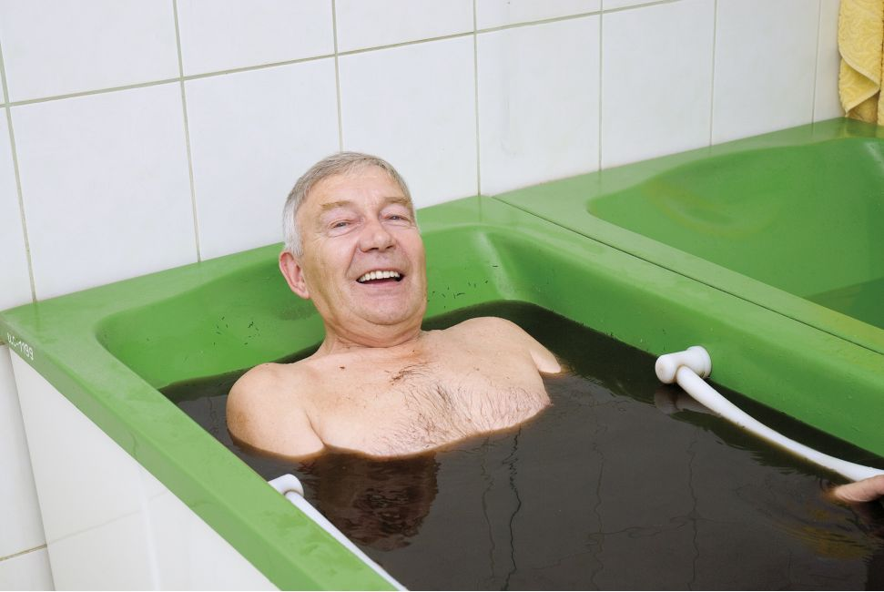
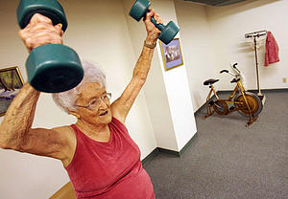
The Key to Longevity?

Slide 8
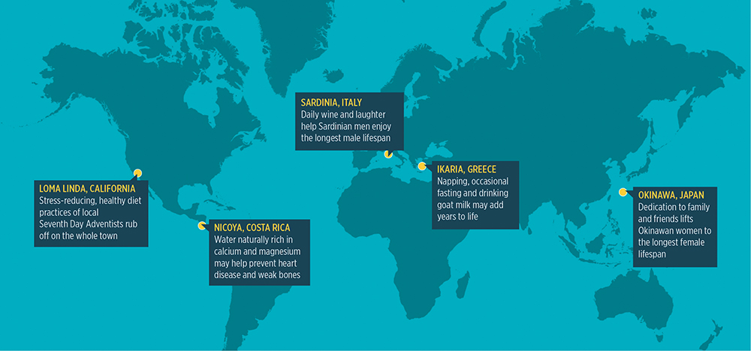
Blue Zones

Slide 9
Ageing population
Digital dependency
Occupational wellness
Social
Trends
Obesity
More singles
Stress
Alternative
medicines
Cosmetic surgery

Slide 10
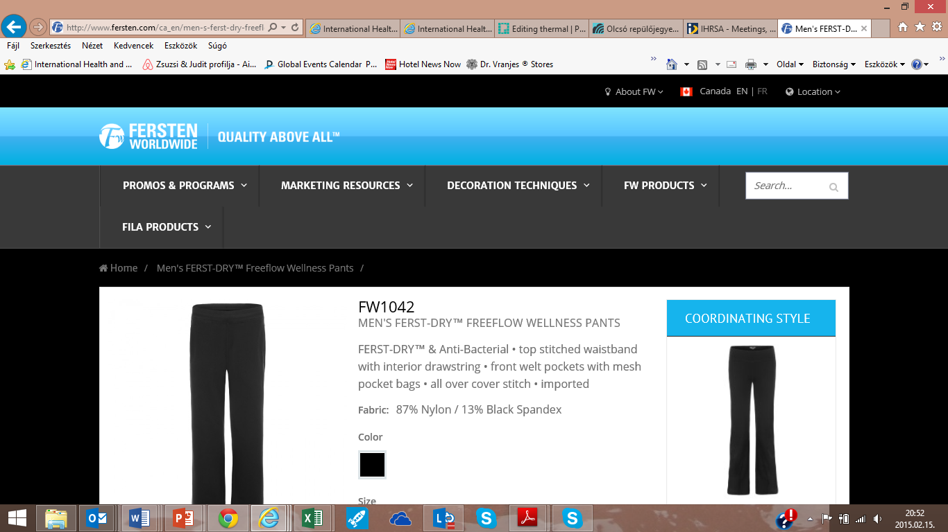
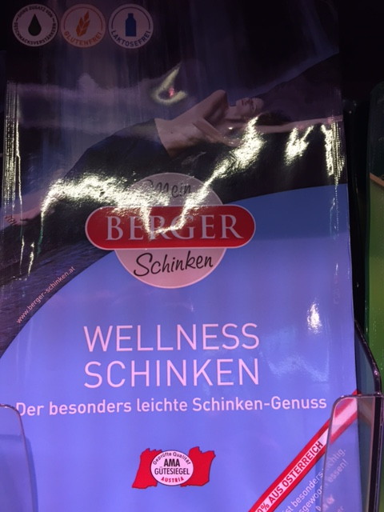
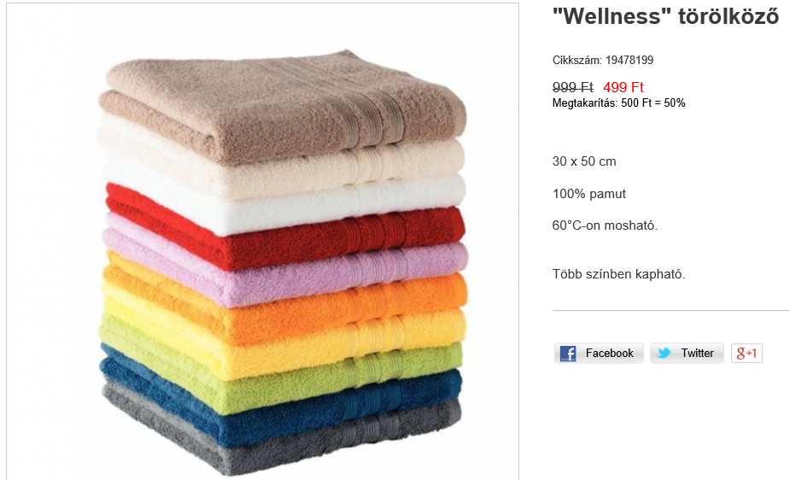


Solution? Wellness!
It’s Everywhere.....

Slide 11
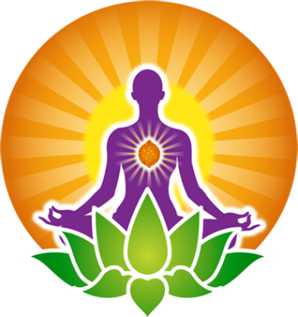

What is Wellness?
And what is not.....?
‘Wellness’ is often over-used to make products and services seem more attractive, and to boost or inflate tourism statistics.
In most countries, wellness tourism (if it is defined relatively narrowly) only constitutes between 3 and 12% of a country’s tourism.
On the other hand, if broad definitions are applied, it can appear to be a far bigger segment than it really is.
Although the Global Wellness Institute (GWS, 2015) report suggests that wellness and wellness tourism are billion, even trillion dollar industries, Smith and Puczkó (2013) urge considerable caution when defining both wellness and wellness tourism.
Wellness tourism should be more closely aligned with health-enhancing activities and treatments which are evidence-based in some way.
Research such as the TOHWS (2015) shows that visitors to spas, wellness and medical facilities are becoming more and more interested in natural and local resources, especially those which can provide evidence to prove their benefits for health.

Slide 12
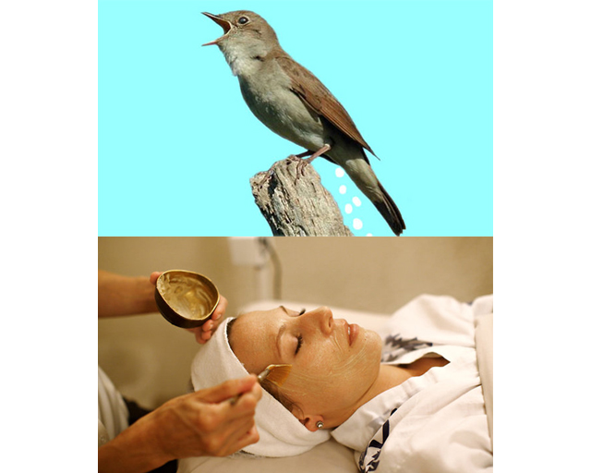
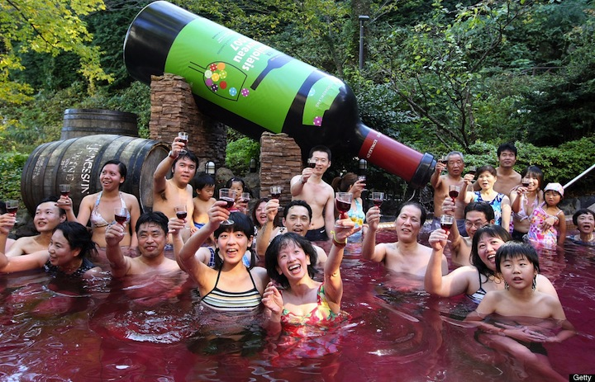
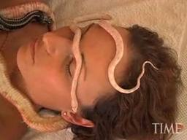
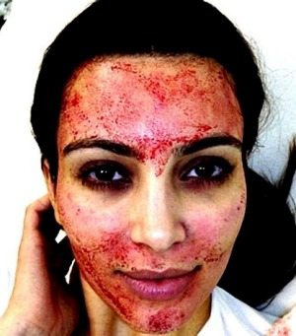
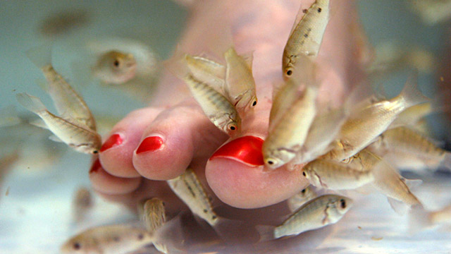
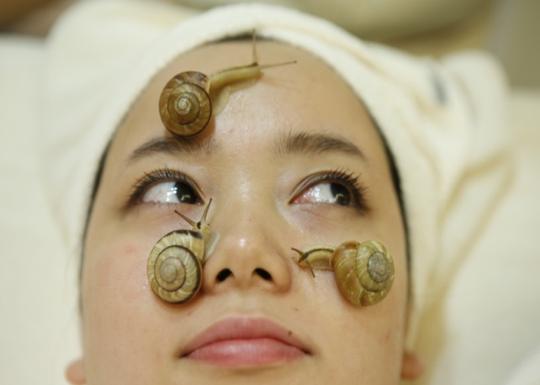
Is this Wellness?

Slide 13
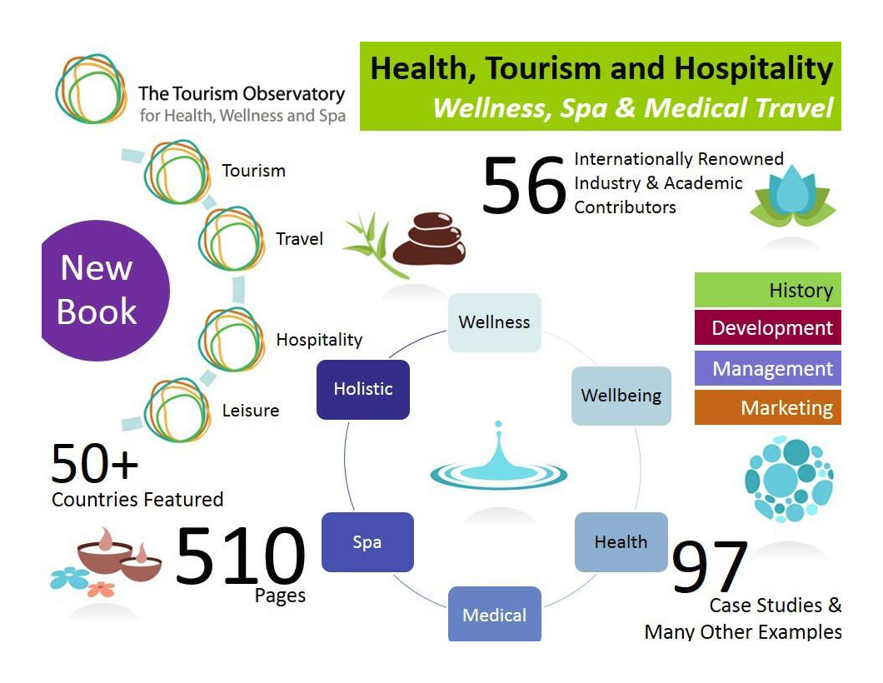
So what if we inflate our statistics?
The Global Wellness Tourism Congress (2014) defined wellness tourism as “all travel associated with enhancing one’s personal well-being”. Wellbeing is an extremely broad concept......
The inflation of statistics in the tourism industry is widespread, but care must be taken that the total statistics actually add up to 100%!
If wellness tourism is estimated too highly, then its share of the total tourism market of a country can become very distorted.
This might result in over-enthusiastic expectations of demand and profit, and the construction of too many spa and wellness facilities.
It can be challenging to continuously develop and maintain high quality wellness tourism facilities.

Slide 14
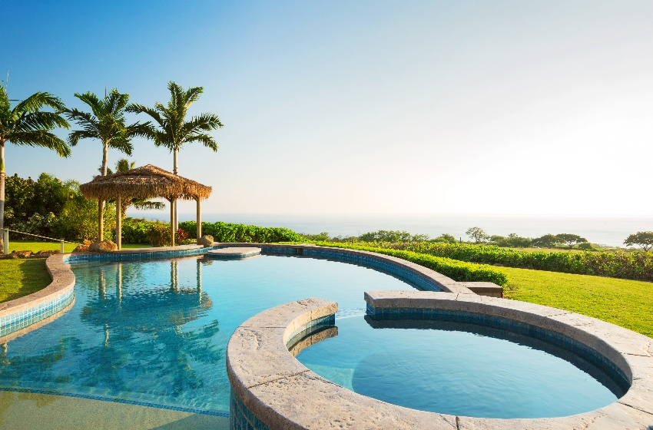
Is Wellness the Commercialization of Wellbeing?

Slide 15
Smith and Puczkó (2013) therefore argue that wellness tourism should be defined with the following limitations to avoid dilutions of meaning and inflation of demand and profit:
In order to qualify as a wellness tourism experience, an active contribution has to be made to improving health in some way. Purely passive experiences like sunbathing should not be counted.
Wellness tourists should be interested in long-term rather than short-term benefits of their experiences (i.e. programmes to take home that improve lifestyle).
Rural tourism is not usually synonymous with wellness or health tourism, only if some nature-based therapy is the main focus (e.g. forest therapy, climatotherapy).
Health enhancement should be a primary motivation for taking the trip. Just visiting a spa because there happens to be one in the destination should not count as wellness tourism.
People who visit thermal baths because they are interested in the heritage are technically not wellness tourists.
Not all tourists who stay in a spa and wellness hotel are wellness tourists, as their main motivation could be business, culture or shopping. They may not even visit the spa or wellness area!
Doing or playing sport on holiday (e.g. tennis, swimming) does not mean that a person becomes a wellness tourist.

Slide 16

Tourism Observatory for
Health, Wellness and Spa Research
Data was collected in 2014 for the Tourism Observatory for Health Wellness and Spa (published in 2015) in order to identify the role tourism and tourists play at various spa and wellness facilities worldwide.
Data was collected from 17 different types of spa and wellness facilities from 56 countries. (e.g. including all kinds of spa, wellness hotels and retreats).
An online questionnaire was distributed using an existing database of co-operating industry partner associations, chains and individual operators. Information was collected from three major demand segments: local customers, domestic tourists and international tourists.
Such data is useful to inform operators of trends in customer preferences.
Treatments remain the most important motivation for international guests, especially massage. Location is also a relevant factor for international/foreign guests.
Technology, design or fashion have no real impact on motivation and decision making.
The TOHWS (2015) research showed that although tourists were most attracted by natural resources with proven impacts and evidence, these were followed in popularity by complementary and alternative therapies.

Slide 17
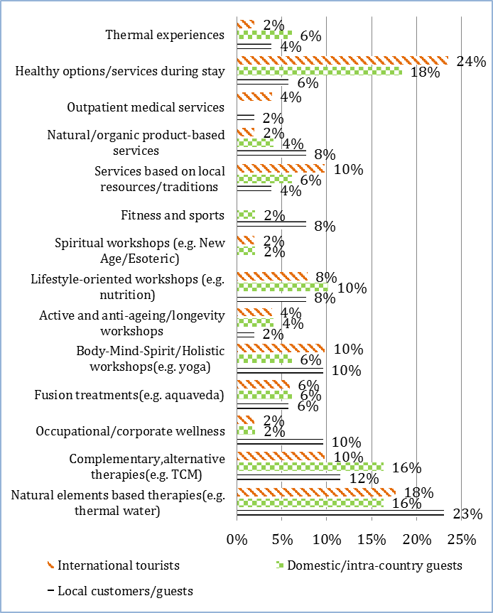
Most Popular Services in Spas and Wellness Centres

Slide 18
Lifestyle Trend or Issue | Related Heath Tourism Product/Service
Lack of exercise | Fitness retreats; gyms and fitness classes in wellness hotels and spas
Growing obesity/unhealthy eating | Boot camps; detox clinics or spas; retreats with vegetarian, vegan, raw and/or organic food; slow food destinations
Over-use of technology | Digital detox retreats; booking into hotels with limited WiFi access, no TV, etc; visiting areas with limited access to technology (e.g. small islands, mountain villages)
Sleep deprivation/poor sleep quality | Sleep therapy clinics in spas; wellness hotels with special features for promoting sleep (e.g. special pillows, aromatherapy oils)
Occupational/work-based stress | Occupational wellness retreats; incentive spa visits
Negative body image | Psychological counselling in a retreat; beauty treatments in a spa; cosmetic surgery in a medical tourism hospital or clinic
Increasing interest in CAM | CAM therapies on spa menus; energy healing in jretreats
Limited contact with nature/unsustainable lifestyles, | Ecotherapy in retreats or spas; eco-retreats; eco-villages; green spas
Need to slow down/mindfulness | Stays in small villages or on remote islands; holistic retreats (e.g. offering meditation, yoga)
Need for spiritual activities | Spiritual ashrams or retreats; stays in monasteries; pilgrimages

Slide 19
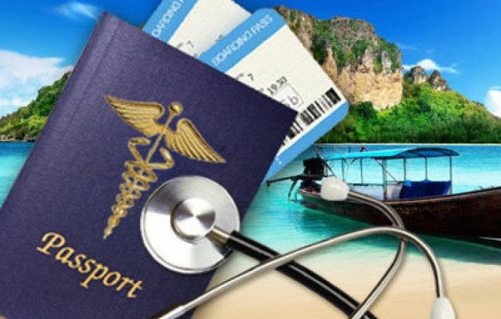
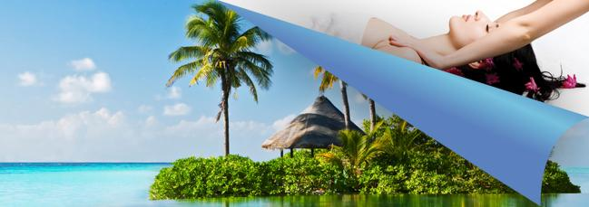
Health & Evidence
Health
Evidence
What is healthy? Research keeps changing!
According to the NHS (2013) despite a continuing trend of increasing life expectancy, overall, many adult populations are less healthy than they used to be.
Crowley and Lodge (2007:30) "Modern medicine does not concern itself with lifestyle problems”.
Harvard Health Letter (2015) researched six healthy lifestyle habits—those who were not smoking, getting regular physical activity, eating a healthy diet, maintaining normal weight, drinking no more than one alcoholic drink per day, and watching TV for seven hours or less per week—were 92% less likely to develop heart disease than those who did not have these lifestyle habits.
The Global Wellness Institute has developed a section on its website devoted to evidence for wellness therapies.
However, there is still scepticism in many medical circles about CAM therapies, thermal waters, climatotherapy and other forms of so-called ‘alternative’ therapies.
Shivdasani (2012:31) believes “There will come a time when destination spas and alternative healing centers will have as much credibility as Western medicine.”
Schweder (2012: 30) discusses the fact that more and more people are questioning the validity of conventional Western medicine, and that substantial academic and scientific research is going into ancient wellness traditions.

Slide 20
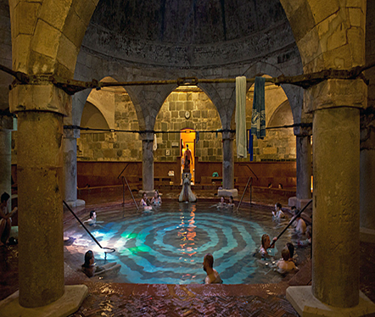
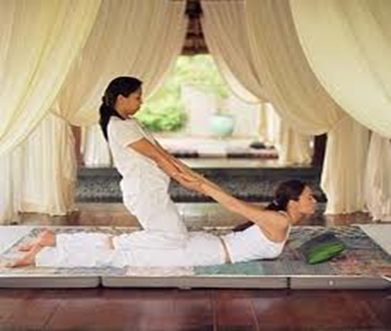
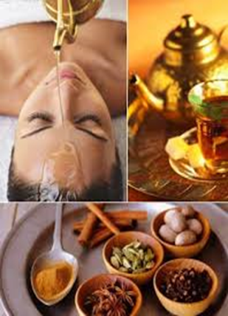
What Evidence is there?
In terms of the evidence base for balneology (medical water-based healing), over the past 30 years, several controlled research trials have tried to demonstrate the medical benefits of these treatments, but they are not accepted in all parts of the world. Gutenbrünner, Bender and Karagülle (2010) suggest that there is a lack of scientific evidence.
Orru, Übner and Orru (2011) discuss the use of muds, peat and peloids in healing, for example, several European countries such as Germany, Austria, Czech Republic, Hungary where there has been some research on the benefits.
Ayurveda lags far behind in scientific evidence in quantity and quality of randomized controlled clinical trials (RCTs) and systematic reviews.
A systematic review on Alpine climate therapy showed that directly after climate treatment, disease activity was decreased in the majority of patients (96%)
Cramer et al.’s (2015) meta-analysis of 301 controlled trials of yoga from 1975-2014 concluded that as a form of healthcare and exercise, yoga is safe and seemingly beneficial.
CAM therapies are mainly seen as placebo!

Slide 21
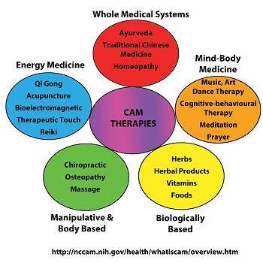

Slide 22
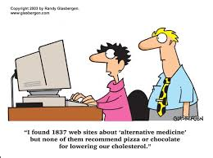
Conclusions
There has been a proliferation of spas and wellness hotels in recent years offering a combination of universally popular global services (e.g. massages, saunas), as well as more location-based treatments and therapies (e.g. thermal waters, muds).
However, increasing competition makes it more and more difficult for businesses to maintain their quality and uniqueness.
The desire to be the ‘Number One Destination for Wellness Tourism’ drives many countries to inflate their statistics and to over-develop their facilities.
However, although wellness is a popular form of tourism, it still only represents a fraction of the whole tourism industry.
On the other hand, a significant number of tourists find wellness services to improve their happiness and wellbeing, at least in the short term. How far their long-term health can benefit is a moot point, but one which is worthy of further research.

Slide 23
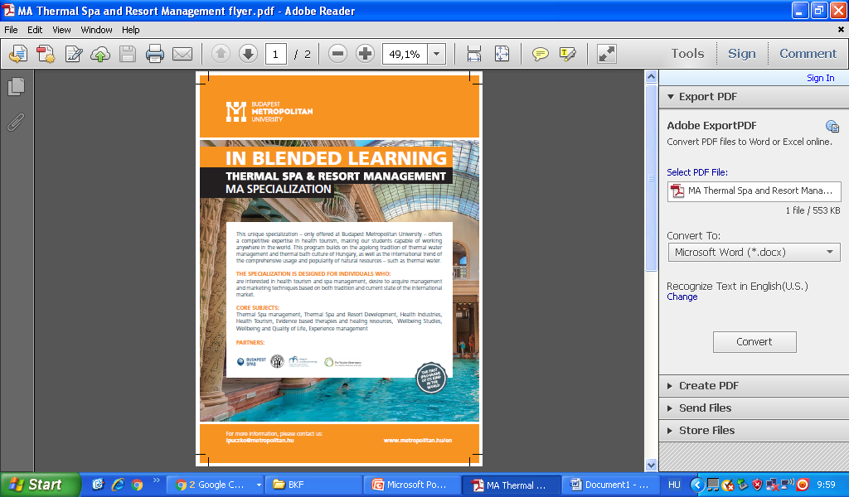
Masters Programme
First of its kind in the world!
Taught by international specialists
Close links to Hungary’s spa, wellness and medical sectors

