Slide 1



The Role of Contemporary Visual Art in Formation of Destination Tourist Brand
I. Shuliateva, National Research University “Higher School of Economics”
www.tourism-student-conference.com

Slide 2
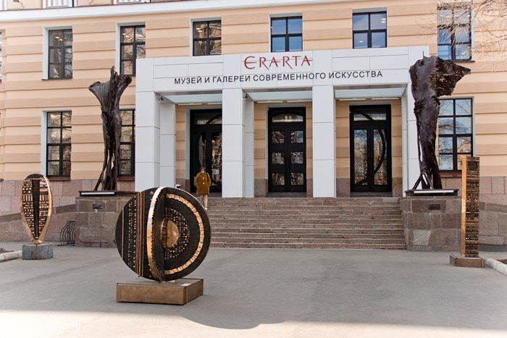
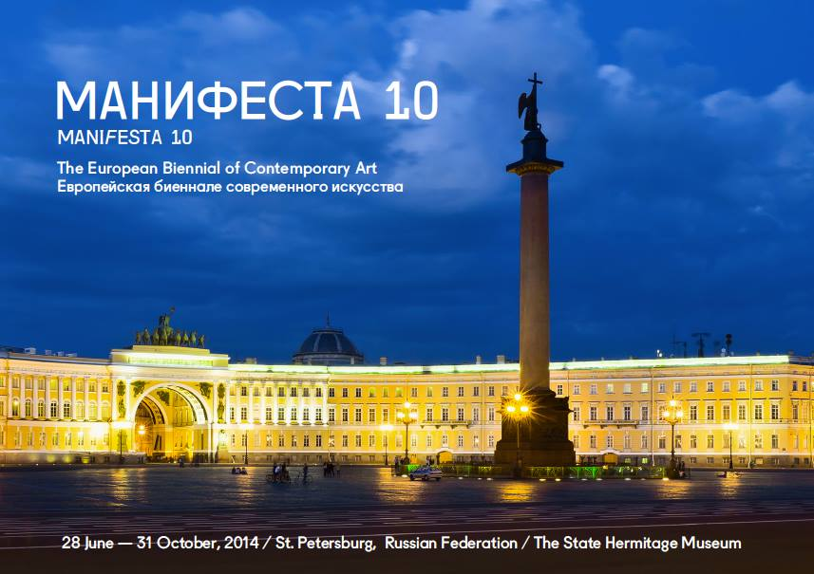
Aim of research
to study the degree of contemporary art development in St.Petersburg, in particular its influence on the brand of the city
ISCONTOUR 2014
Notes:
Of research

Slide 3
Research relevance
Crisis in touristic sector
Necessity for image renovation
- Attraction of new categories of tourists
- Attraction of investment
ISCONTOUR 2014

Slide 4
Theoretical background
What is…?
Branding
identification
Cultural tourism
arts tourism
heritage tourism
Contemporary art
circumstances of «contemporaneity»
diverse, mobile
differentiation.
ISCONTOUR 2014

Slide 5
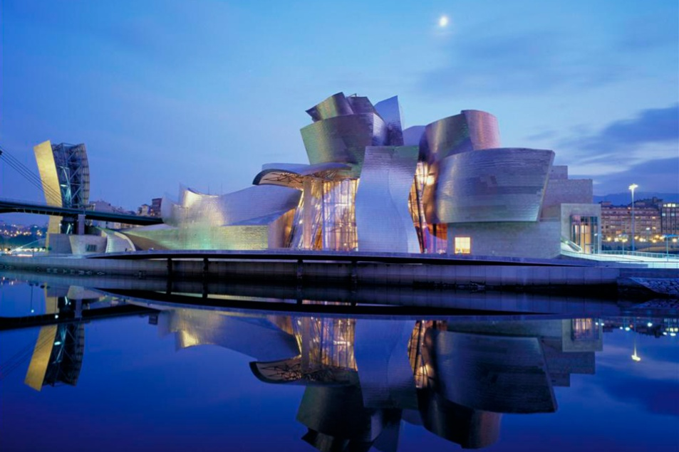
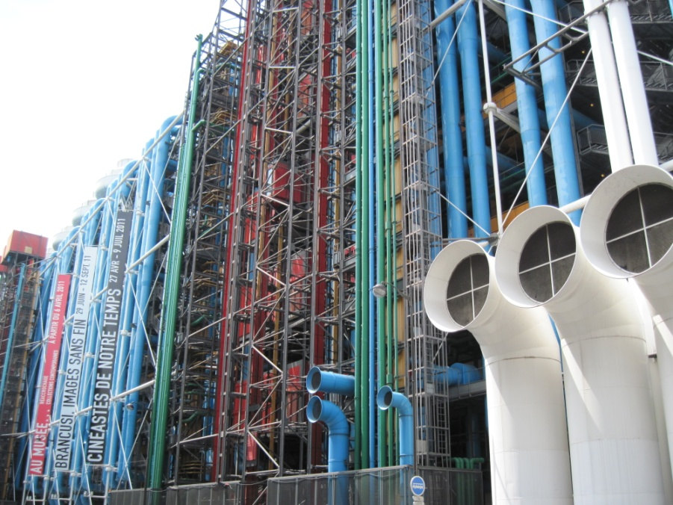
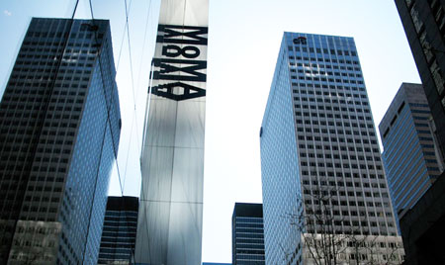
Theoretical background. Case studies
ISCONTOUR 2014

Slide 6
Current situation in St.Petersburg
Basic tendencies:
  the main emphasis on the historic past (Sheptuhina, 2012)
  galleries and exhibition centres - a territory for contemporary art development (Gusev, 2013)
  association with “history, heritage and white nights” / with “North capital, cultural capital and nice city” (Kopilova, 2013)
ISCONTOUR 2014

Slide 7
Methodology. Expert Survey
Criteria
Contemporary art is one of the directions of institution’s work
Questionnaire
the organisation’s activity and the role of contemporary art in it
Organisations analyzed
1 classical museum
Experts
Intensive event and cultural activities
Educational activity and contemporary art promotion
audiences of organisation
the role of the organisation and contemporary in the formation of city brand
5 art-galleries
3 art-centres
1museum of contemporary art
organisations’ directors
fine art experts
employees of the advertisement departments
departments which work with tourist groups
ISCONTOUR 2014

Slide 8
Methodology. Content-Analysis
Criteria
First 50 sites in Russian and English language in Google
Analysis units
Contemporary art, Contemporary Visual Art
Museum of contemporary art, Gallery of contemporary art, Contemporary Art Centre
Organisations analyzed
50 Russian sites
50 English sites
Search request “Tours to St.Petersburg”
ISCONTOUR 2014

Slide 9
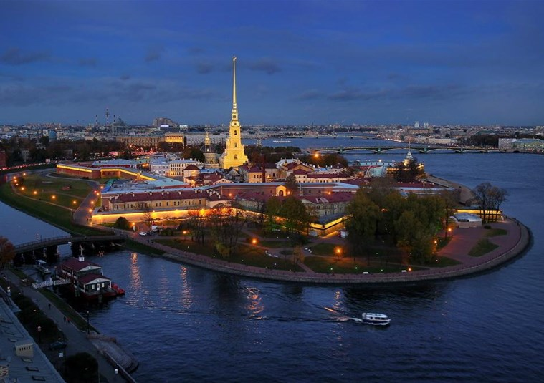
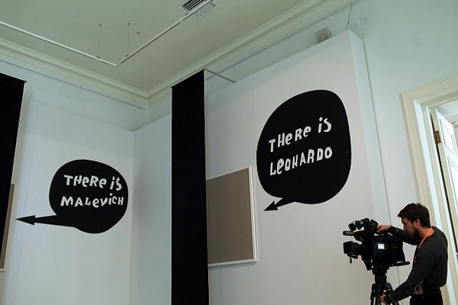
The role of contemporary art in St.Petersburg brand formation
there is a “great St.Petersburg past which dominates…and evokes the response and interest in the first moment”
“contemporary art cannot enter the life of the city immediately”
“mass tourist is not interested in it”
Two cases of visiting:
  Individual art-tourism
  High tourist seasons
ISCONTOUR 2014

Slide 10


The role of contemporary art in St.Petersburg brand formation
Tourists are attracted by large contemporary art museums and big projects organized by classical museums
ISCONTOUR 2014

Slide 11
The role of contemporary art in St.Petersburg brand formation
ISCONTOUR 2014

Slide 12
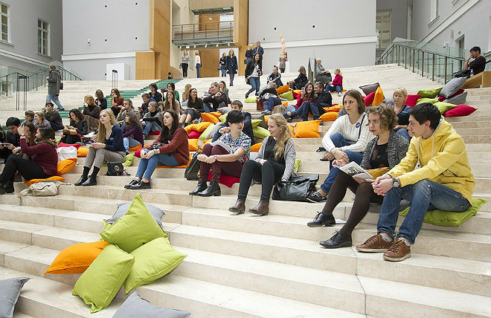
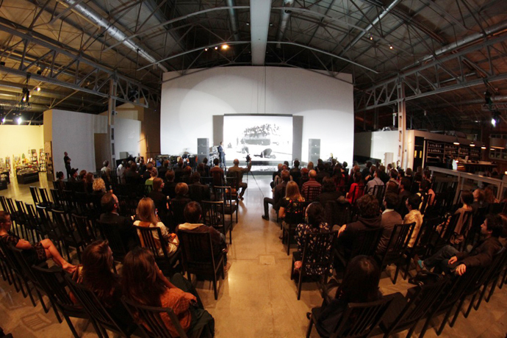
Ways to integrate contemporary art
Adaptation of contemporary art for mass tourists
Active promotion and popularization of contemporary art
Constant review of foreign practices
Creation of excursion routes and creative clusters
ISCONTOUR 2014

Slide 13
Thank You!

