Slide 1



Wine Tourism. A Rural Perspective
Anna Roncaglia, FH Salzburg, Italy
www.tourism-student-conference.com

Slide 2
Agenda
Introduction and Problem Definition
Research Questions
Empirical research
Comparative fields
Findings and Propositions
Limitation to the study
Recommendation for future research
Conclusion
ISCONTOUR 2016

Slide 3
Wine Tourism
“Wine tourism is a form of consumer behavior based on the appeal of the wine and wine regions, and a development and marketing strategy for the wine industry and destinations in which wineries and wine related experiences are the dominant attractions”.
Getz, D., Dowling, R., Carlsen, J. and Anderson, D. (1999). Critical success factors for wine tourism. International Journal of Wine Marketing, 11 (3), p. 21.
ISCONTOUR 2016

Slide 4
Introduction and Problem Definition
Rural Tourism: the rediscovery of remote areas
Wine tourism as a catalyst: place-based marketing
Wine Tourism competitiveness level
Comparative case study: Mantua
ISCONTOUR 2016

Slide 5
Research Questions
RQ1: Which competitive factors influence the touristic development of a non-urban destination?
How do wine tourism practices contribute to the visibility of the destination?
ISCONTOUR 2016

Slide 6
Research Questions
RQ2: To what extent does Mantua have the potential to become a wine tourism destination to increase tourism in its non-urban settings?
ISCONTOUR 2016

Slide 7
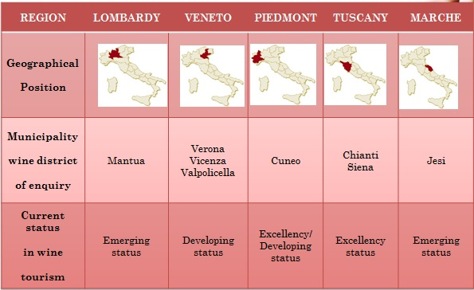
Comparative fields
ISCONTOUR 2016

Slide 8
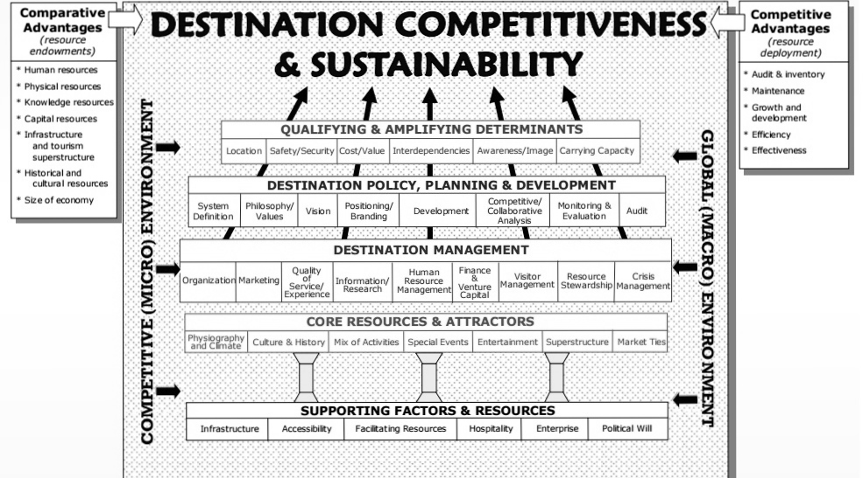
Research Framework
ISCONTOUR 2016

Slide 9
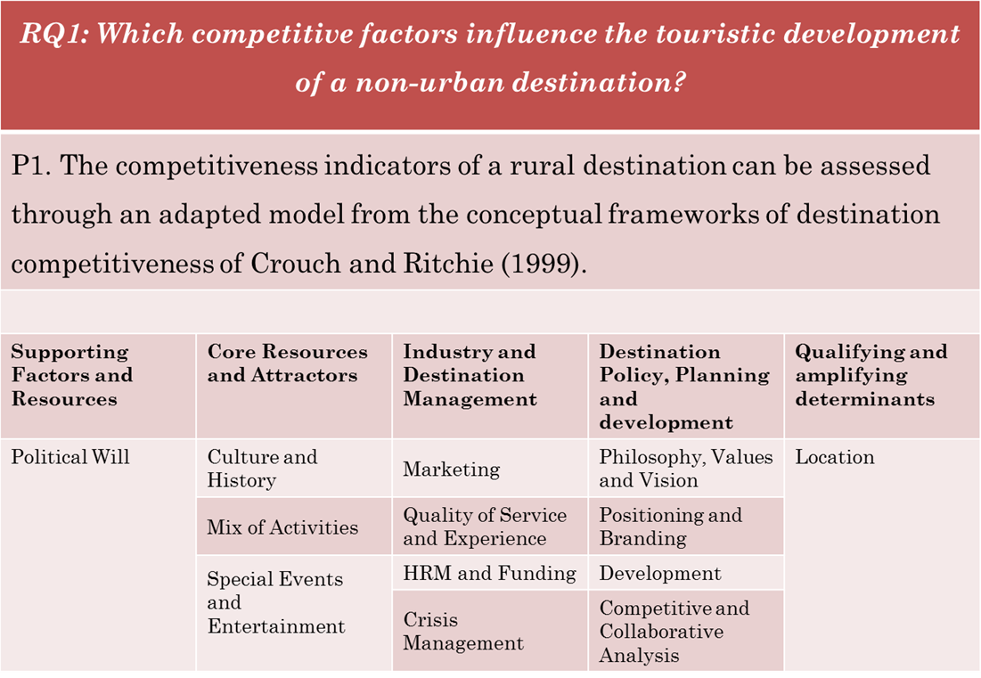
Findings and Propositions (I)
ISCONTOUR 2016

Slide 10
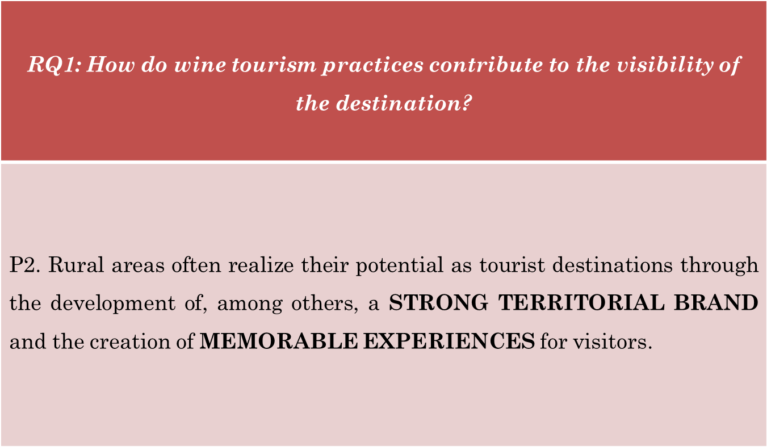
Findings and Propositions (II)
ISCONTOUR 2016

Slide 11
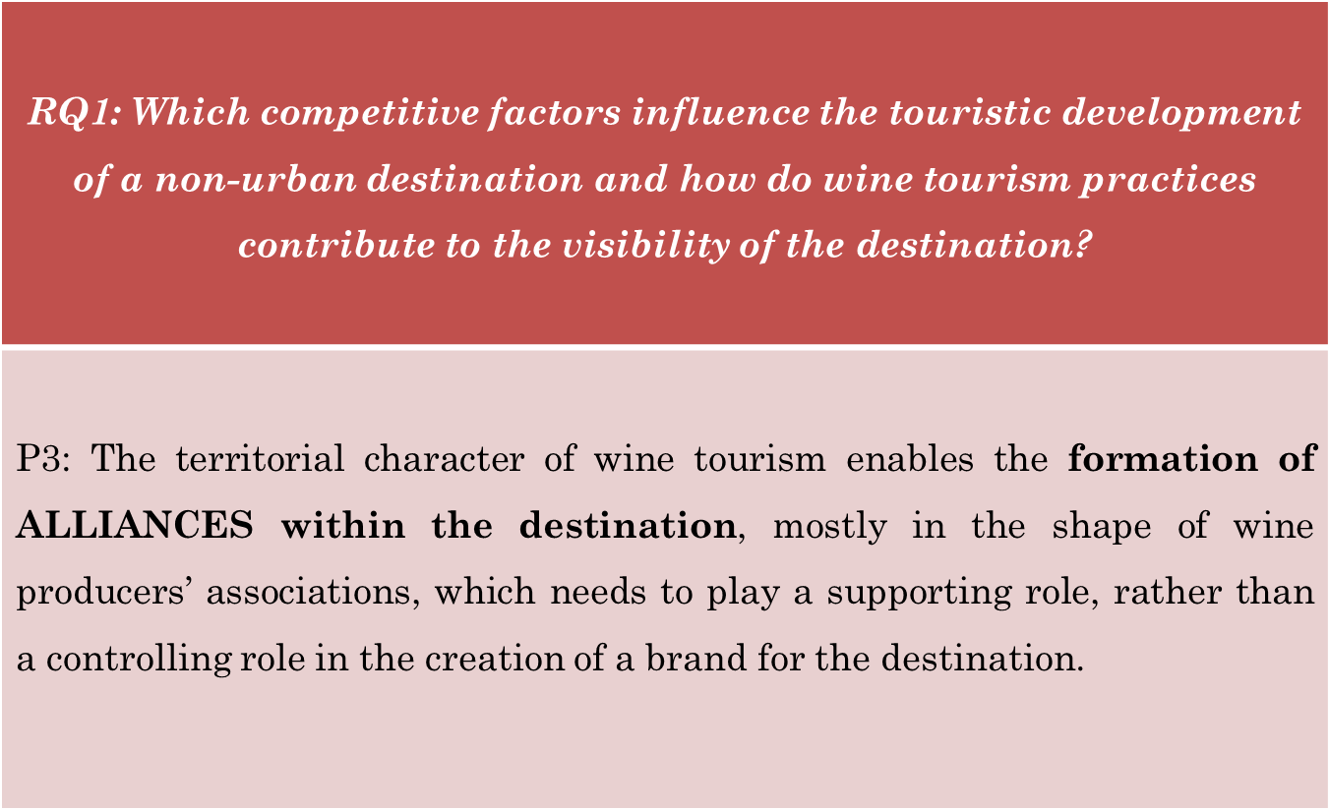
Findings and Propositions (III)
ISCONTOUR 2016

Slide 12
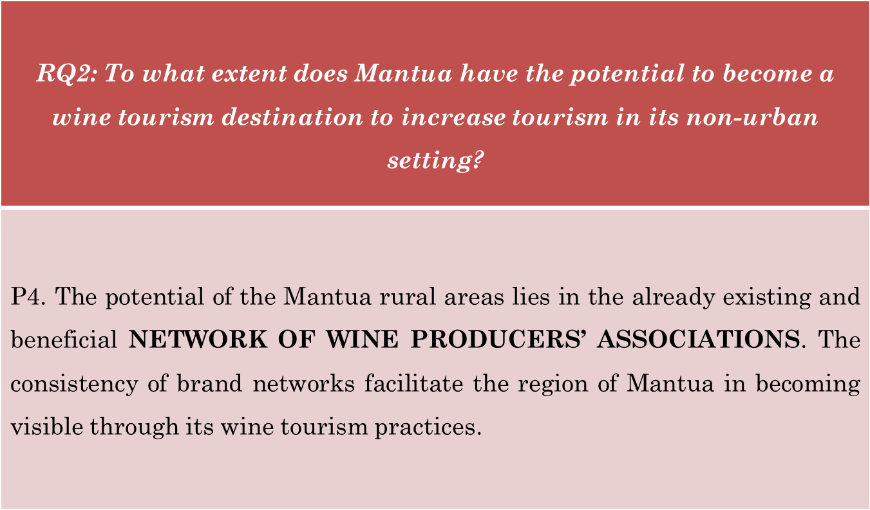
Findings and Propositions (IV)
ISCONTOUR 2016

Slide 13
Limitation to the study
Limited availability of partners
Location of partner’s businesses
Mantua as a single case study
Translation of the interviews
Tendency to speak about own company: frequent changes in the questions
ISCONTOUR 2016

Slide 14
Future Research
Focus on the Image of the Italian wine sector worldwide
Integration of other stakeholders: Local community perception and visitors’ perspective
Gender perspective
Mantua Capital of Culture 2016
ISCONTOUR 2016

Slide 15
Conclusion
Strong and strategic partnerships
Maintaining the focus on the territory
Communication flow between the stakeholders
Visibility for Mantua rural areas: ACHIEVABLE!
From an “Area of Production” to an
“Area of Promotion”…
ISCONTOUR 2016

Slide 16
Thank you for your attention!
Anna Roncaglia, FH Salzburg, Italy
www.tourism-student-conference.com

