Slide 1



Services Industry: An Assessment of Social Media Campaigns and the Importance of Consumer Engagement
Neringa Rackauskaite, Fathiya Al Kindi,
Nikisha Rabess, Viktoriia Sidorova, Jenny Suno Wu,
Stefan Ebanks
University of Surrey, UK
www.tourism-student-conference.com

Slide 2
Agenda
Literature review
Methodology
Results
Discussion
ISCONTOUR 2014

Slide 3
Literature review
The benefits of using social media
The importance of content quality
The power of emotional content
The significance of consumer engagement
ISCONTOUR 2014

Slide 4
Methodology:
Aim: To assess the Airbnb campaign “OneLessStranger” on engagement potential customers
Social Media Platforms: Facebook, Twitter and YouTube
Sample Size: Six (6) other Services Industry campaigns who were finalists of the ‘Social Good’ category of the 2015 ‘Shorty Awards’.
Terminology : Facebook and Twitter, the “Likes” were replaced with “Favourites” and “Shares” with “Retreats”
Table 1. : Facebook and Twitter Category and Criteria
ISCONTOUR 2014

Slide 5
Methodology (2)
Table 2: YouTube Criteria
Table 3: Engagement Criteria
ISCONTOUR 2014

Slide 6
Methodology (3)
Table 4: Coding Method
Table 5: Campaign Scoring Method
ISCONTOUR 2014

Slide 7

Results
Facebook
The most engaging campaign is “OneLessStranger”
Video based vs. Picture based
Emotional, inspirational and original content
Correlation between Engagement score and likes is very weak
Correlation between Engagement score and comments, shares and “Take an Action” is strong
ISCONTOUR 2014

Slide 8

Results (2)
Twitter
Mostly text type of content
No correlation between engagement score and type of content
Correlation between Engagement score and likes, comments and shares is very strong
Correlation between Engagement score and “Take an Action” is weak
ISCONTOUR 2014

Slide 9

Results (3)
YouTube
AirBnB is more active on YouTube than other campaigns
AirBnB’s channel is highly interactive
Correlation between Engagement score and likes, comments is weak
Correlation betweem Engagament score and “Take an Action” is very strong
ISCONTOUR 2014

Slide 10
Discussion
YouTube is the most engaging platform
    Interactive video-based content
    Emotional content
Facebook is more engaging than Twitter
  Facebook aims to maintain relationships
  Twitter provides real-time status updates
Quality of content
  Accuracy, timeliness, relevance, consistency and completeness
  Builds customer confidence and trust
  Close relationship between quality of content and successful engagement
ISCONTOUR 2014

Slide 11
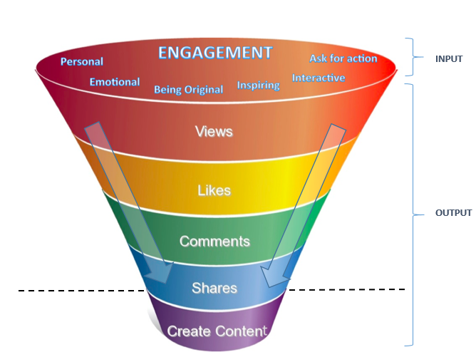
Discussion (2)
Effect of engagement on outcome
  The output elements are in degree of effort
    Liking posts requires minimal level of effort
    Sharing posts is a stronger indictor of users identifying themselves with the campaign
    Creating content has the highest level of engagement
ISCONTOUR 2014

Slide 12
Discussion (3)
Managerial Implications and Future Research
Engagement criteria should be wider
  Celebrity endorsement
  Humor
  Slice of Life
Platforms should be linked
Future Research
  Sample size
  Engagement criteria
ISCONTOUR 2014

Slide 13
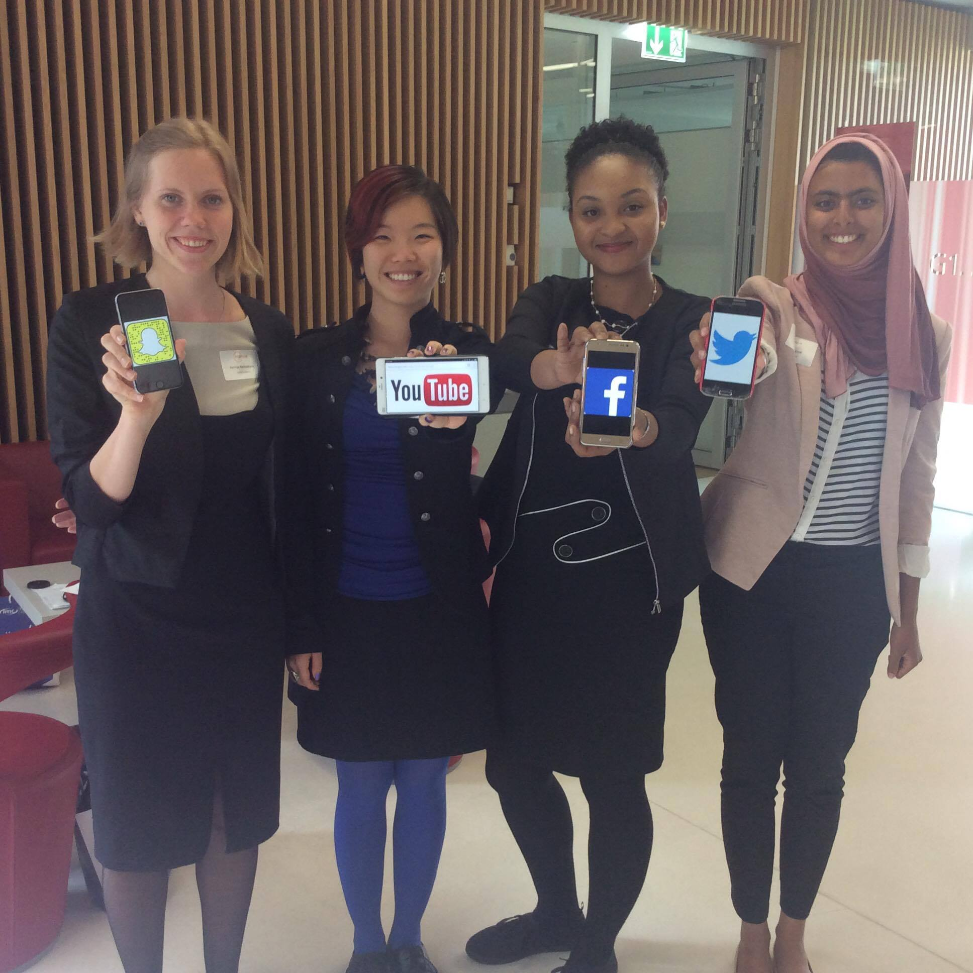
Any questions?
ISCONTOUR 2014

