Slide 1


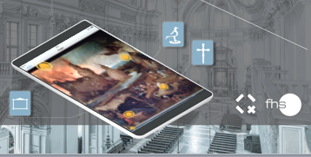

Augmented Reality as a tool to enhance the experience of museum visitors
Larissa Neuburger, FH Salzburg, Austria
www.tourism-student-conference.com

Slide 2
Purpose
MUSEUM
AUGMENTED REALITY
EXPERIENCE
ISCONTOUR 2016

Slide 3
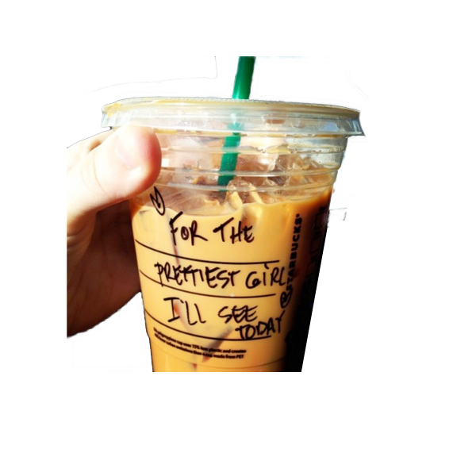

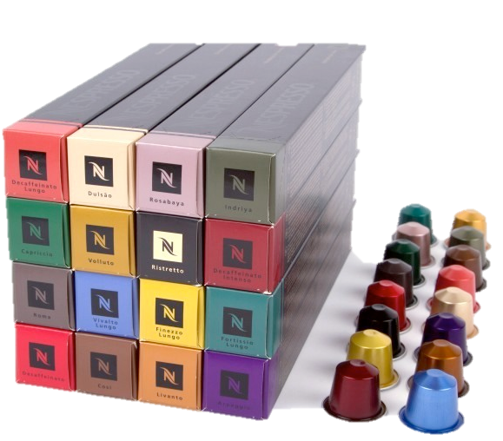

Experience Economy
DIFFERENTIATION
EXPERIENCE
SERVICE
GOODS
COMMODITIES
PRICING
(Pine II and Gilmore, 2011)
ISCONTOUR 2016

Slide 4
Museum Experience
(Falk and Dierking, 2002)
ISCONTOUR 2016

Slide 5
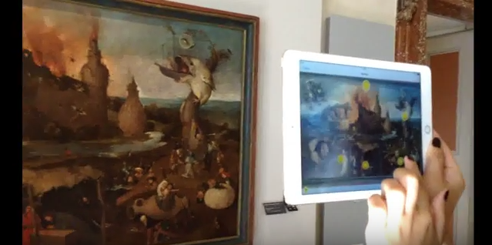
Augmented Reality
“With AR, users feel that the real and the virtual objects coexist in the same space.“ (Linaza et al. 2013)
ISCONTOUR 2016

Slide 6
Research Questions
RQ1:
RQ2:
RQ3:
Which factors influence the experience of a museum's visitor?
How can Augmented Reality enhance the experience of visitors in museums?
How can Augmented Reality be implemented in museums from a technical point of view?
Does Augmented Reality have the potential to enhance
the experience of visitors in museums?
ISCONTOUR 2016

Slide 7
Research Models
ENGAGEMENT
KNOWLEDGE/
LEARNING
MEANINGFUL
EXPERIENCE
EMOTIONAL
CONNECTION
Museum Experience Scale
Experience Model
ISCONTOUR 2016

Slide 8
Research Design
Experimental
Group
Experiment
Questionnaire
Control
Group
ISCONTOUR 2016

Slide 9
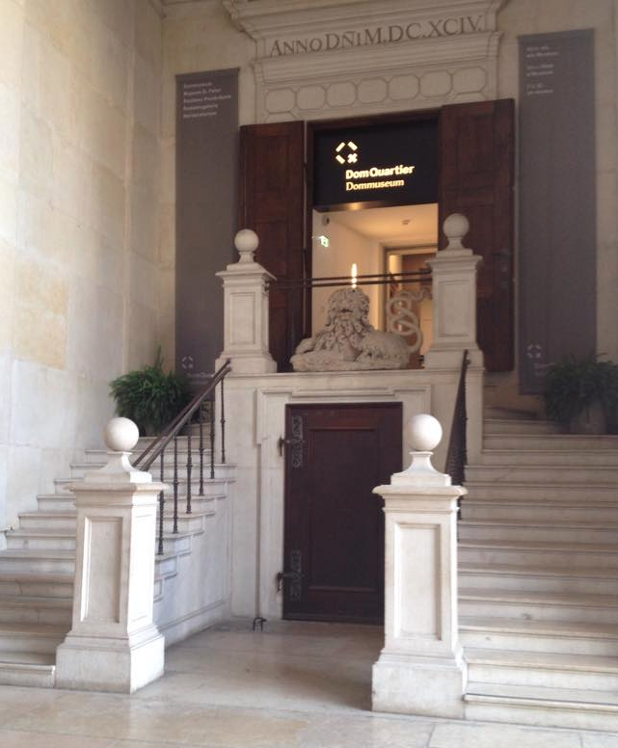
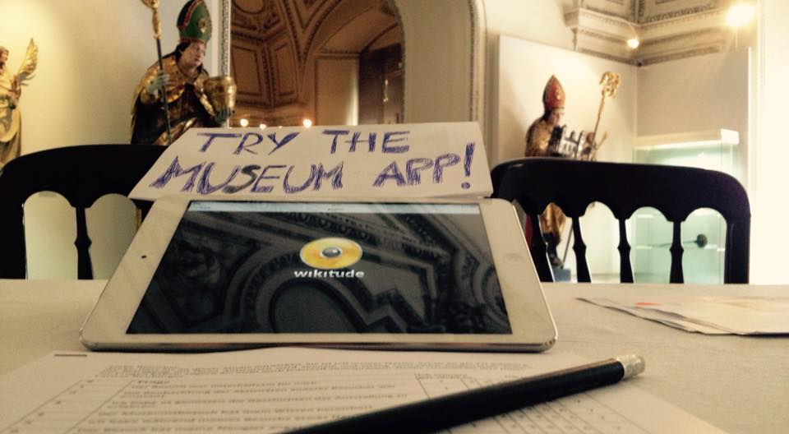
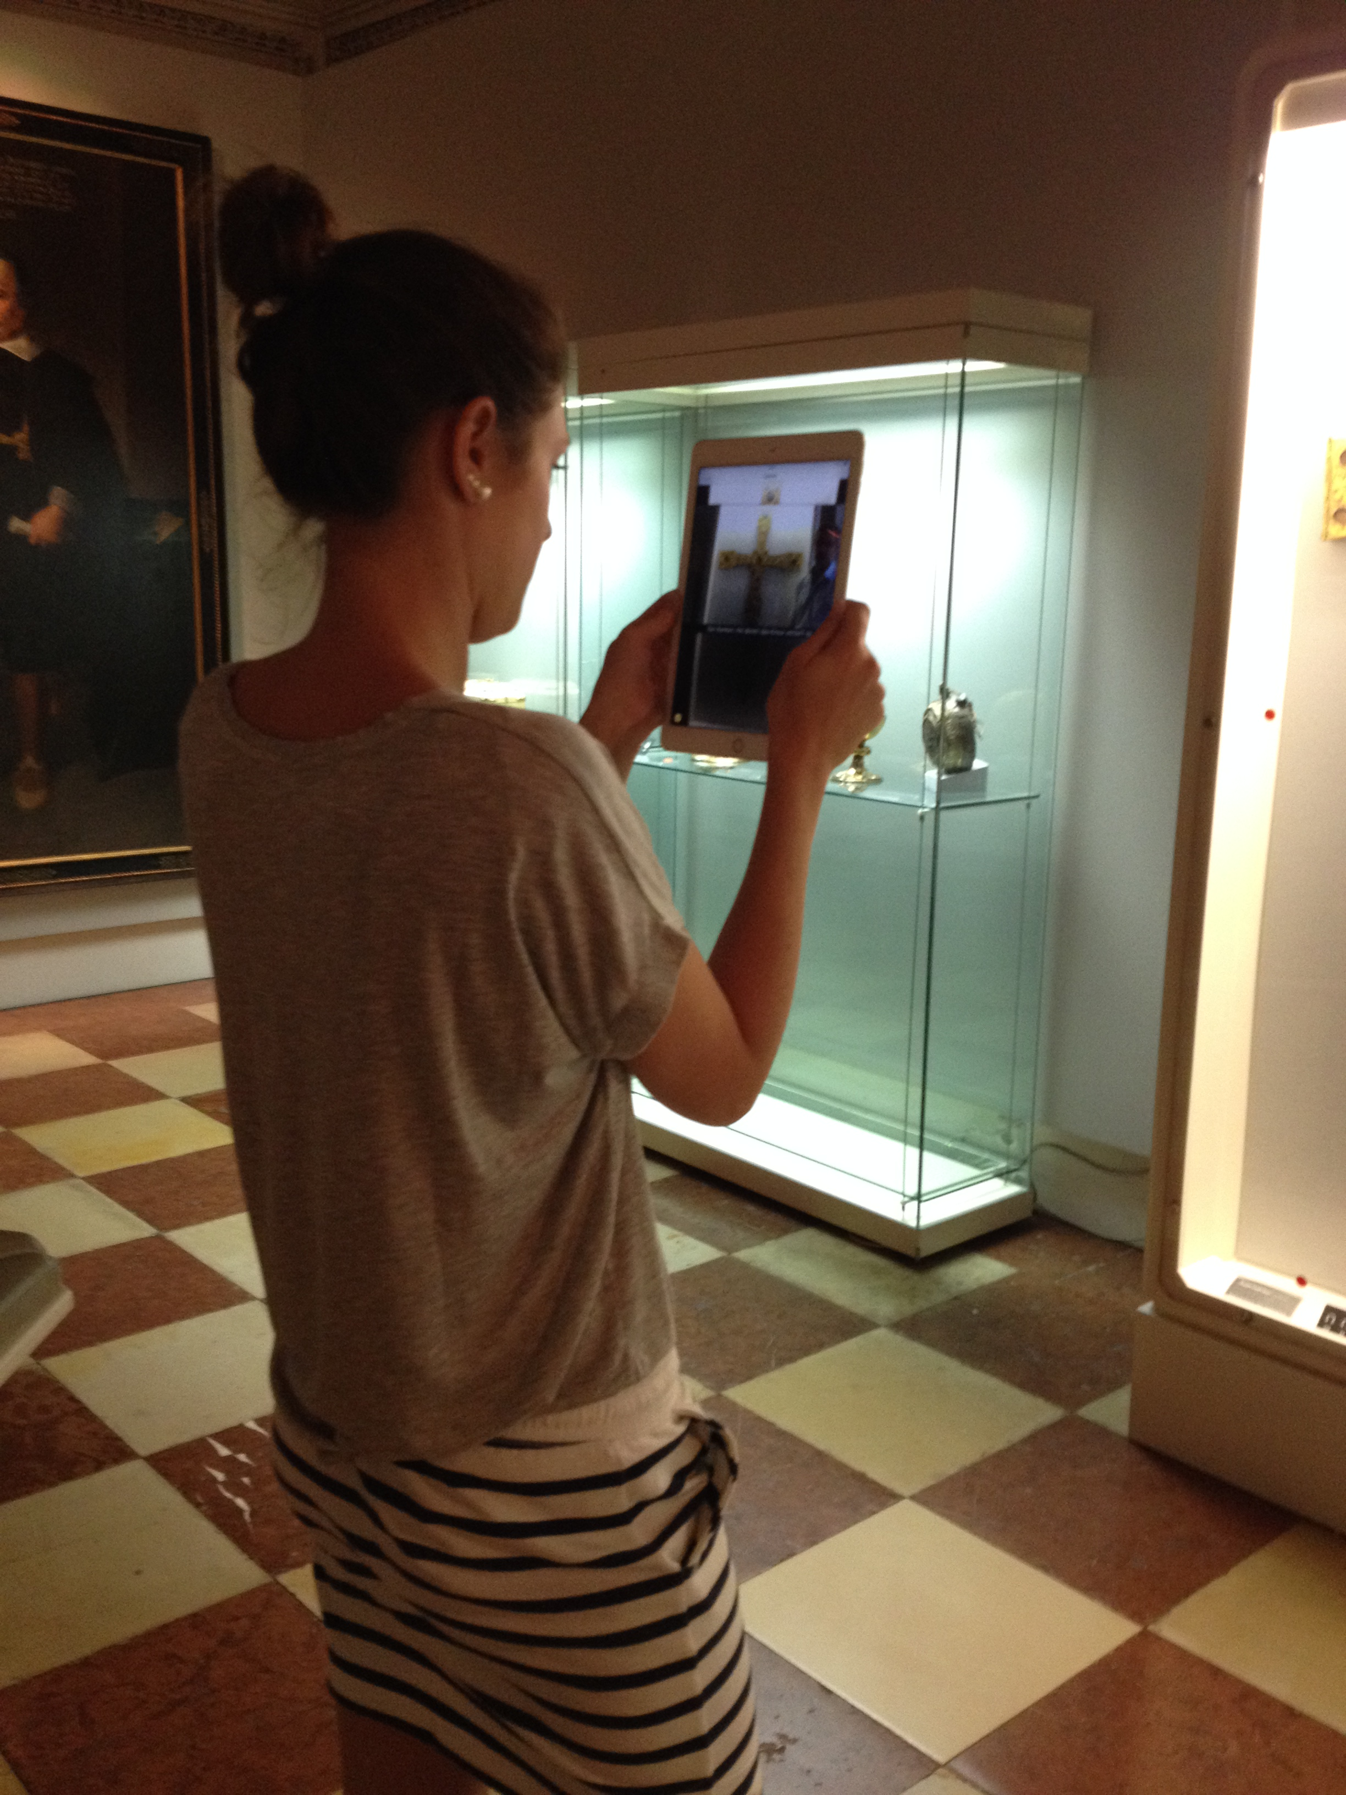
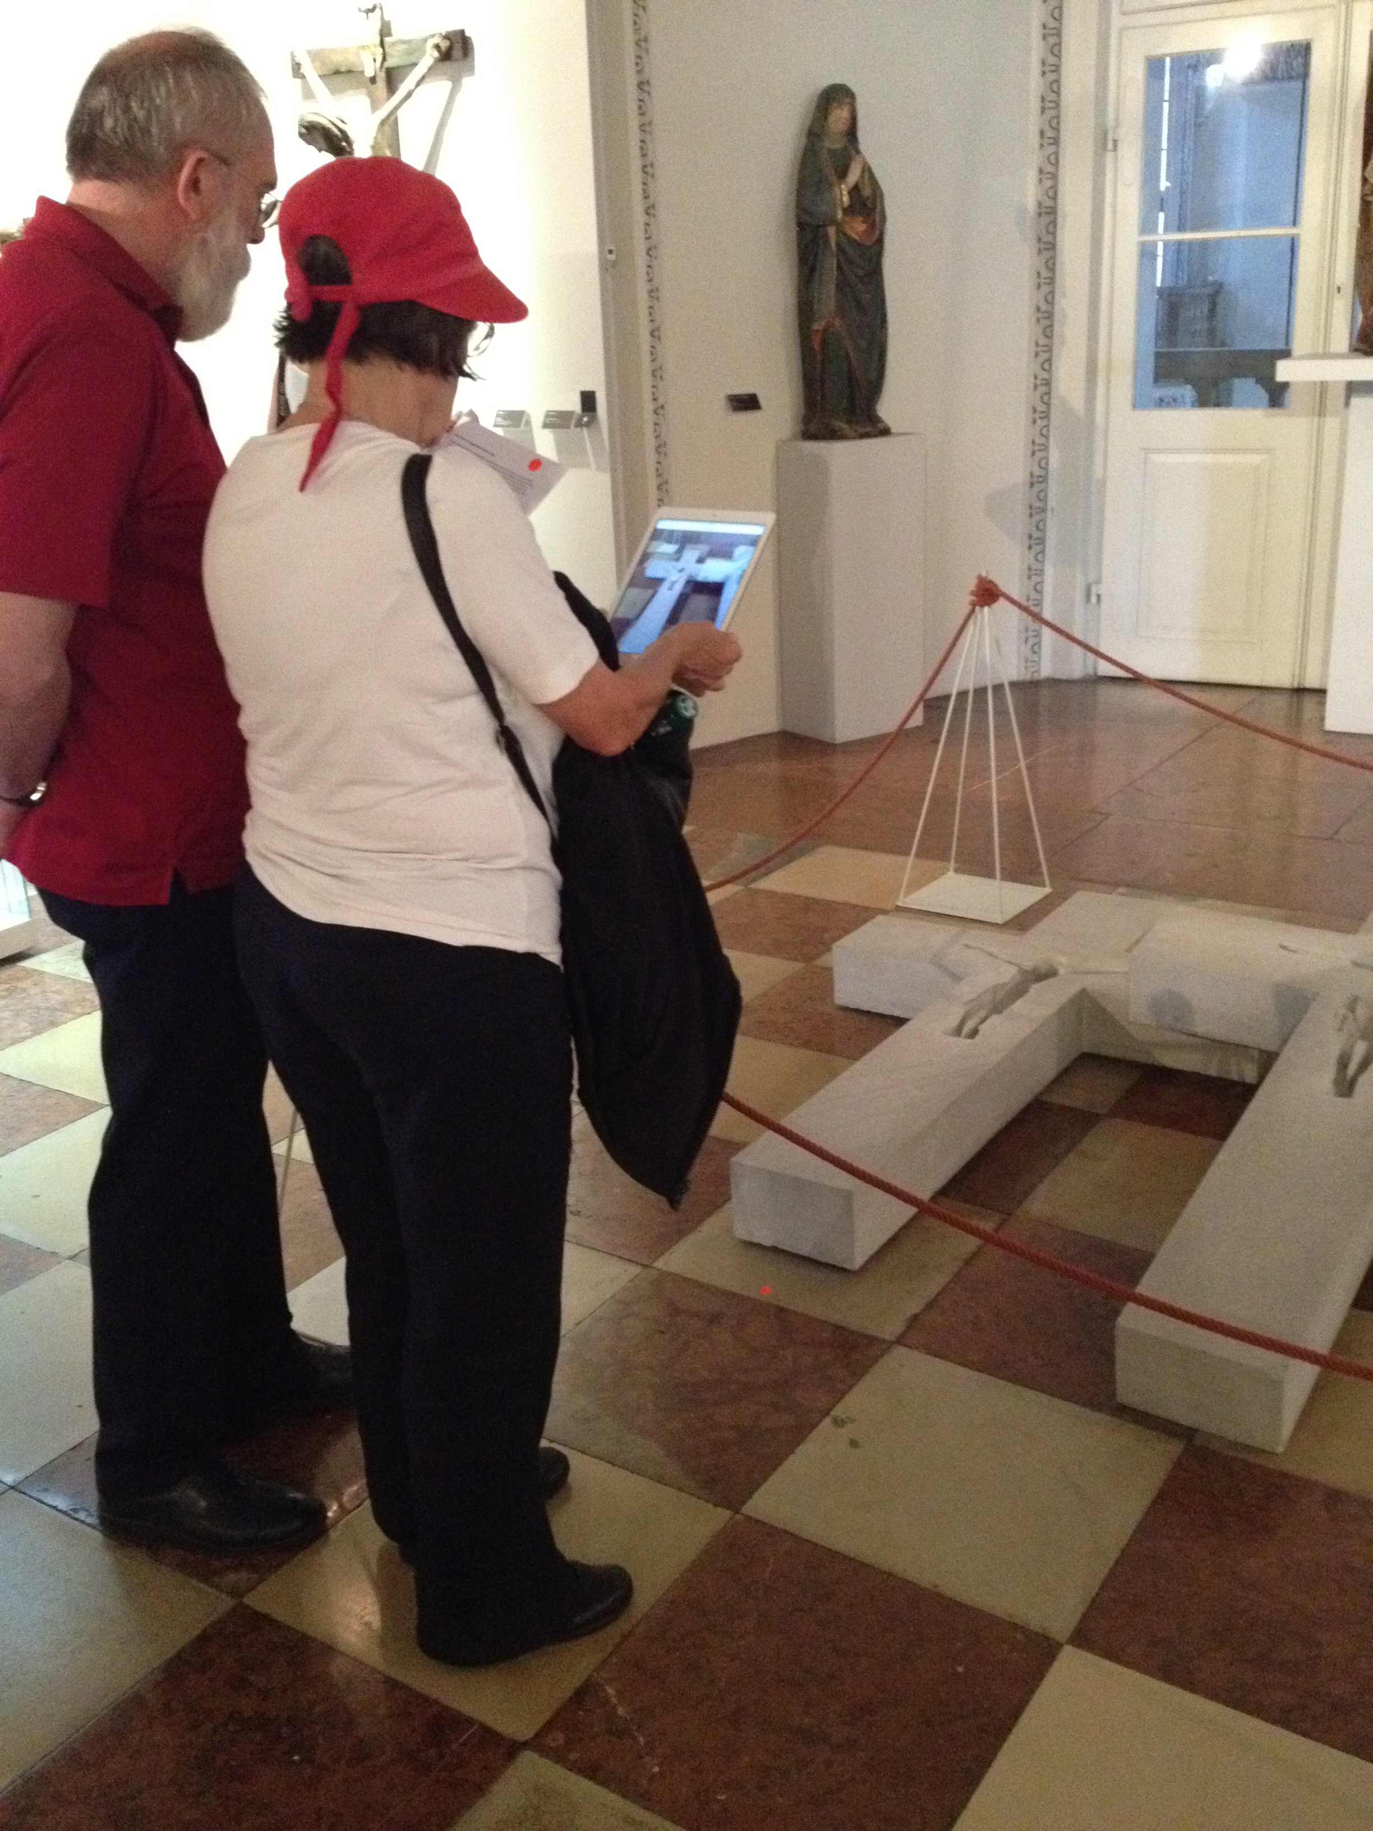
Experiment
ISCONTOUR 2016

Slide 10
Collected Data
Sample Size = 178
Reliability Test: Cronbach´s Alpha
> 0.7 required & validated
All results significance level:
p < 0.05 or p < 0.01
ISCONTOUR 2016

Slide 11


Results T-Test Experience
Construct | Results (n=178)
Education | Significant Result
Entertainment | Significant Result
Escapism | Significant Result
Esthetics | Not Significant Result
Overall Experience | Significant Result
ISCONTOUR 2016

Slide 12
Results T-Test Museum Experience Scale
Construct | Results (n=178)
Knowledge/Learning | Significant Result
Engagement | Significant Result
Meaningful Experience | Significant Result
Emotional Connection | Significant Result
Overall MES | Significant Result
ISCONTOUR 2016

Slide 13
Conclusion
AR can enhance the experience of museum visitors
  without disturbing designed exhibition
  adding interesting & educational information to artefacts
  should be provided for own device of visitors (WIFI available!)
AR – not full potential yet but will be technology of the future
Museums – will persist in future by combining high touch with high tech
ISCONTOUR 2016

Slide 14
Recommendations
Pictures showing different aspects of artefact (background images, inside insights or detail view) or reference images to explain background of artefacts favoured the most
Additional interactive elements enhance user experience
Videos: need improved technology
  Partly obstructive
  Partly interesting
ISCONTOUR 2016

Slide 15
Limitations
Language restrictions
Visit time could not be measured
Experimental group needed guidance
No further split up in experience with audio-guide
Research depended on existing rare material of the museum
ISCONTOUR 2016

Slide 16
Thank your for your attention
ISCONTOUR 2016

