Slide 1




Analysis of the Usefulness, Hedonic and Utilitarian Attitudes of Smartphone Users toward Mobile Tracking Applications
Sheila Koo
Ioana Muntean
Oi Lam Ho
Jinwoo Kang
Malina Gangut
University of Surrey
United Kingdom
www.tourism-student-conference.com

Slide 2

Agenda
Introduction
Literature Review
Methodology
Results
Conclusion
ISCONTOUR 2016

Slide 3
Introduction
Potential for the mobile tracking application market to grow
  Analyse consumers‘ attitudes in the context of travelling
USEFULNESS
HEDONISM AND UTILITARIANISM
+ EXTENT OF USAGE
ISCONTOUR 2016

Slide 4
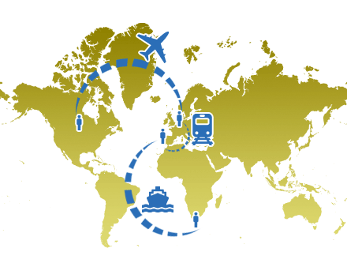


Introduction
LIGHT USERS vs HEAVY USERS
USEFULNESS
HEDONISM
UTILITARIANISM
TrackMyTour
Timego
ISCONTOUR 2016

Slide 5
Literature Review
Technology Acceptance Model (Davis, 1989)
Perceived Usefulness
External Variables
Attitudes Towards Using
Behavioural Intention to Use
Actual System Use
Perceived Ease of Use
ISCONTOUR 2016

Slide 6
Literature Review
Technology Acceptance Model (Davis, 1989) in the context of travelling
Perceived Usefulness
Trip Experience
Tourists’ Views Towards Using
Willingness to Use in Travel Circumstance
Actual System Use
Technology Embracing
Perceived Ease of Use
ISCONTOUR 2016

Slide 7
Literature Review
Utilitarianism
Hedonism
Rational
Effective
Task oriented
Focus on the functional features of a product
Achieved only if the acquisition trip was concluded efficiently
Subjective
Affective
Possible entertainment and emotional benefit of a shopping experience
May be induced even if there is no intention of purchase
ISCONTOUR 2016

Slide 8
Literature Review
Utilitarianism
Hedonism
Values interfere in the decision making processes
Consumers choose products to please their hedonic wants and realise their utilitarian demands
ISCONTOUR 2016

Slide 9


Literature Review
Light and heavy smartphone users
Not all users are utilising the applications the same way
It is likely that heavy smartphone users evoke stronger attitudes toward the usage of mobile tracking applications
ISCONTOUR 2016

Slide 10
Hypotheses
H1a-b: Heavy smartphone users will find mobile tracking applications such as a) Timego and b) TrackMyTour more useful than light users.
H2a-b: Heavy smartphone users will have stronger hedonic attitudes in a shopping trip when using mobile tracking applications such as a) Timego and b) TrackMyTour.
H3a-b: Heavy smartphone users will have stronger utilitarian attitudes in a shopping trip when using mobile tracking applications such as a) Timego and b) TrackMyTour.
ISCONTOUR 2016

Slide 11
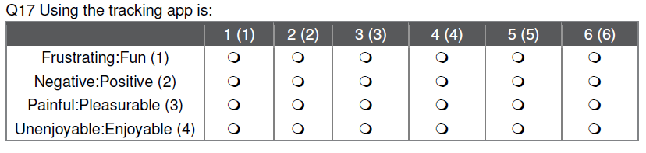
Methodology
An anonymous online survey of 36 questions was distributed
Random sampling method
Type of questions:
- 6-points Likert Scale
To analyse the data:
- frequency distribution of the variables are used.
ISCONTOUR 2016

Slide 12
  Results – 696 Respondents‘ profile
Timego | TrackMyTour
386 | 310
Light Users | Heavy Users
290 | 406
Primary | 2%
Secondary and college | 48.3%
Undergraduates | 35.9%
Postgraduates and above | 10.6%
ISCONTOUR 2016
Notes:
Usefulness: useful, practical and functional
Hedonic: enjoyable, adventurous, joyful and escape-like shopping trip
Utilitarian: was assessed by inquiring whether using the application assisted the respondents in purchasing what they intended to get or accomplishing what they planned for the shopping trip

Slide 13
Results – 696 Respondents‘ profile
iPhone | 59.40%
Android | 35.70%
Windows | 2.70%
Blackberry | 1.60%
Others | 0.40%
ISCONTOUR 2016

Slide 14
Results – Usefulness
H1: USEFULNESS
Variables | Light users (mean) | Heavy users (mean) | p-value | Support
H1a: Timego
I find the tracking app useful. | 3.74 | 4.24 | <0.001 | Yes
I find the services offered by the tracking app practical. | 3.85 | 4.26 | <0.001 | Yes
I find the tracking app functional. | 3.95 | 4.30 | 0.005 | Yes
Overall, I find the tracking app useful. | 3.92 | 4.29 | 0.004 | Yes
H1b: TrackMyTour
I find the tracking app useful. | 3.85 | 4.25 | 0.005 | Yes
I find the services offered by the tracking app practical. | 3.87 | 4.18 | 0.029 | Yes
I find the tracking app functional. | 3.95 | 4.27 | 0.029 | Yes
Overall, I find the tracking app useful. | 3.95 | 4.27 | 0.025 | Yes
Table 1
ISCONTOUR 2016

Slide 15
Results – Hedonism
H2: HEDONISM
Variables | Light users (mean) | Heavy users (mean) | p-value | Support
H2a: Timego
I enjoyed being immersed in shopping. | 3.72 | 4.20 | <0.001 | Yes
Compared to other things, the time I spent shopping was truly enjoyable. | 3.68 | 4.19 | <0.001 | Yes
This shopping trip felt like an escape. | 3.37 | 4.00 | <0.001 | Yes
While shopping, I felt a sense of adventure. | 3.52 | 4.16 | <0.001 | Yes
This shopping trip was truly a joy. | 3.55 | 4.04 | <0.001 | Yes
H2b: TrackMyTour
I enjoyed being immersed in shopping. | 3.97 | 4.25 | 0.077 | No
Compared to other things, the time I spent shopping was truly enjoyable. | 3.77 | 4.15 | 0.013 | Yes
This shopping trip felt like an escape. | 3.40 | 4.06 | <0.001 | Yes
While shopping, I felt a sense of adventure. | 3.79 | 4.15 | 0.021 | Yes
This shopping trip was truly a joy. | 3.68 | 4.19 | 0.001 | Yes
ISCONTOUR 2016

Slide 16
Results – Utilitarianism
H3: UTILITARIANISM
Variables | Light users (mean) | Heavy users (mean) | p-value | Support
H3a: Timego
While shopping, I found the item(s) I was looking for. | 4.13 | 4.29 | 0.203 | No
I couldn’t buy what I really needed. | 3.06 | 3.68 | <0.001 | Yes
I accomplished just what I wanted to do on this shopping trip. | 4.09 | 4.32 | 0.084 | No
H3b: TrackMyTour
While shopping, I found the item(s) I was looking for. | 4.06 | 4.43 | 0.019 | Yes
I couldn’t buy what I really needed. | 3.40 | 3.76 | 0.034 | Yes
I accomplished just what I wanted to do on this shopping trip. | 4.10 | 4.40 | 0.054 | No
ISCONTOUR 2016

Slide 17

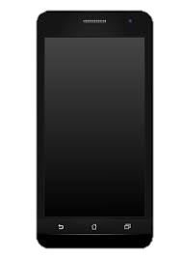
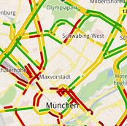

Conclusion
Focus on demands of heavy users
Provide adequate relevant features
Improve ease of use for light users
ISCONTOUR 2016

Slide 18
Thank you For you Attention!

