Slide 1



The status quo of how hospitality industry companies successfully engage in social media: a comparison of Airbnb with its competitors
Gerasimos Margelis, University of Surrey, Greece
Maria Glogoviti, University of Surrey, Greece
Shengshuang Cui, University of Surrey, China
Tatiana Melaki, University of Surrey, Greece
Yili Ding, University of Surrey, China
www.tourism-student-conference.com

Slide 2

Outline
Purpose of our Report
Background Information
Methodology
Results
Discussion
Picture source: https://www.google.at/search?q=image&espv=2&biw=1280&bih=685&tbm=isch&tbo=u&source=univ&sa=X&ved=0ahUKEwiZ3Pqnyu7MAhWEZpoKHY7HAqQQsAQIKw#tbm=isch&q=social+media&imgrc=qq4BRjqEG0-LIM%3A
ISCONTOUR 2016

Slide 3

Purpose of our Report
The purpose of the report is to analyse how companies use different social media to launch their campaigns and manage to engage their customers with them.
Picture source: https://www.google.at/search?q=image&espv=2&biw=1280&bih=685&tbm=isch&tbo=u&source=univ&sa=X&ved=0ahUKEwiZ3Pqnyu7MAhWEZpoKHY7HAqQQsAQIKw#tbm=isch&q=social+media&imgrc=1v57-Ceysnc5wM%3A
ISCONTOUR 2016

Slide 4

Largest accommodation provider own no real estate ?
Picture source: https://www.google.at/search?q=image&espv=2&biw=1280&bih=685&tbm=isch&tbo=u&source=univ&sa=X&ved=0ahUKEwiZ3Pqnyu7MAhWEZpoKHY7HAqQQsAQIKw#tbm=isch&q=airbnb&imgrc=xjXYPUUh6fSz3M%3A
ISCONTOUR 2016

Slide 5
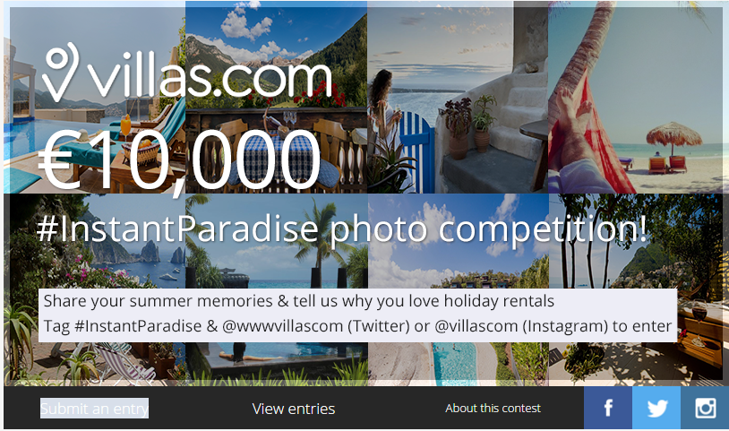
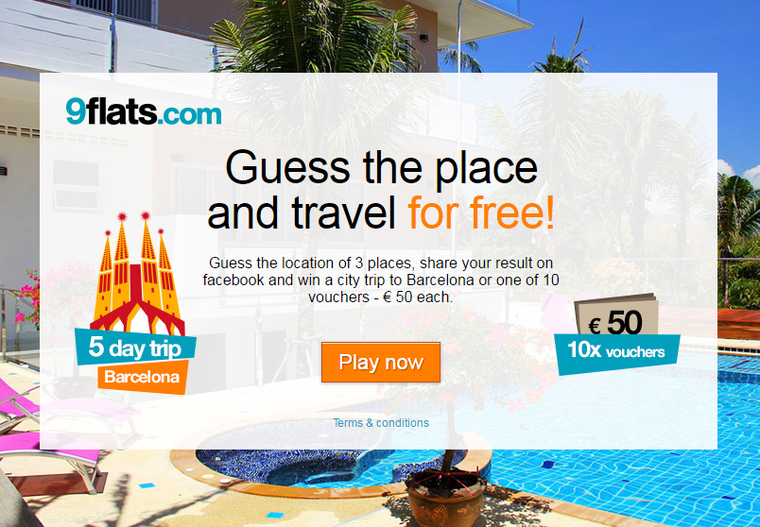
Background Introduction
Airbnb: ‘Wall and Chain’
https://www.youtube.com/watch?v=BpAdyFdE3-c
Homeaway: ‘A Whole Vacation’
Wimdu: ‘Berlin Travel Guide ­Wimdu’
Villas: ‘Photo competition’ 9flats: ‘Travel Quiz’
ISCONTOUR 2016

Slide 6





Methodology
Research Object: Airbnb and 4 competitors (Homeaway, 9flats, Wimdu and Villas)
SM: 7 platforms (Facebook, Twitter, Instagram, Google+, Pinterest, LinkedIn and YouTube) & Homepage website
Criteria: SM: Followers, Likes, Shares/Retweet
Homepage website: reply speed, contact information
ISCONTOUR 2016

Slide 7
Results
General Information in SM: Followers
ISCONTOUR 2016

Slide 8

Campaign result: Likes
Results
ISCONTOUR 2016

Slide 9
Engagement: Share/Retweets
Results
ISCONTOUR 2016

Slide 10
Discussion
Followers
Promoting & advertising
Likes
Exposure
Shares&Retweets
Recognisability
Potential customers
YouTube
Online marketing
Exposure
Engagement
ISCONTOUR 2016

Slide 11

Discussion
Reply
Speed
Actively Update
Free Call Back
ISCONTOUR 2016

Slide 12
Reference
Hanna R., Rohm, A., and Crittenden, V.L. (2011) ‘We’re all connected: The power of the social media ecosystem’, Business Horizons 54(3), pp.265-273.
Gu, R., Higa, K., and Moodie, D. R. (2011) ‘A study on communication media selection: comparing the effectiveness of the media richness, social influence, and media fitness’, Journal of Service Science and Management, 4(03), pp.291-299.
Brodie, R. J., Illic, A., Juric, B. and Hollebeek, L. (2013) ‘Consumer engagement in a virtual brand community: an exploratory analysis’, Journal of business Research, 66(1), pp.105-114.
Oliver, R.L. (1999) ‘Whence consumer loyalty?’, Journal of Marketing, 63, pp.33-44.
Woerndl, M., Papagiannidis, S., Bourlakis, M. and Li, F. (2008) ‘Internet-induced marketing techniques: Critical factors in viral marketing campaigns’, International Journal of Business Science and Applied Management, 3(1), pp.33-45.
Hays, S., Page, S. J., and Buhalis, D. (2013) ‘Social media as a destination marketing tool: its use by national tourism organisations’, Current Issues in Tourism, 16(3), pp.211-239
Cheung, M. (2015) Social media and customer service in 2015: how are brands coping?. Available at: http://www.eptica.com/blog/social-media-and-customer-service-2015-how-are-brands-coping (Accessed at: 19 December 2015).
Goodman, G. F. (2012) Engagement marketing: how small business wins in a socially connected world. John Wiley & Sons
Kabani, S. (2010). The Zen of social media marketing: an easier way to build credibility, generate buzz, and increase revenue. Dallas: BenBella Books.
Xiang, Z., and Gretzel, U. (2010) ‘Role of social media in online travel information search’, Tourism Management, 31(2), pp.179-188.
ISCONTOUR 2016

