Slide 1



Three Atractive Examples of Viable Tourism Systems in Serbia
Jelena Kovačević, Singidunum University, Serbia
www.tourism-student-conference.com

Slide 2
EXIT / GUČA / KÜSTENDORF
Ah, music… a magic beyond all we do here!
J.K. Rowling
Annual events with festive and musical character
Local festivals that grew and became international
Take place away from the capital
An opportunity to foster tourism in their respective regions
ISCONTOUR 2016

Slide 3
Festivals take part in cultural heritage of Serbia
EXIT
– youth and urban heritage of Novi Sad
GUČA
– rural heritage of the region Dragačevo, and wider
KÜSTENDORF
– natural and (new) artistic centre of the western Serbia
ISCONTOUR 2016

Slide 4
The best results can be achieved if tourism were to be treated as a subsystem of the socio-cultural system.
Tadeja Jere Jakulin
ISCONTOUR 2016

Slide 5
Viable system...
...is any organism or organisation that is capable of maintaining its identity independently of other such organism within a shared environment.
Stafford Beer
ISCONTOUR 2016

Slide 6
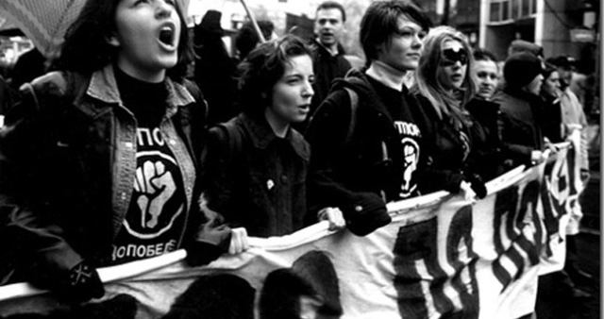
EXIT in 2000
ISCONTOUR 2016

Slide 7
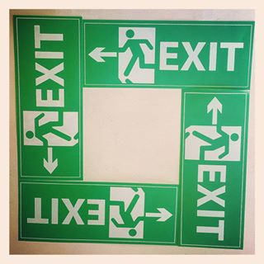
EXIT in 2000
ISCONTOUR 2016

Slide 8
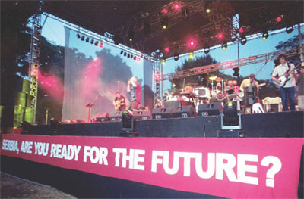
EXIT in 2000
and in 2001
ISCONTOUR 2016

Slide 9
EXIT
ISCONTOUR 2016

Slide 10
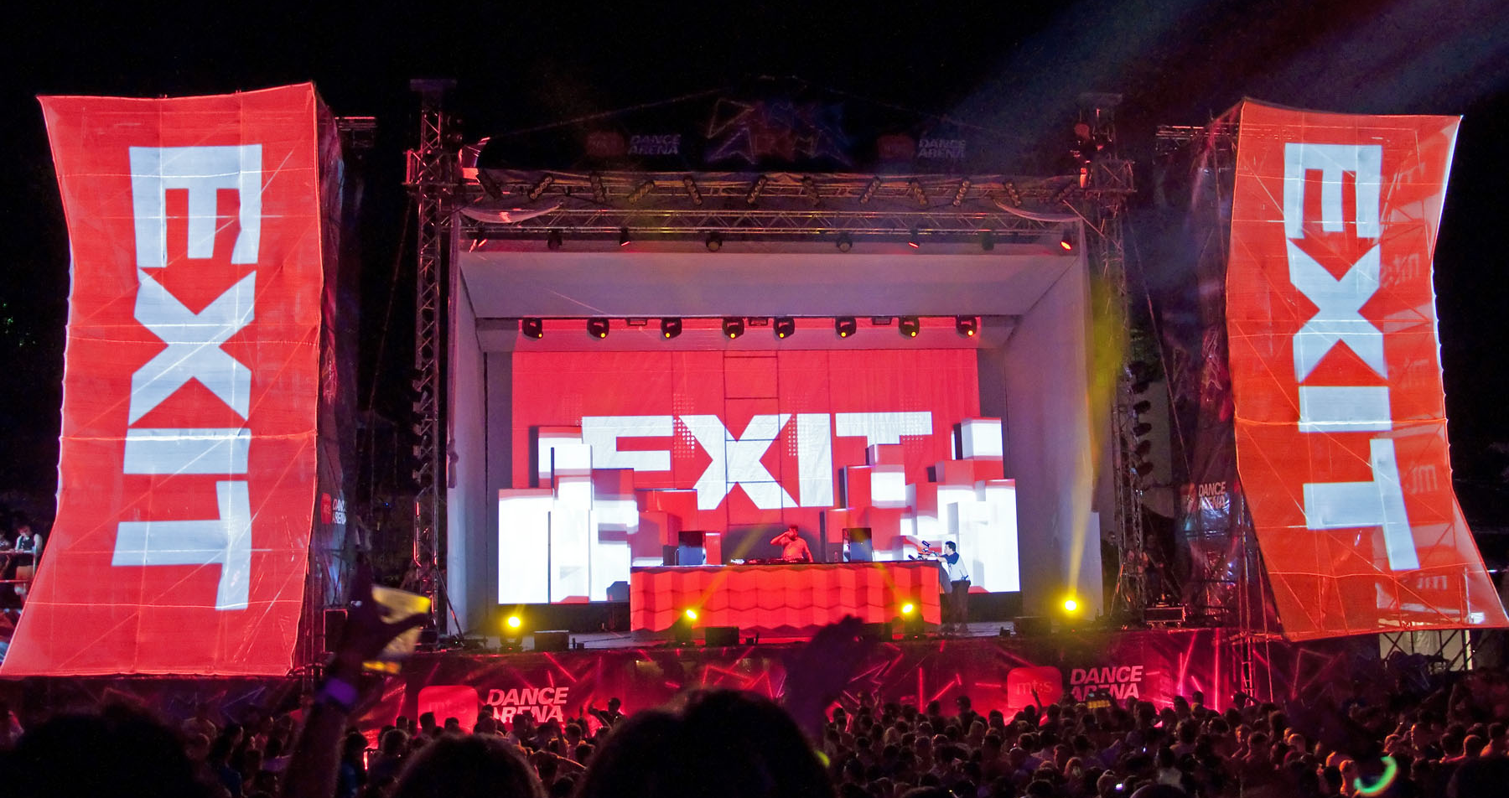
EXIT nowadays
ISCONTOUR 2016

Slide 11
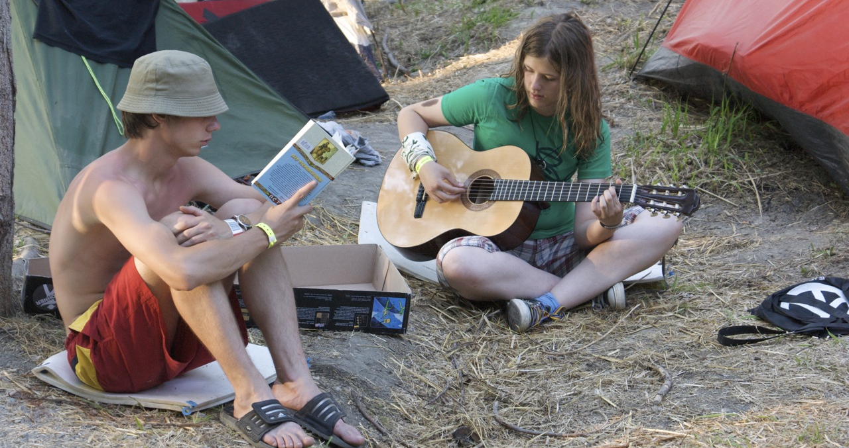
EXIT nowadays
ISCONTOUR 2016

Slide 12
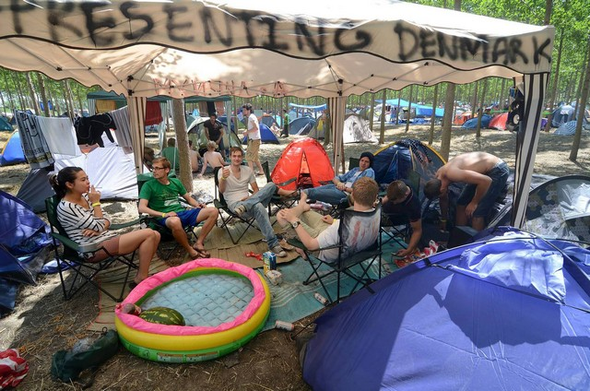
EXIT nowadays
ISCONTOUR 2016

Slide 13
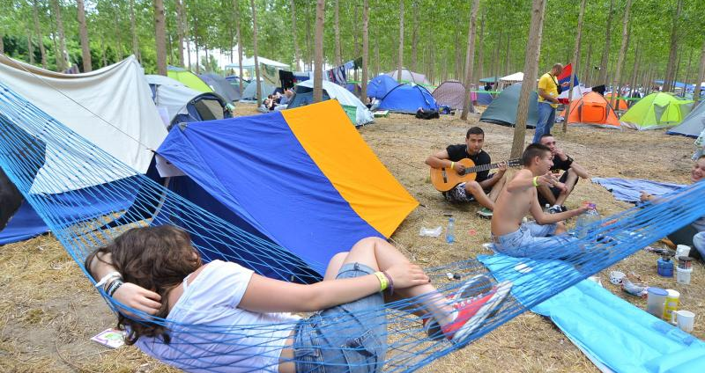
EXIT nowadays
ISCONTOUR 2016

Slide 14
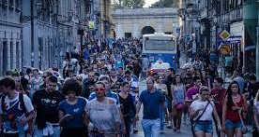
EXIT nowadays
ISCONTOUR 2016

Slide 15
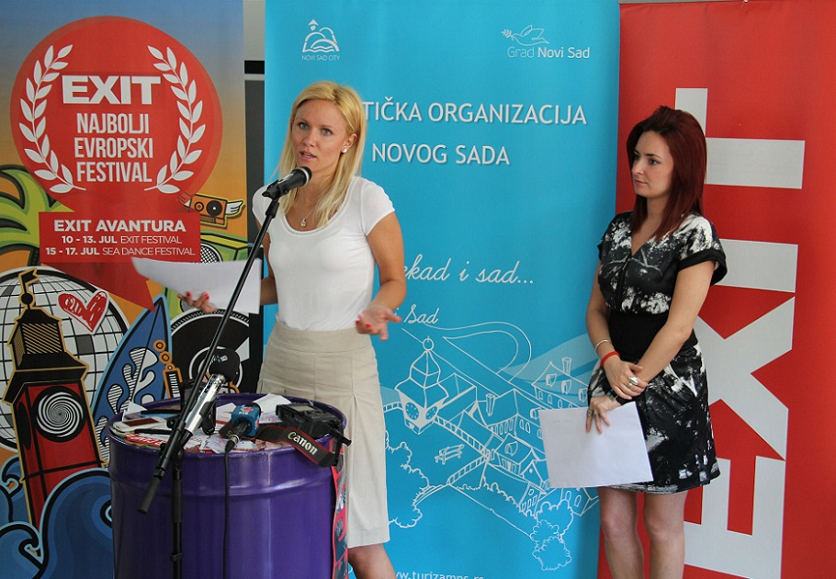
EXIT nowadays
ISCONTOUR 2016

Slide 16
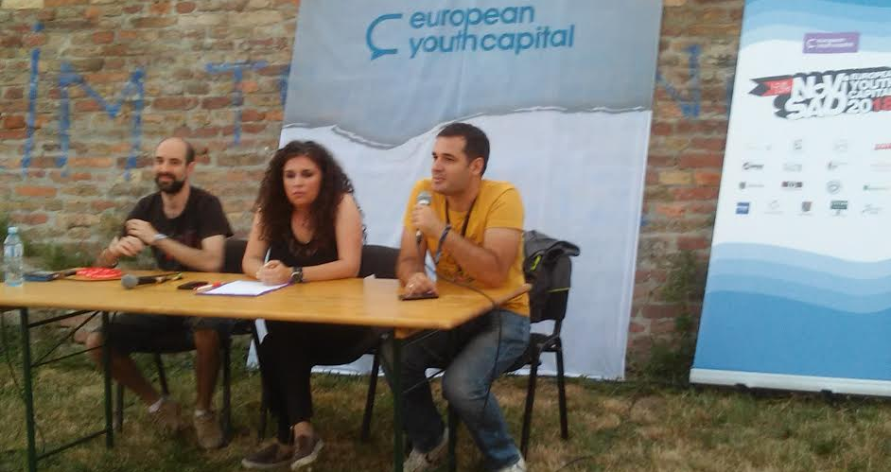
EXIT nowadays
ISCONTOUR 2016

Slide 17
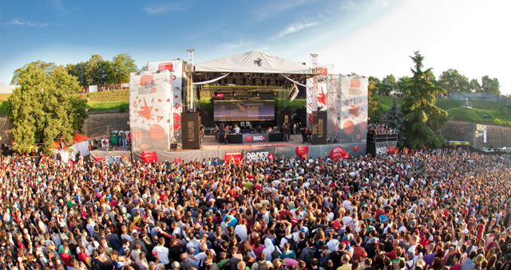
EXIT nowadays
ISCONTOUR 2016

Slide 18
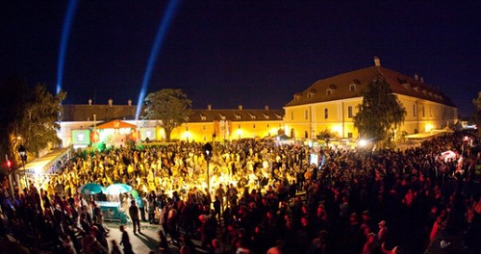
EXIT nowadays
ISCONTOUR 2016

Slide 19
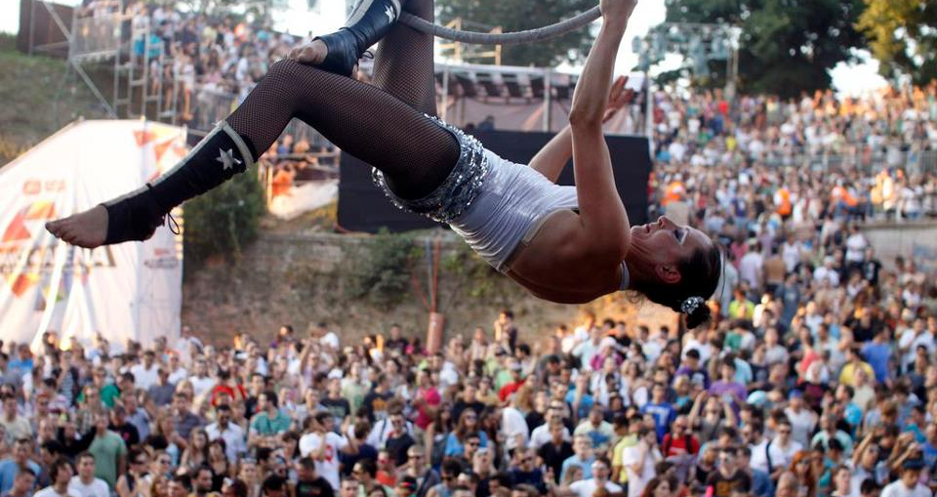
EXIT nowadays
ISCONTOUR 2016

Slide 20
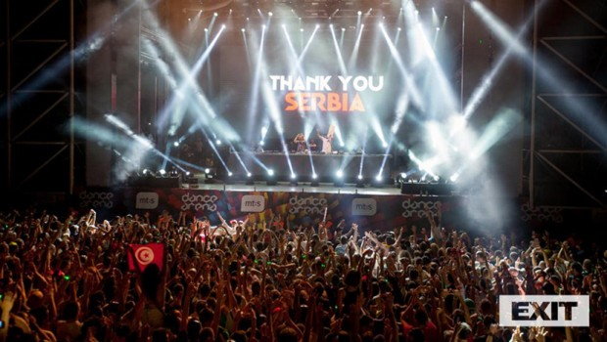
EXIT nowadays
ISCONTOUR 2016

Slide 21
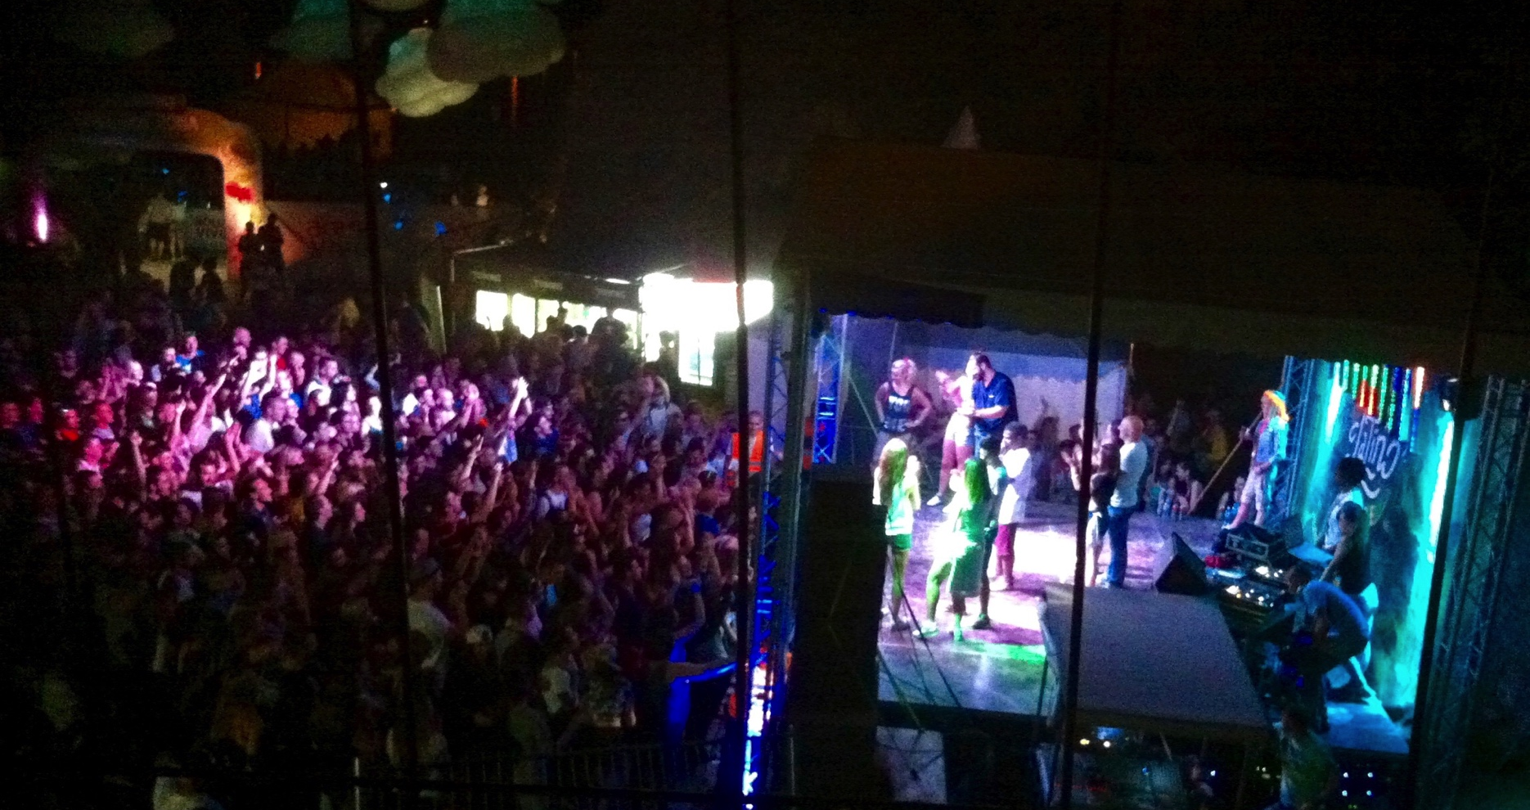
EXIT nowadays
Latin dance competition
ISCONTOUR 2016

Slide 22
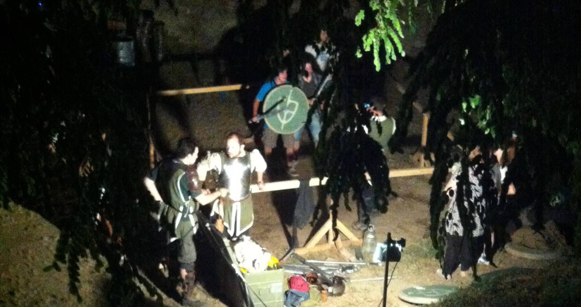
EXIT nowadays
LARP
ISCONTOUR 2016

Slide 23
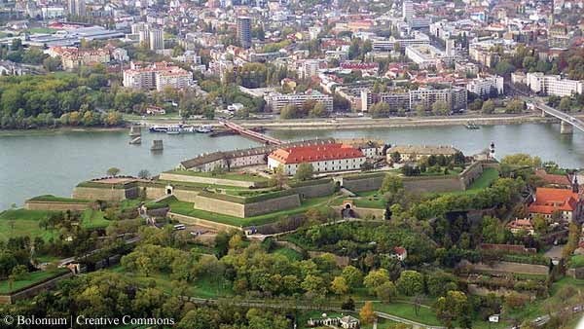
EXIT – Petrovaradin Fortest;
Novi Sad in the background
ISCONTOUR 2016

Slide 24
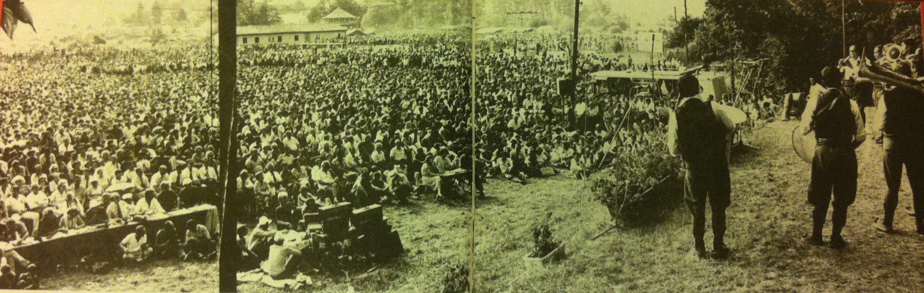
GUČA in the past
ISCONTOUR 2016

Slide 25
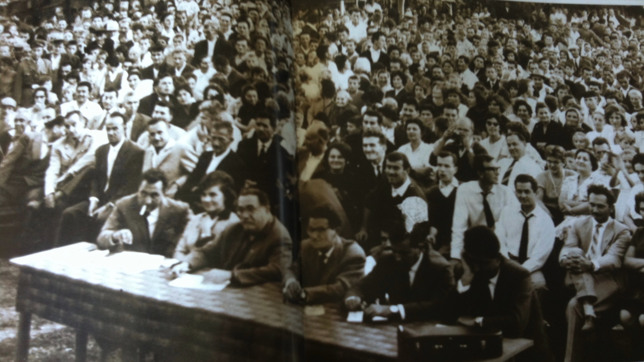
GUČA
ISCONTOUR 2016

Slide 26
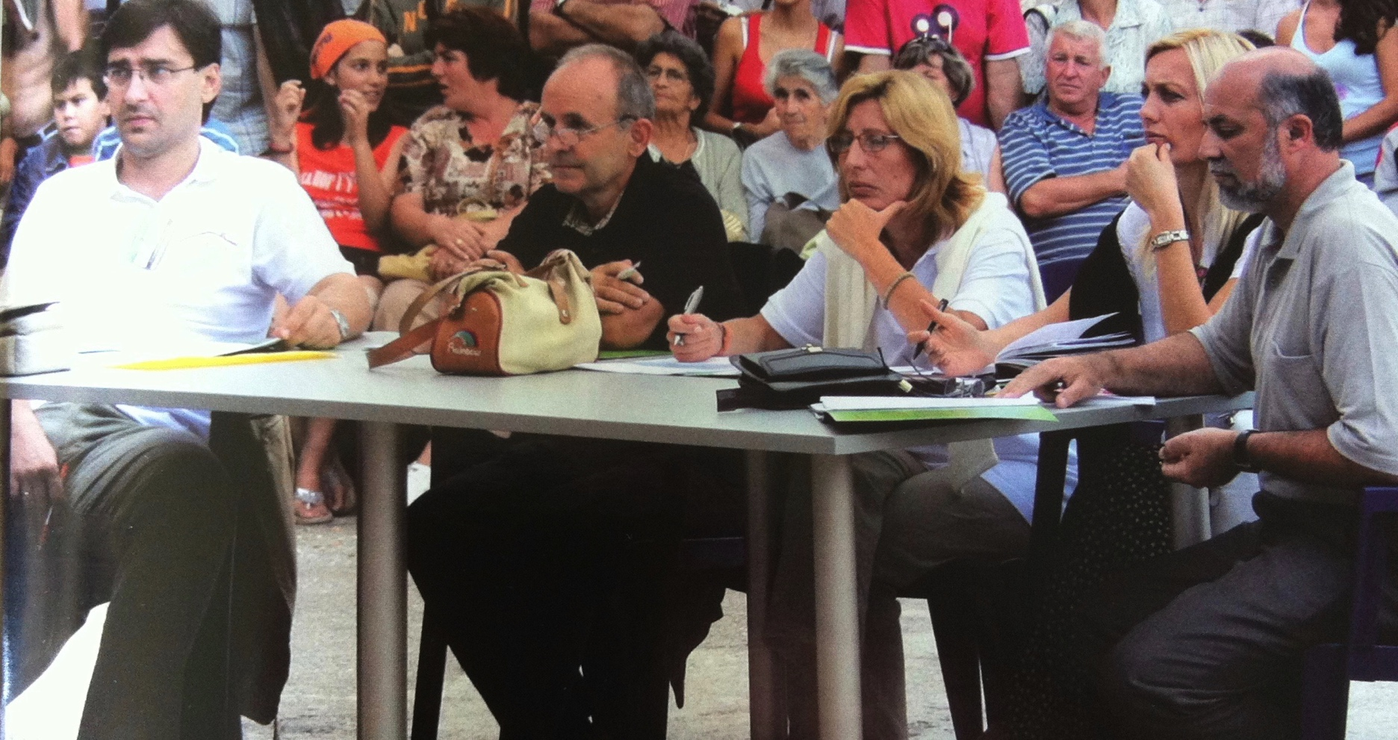
GUČA
ISCONTOUR 2016

Slide 27
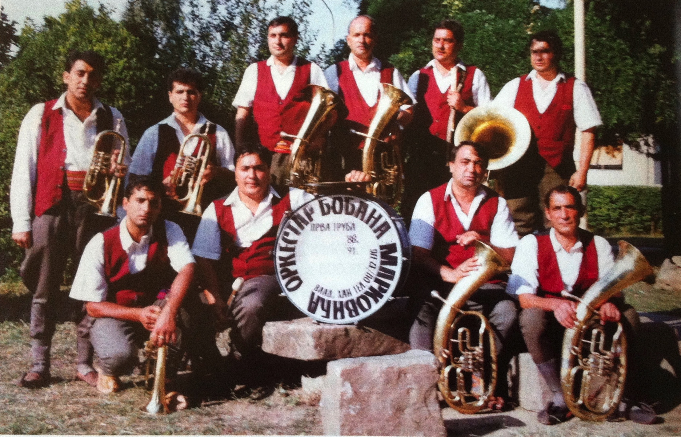
GUČA
ISCONTOUR 2016

Slide 28
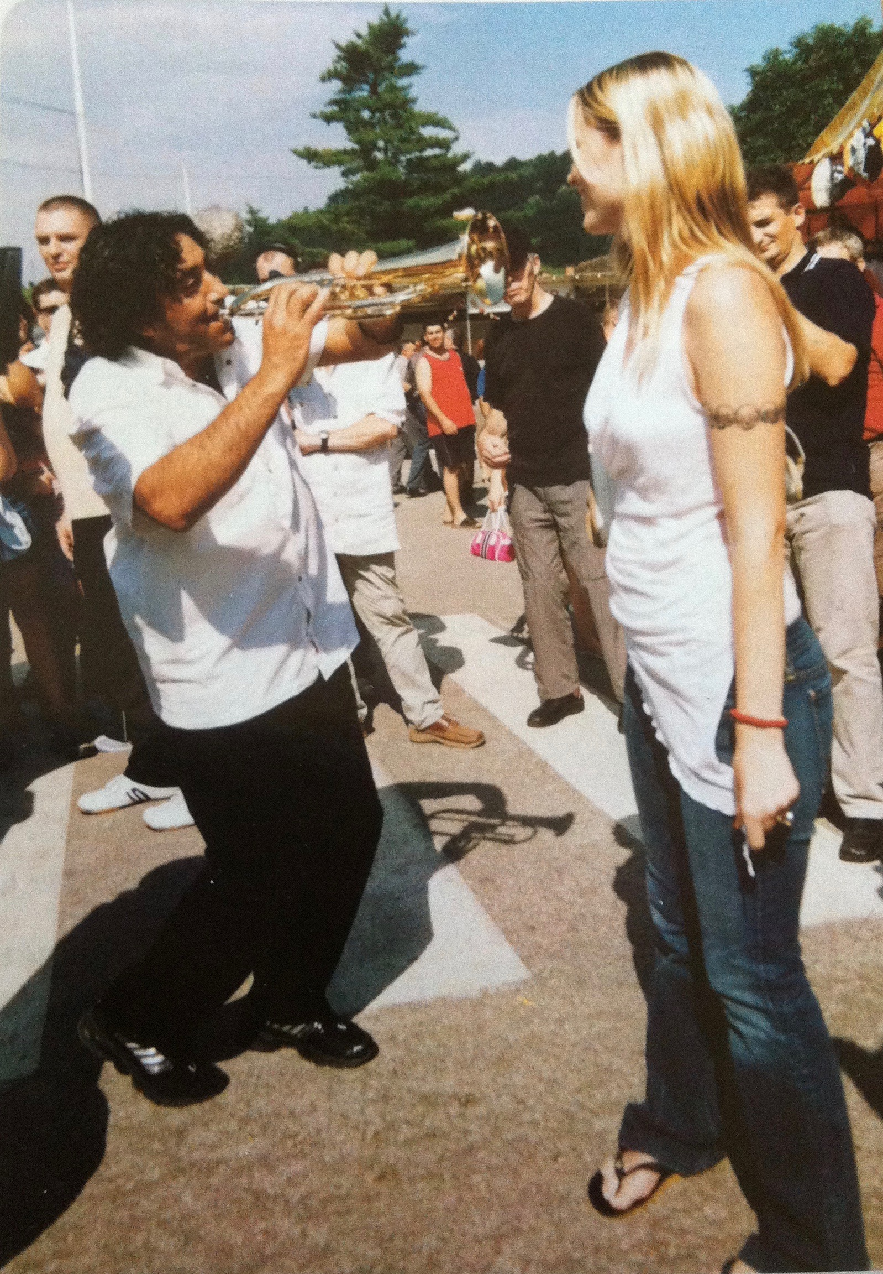
GUČA
Boban Marković
plays for Kiera Chaplin
ISCONTOUR 2016
Notes:
BOBAN Markovic plays trumpet to Ciara Chaplin

Slide 29
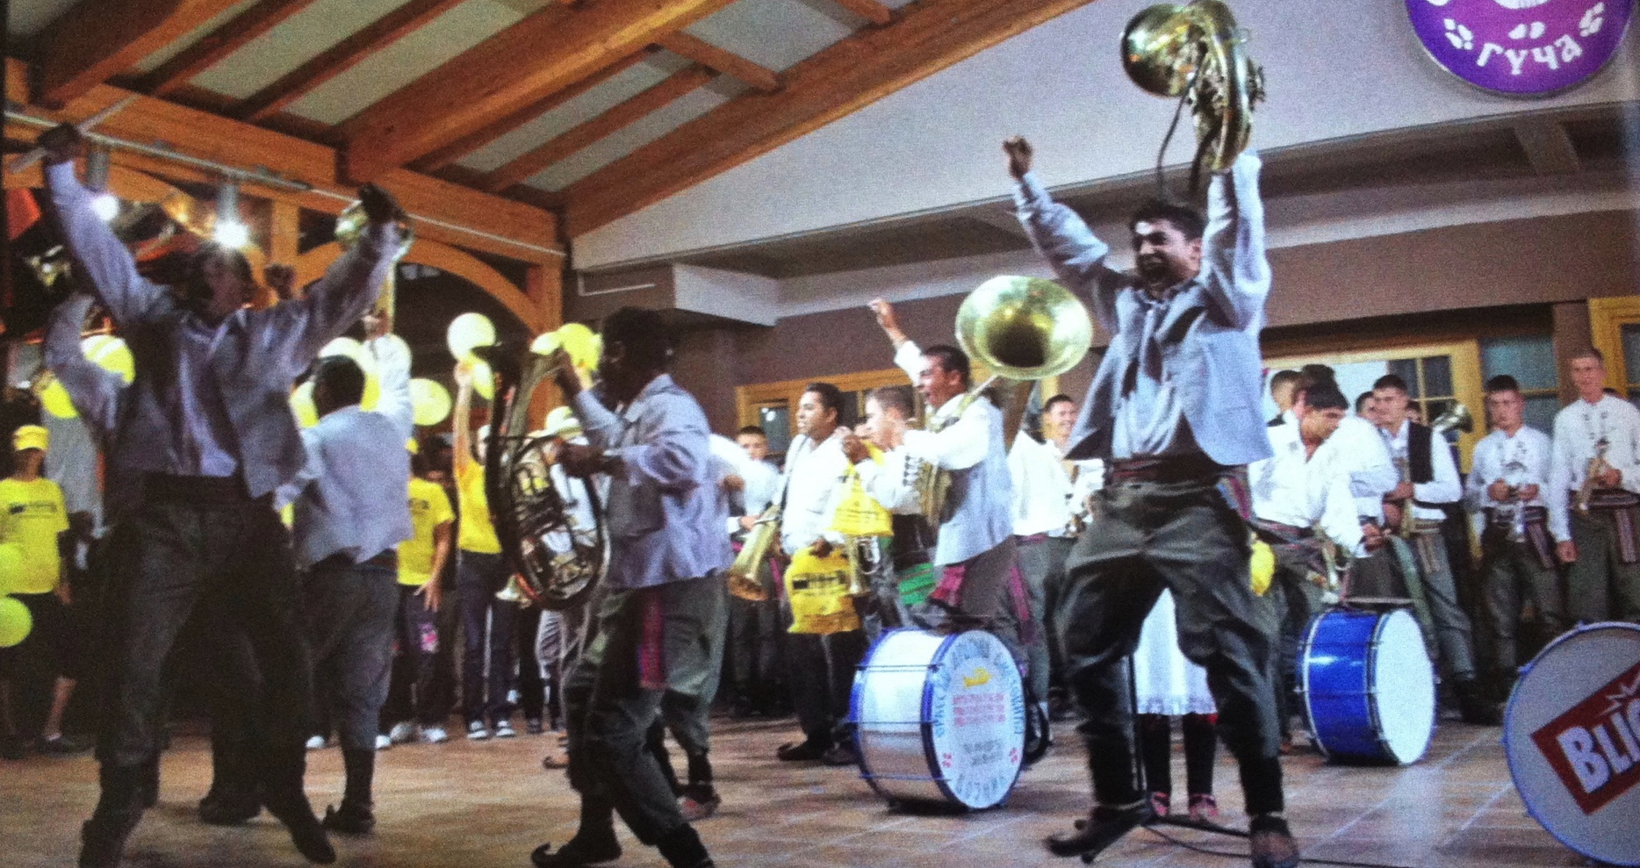
GUČA
Winners…
ISCONTOUR 2016

Slide 30
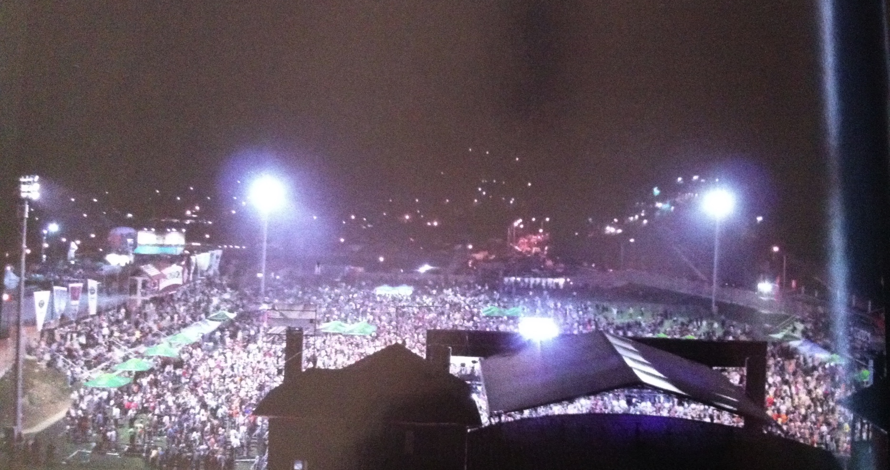
GUČA
ISCONTOUR 2016

Slide 31
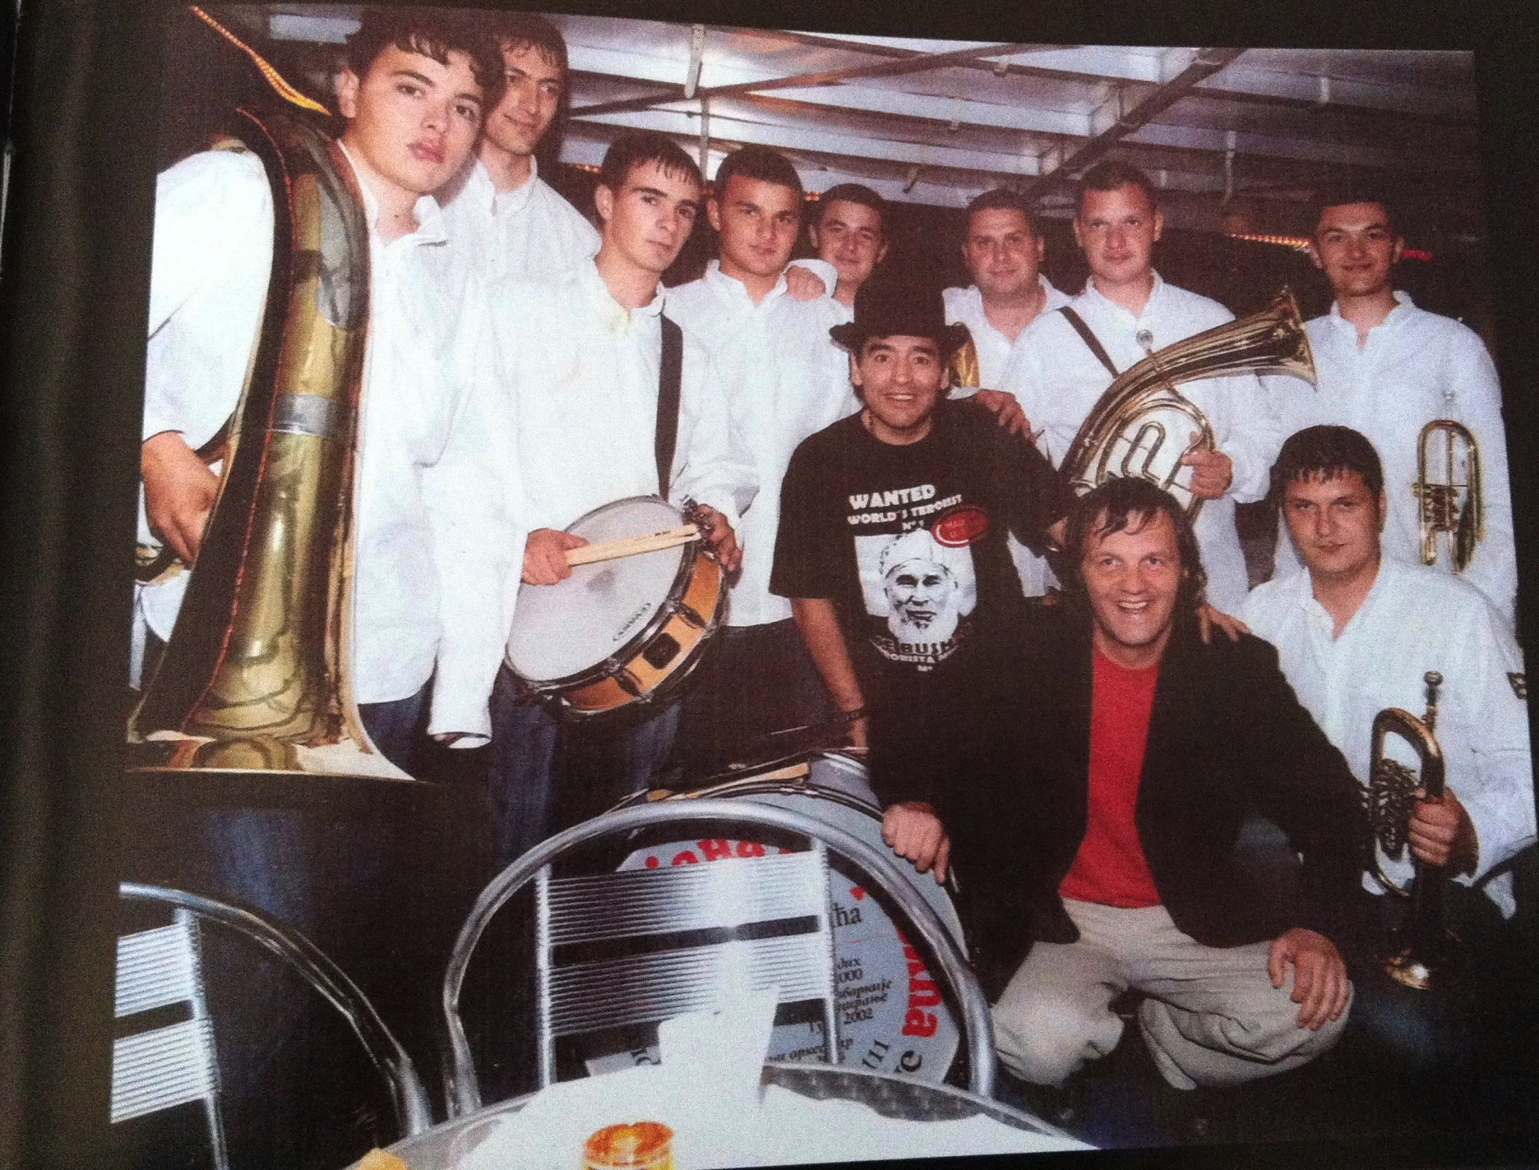
GUČA
Emir Kusturica
with
trumpet band
ISCONTOUR 2016

Slide 32
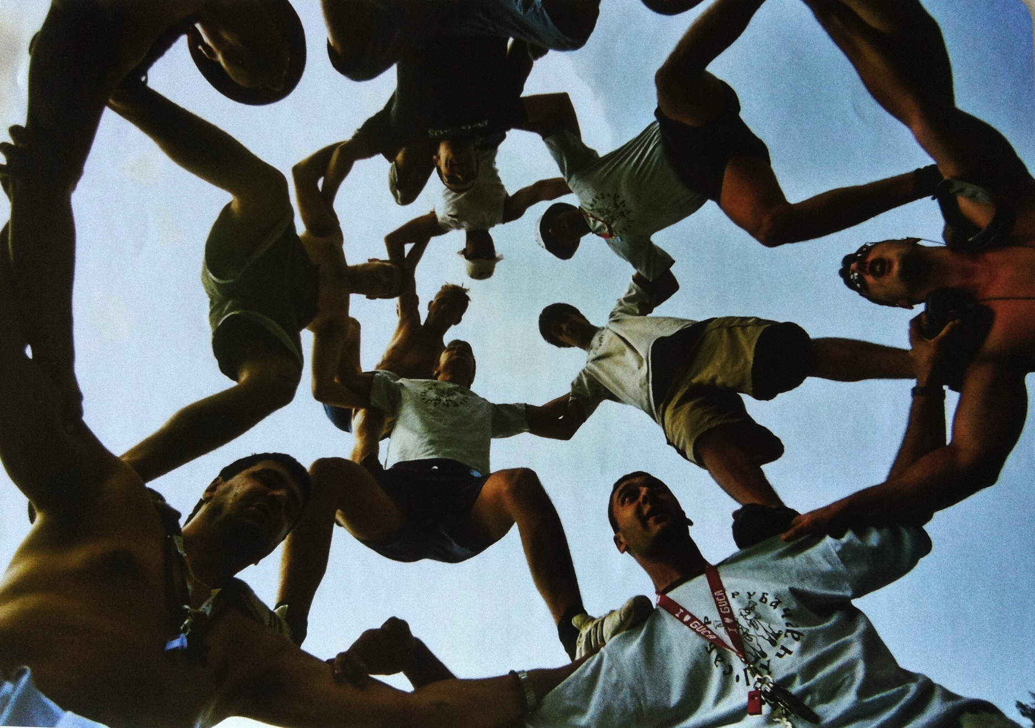
GUČA
ISCONTOUR 2016

Slide 33
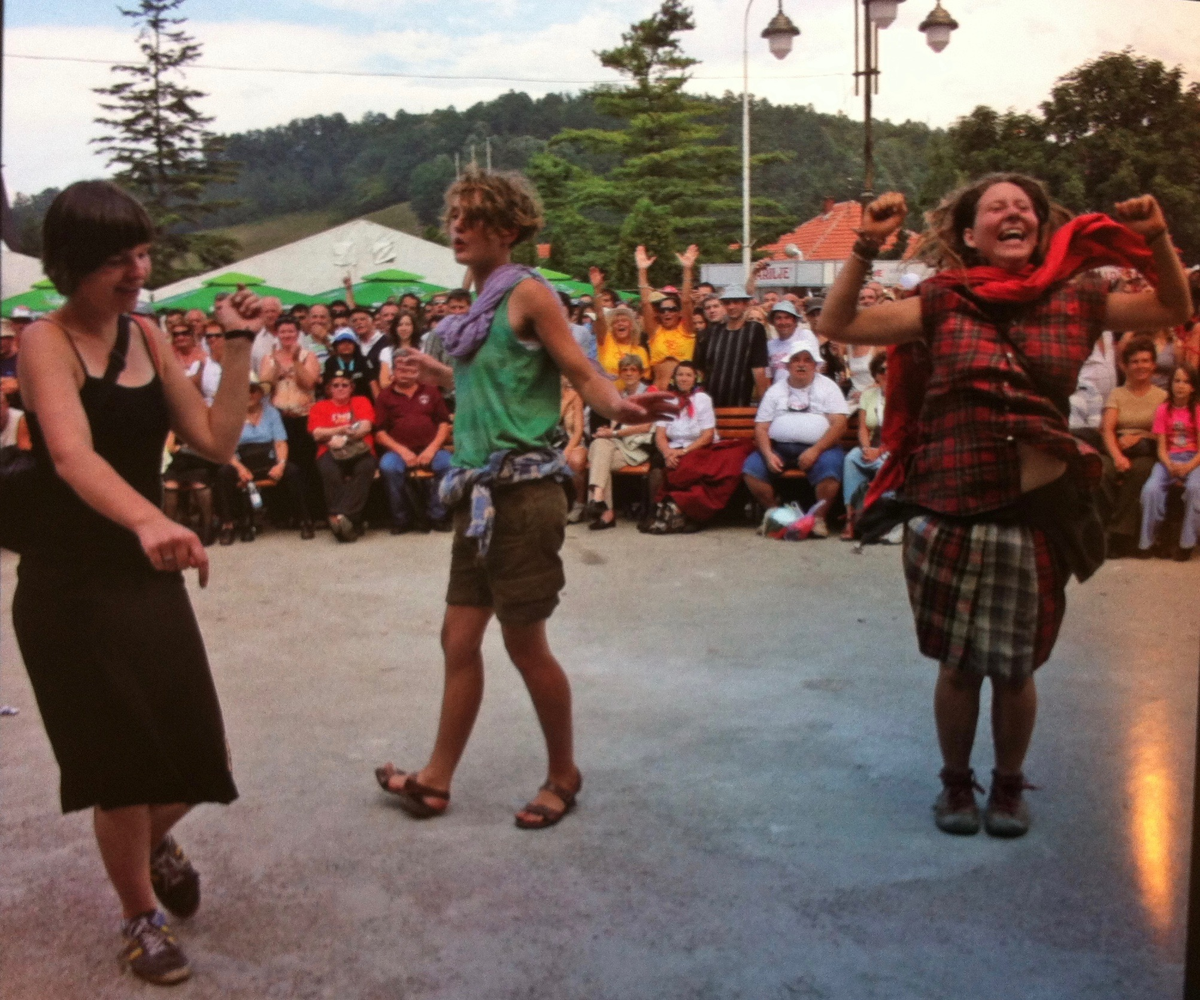
GUČA
ISCONTOUR 2016

Slide 34
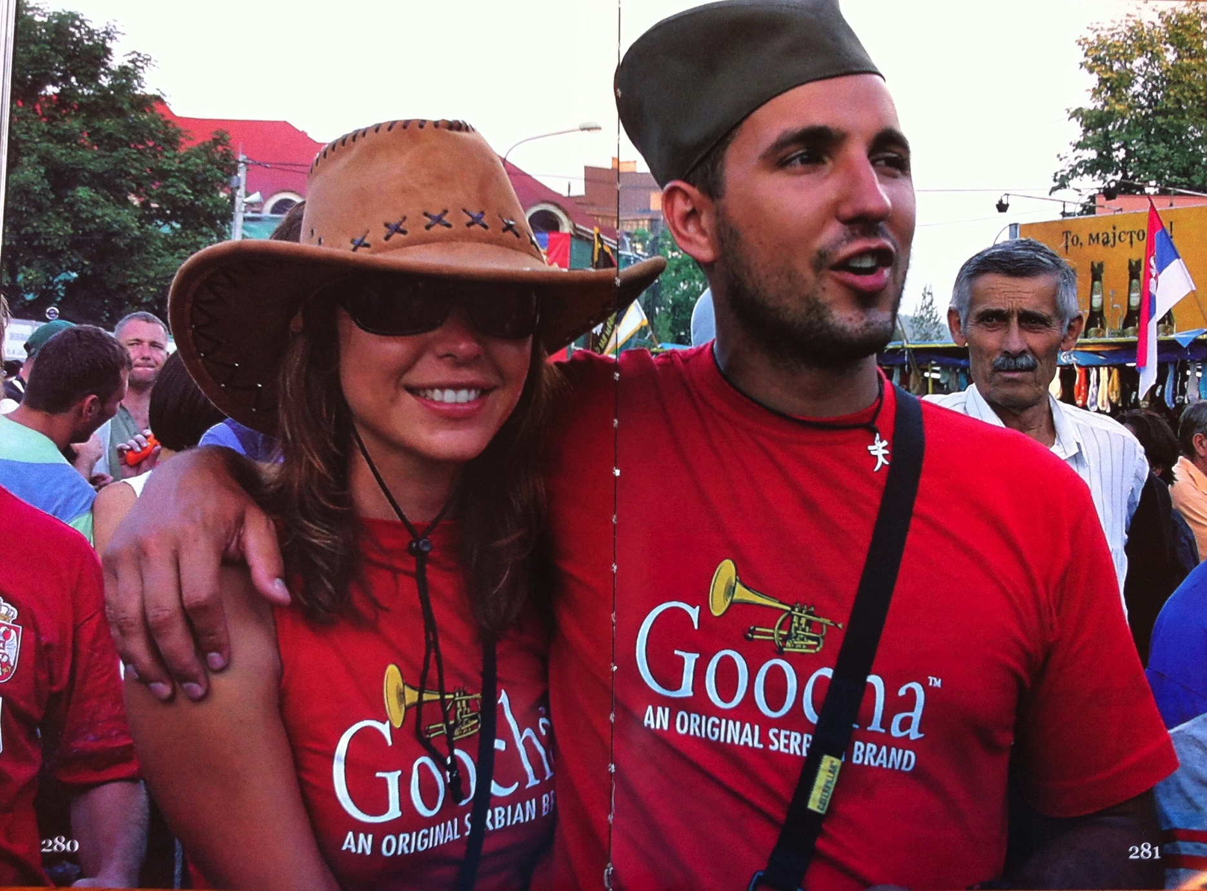
Goocha
ISCONTOUR 2016

Slide 35
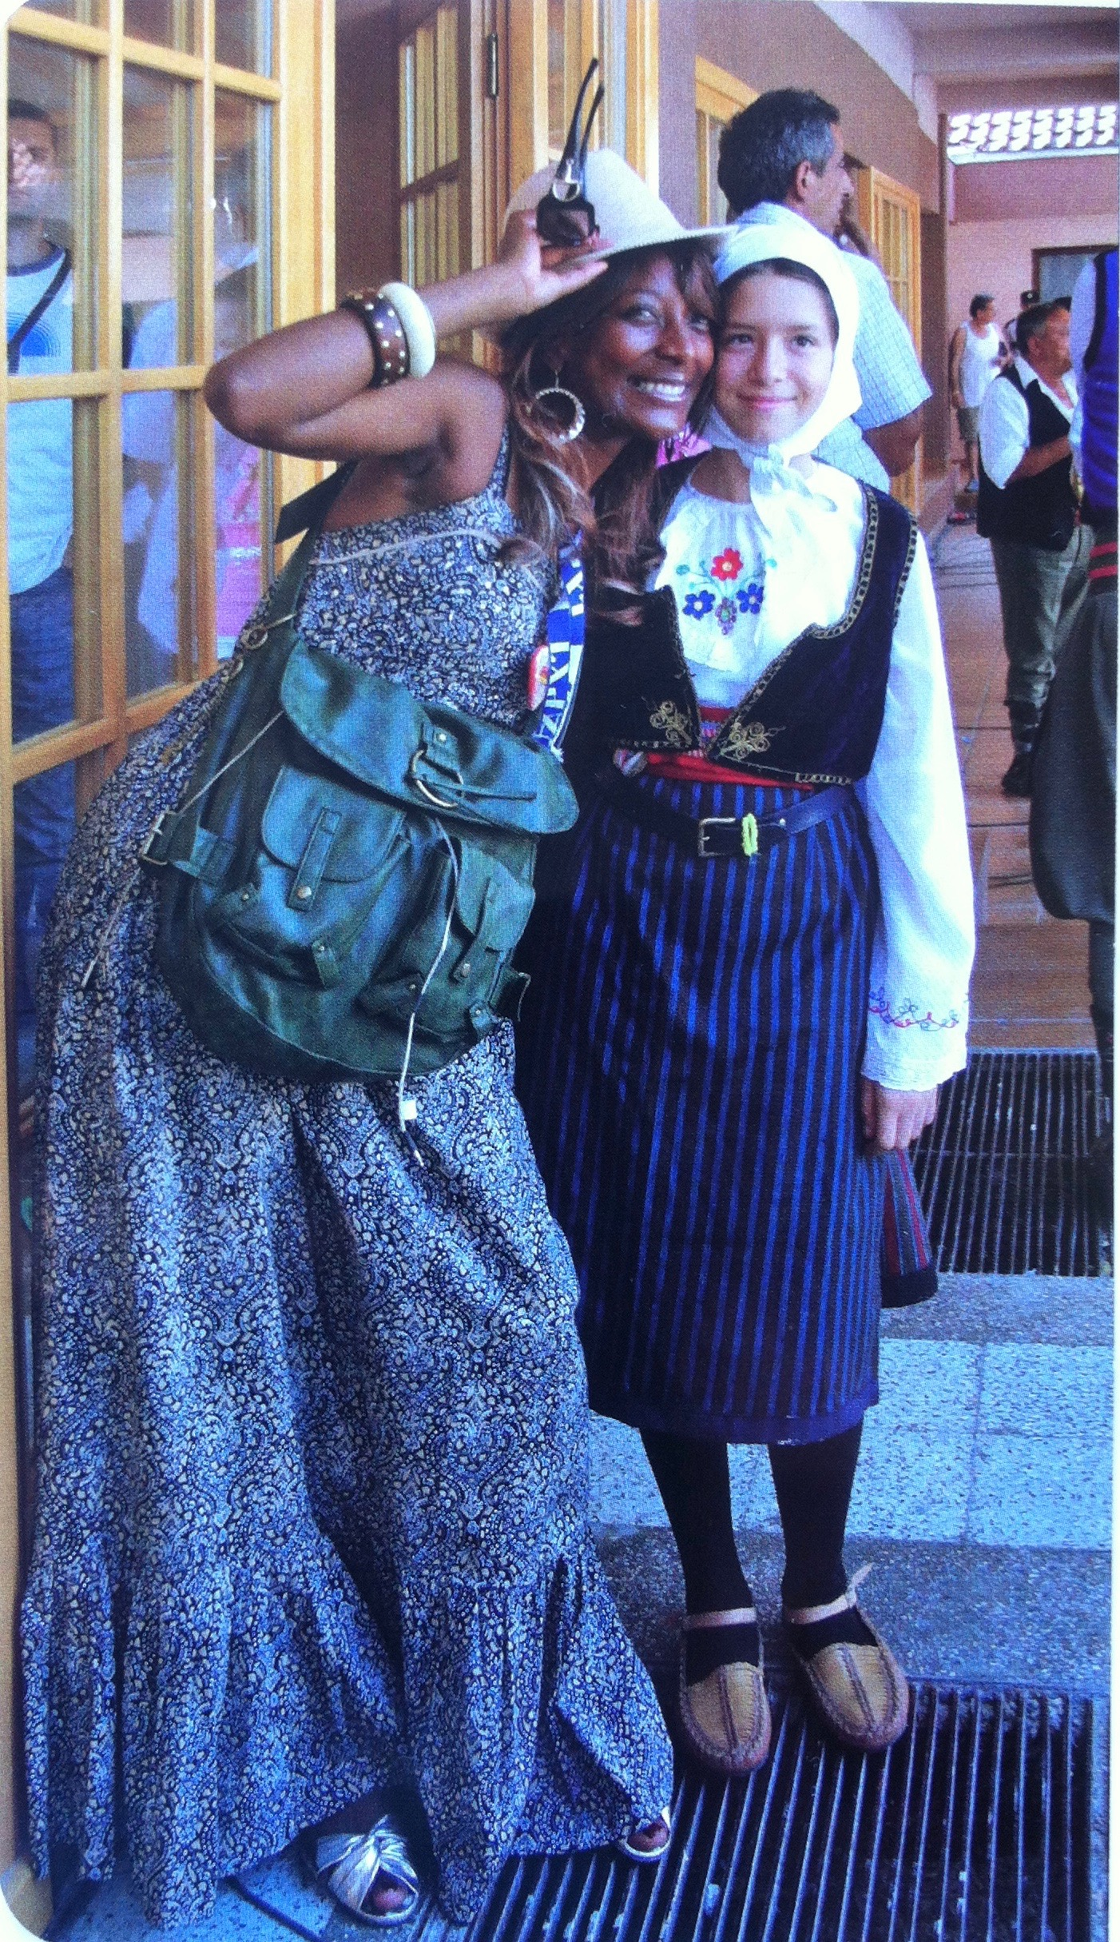
GUČA
ISCONTOUR 2016

Slide 36
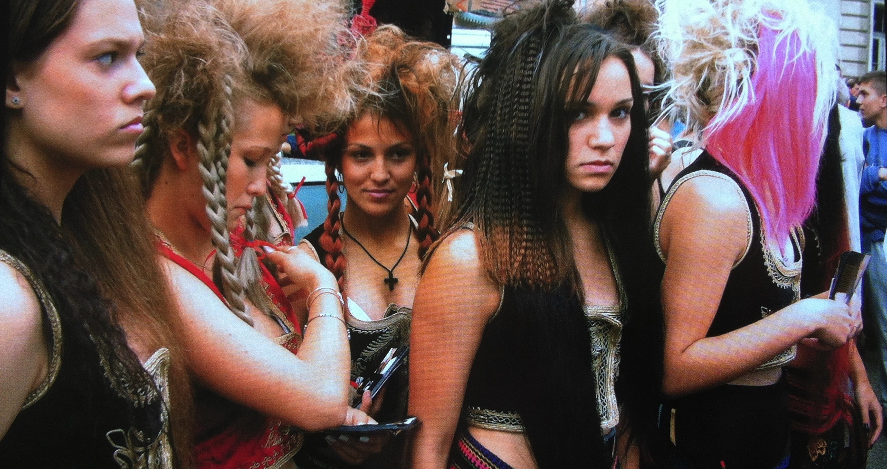
GUČA
ISCONTOUR 2016

Slide 37
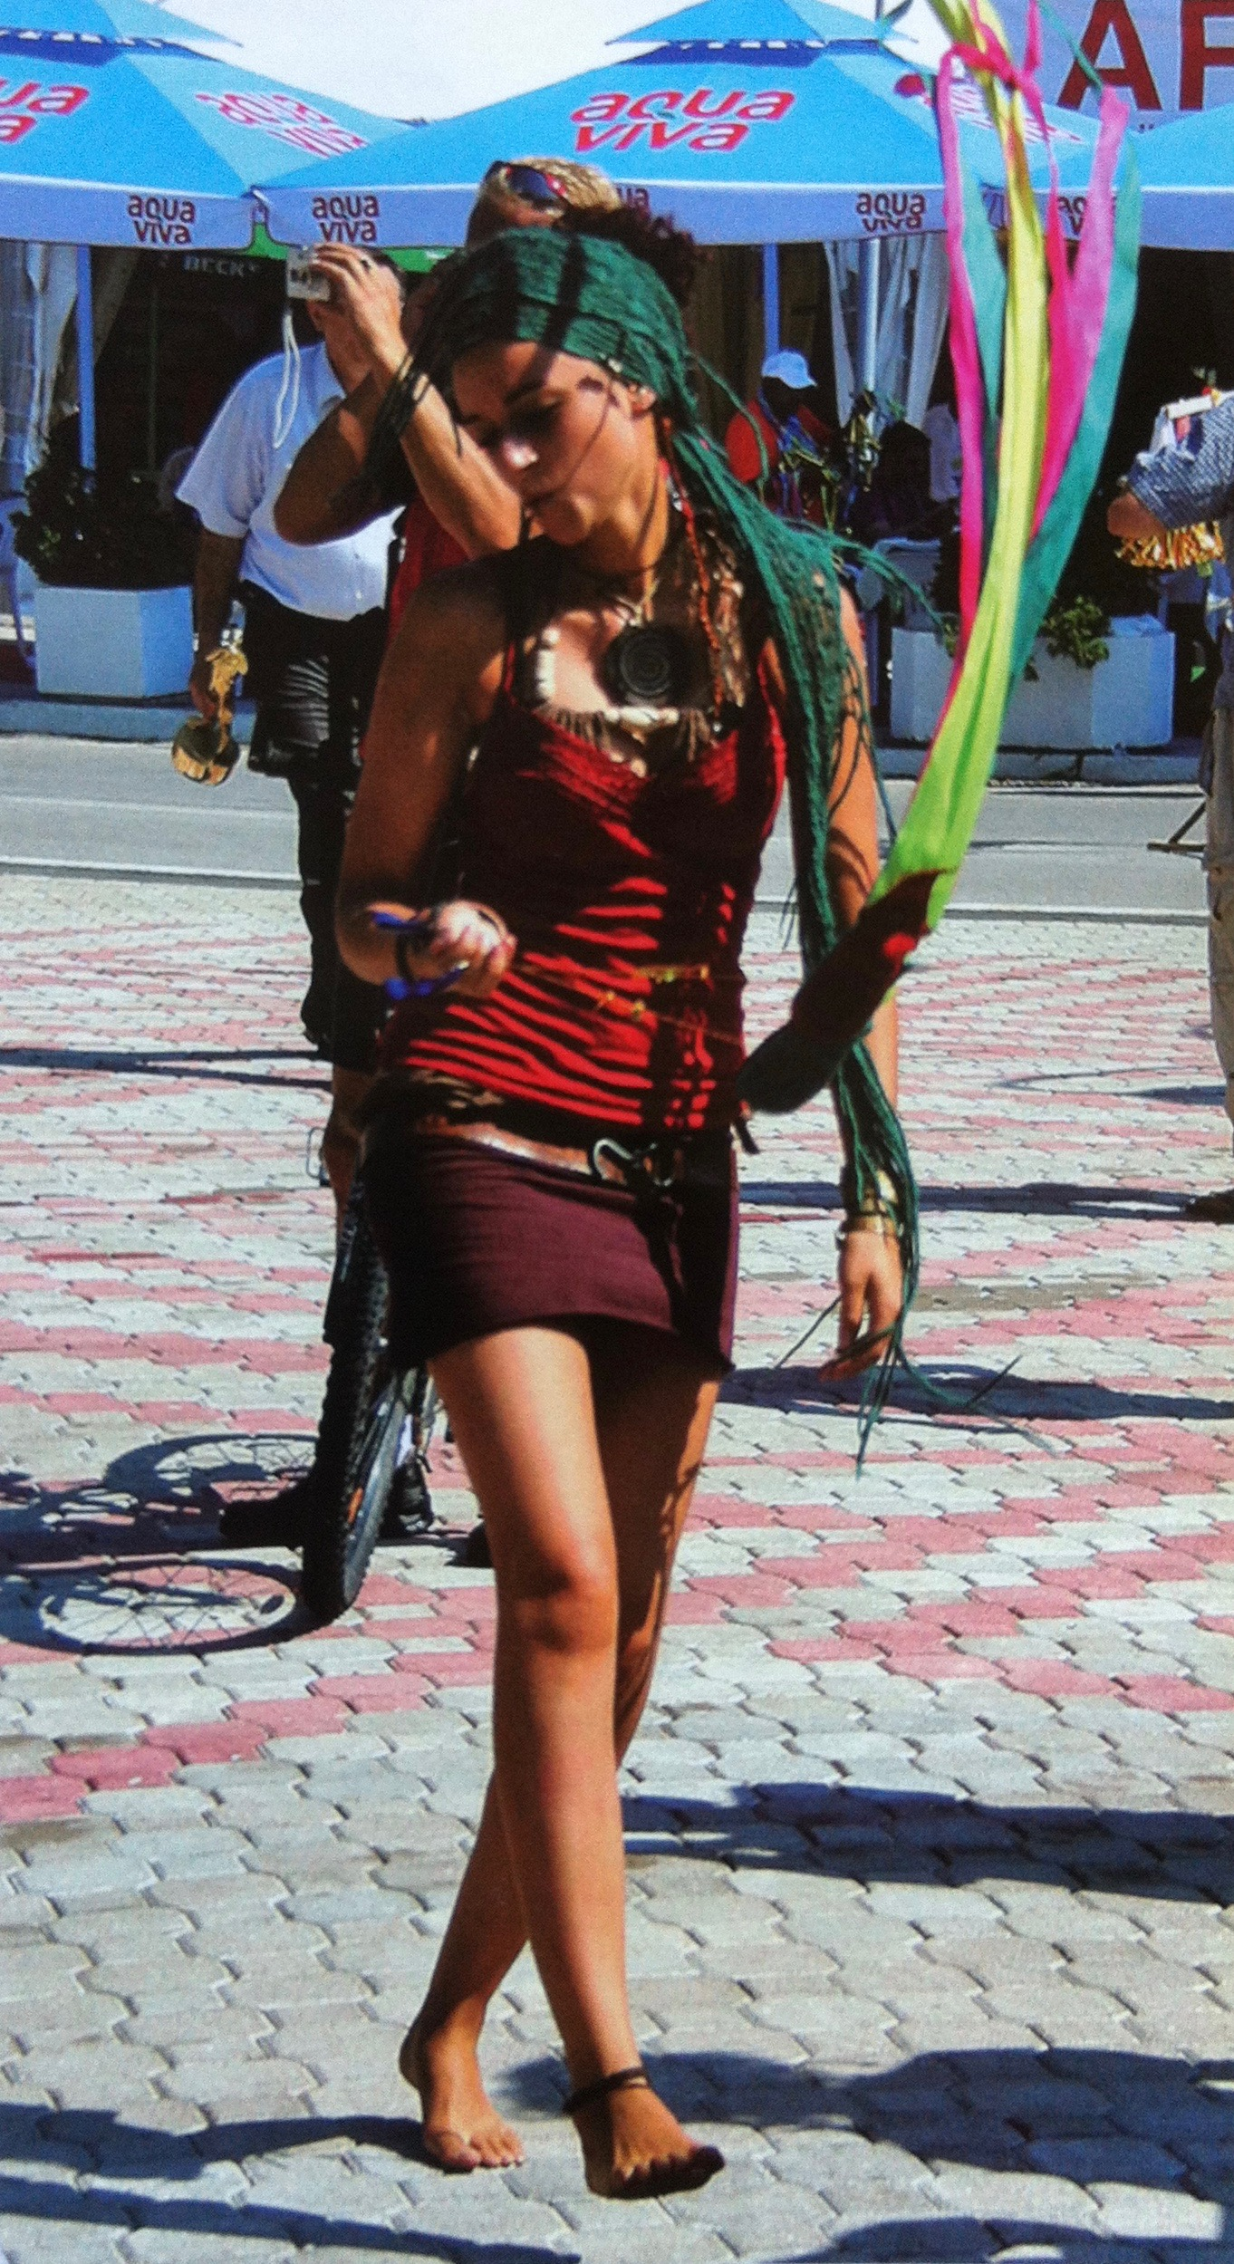
GUČA
ISCONTOUR 2016

Slide 38
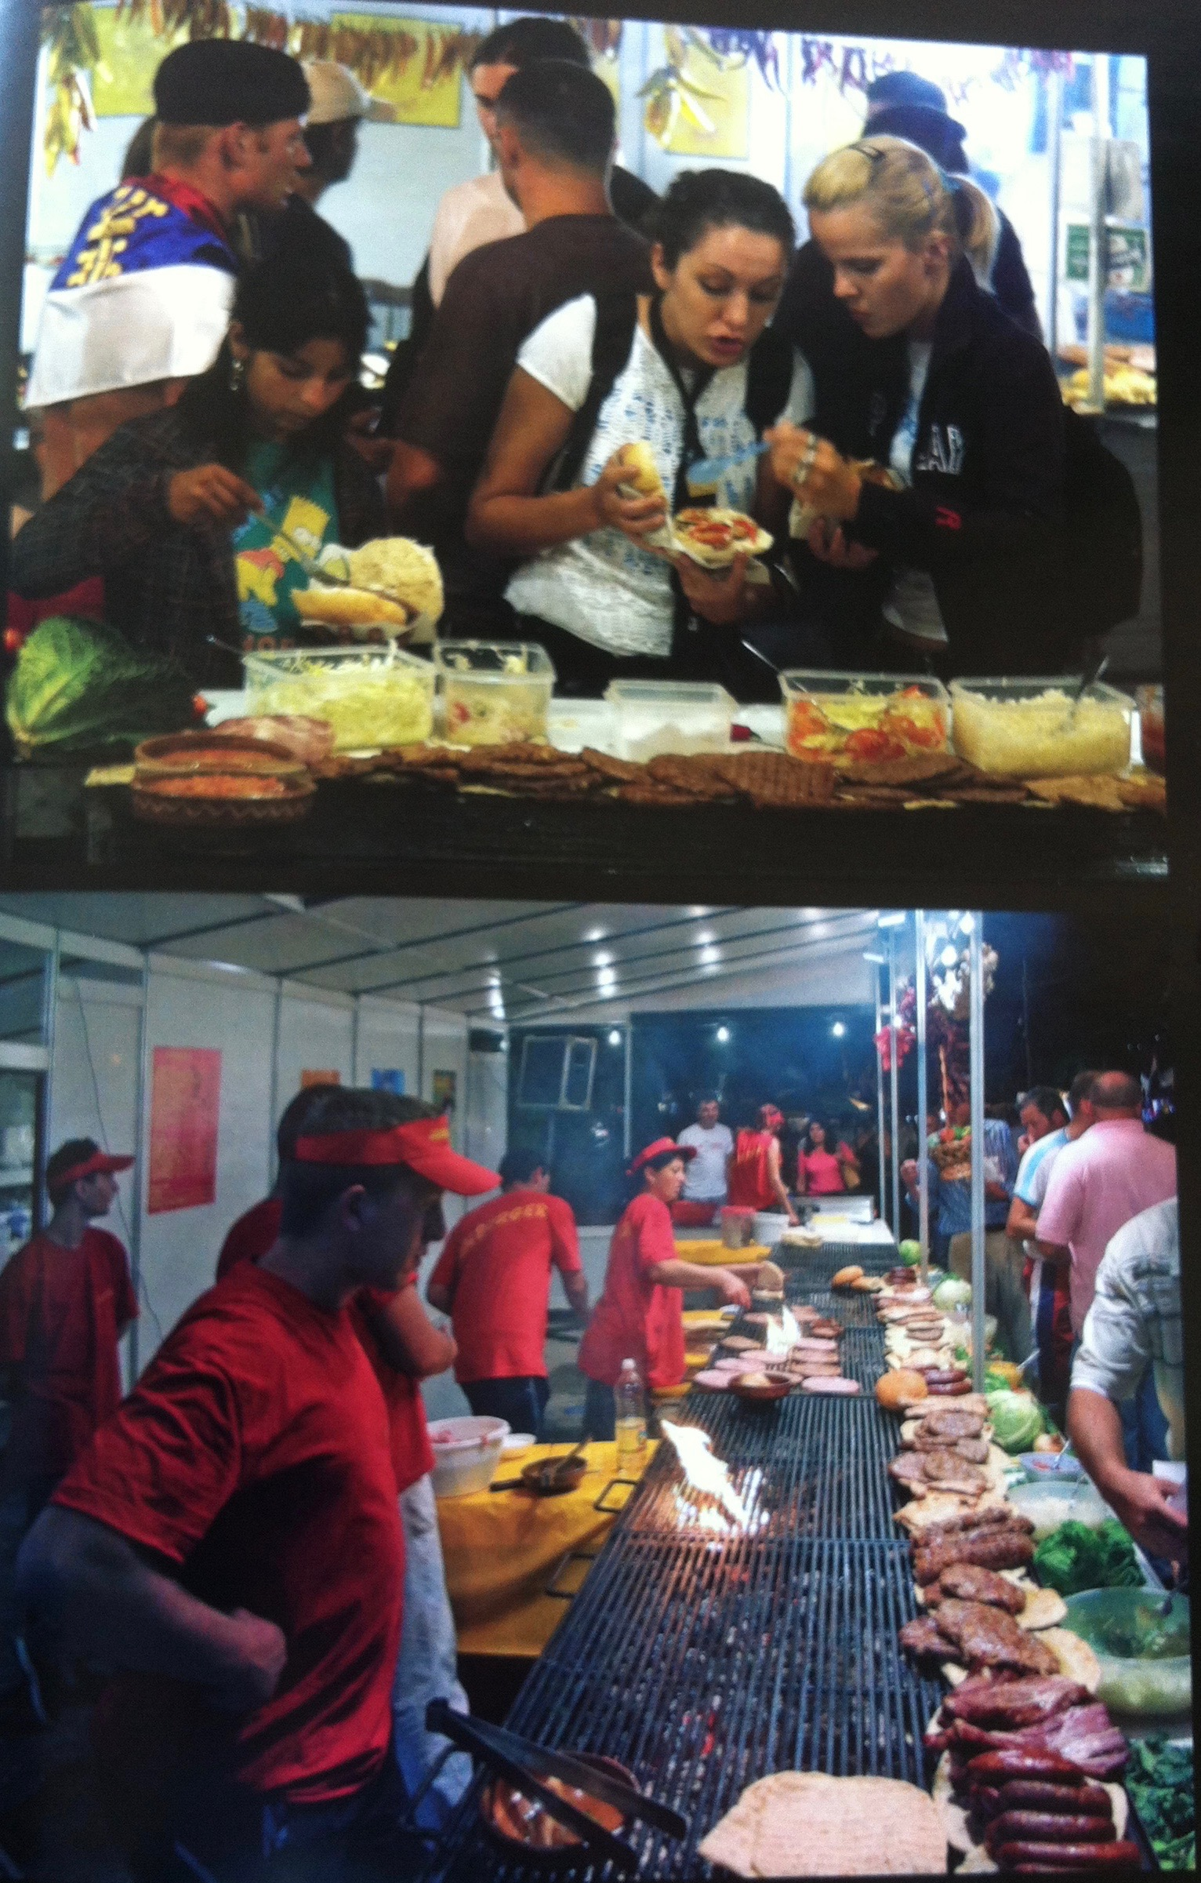
GUČA
ISCONTOUR 2016

Slide 39
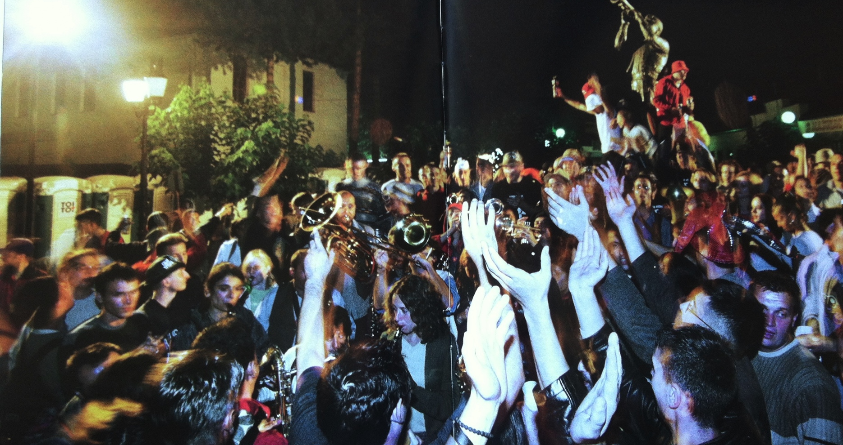
GUČA
ISCONTOUR 2016

Slide 40
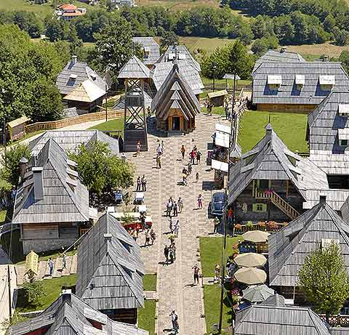
KÜSTENDORF
ISCONTOUR 2016

Slide 41
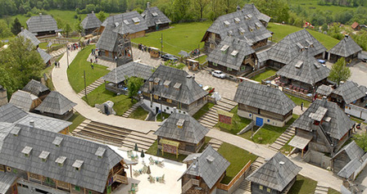
KÜSTENDORF
ISCONTOUR 2016

Slide 42
KÜSTENDORF
“I lost my city [Sarajevo] during the war. That is why I wished to build my own village. It bears a German name: Küstendorf. I will organize seminars there, for people who want to learn how to make cinema, concerts, ceramics, painting. It is the place where I will live and where some people will be able to come from time to time. There will be of course some other inhabitants who will work. I dream of an open place with cultural diversity which sets up against globalization.“ Emir Kusturica
(http://kustu.com)
ISCONTOUR 2016

Slide 43
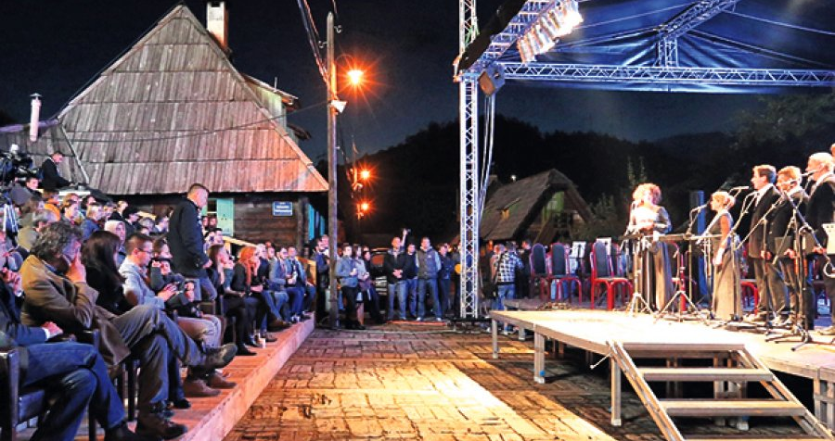
KÜSTENDORF
ISCONTOUR 2016

Slide 44
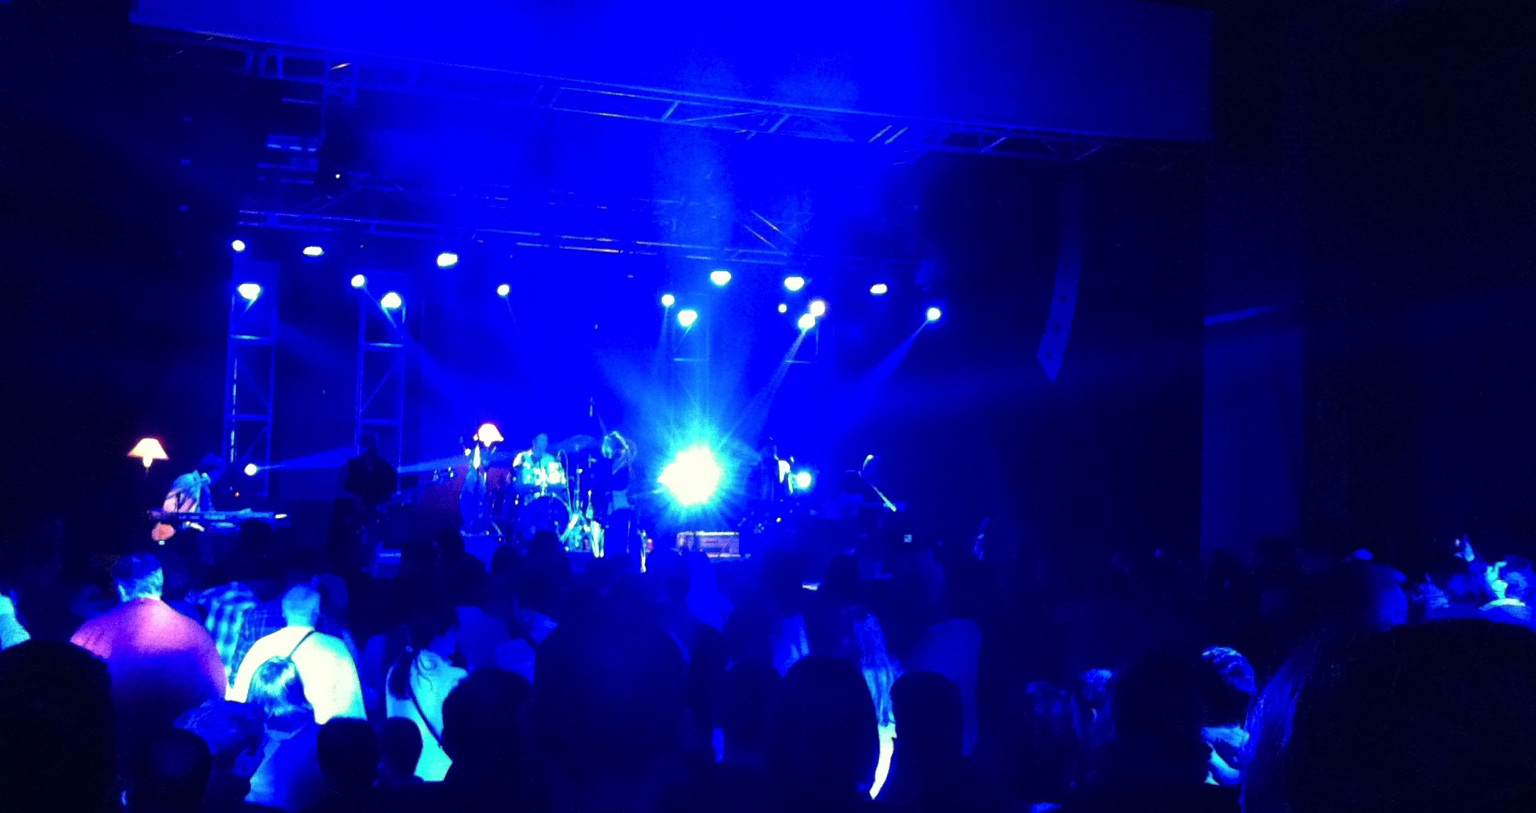
KÜSTENDORF
ISCONTOUR 2016

Slide 45
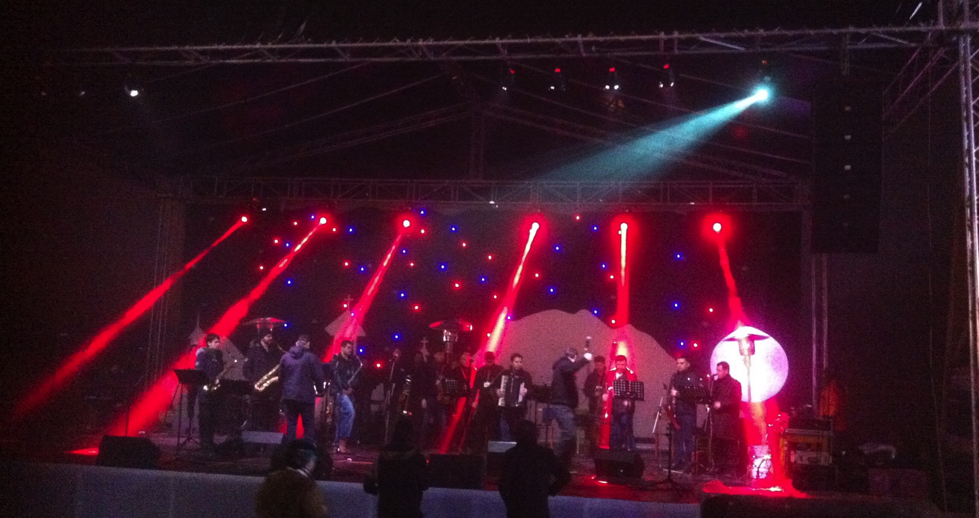
KÜSTENDORF
ISCONTOUR 2016

Slide 46
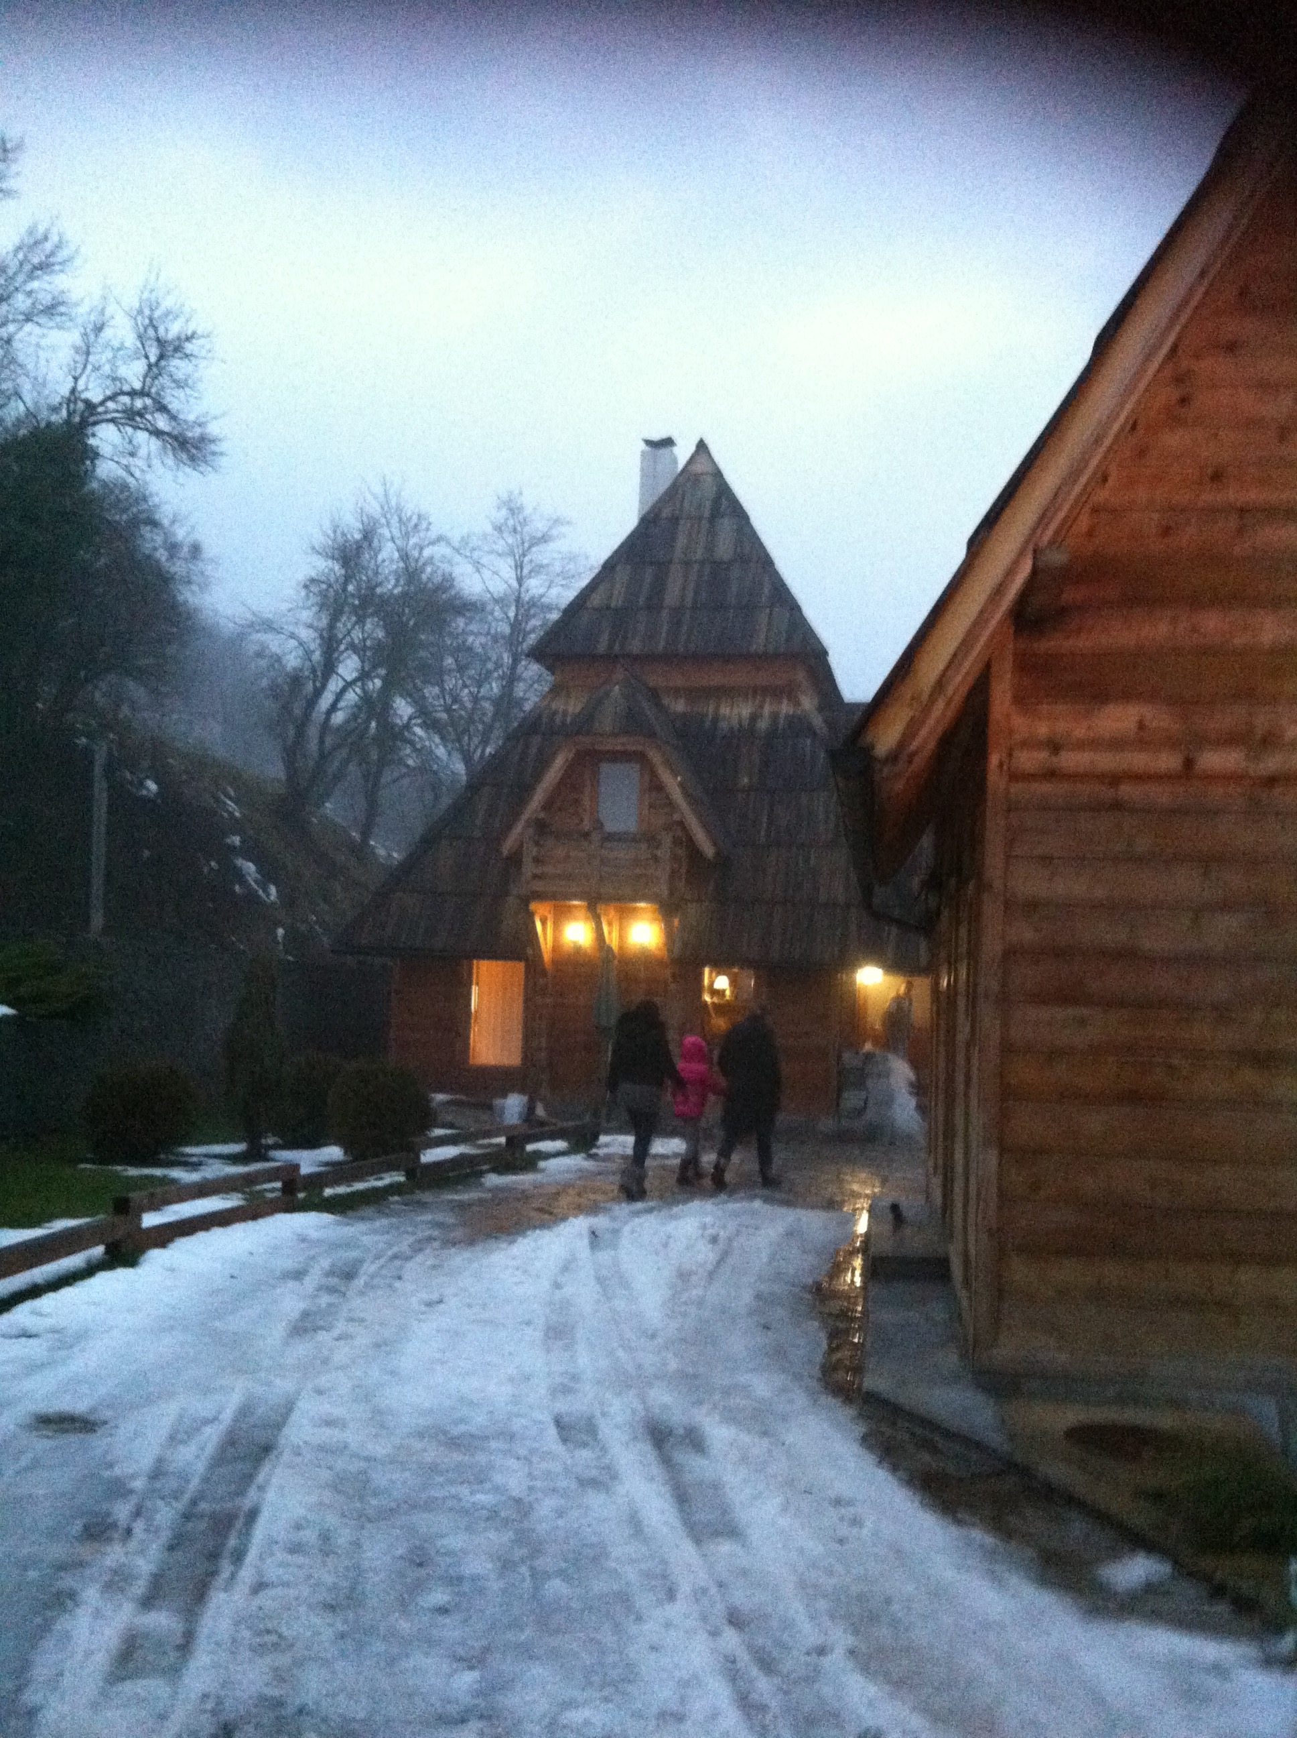
KÜSTENDORF
ISCONTOUR 2016

Slide 47
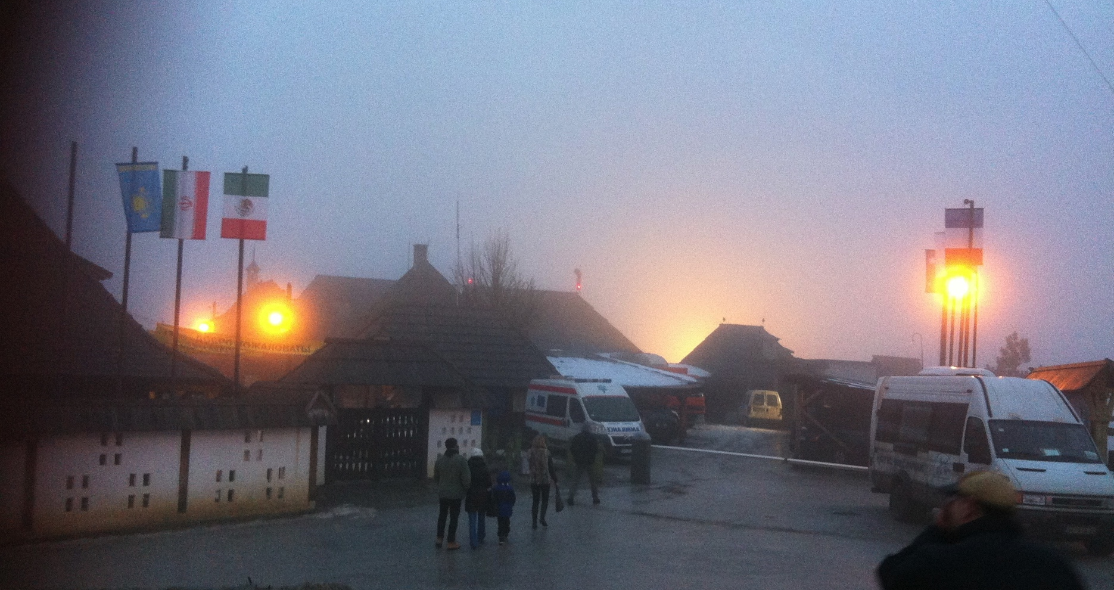
KÜSTENDORF
ISCONTOUR 2016

Slide 48
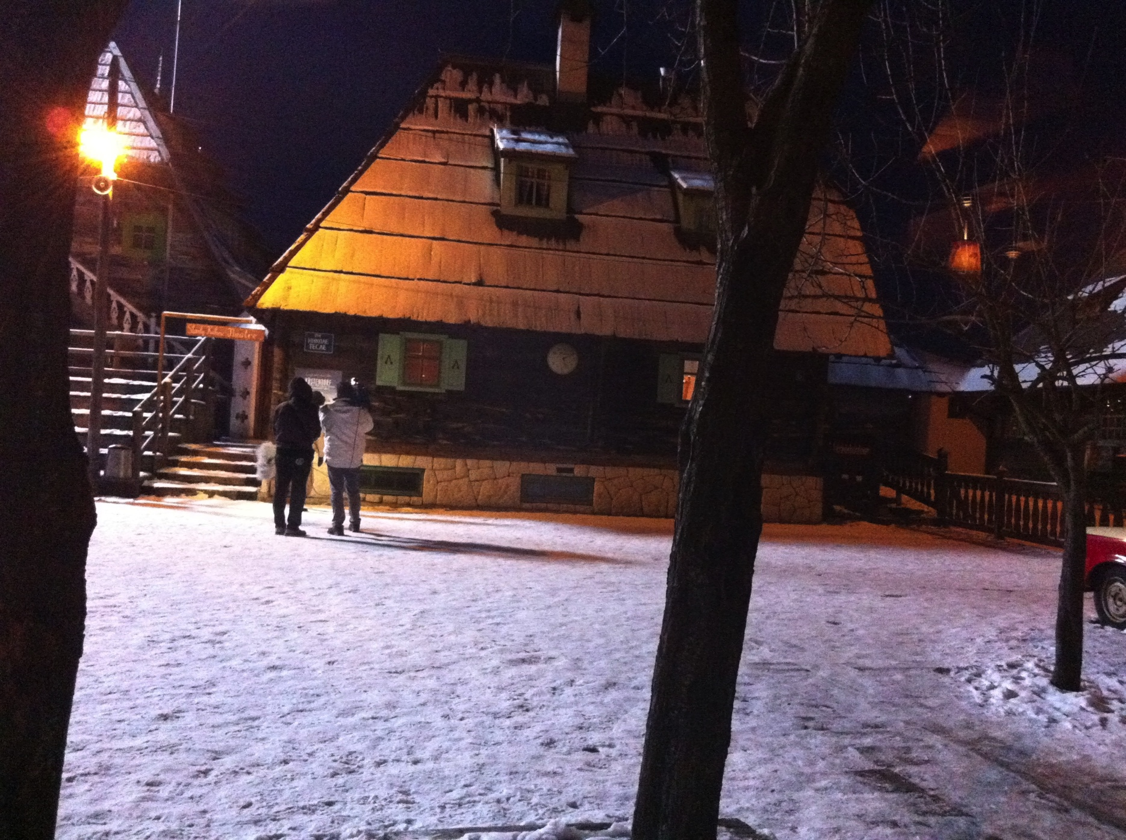
KÜSTENDORF
ISCONTOUR 2016

Slide 49
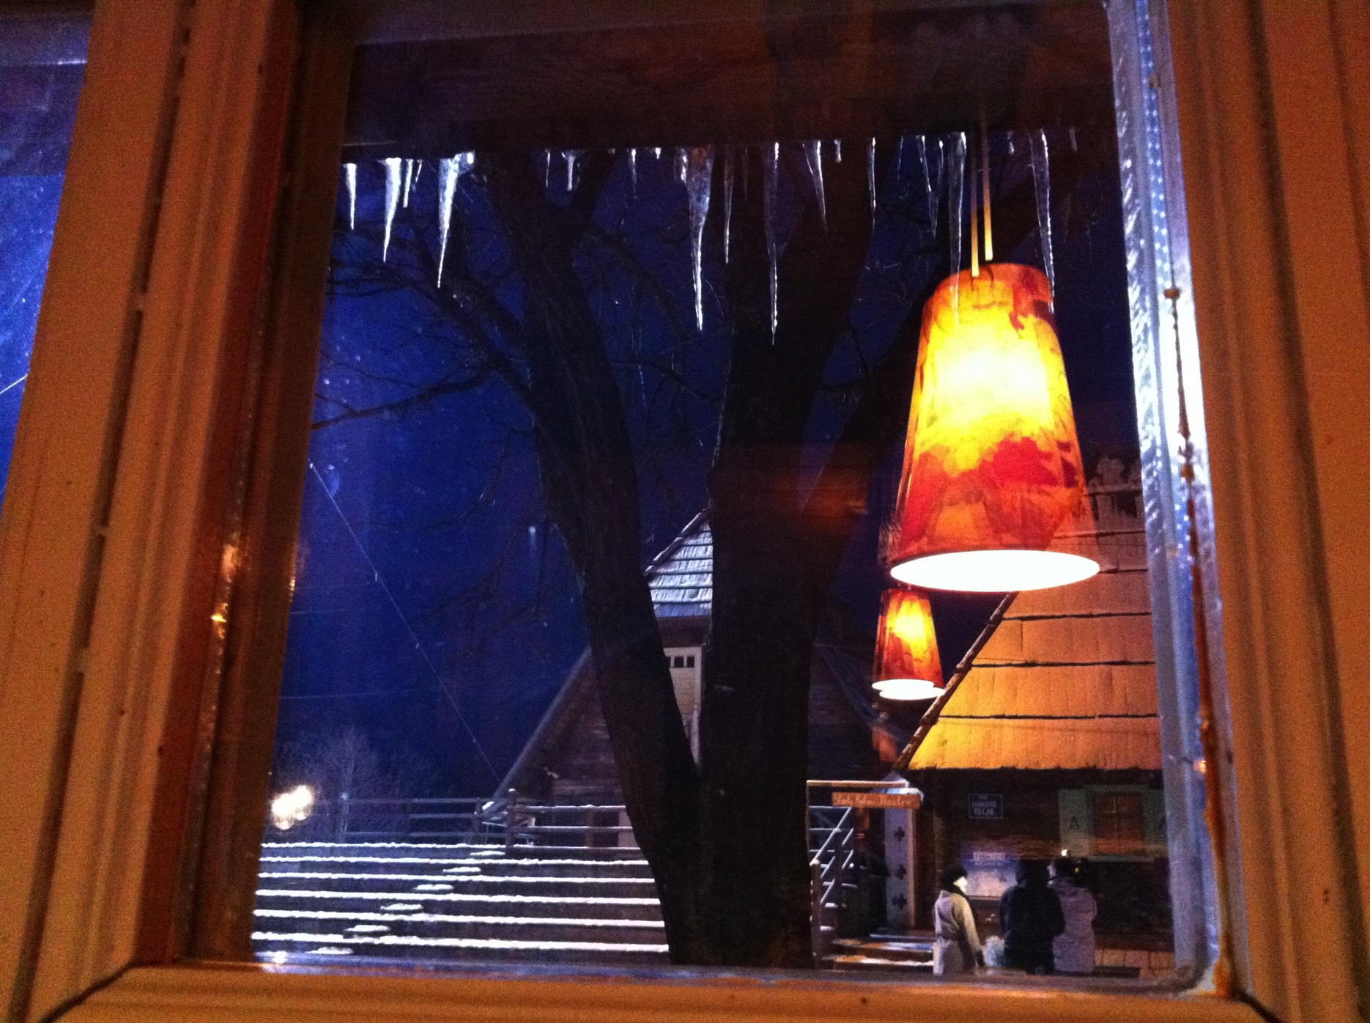
KÜSTENDORF
ISCONTOUR 2016

Slide 50
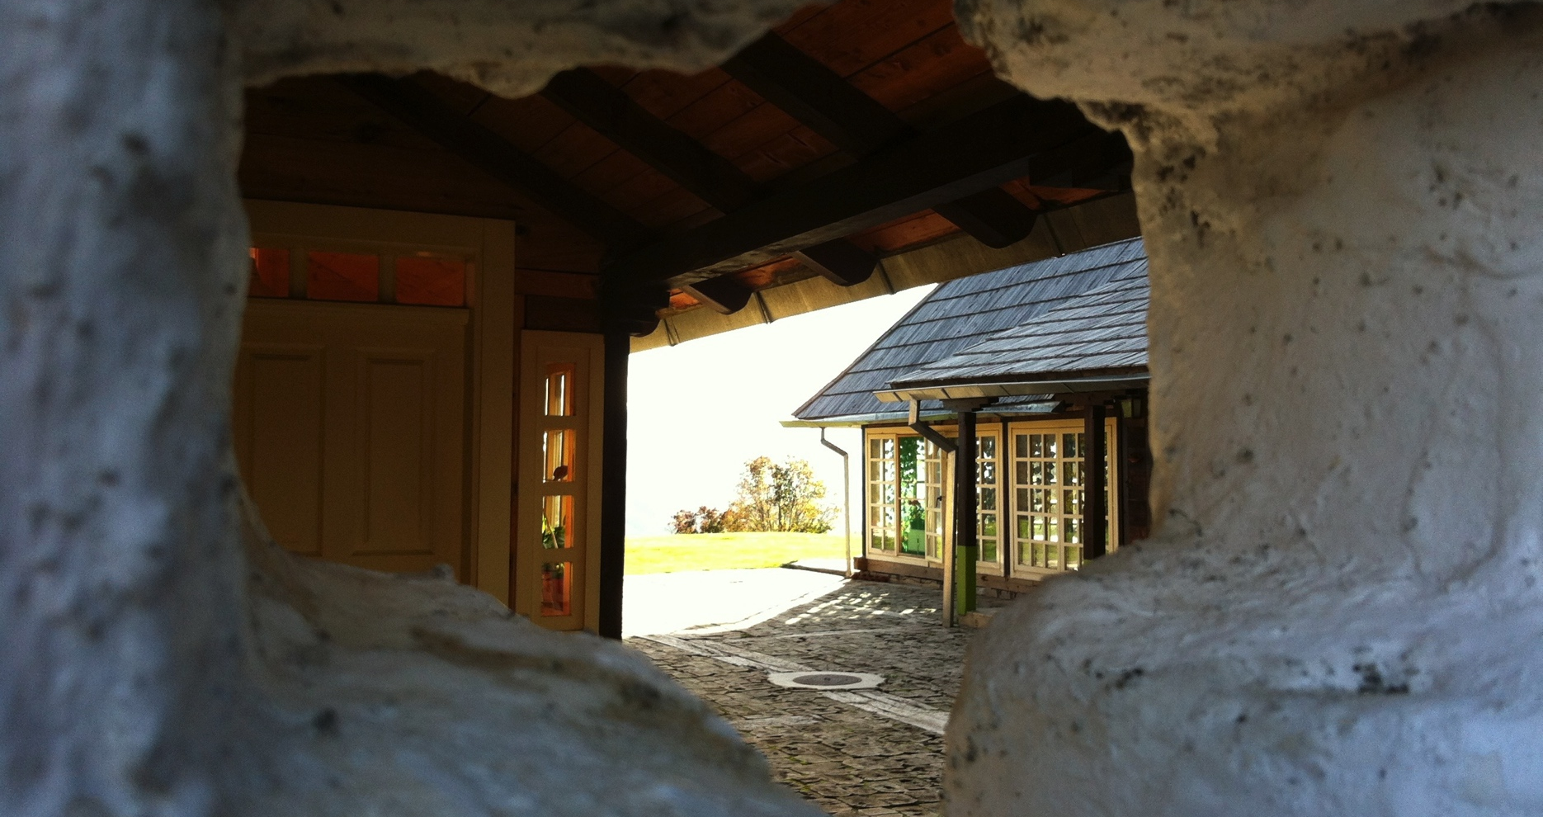
KÜSTENDORF
ISCONTOUR 2016

Slide 51
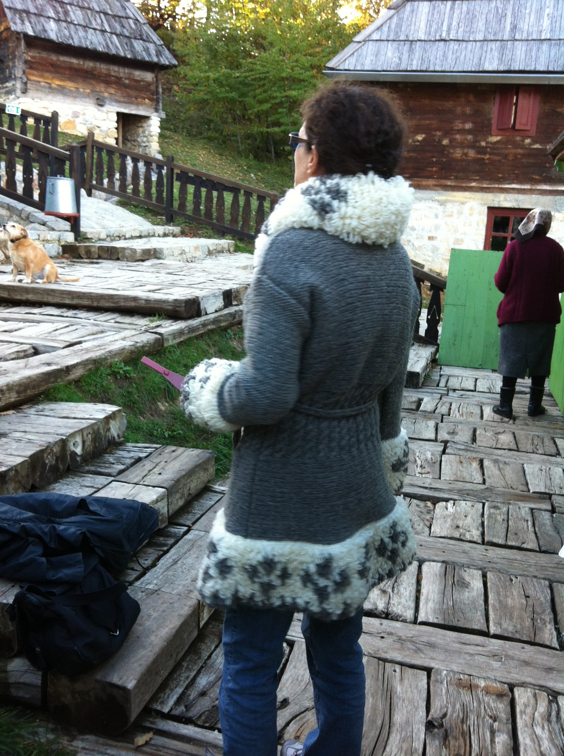
KÜSTENDORF
ISCONTOUR 2016

Slide 52
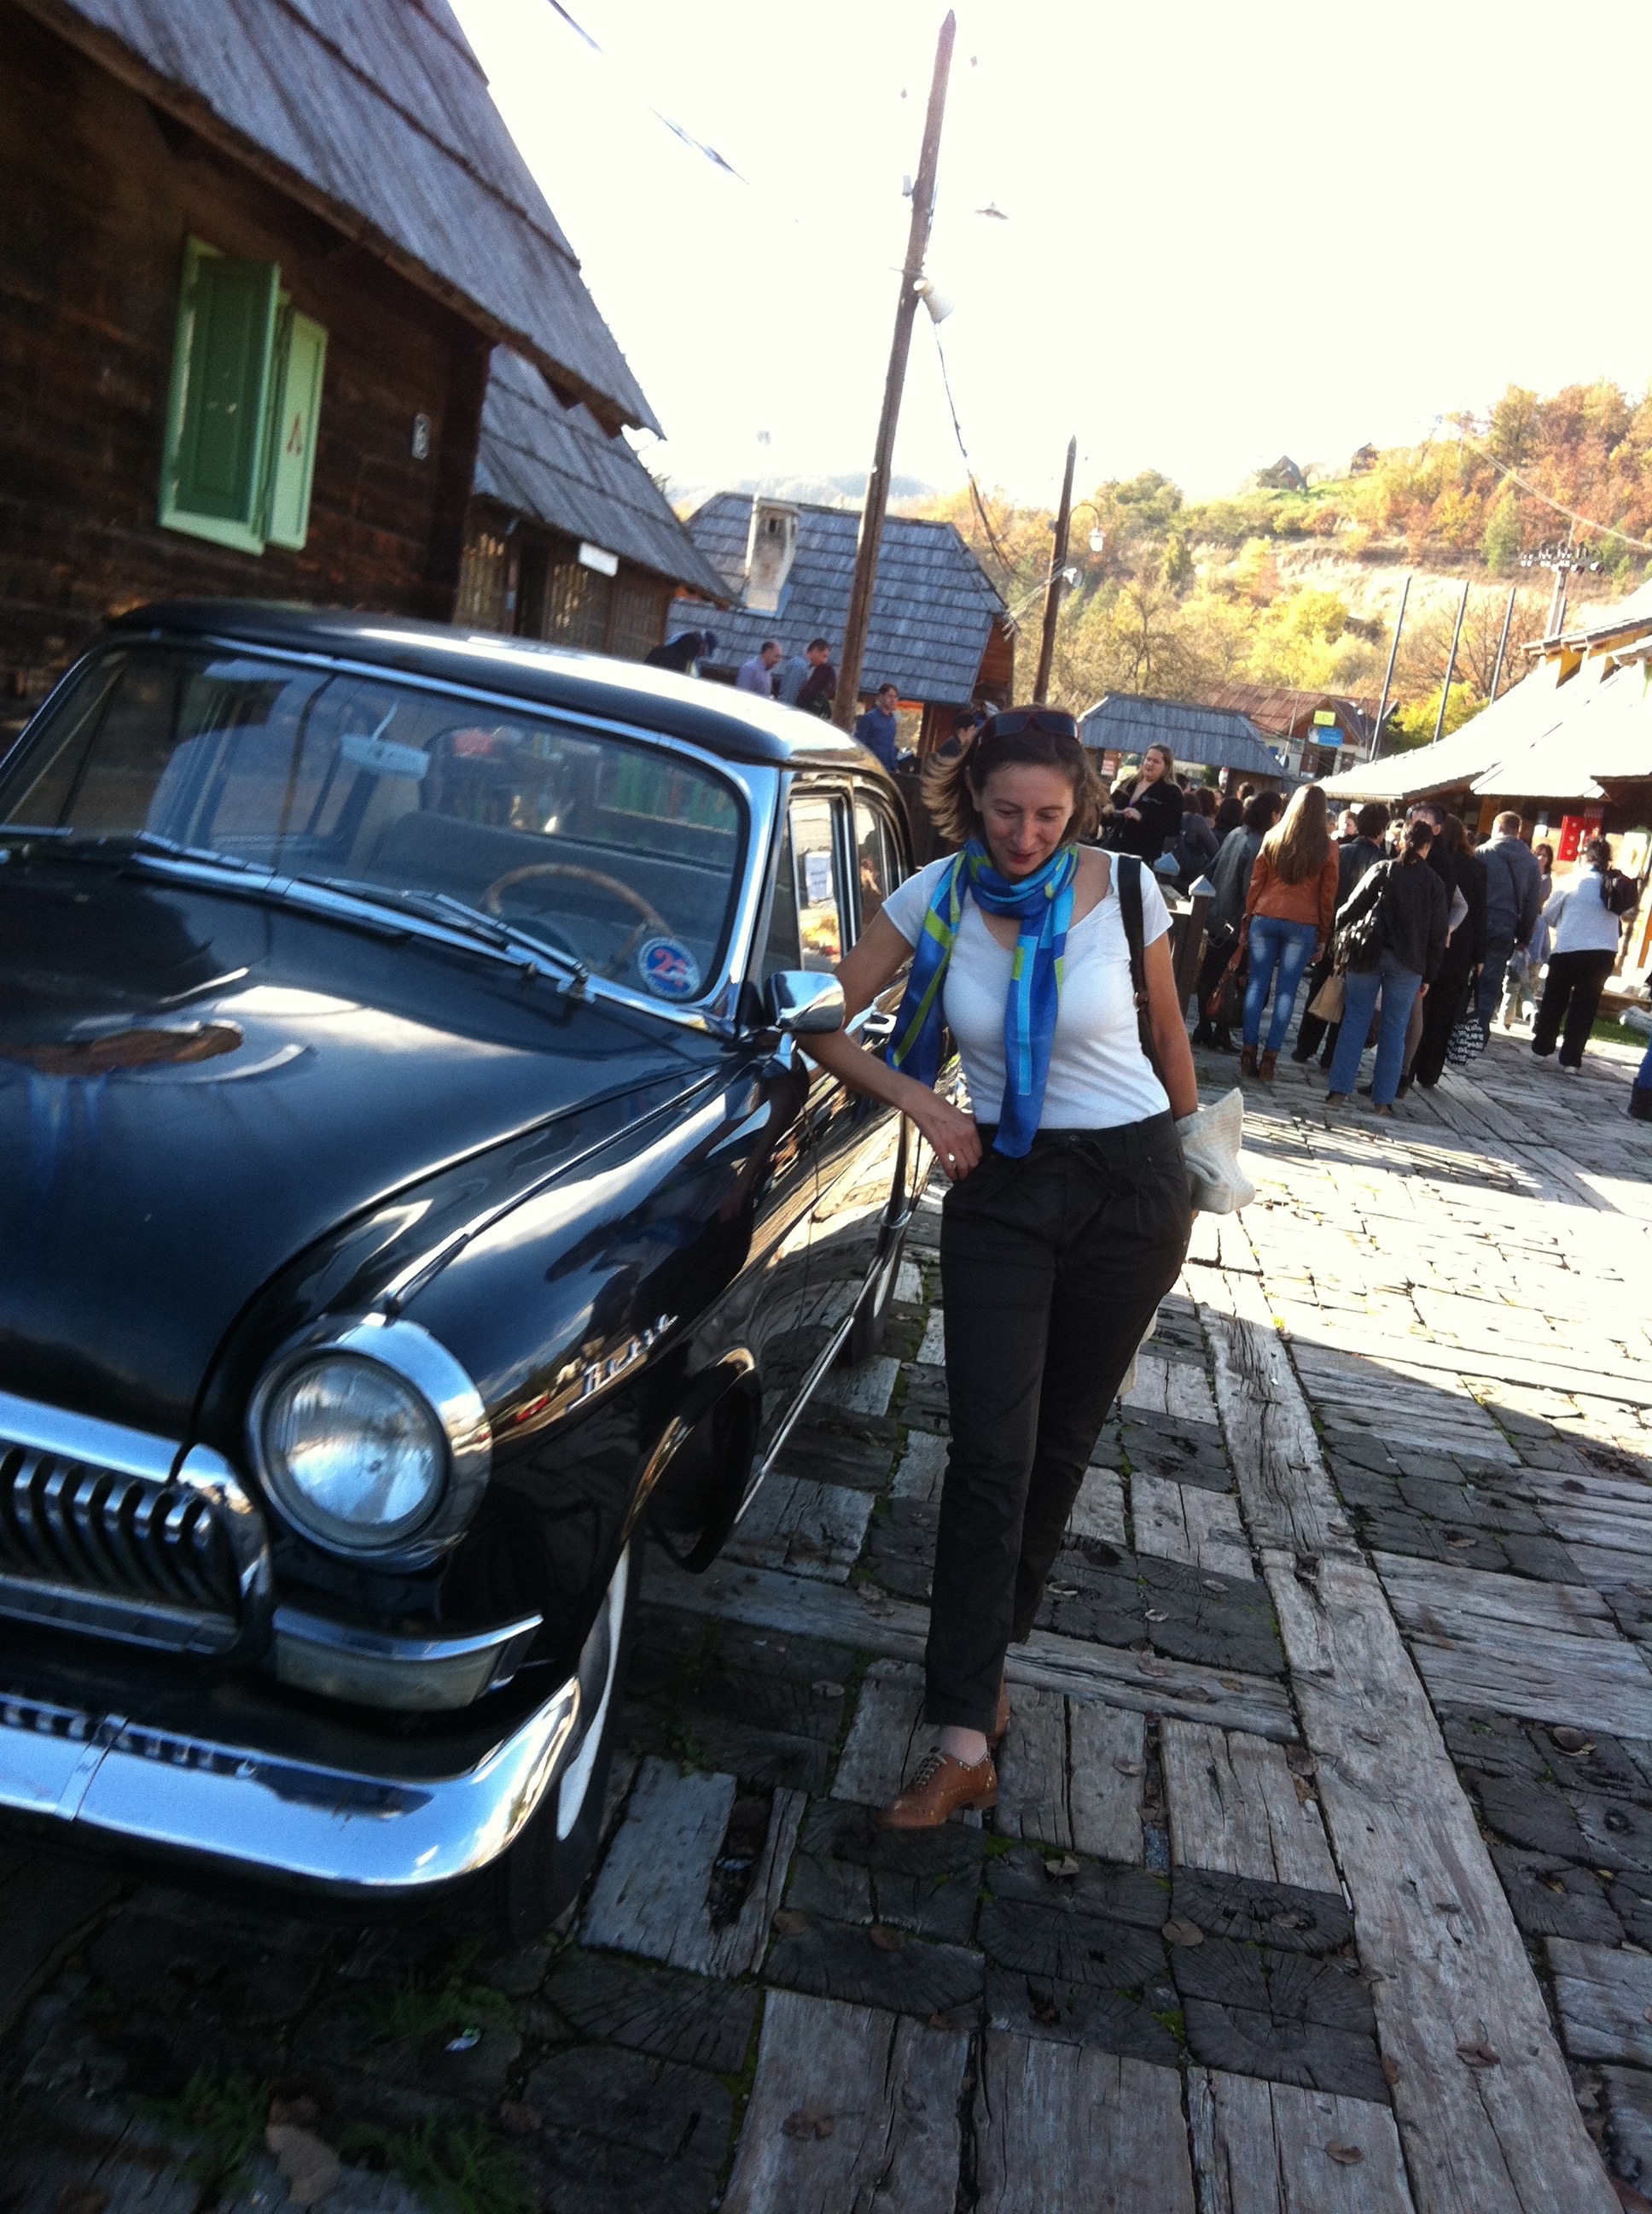
KÜSTENDORF
ISCONTOUR 2016

Slide 53

KÜSTENDORF
ISCONTOUR 2016

Slide 54
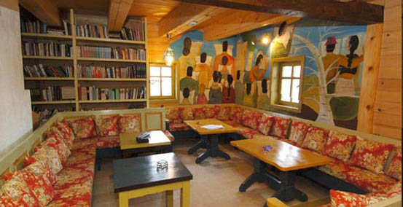
KÜSTENDORF
ISCONTOUR 2016

Slide 55
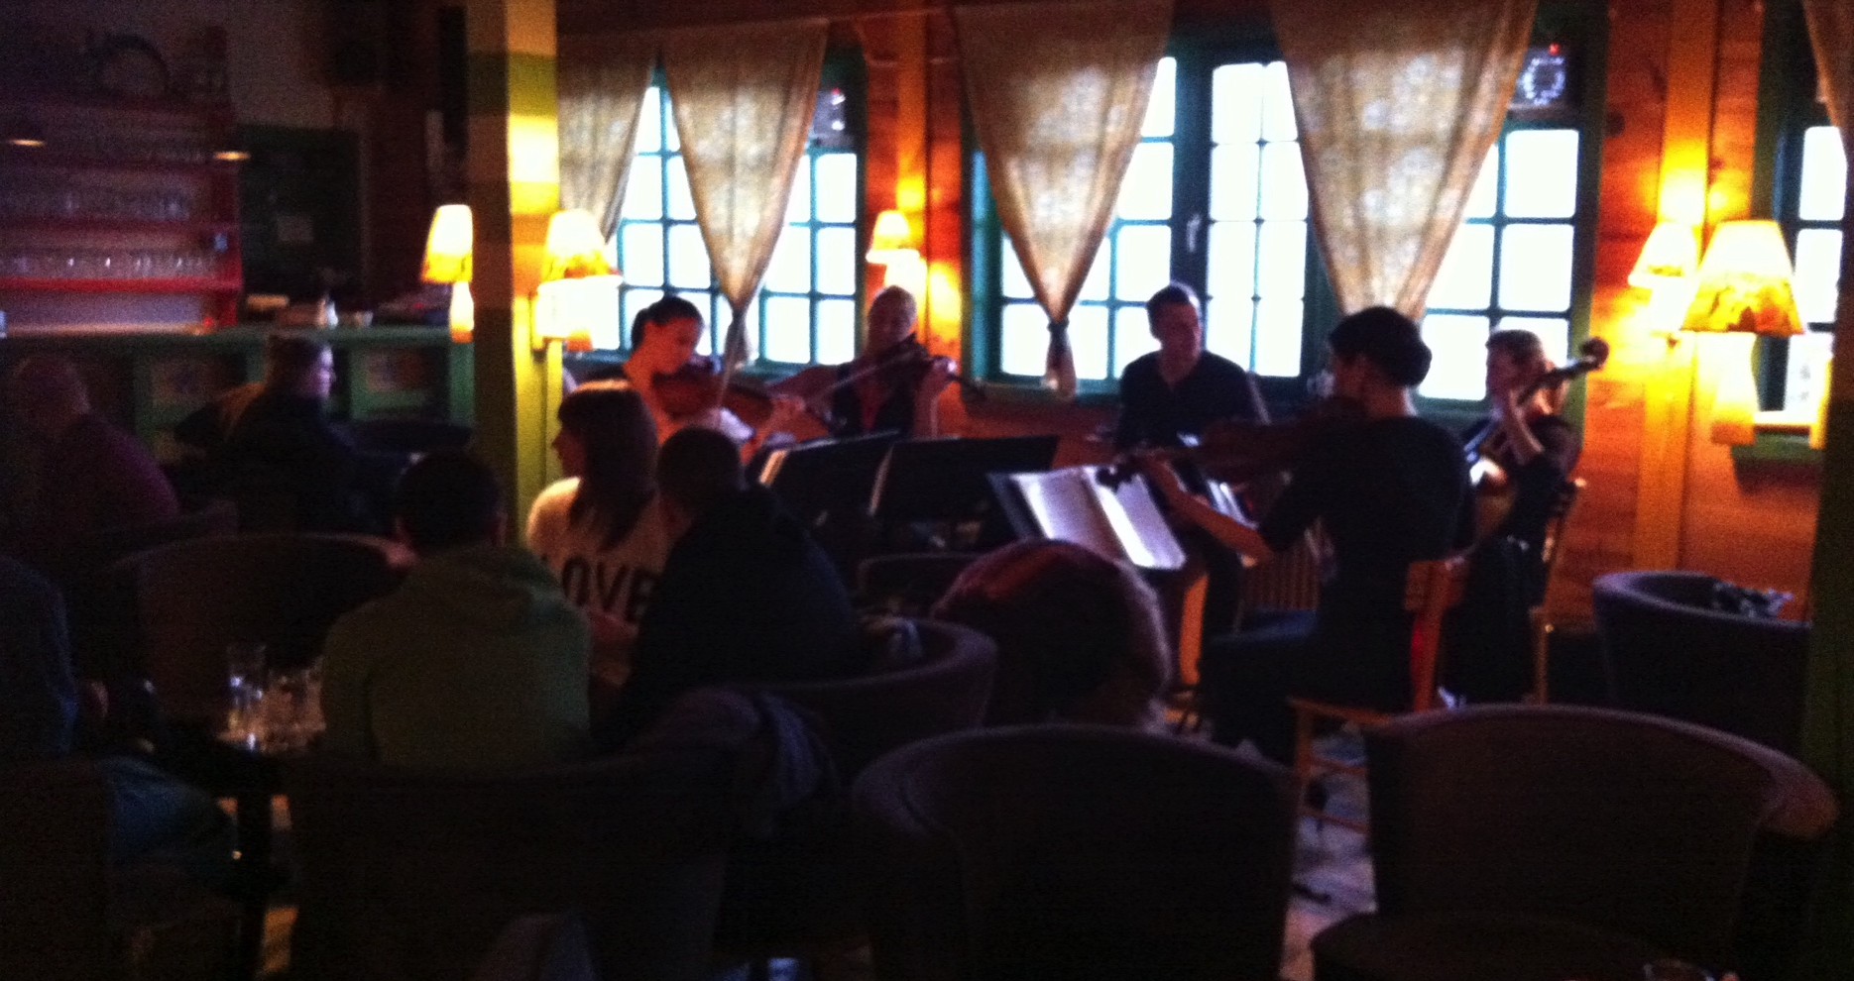
KÜSTENDORF concert in the café
ISCONTOUR 2016

Slide 56
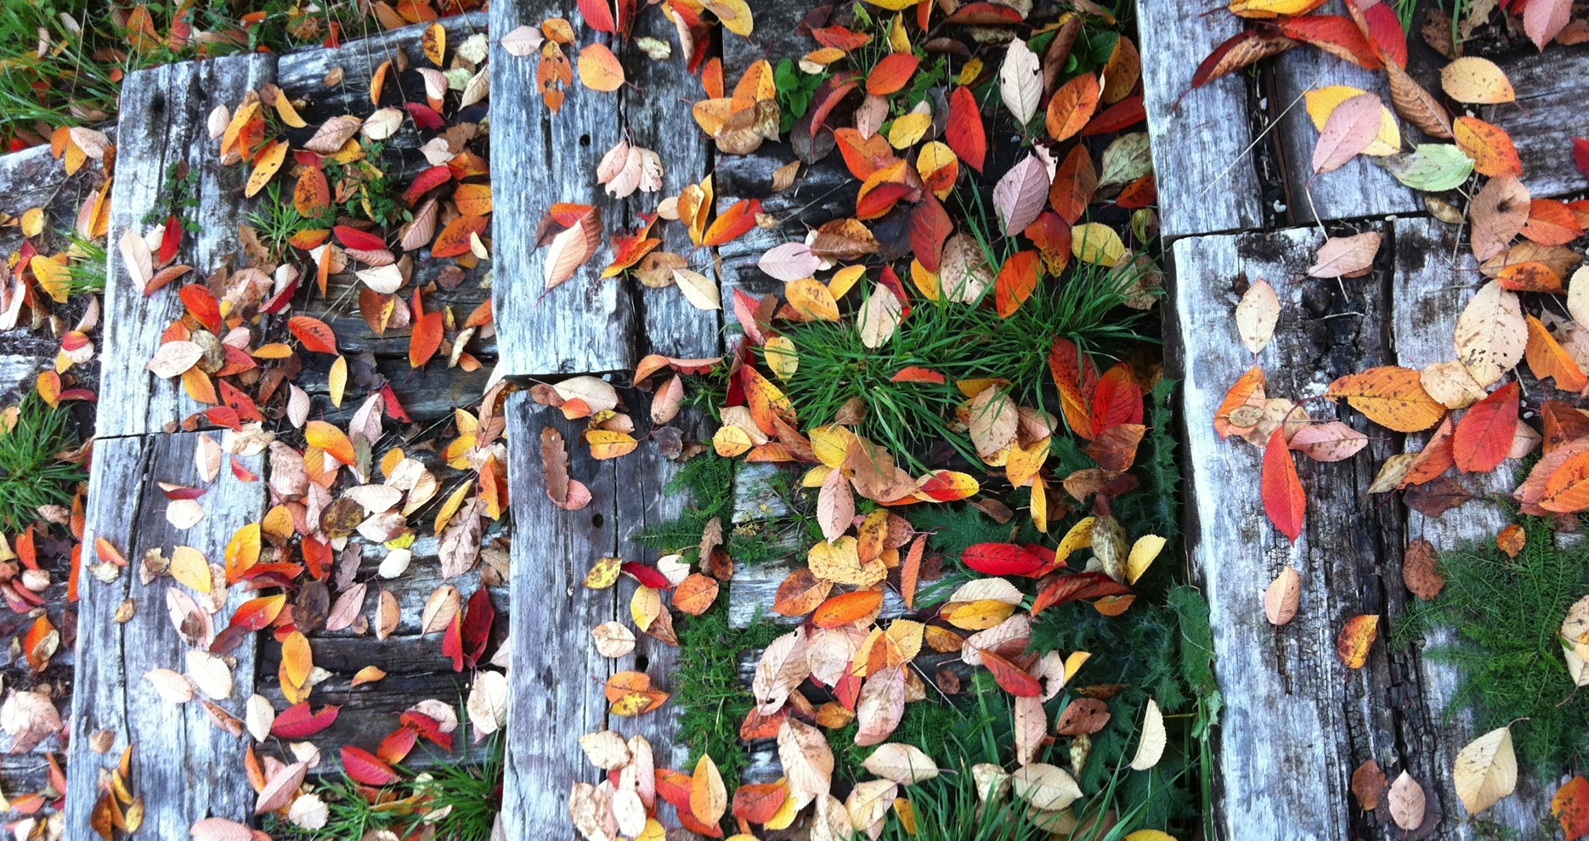
KÜSTENDORF
ISCONTOUR 2016

Slide 57

Tourism development and threat of globalisation?
ISCONTOUR 2016

Slide 58
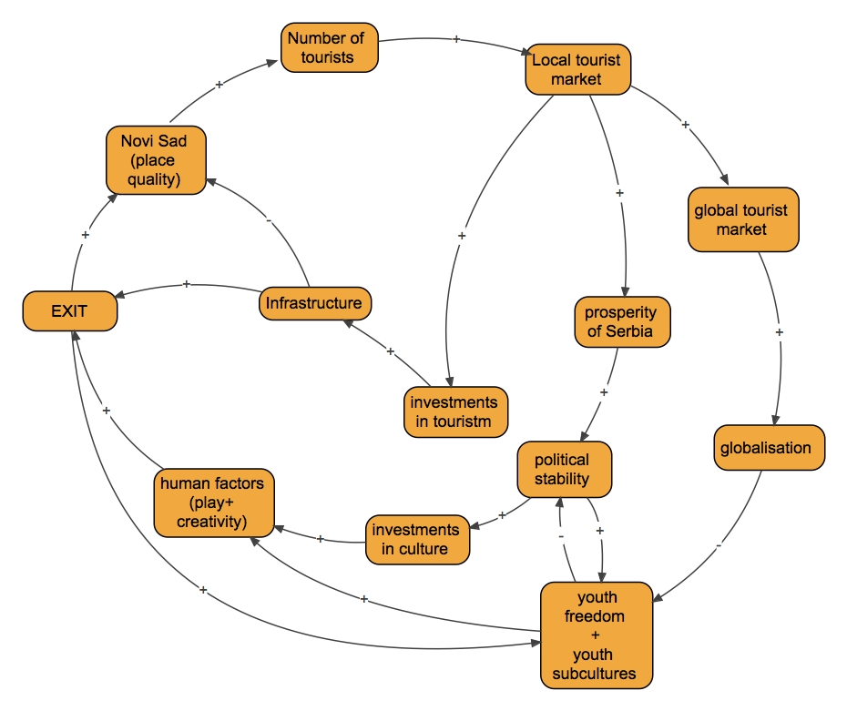
EXIT Causal Loop Diagram (CLD)
ISCONTOUR 2016

Slide 59
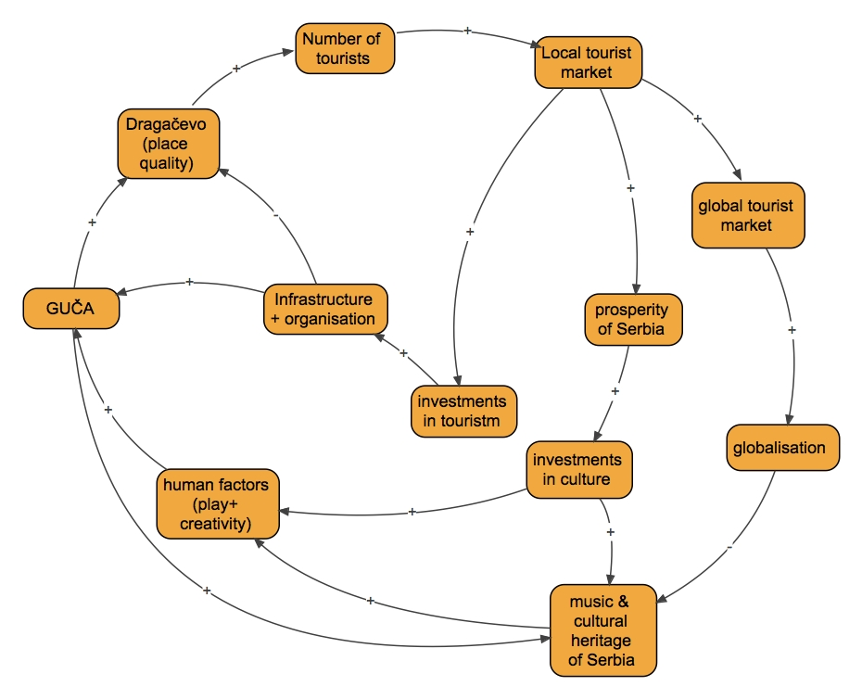
GUČA Causal Loop Diagram (CLD)
ISCONTOUR 2016

Slide 60
Mihaly Csikszentmihalyi (1934–) psychologist of happiness
Psychology of optimal experience : flow
Happiness through play is an individual and authentic need
ISCONTOUR 2016

Slide 61
Roger Caillois (1913 – 1978), French intelectual
FOUR TYPES OF PLAYS:
Agon – competition
Mimicry – illusion, role play
Ilynx – vertigo effect
Alea – gambling
ISCONTOUR 2016

Slide 62
References
Beer, Stafford (1984): „The Viable System Model: Its Provenance, Development, Methodology and Pathology“ in Systems Thinking, Vol. II: Systems Theories and Modelling.
Caillois, Roger (1979): Igre i ljudi. Beograd, Nolit
Csikszentmihalyi, Mihaly (1999): Tok. Psihologija optimalnog iskustva. Novi Sad, Forum
GUČA: pola veka sabora trubača u Guči (1961–2010). (2010). ed. Tadić, Adam et al. Guča–Beograd, Centar za kulturu, sport i turizam opštine Lučani “Dragačevo”
Jere Jakulin [Lazanski], Tadeja (2009): Sistemski pristop in modeliranje kot metodi za oblikovanje strateških odločitev v turizmu. Ljubljana, Turistica, Visoka šola za turizem
Photos: personal archive; GUČA (book); web-sites of Hotel “Mećavnik”; EXIT
ISCONTOUR 2016

