Slide 1
Monitoring Tourist Spatial-Temporal Behavior in Urban Destinations, a Methodological Investigation and GPS Case Study
Lenka Kellner, Fachhochschule Salzburg, Austria
www.tourism-student-conference.com

Slide 2
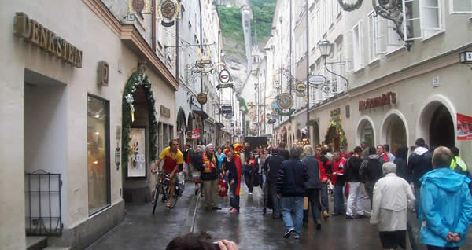
Background
Tourism industry is one of the most important sources of revenue and foreign exchange
Urban destinations are becoming more popular
ISCONTOUR 2016

Slide 3
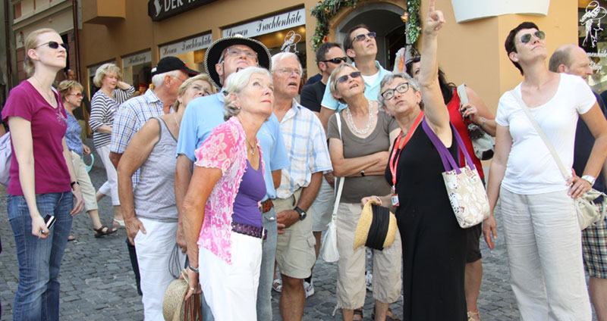
Research gap
ISCONTOUR 2016

Slide 4
Research gap
Various methods and techniques for tracking tourist mobility, however, no research so far on detailed analysis of these methods
ISCONTOUR 2016

Slide 5
Aim
Overview of advantages and disadvantages of all existing tracking techniques for monitoring tourist spatial-temporal behavior in urban places
ISCONTOUR 2016

Slide 6
Research Question
RQ1: What are the possible methods for tracking tourist spatial-temporal behavior in urban places?
RQ2: What are the advantages and disadvantages of the methods used for tracking tourist spatial-temporal behavior in urban places?
ISCONTOUR 2016

Slide 7
Methods for tracking tourist spatial-temporal behavior
Observation
Precise and detailed data
Can obtain non-spatial data of tourist
Time consuming
Low sample size
Labor intensive
ISCONTOUR 2016

Slide 8
Methods for tracking tourist spatial-temporal behavior
Interviews
Detailed and deep information
about spatial behavior
More flexible in gathering data
Loss of memory in the specific
activities done in the city
ISCONTOUR 2016

Slide 9
Methods for tracking tourist spatial-temporal behavior
Questionnaire Survey
Large sample size
Detailed spatial information
Not relevant data provided by
tourists because of no interest
ISCONTOUR 2016

Slide 10
Methods for tracking tourist spatial-temporal behavior
Self-administrated diaries and spatial maps
Simple method
High flexibility
Intrusive
Loss of some tracking data due
to the tourist’s inattention
ISCONTOUR 2016

Slide 11
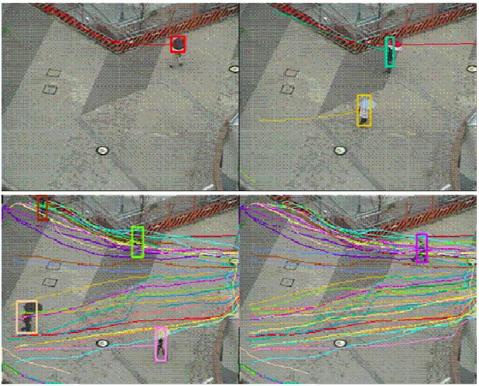
Methods for tracking tourist spatial-temporal behavior
Video-based analysis
Micro-level movements
Automatic counts of tourists
Illumination changes might
have a negative impact on the video quality
Difficulties with an analysis
ISCONTOUR 2016

Slide 12
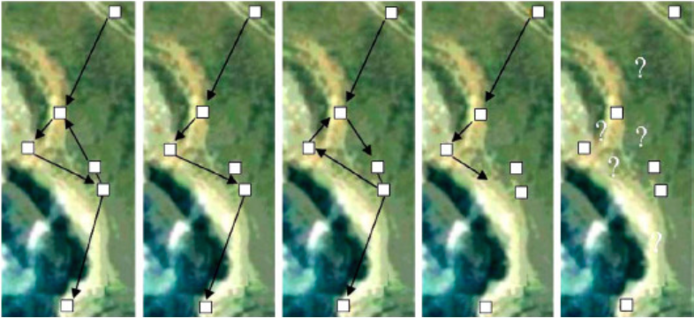
Methods for tracking tourist spatial-temporal behavior
Timing systems
Time and location
data monitoring
Ideal for
outdoor tracking
No data recorded if tourists don’t pass the receiver
Limitation of data logger memory capacity
ISCONTOUR 2016

Slide 13
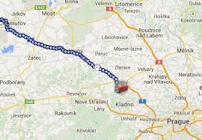
Methods for tracking tourist spatial-temporal behavior
GPS Tracking
Accuracy
Collection of data for longer
period of time
Efficiency in large urban areas
Possibility of tracking in various fields
Ethical issues
No info on demographic data
ISCONTOUR 2016

Slide 14
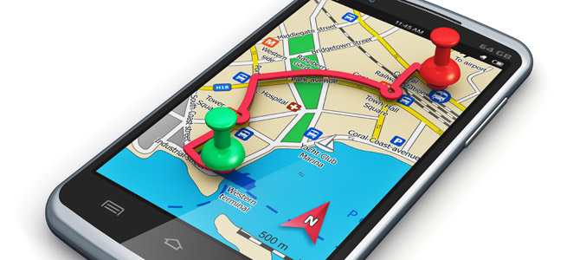
Methods for tracking tourist spatial-temporal behavior
Mobile phone tracking
Additional information on tourist’s preferences and decisions provided
Simplicity in usage
Roaming costs
Ethical issues
Possibility of usage only in urban areas/regional level
ISCONTOUR 2016

Slide 15
GPS Case Study
ISCONTOUR 2016

Slide 16
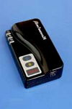
Data Collection and Analysis
Where? YOHO Youth Hostel Salzburg
How? GPS loggers and online questionnaire
Analysis? ArcGis, QGIS Software,
Webmap.sk
ISCONTOUR 2016

Slide 17
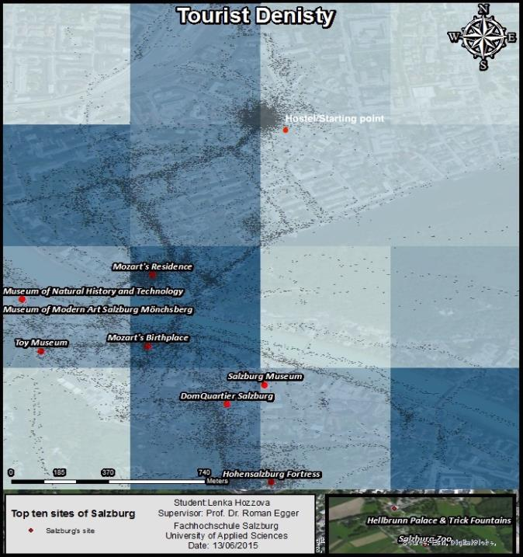
ISCONTOUR 2016

Slide 18
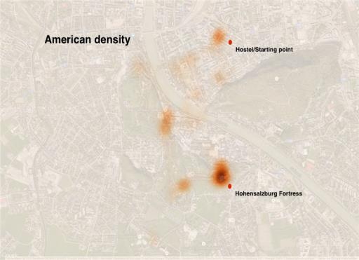
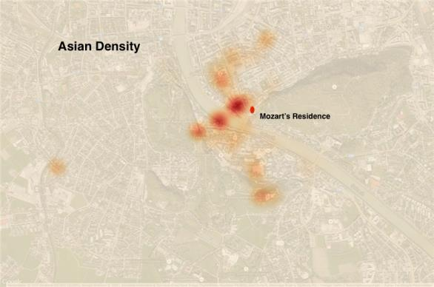
Findings and results: advantages
ISCONTOUR 2016

Slide 19
Findings and results: advantages
https://www.youtube.com/watch?v=s-PGLo3qs_k
ISCONTOUR 2016

Slide 20
Findings and results: disadvantages
Complexity of GPS data analysis
Risk of losing the GPS device
No socio-demographic data provided
Ethical issue
Inaccuracy
ISCONTOUR 2016

Slide 21
Limitations Recommendations
No generalization of results
Focus on urban destinations only
GPS testing only
Self-completion questionnaire
Risk of not returned GPS devices
One-day tracking research
Larger sample
Future research in rural areas, theme parks, ski resorts, etc.
Other methods could be tested in urban areas
E.g. GimTop Toolkit (GTK)
Room number, e-mail address, phone number
Two or more days tracking study
ISCONTOUR 2016

Slide 22
Thank you for your attention!
Any questions?
ISCONTOUR 2016

