Slide 1



Macau Residents’ Perceptions towards the Sustainability of the Macau Food Festival
JIAYU GENG, Gabriela
Institute for Tourism Studies, Macau, China
www.tourism-student-conference.com

Slide 2
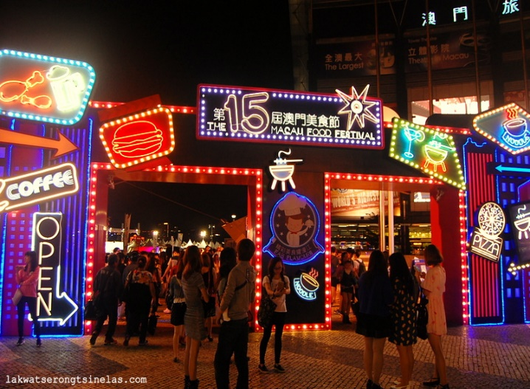
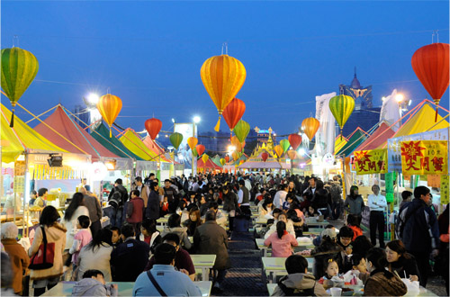
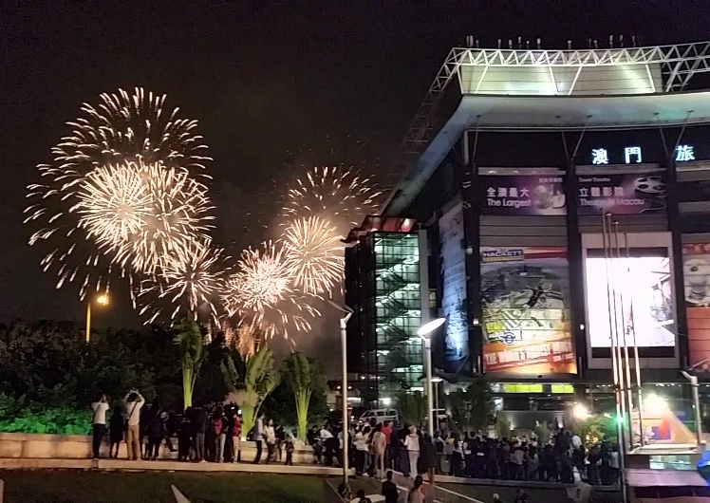
Why Macau Food Festival?
Annual event, combined with the Macau Grand Prix, since 2000
A diverse food carnival
Tourist authority: less popular in recent years
Residents’ perceptions: tend to focus on food quality and hygiene
(personal communication, 17 October, 2015)
ISCONTOUR 2016
Notes:
Every November the date have , the 63rd Macau Grand Prix is tentatively going to be held during Nov. 17-20.
fireworks shows, live dancing performances and a photography competition. Therefore, tourists and citizens can enjoy both the sporting event and gastronomy simultaneously
Festivals and events are important component of this new direction. The MFF is, as said, potentially important in this respect, but authorities are aware the food festival is no longer as popular as it once was. Some comments to the author from residents show the festival to be perceived both positively and negatively. While previously people found the food festival is fun and convenient, with low-cost good quality readily available. More recently, they have been concerned about food quality and hygiene (personal communication, 17 October, 2015).

Slide 3
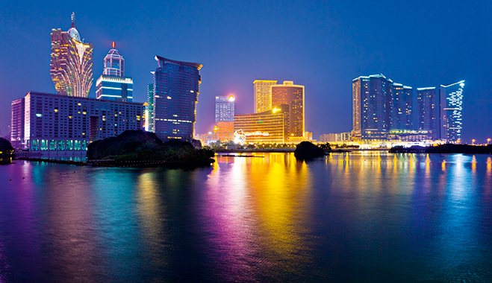
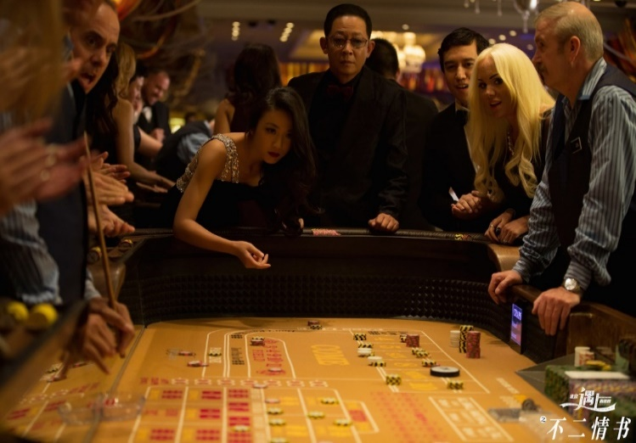
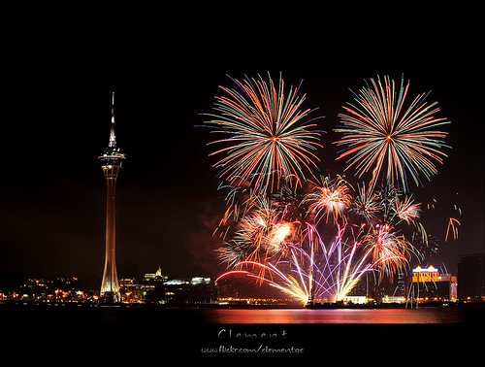
Background of Macau
Colony of Portugal, heritage, gambling and recreation city, luxury hotels
Macau gaming revenue is falling (Corben, 2014)
Need diversify and enhance the SAR’s image and tourism offerings (Macau Year Book, 2013)
Festivals and events are important component of this new direction
ISCONTOUR 2016
Notes:
1. Macau is a flourishing gaming city, having enjoyed double digit economic growth arising from mainland Chinese gaming tourists. Currently, however, gaming revenue is falling as a result of President Xi Jinping’s vigorous anti-corruption campaign (Corben, 2014). In consequence, and in line with the mainland government’s overall policy, tourism authorities in Macau are looking to diversify and enhance the SAR’s image and tourism offerings (Macau Year Book, 2013).
2. Leisure and entertainment

Slide 4
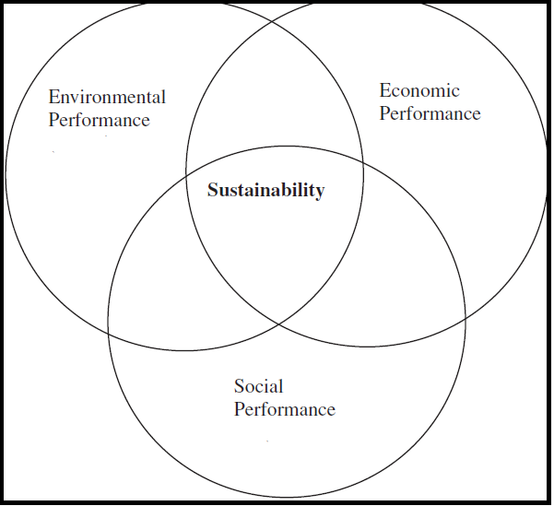

Research Questions
Do local residents enjoy the Macau Food Festival (MFF)? What kind of positive benefits and negative aspects of the MFF are of concern to local residents?
How do local residents perceive the sustainability of the MFF? Are there any improvements and suggestions in terms of the future development of MFF?
ISCONTOUR 2016

Slide 5
Outline
Theoretical Background
Development of Event Industry Research
Methodology
Semi-structured Interview
Results
Satisfaction and Demand from Respondents
Conclusions, limitations and outlook to further research
Research Constraints
Residents’ Perceptions of Mega Events
Residents’ Perceptions of the Macau Grand Prix
The Macau Food Festival
Local Students and Full-time Employees
Interviewees’ Suggestions for the Future
Positive and Negative Perceptions
Future Studies and Implementation
ISCONTOUR 2016

Slide 6
Theoretical Background
Methodology
Results
Conclusions, Limitations and Outlook to Further Research
ISCONTOUR 2016

Slide 7
Development of Event Industry Research
“Studies on events show a development path from being simply focused on the economic impact of events to exploring the reasons people attend events, and then turned to specific aspects of events” (Getz, 2008)
“Marketing and management issues and evaluation of economic benefits; local community opinions and attitudes towards these impacts, have been relatively few” (Zhou & Ap, 2009, p. 1)
“Relatively few studies examining the social, cultural, and environmental impacts of such events, and local community opinions and attitudes towards these impacts” (Zhou & Ap, 2009, p. 1)
“A number of community perception studies conducted in the last decade” (Fredline & Faulkner, 2000; Gursoy & Kendall, 2006; Zhou & Ap, 2009, p. 139)
“The most noticeable research theme to emerge in the last decade is how residents perceive the impact of these events on the community itself”
(Chen, as cited in Getz, 2008, p. 107).
ISCONTOUR 2016
Notes:
These studies show that residents’ perceptions of events could really affect the success of the events. Residents’ perceptions are important for two reasons: firstly, they are impacted by the event in their daily life; secondly they often make up a large proportion of visitors to the event. Therefore, residents should be taken into account and brought into further investigation.

Slide 8
Residents’ Perceptions of Mega Events
“Local Beijing residents held very positive perceptions towards the impacts of the 2008 Olympic Games, with 96% of respondents indicating support for the event” (Zhou & Ap, 2009, p. 10)
“Most resident respondents of a study of residents’ perceptions of the 2010 Shanghai EXPO showed largely positive outcomes especially from those employed in the industries closely related to city image enhancement and consolidation” (Yang, Zeng & Gu, 2010, p. 167).
ISCONTOUR 2016

Slide 9
Residents’ Perceptions of the Macau Grand Prix
“During the period of the event, somewhat inconvenient traffic management and control measures are implemented, such as temporary closure of some roads and parking spaces, and therefore, access of vehicle traffic to and from the area is restricted” (Wong & Yu, 2011, p. 282)
“Resident’s perceptions of the Macau Grand Prix were mainly influenced by age and pre-existing attitudes about government performance in the organization of the Grand Prix” (Zhou, 2010).
“Macau Government should consider more about how local residents perceived of negative impacts” (Wong & Yu, 2011).
ISCONTOUR 2016

Slide 10
The Macau Food Festival
“The MFF usually consists of around one hundred booths featuring food from diverse cultures all over the world. The booths are typically run by existing restaurants in Macau, the city being well-known for gourmet food”
(Macau Cguide Editorial Team, 2014).
“A festival about food is good for attracting more people because food is one of the most important segments in our daily routine”
(Wu, Wong & Cheng, 2013)
“There is general agreement that a high level of service quality will result in satisfied festival attendees who are then more likely to be communicators of positive word-of-mouth and become repeat visitors”
(Cole & Illum, 2006, p. 2).
“The management of food festivals should allocate more resources to improve food quality, making an effort to provide a variety of food to satisfy the visitors’ demands and understand what kinds of food the majority of visitors prefer to taste while visiting the food festival”
(Wu, Wong & Cheng (2013, p. 1297)
ISCONTOUR 2016

Slide 11
Theoretical Background
Methodology
Results
Conclusions, Limitations and Outlook to Further Research
ISCONTOUR 2016

Slide 12

Semi-structured Interview
Scheduled interview with open-ended questions
Interviewees requirements:
  (1) previous attendance at the MFF more than once
  (2) Macau residents
Advantages:
  Collect diversified attitudes and opinions
  Illustrate perspectives fully in details
  Deeper understanding
  Unearthing of as broad a range of issues as possible
ISCONTOUR 2016
Notes:
Scheduled interview with open-ended questions
Interviewees requirements:
(1) previous attendance at the MFF
(2) Macau residence
Advantages:
Collect diversified attitudes and opinions
Illustrate perspectives fully in details
Deeper understanding
Unearthing of as broad a range of issues as possible

Slide 13
Demographic Information of the Interviewees
Case Number | Gender | Age | Occupation
Interviewee 1 | Male | 18 | High school student
Interviewee 2 | Female | 24 | Civil Servant
Interviewee 3 | Female | 22 | University student, part time telecom promoter
Interviewee 4 | Female | 23 | University student, part time in travel agency
Interviewee 5 | Male | 22 | University student, part time hotel assistant
Interviewee 6 | Female | 27 | Hotel human resources executive
Interviewee 7 | Male | 23 | University student, part time bank call center assistant
Interviewee 8 | Male | 26 | Supervisor of housekeeping
Interviewee 9 | Female | 24 | University student, part time in house teacher
Interviewee 10 | Male | 28 | Hotel sales assistant
Interviewee 11 | Female | 42 | Community leader
Interviewee 12 | Female | 30 | Hotel training manager
ISCONTOUR 2016
Notes:
Respondent selection: (1) previous attendance at the MFF and (2) Macau residence.
6 Half the samples were tourism students at four of Macau’s tertiary education institutions, some of whom were students of Event Management, and the remainder students of Hotel Management. These students could be considered experts due to their studies and attendance at the festival. In addition, the author was aware that young people under 30 make up the largest proportion of attendees at the festival, and hence wanted to ensure they were well represented in the sample.

Slide 14
Theoretical Background
Methodology
Results
Conclusions, Limitations and Outlook to Further Research
ISCONTOUR 2016

Slide 15

Results
1. (Ice Breaker) Preference for Participating in Local Festivals and Events
  Personal interest and the event schedule
  Visit directly after work or during weekends with family or friends
  Ten interviewees attended more than one time each year
2. Means of Transportation and the Traffic Conditions
  Driving (7), take a bus (4) and walk (1)
  Lack of parking area
  Too crowed on buses, tourists and residents
ISCONTOUR 2016

Slide 16
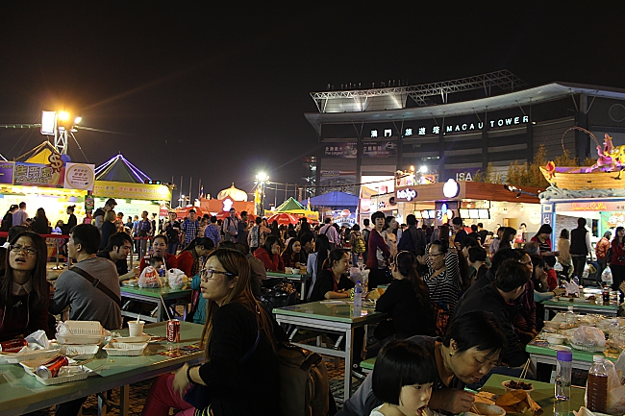
Results
3. Food Quality and Price
  Five point scale, Mean=3.92
4. Staff Service and Infrastructure
  Long time of waiting (›10mins)
  No queue control
  Limited seating area as well as the toilets
ISCONTOUR 2016

Slide 17
Results
5. Cleanliness and Waste
  Waste of disposable plastic cutlery
  Cleanliness was not good enough
6. Likelihood of Visiting Next Year
  Curious of new theme
  Lack of brand new concept and avoid crowded atmosphere
7. Interviewees’ Suggestions for the Future of the MFF
 | Would you like to visit the MFF next year?
Ranking results (reasons): | Will | Will Not
First | Friend or family gathering | Nothing new
Second | Enjoy the food | Crowded
Third | Novelty seeking | Limited parking area
Fourth | Enjoy the live performances | Expensive
Fifth | Have free time | Better service in restaurant
ISCONTOUR 2016

Slide 18
Theoretical Background
Methodology
Results
Conclusions, Limitations and Outlook to Further Research
ISCONTOUR 2016

Slide 19


Conclusions
Mostly viewed the MFF positively as an opportunity to spend time with family and friends
Satisfied with the length of time the MFF
Noted as convenient, good atmosphere with fireworks shows and live performances
Need to improve the cleanliness of the location, waste and garbage management
Service performance mainly determines whether people are willing to attend such an event again
ISCONTOUR 2016

Slide 20
Limitations and Outlook to Further Research
Limitations
Sample size
Before and after the MFF
For future research…
Local exhibitors
  different perspectives
  event experience and foresights
Validation of implementation
ISCONTOUR 2016

Slide 21
References
Akarapong Untong, Mingsarn Kaosa-ard & Vicente Ramos et. al. (2010). Factors Influencing Local Resident Support for Tourism Development: A Structural Equation Model. Macau, China: The APTA Conference 2010.
Chen, S. C. (2011). Residents’ Perceptions of the Impact of Major Annual Tourism Events in Macao: Cluster Analysis. Journal of Convention & Event Tourism, 12, 106–128. doi:10.1080/15470148.2011.569877
Cole, S. T., & Illum, S. F. (2006). Examining the mediating role of festival visitors’ satisfaction in the relationship between service quality and behavioral intentions. Journal of Vacation Marketing, 12 (2), 160–173.
Corben, R. (2014, December 19). Xi Arrives in Macau as Anti-Corruption Campaign Hits Casinos. Retrieved from Voice of America: http://www.voanews.com/content/china-president-arrives-in-macau-as-anti-corruption-campaign-hits-casinos/2565536.html
Fredline, E., & Faulkner, B. (2000). Host community reactions: A cluster analysis. Annals of Tourism Research, 27 (3), 763–784. doi:10.1016/S0160-7383(99)00103-6
Gelan, A. (2003). “Local Economic Impacts, the British Open.”. Annals of Tourism Research, 30 (2), 406-25.
Getz, D. (2008). Event tourism: Definition, evolution, and research. Tourism Management, 29, 403–428.
Gursoy, D., & Kendall, K. W. (2006). Hosting mega events: Modeling locals’ support. Annals of Tourism Research, 33(3), 603–623. doi:10.1016/j.annals.2006.09.004.
ISCONTOUR 2016

Slide 22
H. C., Wu, Jose Wong & C. C., Cheng. (2013). An Empirical Study of Behavioral Intentions in the Food Festival: The Case of Macau. Asia Pacific Journal of Tourism Research, 1278-1305.
Huiping, X. (2008). Lost in translation? Language, culture and the roles of translator in cross-cultural management research. Qualitative Research in Organizations and Management: An International Journal, 231-245.
Jie Yang, X. H., Zeng & Y. K., Gu. (2010). Local Residents’ Perceptions of the Impact of 2010 EXPO. Journal of Convention & Event Tourism, 11:3, 161-175.
K.I., Wong & S. A., Yu. (2011). Estimation of origin–destination matrices for mass event: A case of Macau Grand Prix. Journal of King Saud University – Science, 23, 281–292.
Kasimat, i. E. (2003). “Economic Aspects and the Summer Olympics: A Review of Related Research.”. International Journal of Tourism Research, 5:433-44.
Kim, Loi & Philip, Pearce. (2012). Powerful stakeholders' views of entertainment in Macao's future. Journal of Business Research, 4-12.
Macau Cguide Editorial Team. (2014, 11 3). Cguide Macau. Retrieved from Macau Food Festival: http://www.cguidemacau.com/macaufestival-cn/
Wong & Yu. (2011). Estimation of origin–destination matrices for mass event: A case of Macau Grand Prix. Journal of King Saud University – Science, 23, 281–292.
Zhou, J. (2010). Resident Perceptions Toward the Impacts of the Macao Grand Prix. Journal of Convention & Event Tourism, 11:2, 138-153.
Zhou, J. Y., & Ap, J. (2009). Residents' Perceptions towards the Impacts of the Beijing 2008 Olympic Games. Journal of Travel Research, 48, 78-91. doi:10.1177/0047287508328792
ISCONTOUR 2016

Slide 23
Gabriela Geng Jiayu
Email:
gengjiayu@live.com
LinkedIn:
https://www.linkedin.com/in/jiayu-geng-6495bb9a?trk=hp-identity-name
ISCONTOUR 2016

