Slide 1



Socio-cultural aspects of tourism services in Kazbegi
Temur Gugushvili & Gvantsa Salukvadze
Tbilisi State University, Georgia
www.tourism-student-conference.com

Slide 2
RESEARCH PROJECT - AMIES II
The research project “AMIES II – Scenario development for sustainable land use in the Greater Caucasus, Georgia“ was conducted in the Kazbegi, Georgia between 2013-2015.
The research was supported by the University of Giessen with cooperation to Tbilisi State University.
ISCONTOUR 2016

Slide 3
Structure of presentation
Methodology
Travelling strategies
Assessment of provided services: the compliance with tourists’ expectations
Informal and formal tourism services in the hotel and hotel-type establishments
ISCONTOUR 2016

Slide 4
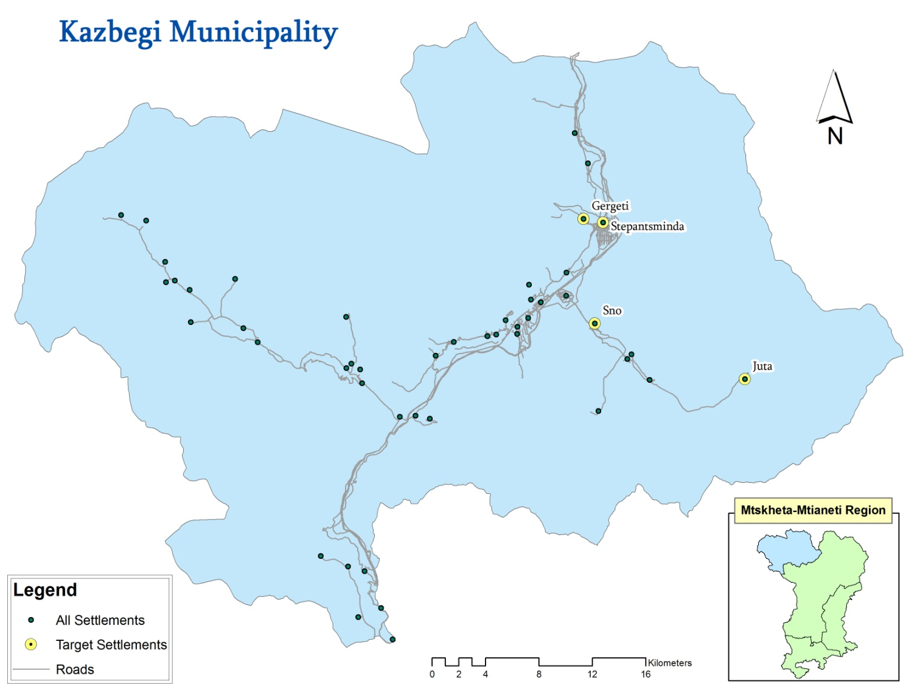
Methodology (Study areas)
ISCONTOUR 2016

Slide 5
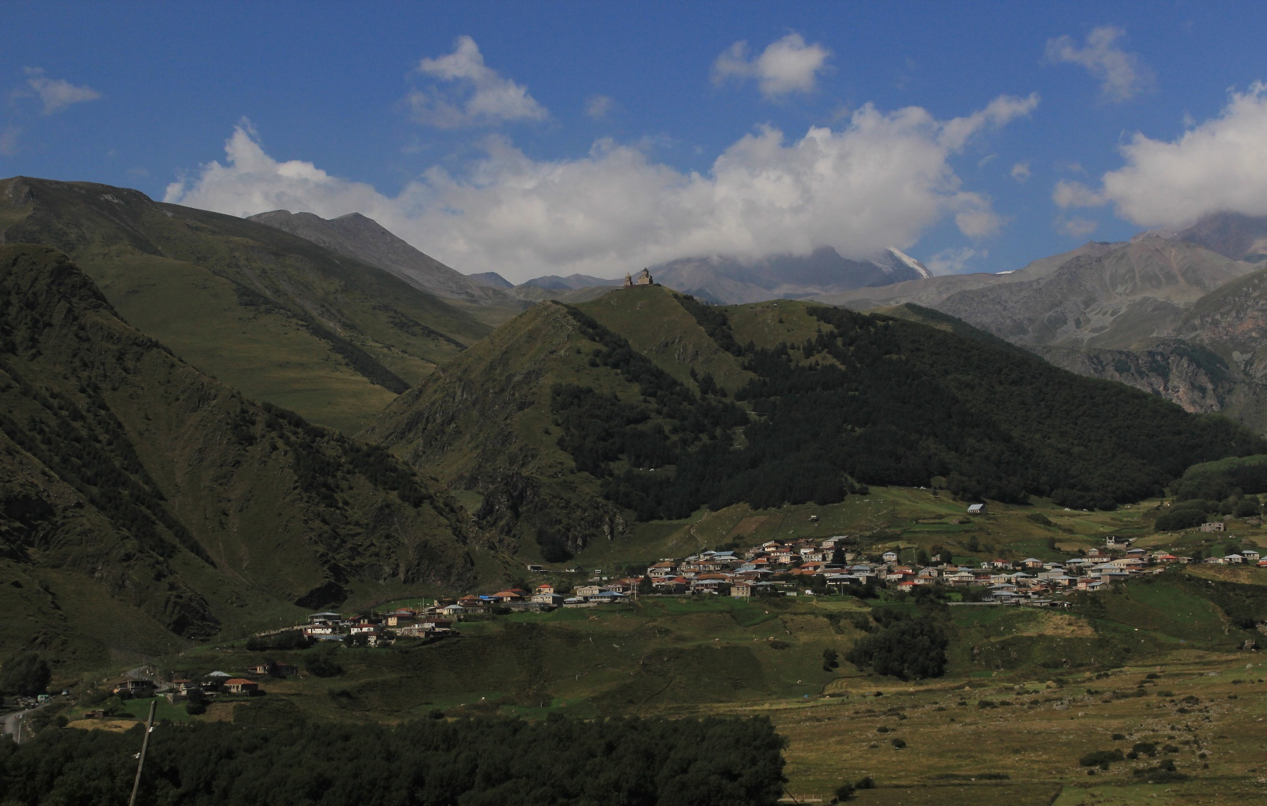
Study area - Stepantsminda
Research area: Stepantsminda
Region: Mtskheta-Mtianeti
Population (2014): 1,326
Coordinates: 42°39'36.96"N 44°38'28.11"E
ISCONTOUR 2016

Slide 6
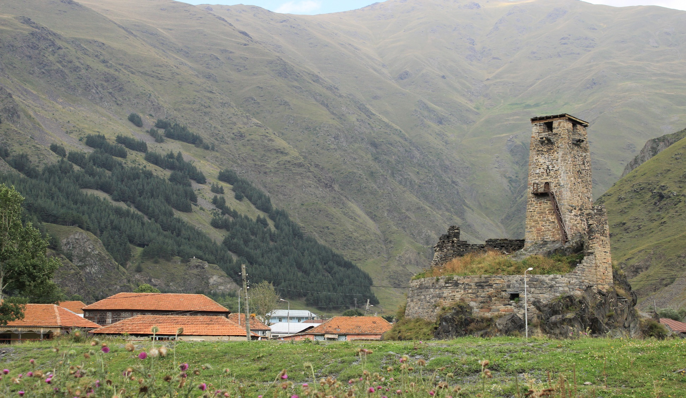
Study area – Village Sno
Research area: Sno
Region: Mtskheta-Mtianeti
Population (2014): 263
Coordinates: 42°36'18.98"N 44°38'19.81"E
Research area: Stepantsminda
Region: Mtskheta-Mtianeti
Population (2014): 1,326
Coordinates: 42°39'36.96"N 44°38'28.11"E
ISCONTOUR 2016

Slide 7
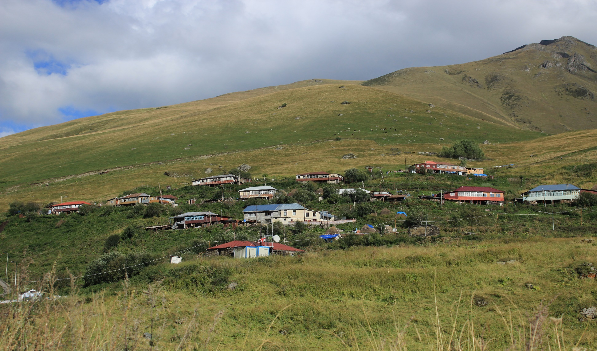
Study area – Village Juta
Research area: Juta
Region: Mtskheta-Mtianeti
Population (2014): 26
Coordinates: 42°34'43.97"N 44°44'47.44"E
Research area: Sno
Region: Mtskheta-Mtianeti
Population (2014): 263
Coordinates: 42°36'18.98"N 44°38'19.81"E
Research area: Stepantsminda
Region: Mtskheta-Mtianeti
Population (2014): 1,326
Coordinates: 42°39'36.96"N 44°38'28.11"E
ISCONTOUR 2016

Slide 8
Methodology (Target group and Respondents)
Target group of the study: tourists who stayed in a hotel and/or guesthouse in Kazbegi
The selection of respondents: purposive sampling
Characteristic of the respondents
Gender
Citizenship (Georgian, Asian, European, post-Soviet countries)
Type of accommodation (hotels and guesthouses)
ISCONTOUR 2016

Slide 9
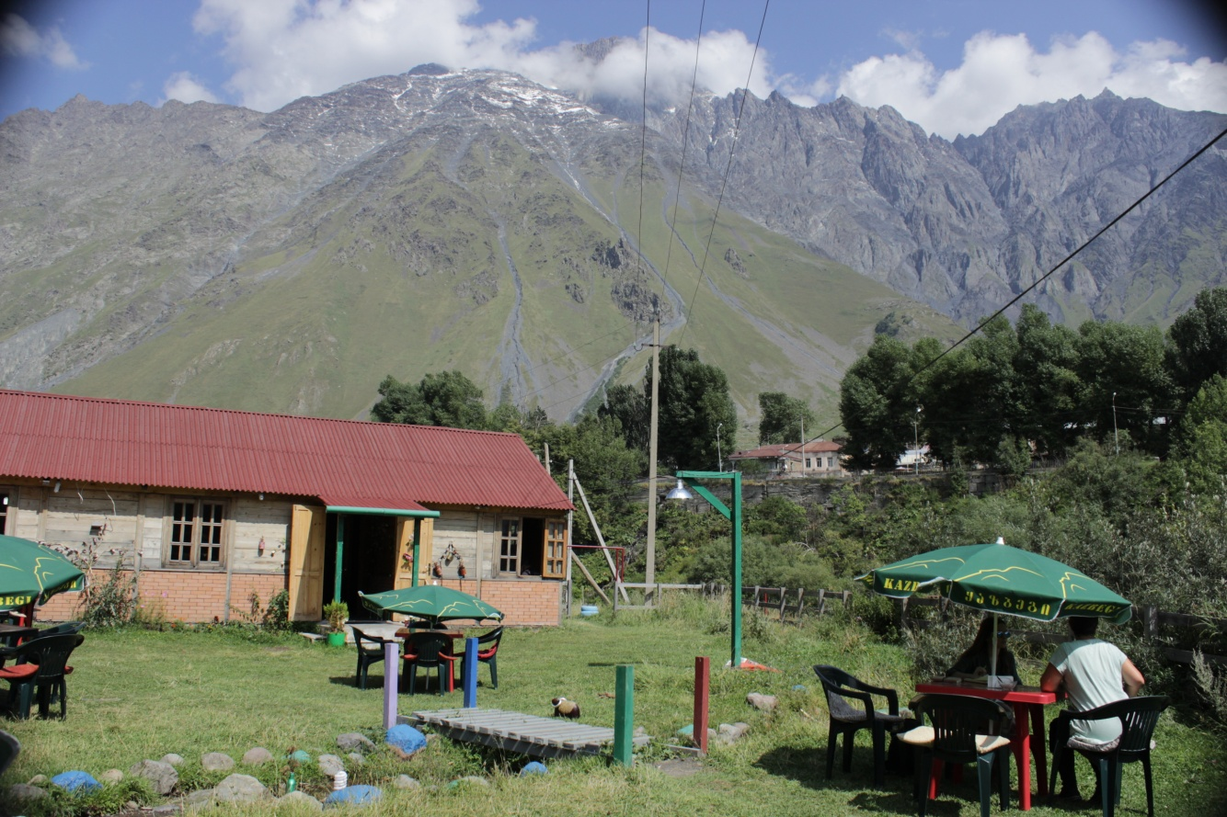
Methodology (In-depth interviews)
10 In-depth interviews were conducted
ISCONTOUR 2016

Slide 10
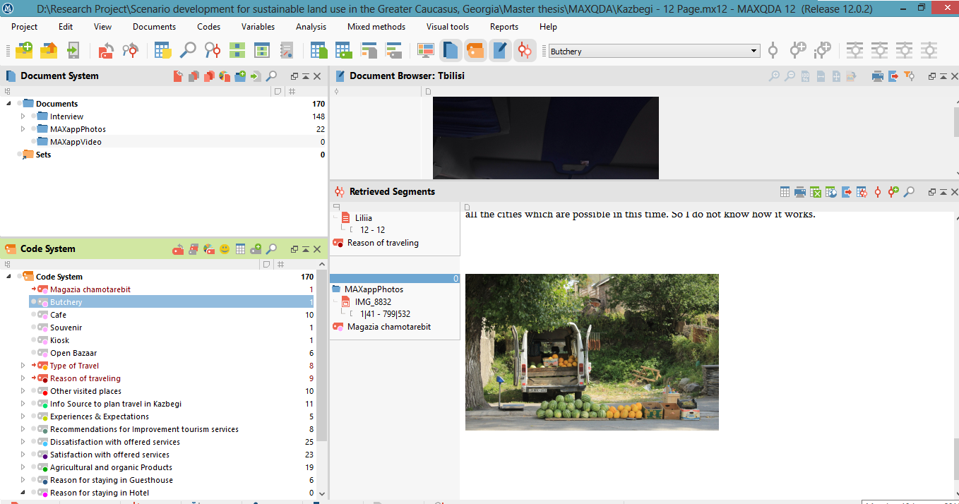
Methodology (Analysis of collected information)
Qualitative content analysis was applied with using of Computer Assisted Qualitative Data Analysis (CAQDA) - software MAXQDA
ISCONTOUR 2016

Slide 11
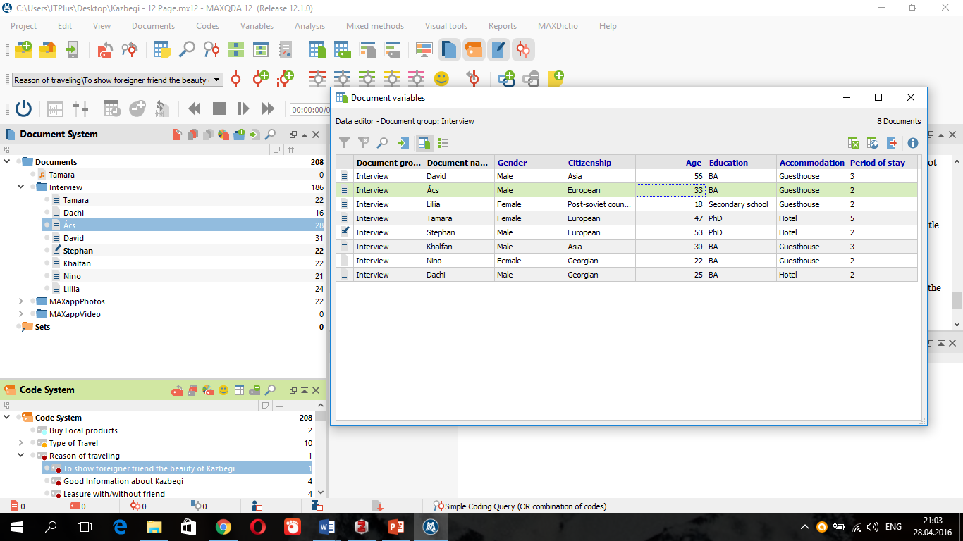
Methodology (Characteristics presented in MAXQDA)
ISCONTOUR 2016

Slide 12
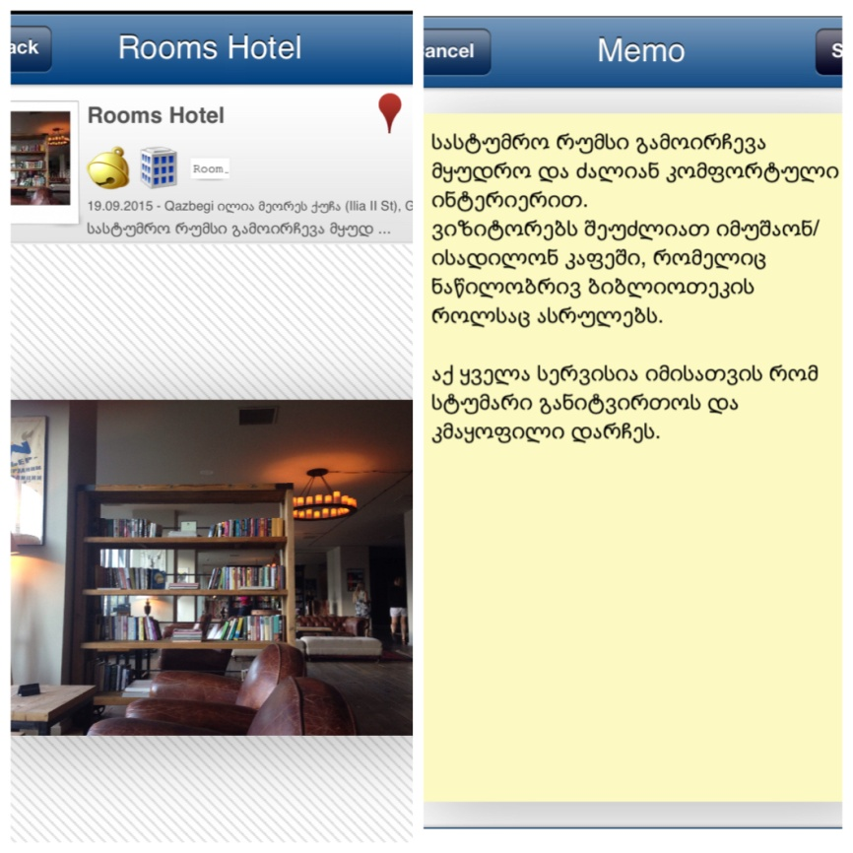
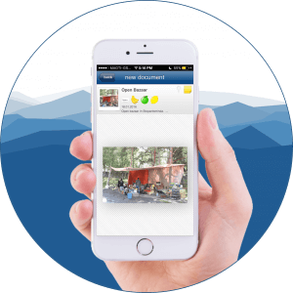
Methodology (MAXApp for collecting data)
MAXApp is application for collecting various type of information
ISCONTOUR 2016

Slide 13
Travelling Strategies
The research has identified three types of travelling strategies:
alone
with friends and/or family.
The majority of sampled respondents noted that leisure and relax is one of the main factors which determines their trip to Kazbegi.
ISCONTOUR 2016

Slide 14
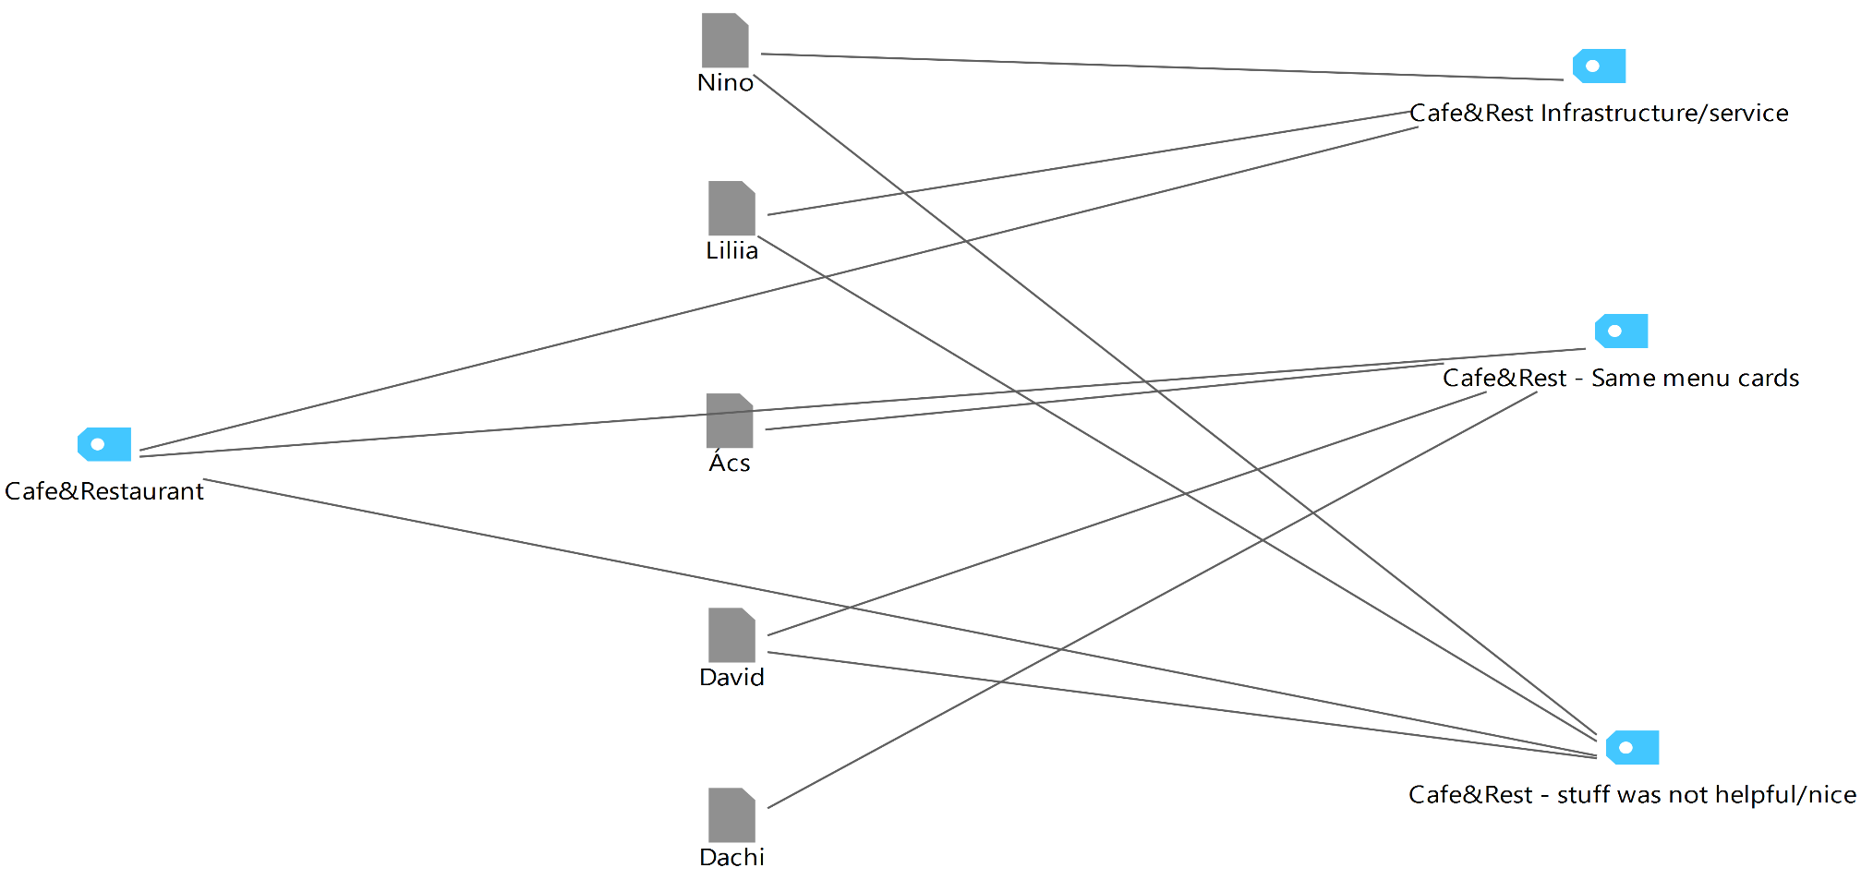
Cafes and Restaurants
The results have shown that the majority of sampled visitors are dissatisfied with the delayed and/or low quality services provided by waiters and waitresses. From their point of view the staff is too stressed and rarely nice, also they don’t have English language skills.
ISCONTOUR 2016

Slide 15
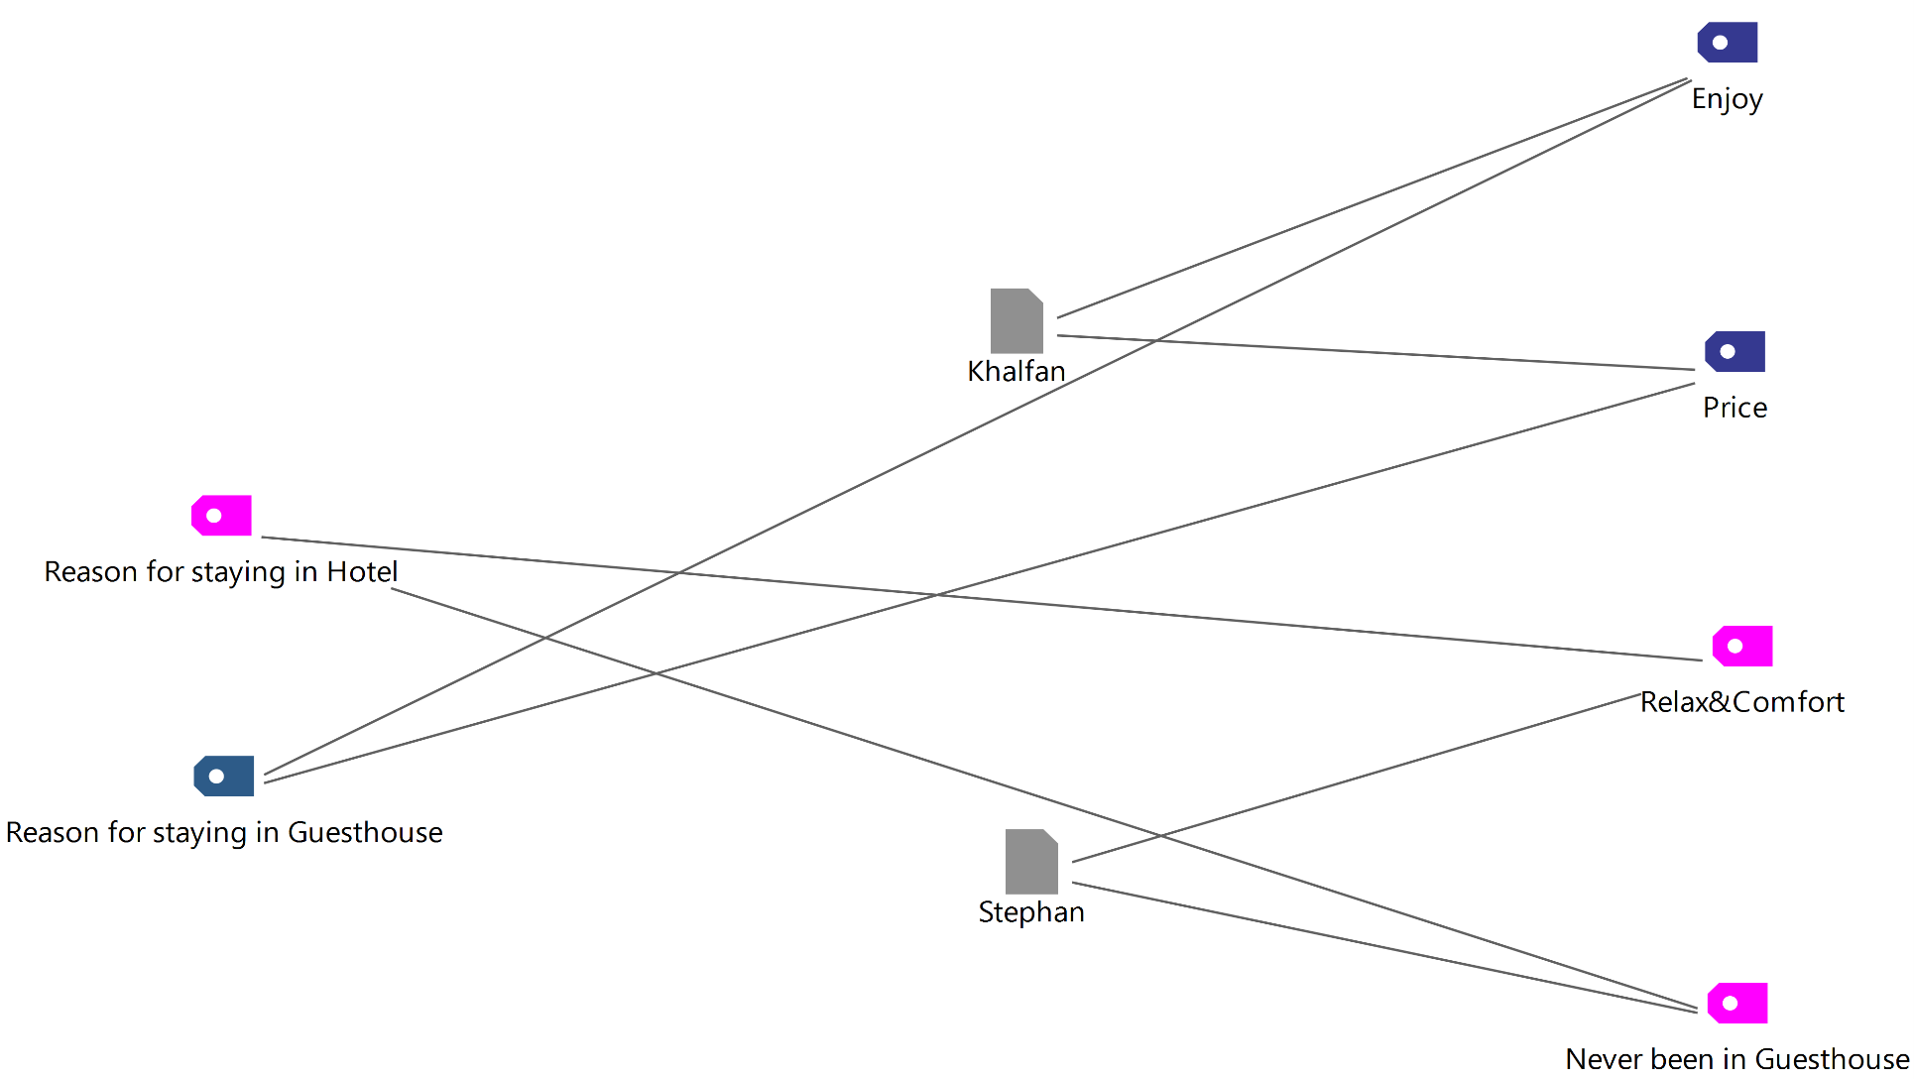
Hotels and Hotel-type establishments
According to the analysis of the narratives, tourists who prefer to stay in hotel in contrast with guesthouse visitors are more focused on offered services and leisure than exploration of wild-nature and local culture.
ISCONTOUR 2016

Slide 16
Hotels and Hotel-type establishments
The majority of visitors of hotels expressed their satisfaction with regard to smart, polite and friendly staff, high quality of offered services and food, excellent and convenient infrastructure. Some of the respondents noted that the prices are quite high but all of them confirmed that it is worth of what they pay for.
The minority of the sampled respondents who stayed in guesthouse felt dissatisfied with shared bathroom, cost of breakfast and disturbed privacy.
"I would prefer hotels more than to live in someone’s house. We need more privacy." (Male, Asia, Guesthouse, Age 56).
ISCONTOUR 2016

Slide 17
Study Findings (Informal Tourism Services)
The guesthouses are characterized by informal services, which are not officially published but are distinguished by their unique value (Georgian hospitality). In particular, when being at a guesthouse, a host willingly offers clients his/her help in solving problems like guide hiring, tour planning, horse rental, information about sightseeing, taxi services, excursions, etc.
ISCONTOUR 2016

Slide 18
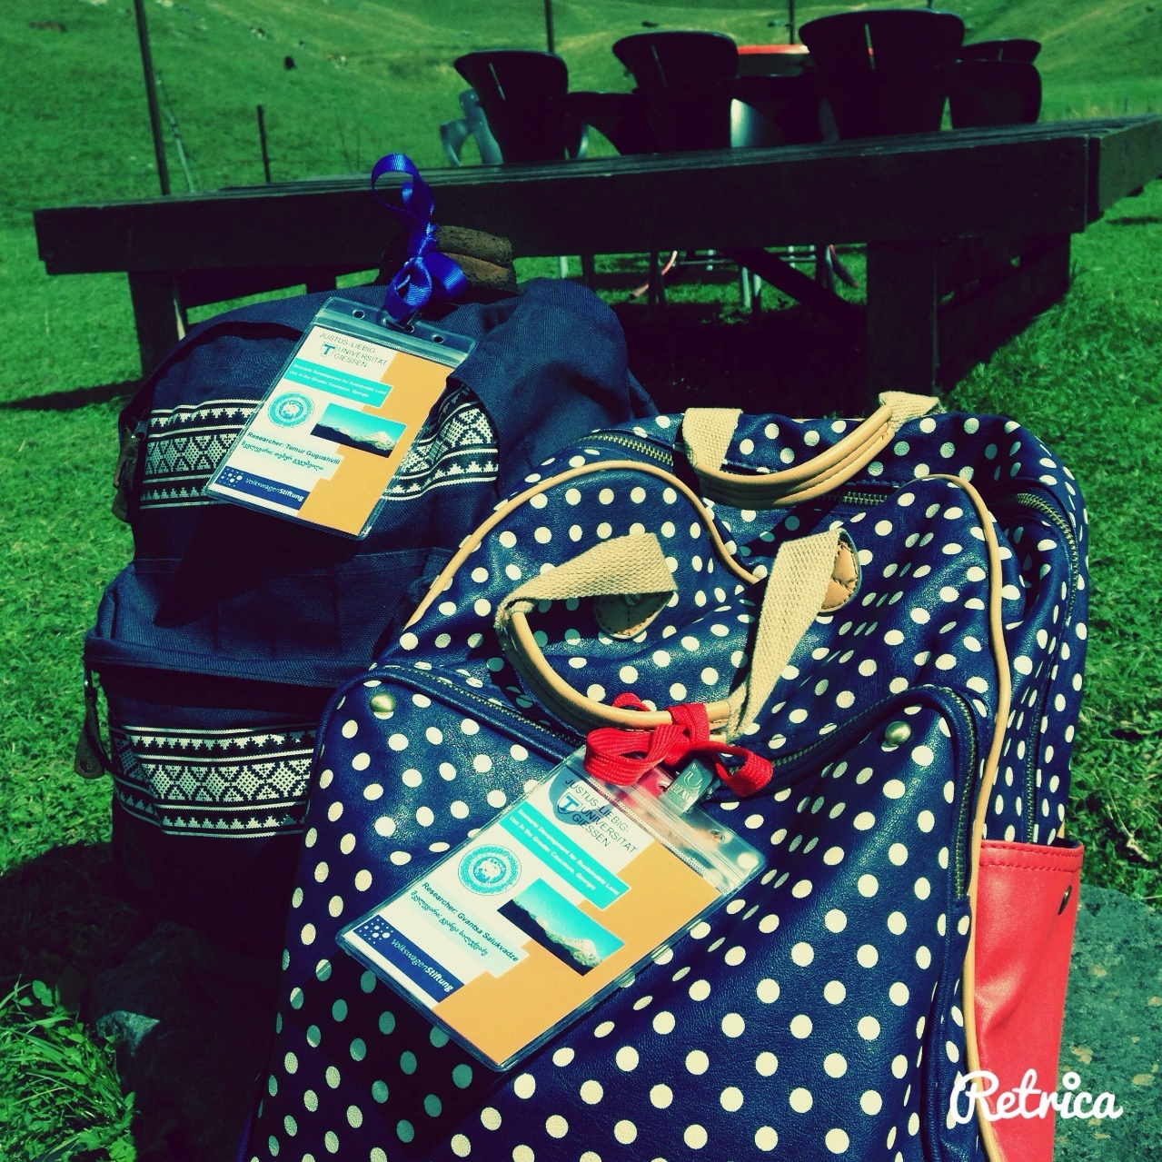
Thank you for your time !!!
ISCONTOUR 2016

