Slide 1



Copy and Paste for Hotel Mobile Websites?
Or: The Power of Screen Sizes
Melanie Fraiss, FH Salzburg, Austria
Sofiya Iliycheva, FH Salzburg, Bulgaria
www.tourism-student-conference.com

Slide 2
Why researching mobile devices in hospitality?
ICTs play a critical role in tourism success
Smartphones as drivers
Extensive adoption of tablets
Facts and figures
  In 2012 more than 1/6 of 300 million visits of on a hotel website came from mobile devices (Adobe Systems Incorporated)
  In 2016 51,8% of all who book trips online will do that via a mobile device (emarketer)
ISCONTOUR 2016

Slide 3
Who are the online customers?
Generation Y (1980 - 1994)
  "Digital Natives“
    Grow up with the internet
      Technology familiarity
They expect high usability
Every mistake can cause a business loss
ISCONTOUR 2016

Slide 4
Usability & Content
Influence the purchasing process
Usability components
  Efficiency
  Effectiveness
Problems
  Search function
  Findability (navigation, links)
  Website Design (layout, readability, scrolling
Content
  Set of content related objects (text, tone, video, other media)
  Important for profit maximization
  Close link to customer satisfaction
ISCONTOUR 2016

Slide 5
Responsive Website Design (RWD)
Website design paradigm
Makes same website adaptive to different screen sizes
Enhancement of user experience on all devices
Desktop experience differs from mobile device experience
ISCONTOUR 2016

Slide 6
Research Questions
What are differences in perceived usability of a hotel mobile website in the context of different screen sizes?
How do perceptions of content importance vary in the context of different screen sizes?
What are implications that can be derived from differences occurring on one and the same website in the context of different screen sizes?
ISCONTOUR 2016

Slide 7
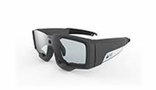

Methodology & Procedure
Triangulation
  Eye-tracking
    Think-aloud protocols
      Semi-structured interviews
Sample size - 2 groups of 7 participants per device
Chosen website for the study: Hotel Blaue Gans
ISCONTOUR 2016

Slide 8
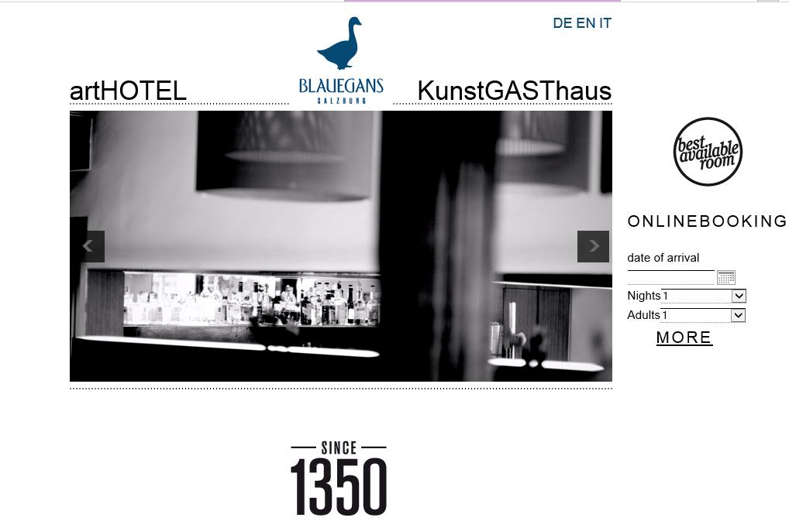
ISCONTOUR 2016

Slide 9
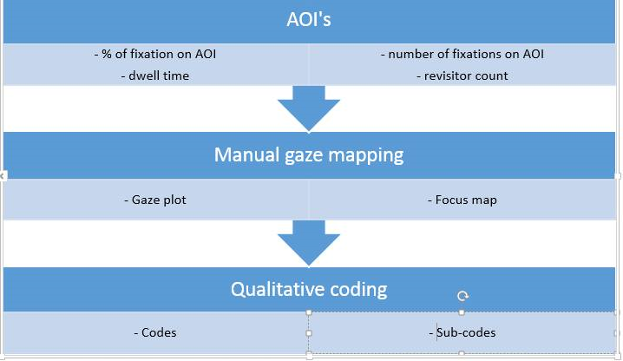
Evaluation and Findings
ISCONTOUR 2016

Slide 10
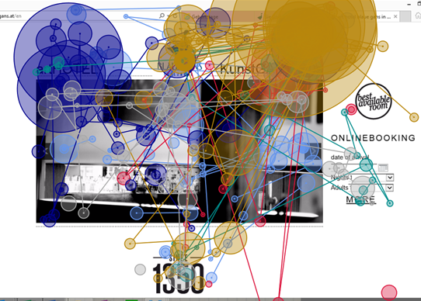
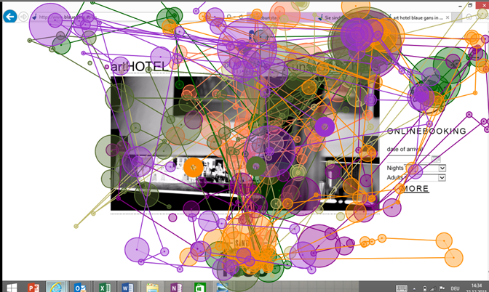
Findings on Content
I-Pad users
I-Phone users
ISCONTOUR 2016

Slide 11
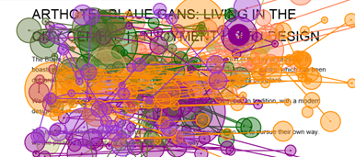
AOI - Text
I-Phone users reading pattern
ISCONTOUR 2016

Slide 12
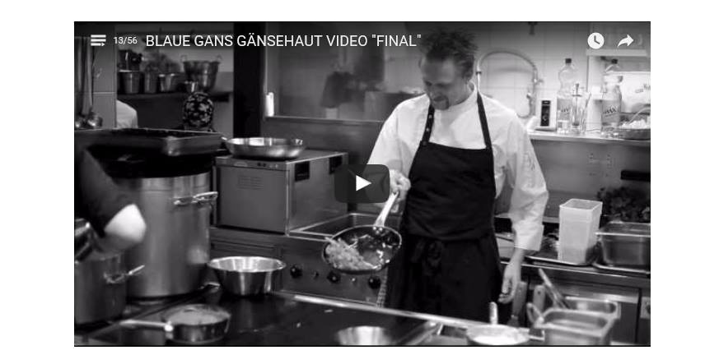
AOI - Video
ISCONTOUR 2016

Slide 13
Attention Catchment Area
Eye tracking analysis
Tablet users
- coherent with findings
Phone users
- overall page equals picture block
ISCONTOUR 2016

Slide 14

Findings on Usability
Problems with language choice
ISCONTOUR 2016

Slide 15
Implications
Same website appearance - major differences
Phone users are more likely to scroll
Focus on letter size
No video on mobile phone websites
Effect of confusion is more negative on small screen sizes - impatience
Tablet users focus on important content - phone users focus on unimportant content
Problems with category names
RWD is not sufficient anymore - content has to be tailored to different devices!
ISCONTOUR 2016

Slide 16
Limitations & further research
Eye-tracking solution - technical issues
Artificial environment
Sample size
Further research - quantitative
ISCONTOUR 2016

Slide 17
Thank you very much for your attention!
ISCONTOUR 2016

