Slide 1
Social Destinations An Exploratory Study of Social Media Use by Destination Marketing Organisations
Dean Creevey
Institute of Technology Tallaght
Dublin, Ireland
www.tourism-student-conference.com

Slide 2
A little bit of background …
Of the 7.4b that make up the world’s population, 3.4b are internet users (46%), 2.3b are active social media (SM) users (31%)
(We Are Social, 2016)
Further research needed into how tourism practitioners are employing SM platforms
(Hays et al., 2013; Morosan, 2015)
Implications of SM marketing still remain unclear
(Ratchford, 2015)
ISCONTOUR 2016

Slide 3
Destination Marketing Framework
Designed by Steven Pike and Stephen Page in 2014 within their review of DM literature post 1973, published in Tourism Management
Authors’ aim was to ascertain to what extent is a DMO ultimately responsible for the competitiveness of the destination
Framework illustrates the pivotal internal and external forces responsible in sustaining destination competitiveness
ISCONTOUR 2016

Slide 4
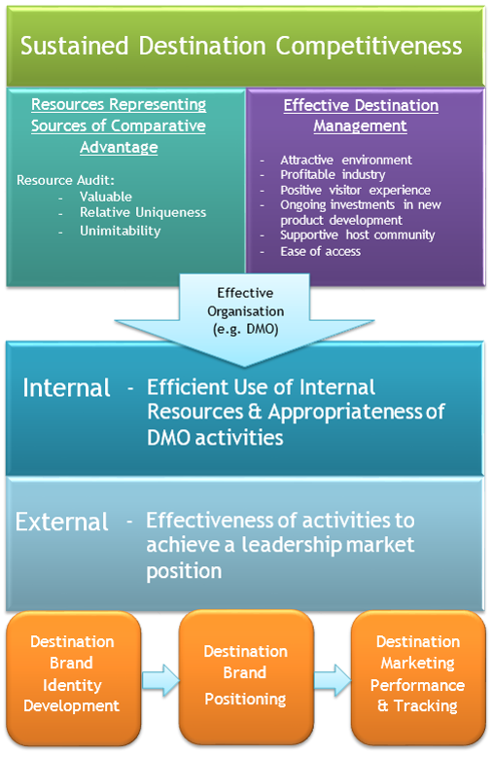
The model itself illustrates the antecedents and requirements on the part of DMOs to achieve “the quintessential goal of all DMOs”, which is “sustained destination competitiveness” (p. 207/208)
The model illustrates the importance of effective external marketing activities, highlighting three key areas which will be explored further in this study within an SM context:
Destination Brand Identity Development;
Destination Brand Positioning;
Destination Marketing Performance Measurement and Tracking.
ISCONTOUR 2016

Slide 5
Research Aims
RQ1: How do DMOs feel SM can contribute in developing and maintaining a positive destination brand identity?
RQ2: How do DMOs feel SM can contribute in achieving a favourable brand position?
RQ3: How do DMOs feel is the most prudent way of measuring and evaluating brand performance on SM?
ISCONTOUR 2016

Slide 6
Methodology
Eight semi-structured interviews conducted with a total of nine SM Managers representing DMOs across three continents
4 national-level DMOs
3 state-level DMOs (USA)
1 city-level DMO
Deductive thematic analysis (Braun & Clarke, 2006) conducted of all qualitative data using NVivo
ISCONTOUR 2016

Slide 7
Destination Brand Identity Development
Pike and Page (2014) describe brand identity as being “the vision for how the destination should be perceived in the marketplace”, entailing such components as values, key competitors, positioning statement, key attributes and benefits, and target audience
Findings include polarising accounts of perceived destination image, but consensus in recognising limited scope/difficulty in achieving a comprehensive shift in identity
Destination as a living location relinquishes control over image
Emphasis on relevant audience engagement, multi-faceted nature of the destination
Leveraging new platforms to reinvigorate attractions and amenities
ISCONTOUR 2016

Slide 8
Destination Brand Positioning
Pike and Page (2014) state it’s the role of the DMO to identify and evaluate stories and narratives regarding their destination and to identify patterns in the anecdotes of visitors in order to achieve consistency and effective brand positioning
While content is specifically designed for granular segments of the audience, hashtags remain consistent
Targeting content and ads, flexibility needed to accommodate volatile platform conditions
Algorithm changes in Facebook (and now Instagram)
ISCONTOUR 2016

Slide 9
Destination Marketing Performance Measurement & Tracking
Pike and Page (2014) make explicit reference to EAV formula as a popular means of value attribution, and was employed in one specific case in the present study
In a social media context; its impact can be useful, but has its shortcomings
Additional formula employed by one DMO:
Benefits from speed and transferability; lacks rigidity; and qualitative analysis is absent
Does Facebook Reactions necessitate in new approach to engagement and sentiment analysis?
Comments + Shares + √ Likes
(total number of)
ISCONTOUR 2016

Slide 10
Thank you for listening!
Braun, V. and Clarke, V. (2006) 'Using Thematic Analysis in Psychology', Qualitative Research in Psychology, 3(2), pp. 77-101.
Hays, S., Page, S. J. and Buhalis, D. (2013) 'Social Media as a Destination Marketing Tool: Its Use by National Tourism Organisations', Current Issues in Tourism, 16 (3), pp. 211-239.
Morosan, C. (2015) 'The Influence of DMO Advertising on Specific Destination Visitation Behaviours', Journal of Hospitality Marketing & Management, 24(1), pp. 47-75.
Pike, S. and Page, S. J. (2014) 'Destination Marketing Organizations and Destination Marketing: A Narrative Analysis of the Literature', Tourism Management, Vol. 41, pp. 202-227.
Ratchford, B. (2015) 'Some Directions for Research in Interactive Marketing', Journal of Interactive Marketing, Vol. 29, pp. v-vii.
Pike, S. and Page, S. J. (2014) 'Destination Marketing Organizations and Destination Marketing: A Narrative Analysis of the Literature', Tourism Management, Vol. 41, pp. 202-227.
We Are Social. (2016) Digital in 2016 [online], available: http://http://wearesocial.com/uk/special-reports/digital-in-2016/ [accessed 02 February 2016].
ISCONTOUR 2016

