Slide 1
It's Not What You Know,
It's Who You Know:
Analyzing relational structures to understand and predict behavior
Inga Carboni, Ph.D.

Slide 2

Learning Objectives
Learn how the network perspective differs from traditional approaches to examining phenomenon.
Understand the central concepts of network analysis, including centrality, density, and brokerage.
Understand the major steps involved in conducting a network study from contacting organizations to creating questionnaires to storing and analyzing data.
Develop a framework for evaluating the value of taking a network approach on future research projects.​

Slide 3
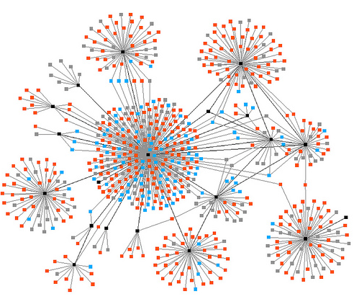
Workshop Agenda
Introduction to networks
Defining social network analysis
Major network concepts and measures
Designing a social network research project

Slide 4
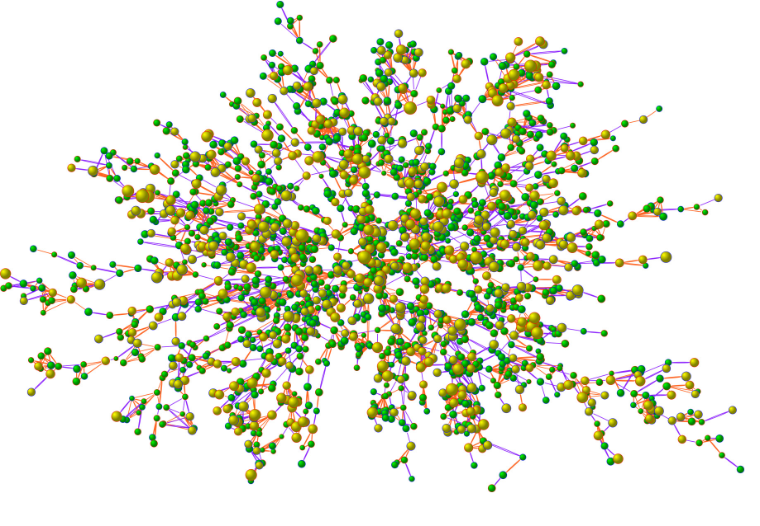
Obesity and Friendship

Slide 5
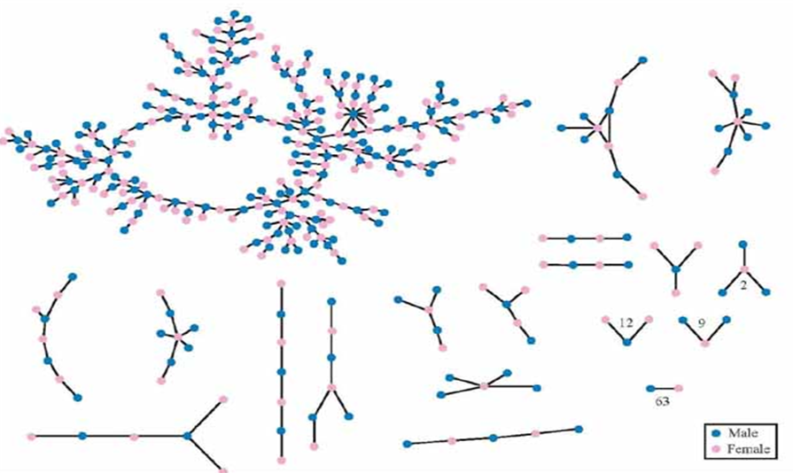

Slide 6
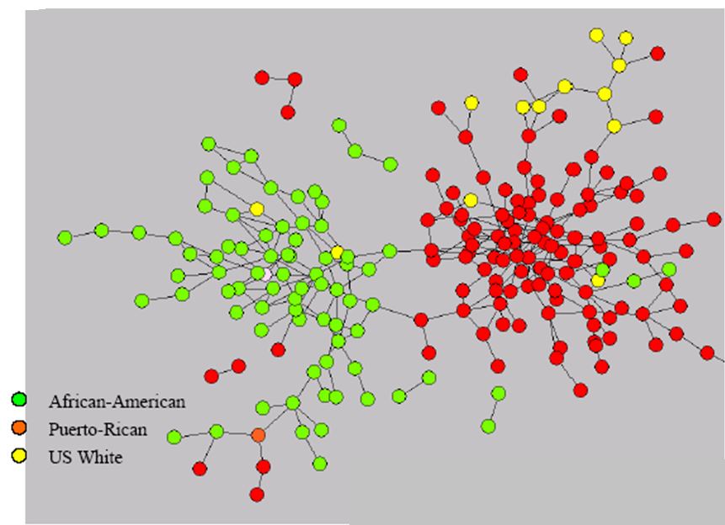

Slide 7
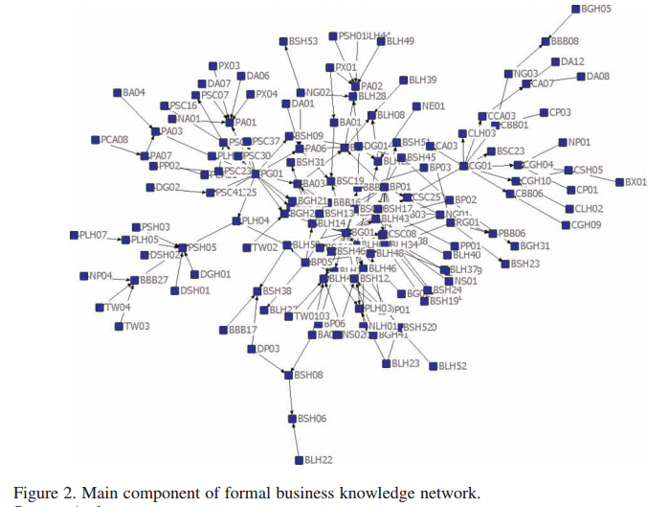
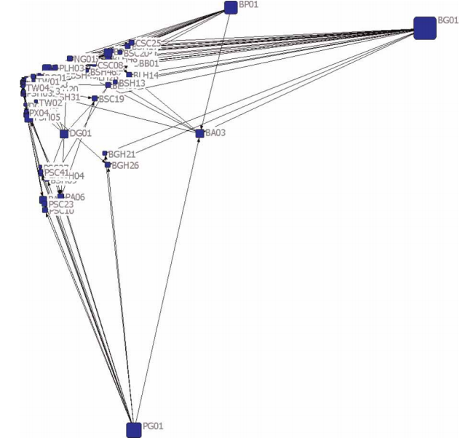

Slide 8
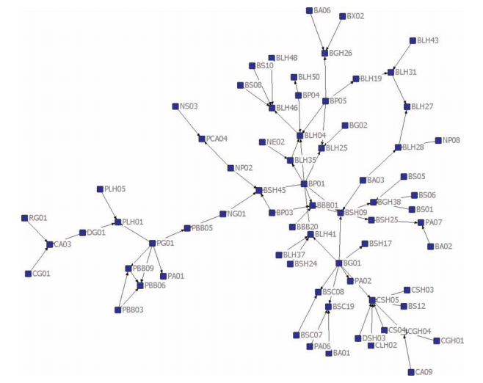
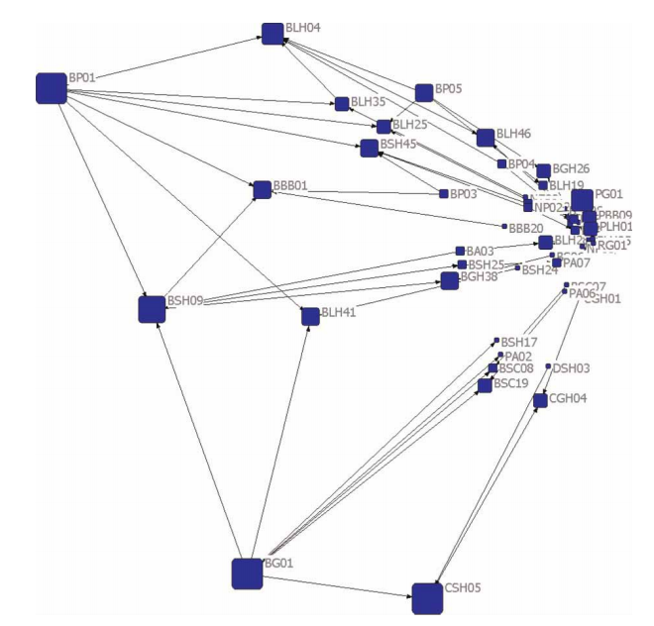

Slide 9
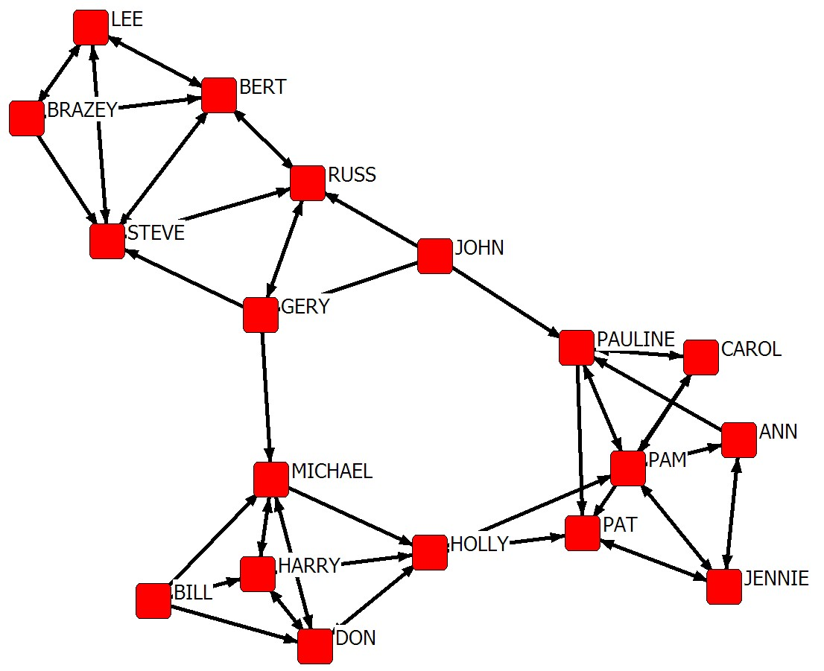
What Defines Social Network Analysis?
Perspective taken
  Network position shapes opportunities and constraints for actors
    Who you know influences what you think, feel, do
  Relations between actors have important consequences
  Networks are holistic, non-reductionist phenomena
Data
  Relations between actors, not attributes of actors
Methods
  Concepts and tools that capture interdependence

Slide 10
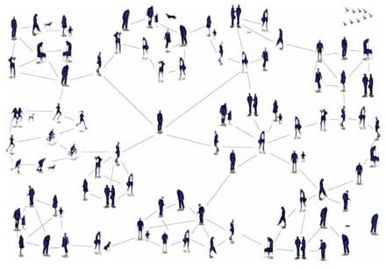
The Network Perspective
Networks have global, local, and dyadic aspects.

Slide 11




Data
Traditional data is attribute data
  self-report (hobbies, likes/dislikes)
  demographics (location, ethnicity, gender)
  group affiliation (religion, nationality)
  satisfaction rating (Yelp, TripAdvisor, etc.)

Slide 12
Attribute Data
Nationality Gender Satisfaction
1 1 1 1
2 7 1 2
3 1 1 1
4 1 2 1
5 3 1 5
6 3 1 1
7 1 2 1
8 3 1 1
9 1 1 3
10 3 1 1

Slide 13
Network Data is Matrix Data
 | HOLLY | BRAZEY | CAROL | PAM | PAT
HOLLY | 0 | 0 | 0 | 1 | 1
BRAZEY | 0 | 0 | 0 | 0 | 0
CAROL | 0 | 0 | 0 | 1 | 1
PAM | 0 | 0 | 0 | 0 | 0
PAT | 1 | 0 | 1 | 0 | 0

Slide 15
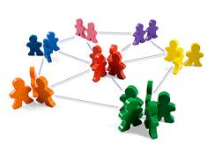
Relationship Types
Cognitive/perceptual
  knows, believes
Role-based
  reports to, friend (of)
  mother, cousin
Physical connection
  road, river, bridge
Affiliations
  belong to same clubs
  visit the same locations
Affective or evaluative
  likes, trusts, enjoys
Behavioral interactions
  give advice, talks to
  travels with
Transfer of material resources
  lends, borrows, receives

Slide 16
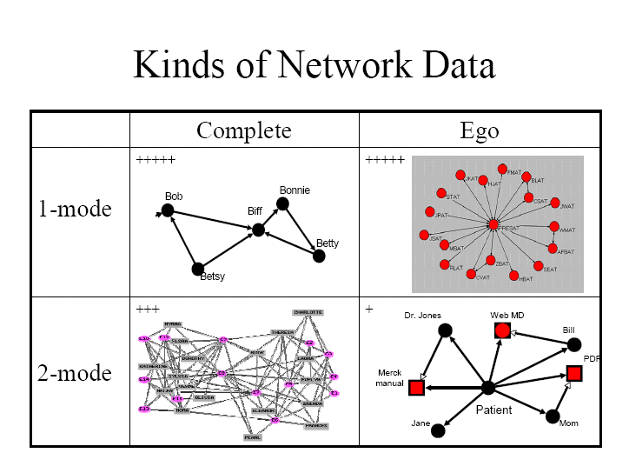

Slide 17
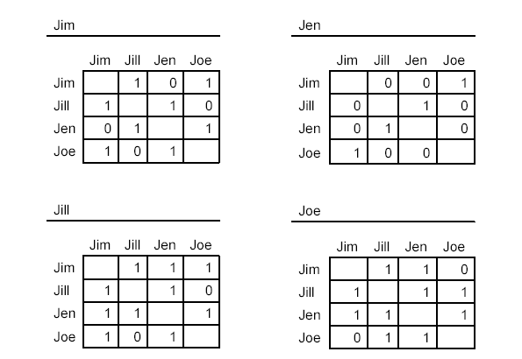
Cognitive Social Structures

Slide 18
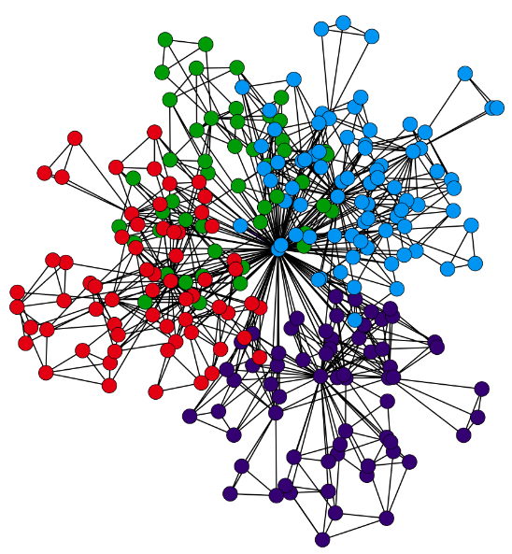
Major network concepts and measures

Slide 19
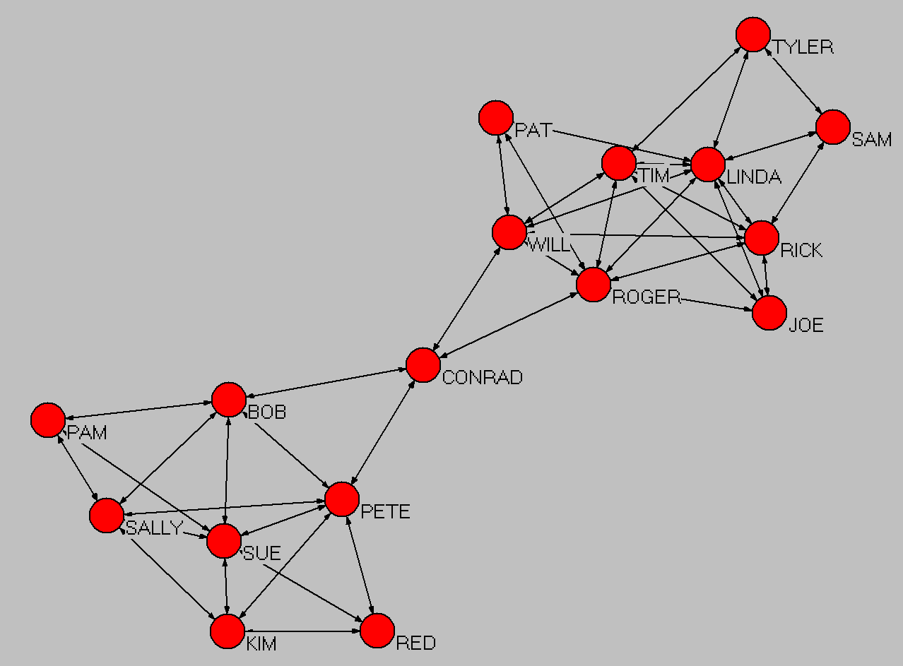
Centrality
Eigenvector
Degree
Closeness
Betweenness
Data courtesy of David Krackhardt

Slide 20
Brokerage and Structural Holes
1
2
2
3
3
1
4
4
5
5
Pat
Chris

Slide 21
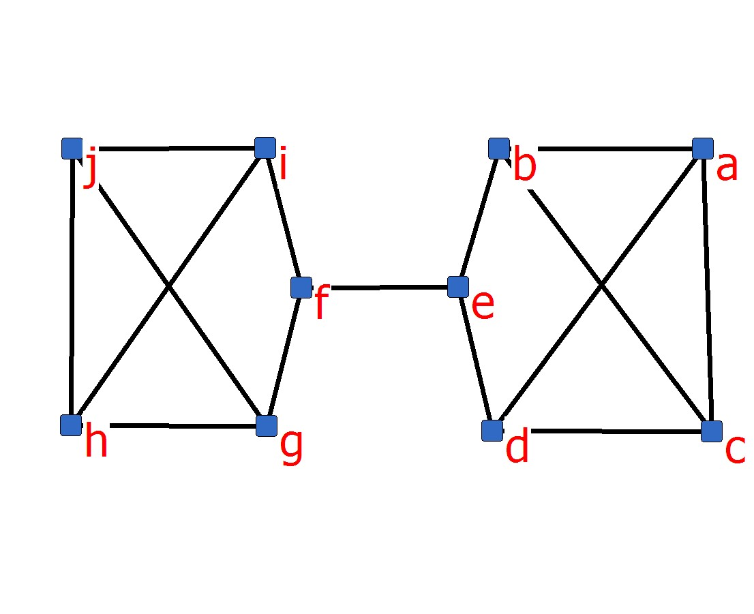
Structural Equivalence

Slide 22
Density and Cohesion
Low Performing Team A
High Performing Team B
Low Performing Team
Who do you trust?

Slide 23
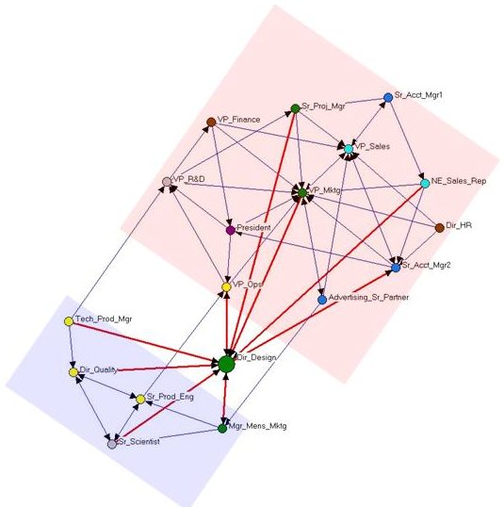
Key Player and Fragmentation

Slide 24
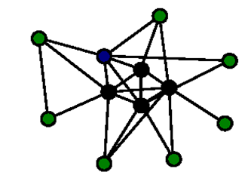
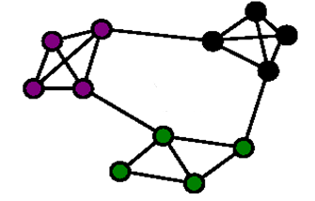
Network Structure
Does the network consist of a core group together with peripheral hangers-on?
Or, does the network consist of distinct clusters or cliques?

Slide 25
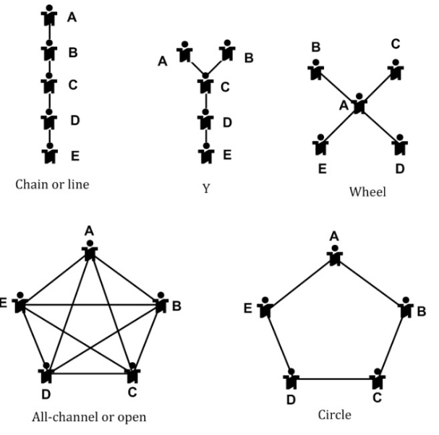
Group Structure

Slide 26
Brokerage Roles
Coordinator
Consultant
Gatekeeper
Representative
Liaison

Slide 27
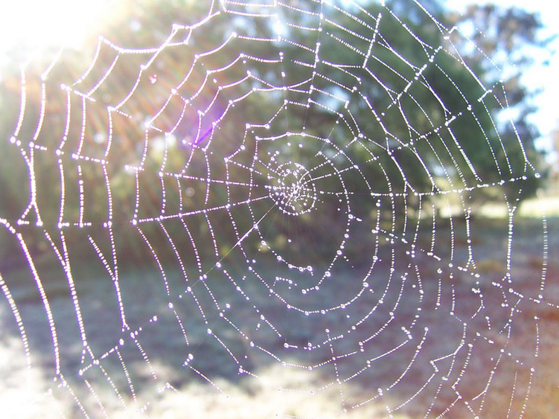
Designing a Social Network Research Project

Slide 28
Start with theory…
Balance theory
  Individuals change their attitudes or their friends in order to achieve balanced relationships
    Individuals will adopt the attitudes of their friends toward another person or thing
Social exchange theory
  Individuals give to others with the expectation that those others will give back to them
    Helping behavior that is not reciprocated will not be repeated
Resource dependency theory
  Actors are powerful to the extent that others are dependent upon them
    People who broker relations between groups are more powerful than people who do not

Slide 29
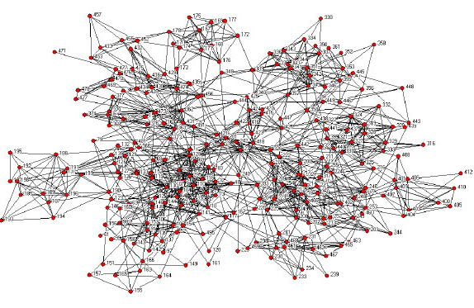
Step One
Identify the population
  Bounding, sampling, access
  One-mode, two-mode, cognitive social structure
  Ego-network, complete network

Slide 30
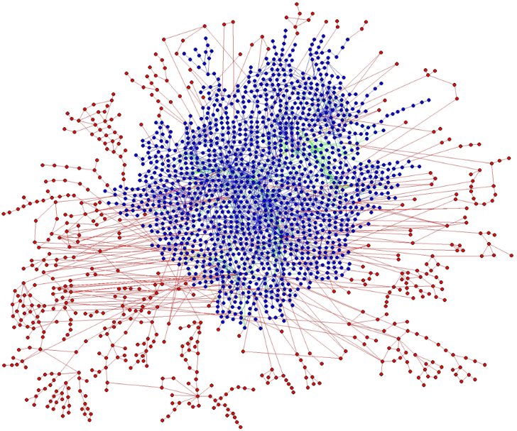
Step Two
Determine data sources
  Archival
  Big data
  Interviews
  Observations
  Surveys

Slide 31

Step Three
Collect data
  Design data collection instrument (if appropriate):
    roster (name generator)
    open-ended
    snowball sample
    CSS
  Questions to ask…

Slide 32
Question Wording Issues
Some words do not mean the same thing to everyone
  Especially across national cultures
Some helpful practices…
  Use one-word label plus two or three sentence description, plus have full paragraph detailed explanation available
  Use homogeneous samples (when appropriate)

Slide 33
Sample Name Generators
Questions that will elicit the names of alters:
From time to time, most people discuss important personal matters with other people. Looking back over the last six months who are the people with whom you discussed an important personal matter? Please just telI me their first names or initials.
Consider the people with whom you like to spend your free time. Over the last six months, who are the one or two people you have been with the most often for informal social activities such as going out to lunch, dinner, drinks, films, visiting one another’s homes, and so on?

Slide 34
Sample Roster
Questions that deal with ego’s relationship with [or perception of] each alter
  How close are you with <alter>?
  How frequently do you interact with <alter>?
  How long have you known <alter>?
All of these questions will be asked for each individual/unit of interest

Slide 35
Sample CSS
Think about the relationship between <alter1> and <alter2>. Would you say that they are strangers, just friends, or especially close?
Note this question is asked for each unique alter. For example, if there are 20 alters, there are 190 alter‐alter relationship questions!
  Typically, we only ask one alter‐alter relationship question

Slide 36
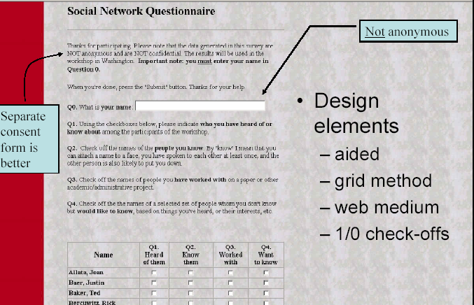

Slide 37

Issues with Network Data
Fatigue
Unexpected asymmetry
Recall biases
  People are not good at understanding their networks
    Bias toward closure & regularly occurring events
  Social desirability, if self-report
Response rates
  Missing data
One-item variables (problem of validity)
  Need very well defined questions

Slide 38

Issues with Network Studies
Statistical tests
  Assumption of interdependence
Developing trust
Lack of anonymity
  IRB and ethics
  Data storage

Slide 39
Some Additional Resources
Introductory text: Scott, J. (2013). Social Network Analysis, A Handbook (3rd edition). London: Sage.
Advanced text: Borgatti, S, Everett, M. & Johnson, J. (2013). Analyzing Social Networks. London: Sage.
Software: Huisman, Mark and van Duijn, Marijtje A.J. (2011). A reader's guide to SNA software. In J. Scott and P.J. Carrington (Eds.) The SAGE Handbook of Social Network Analysis (pp. 578-600). London: SAGE. (http://www.gmw.rug.nl/~huisman/sna/software.html)
UCInet can be downloaded free for one month at www.analytictech.com
More network-related links:
  CASOS: Center for Computational Analysis of Social and Organizational Systems
  INSNA: International Network for Social Network Analysis
  LINKS: University of Kentucky, LINKS center
  NetWiki: Collecting data and collaborating on research about complex networks and applications of network science.
  SNA Tools and formats diagram (Mark Round)
  SIENA homepage: Statistical analysis of network data
  Wikipedia: Social network analysis software

