Slide 1
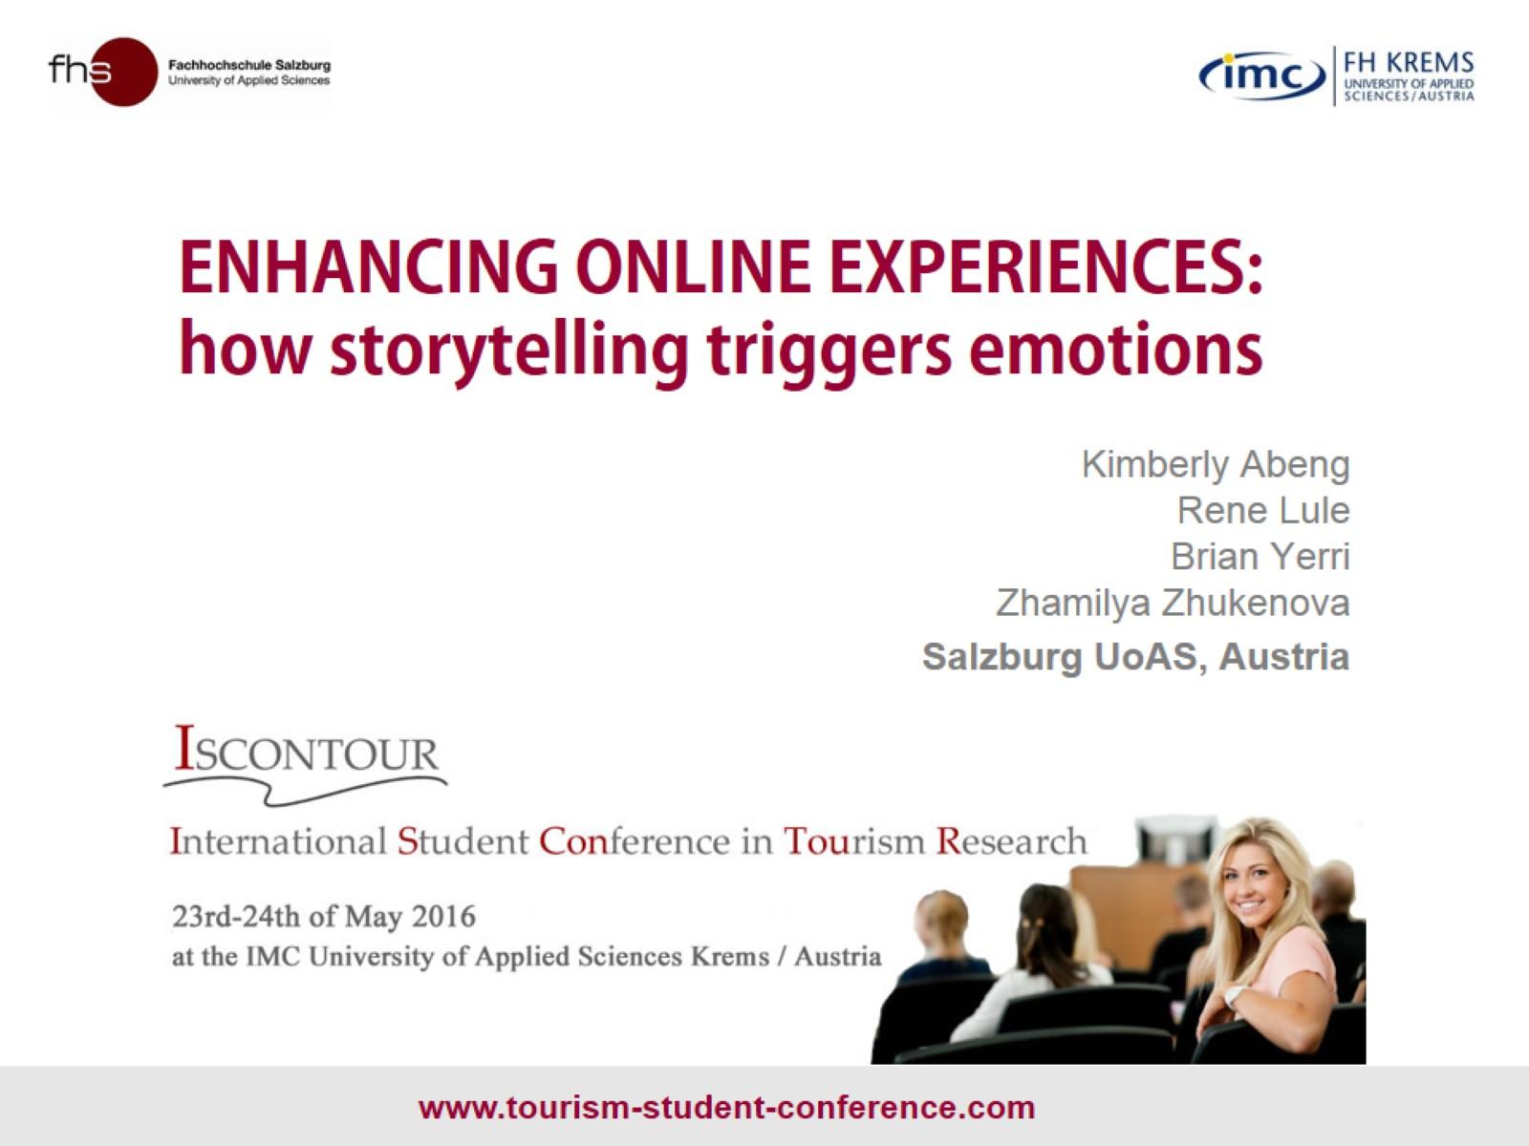
ENHANCING ONLINE EXPERIENCES: how storytelling triggers emotions

Slide 2

EXPERIENCE

Slide 3
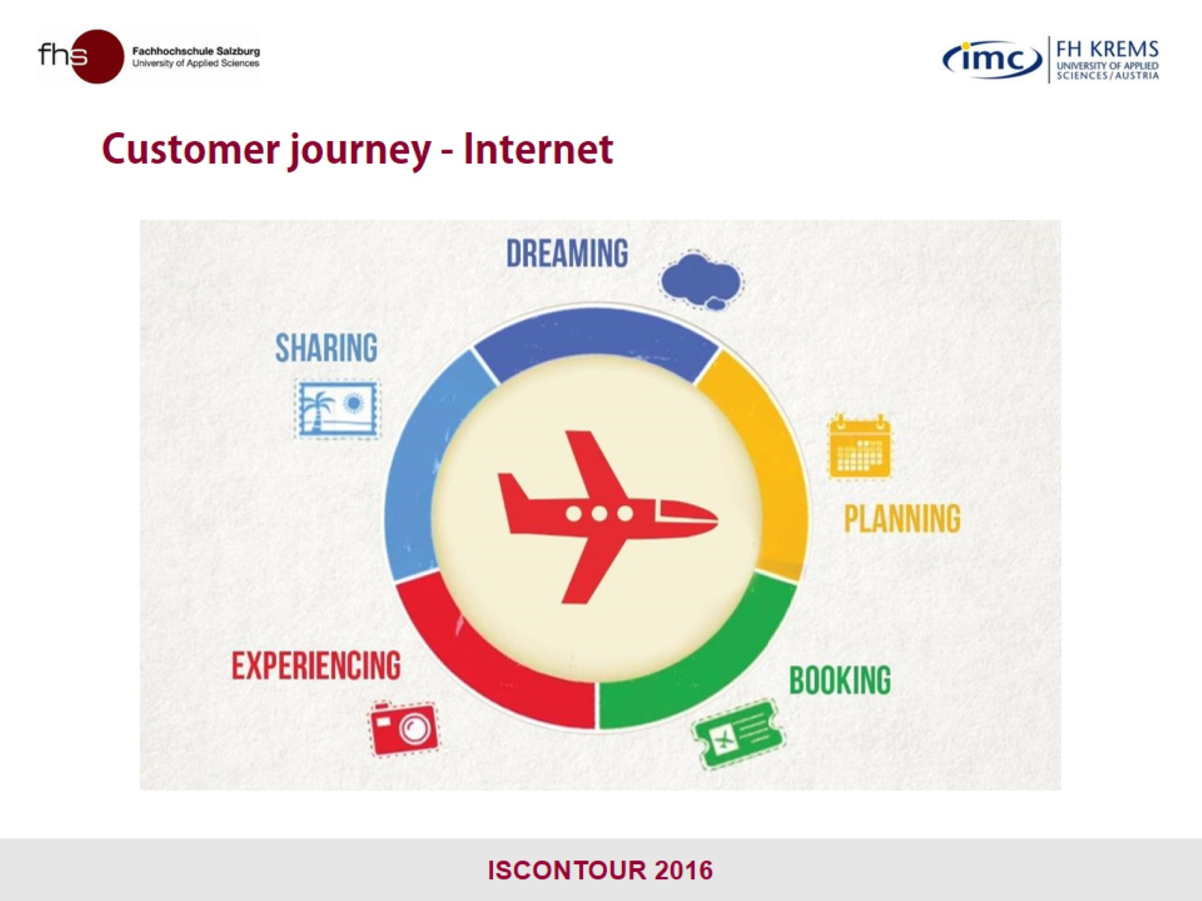
Customer journey - Internet

Slide 4
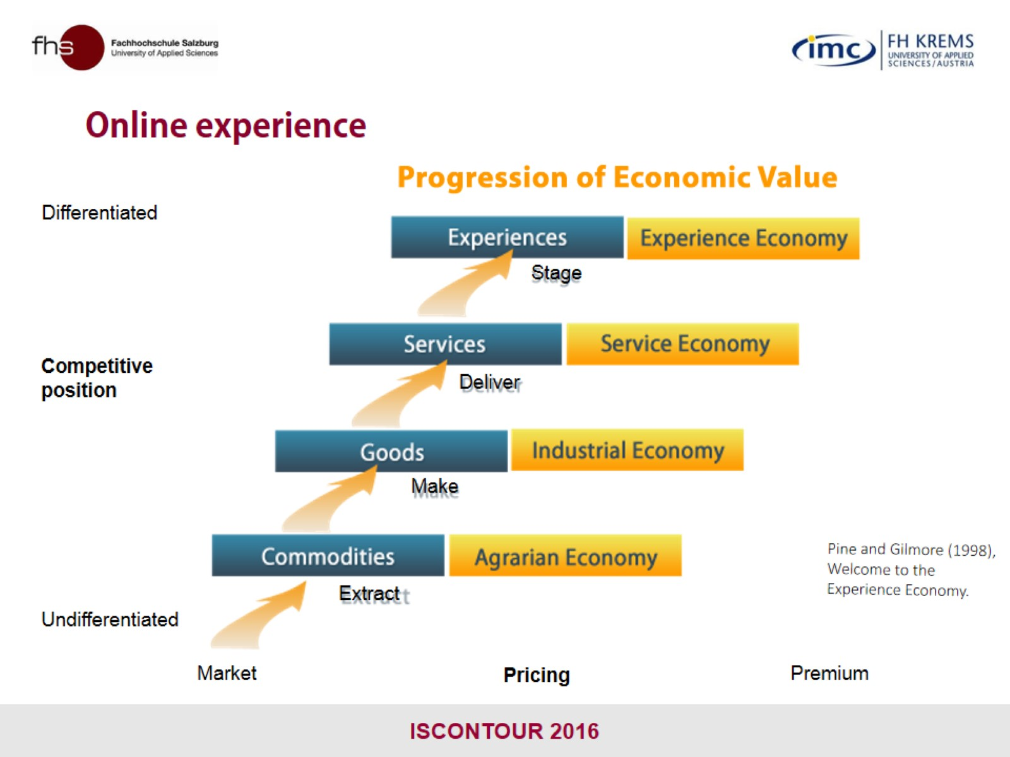
Online experience

Slide 5

STORYTELLING

Slide 6
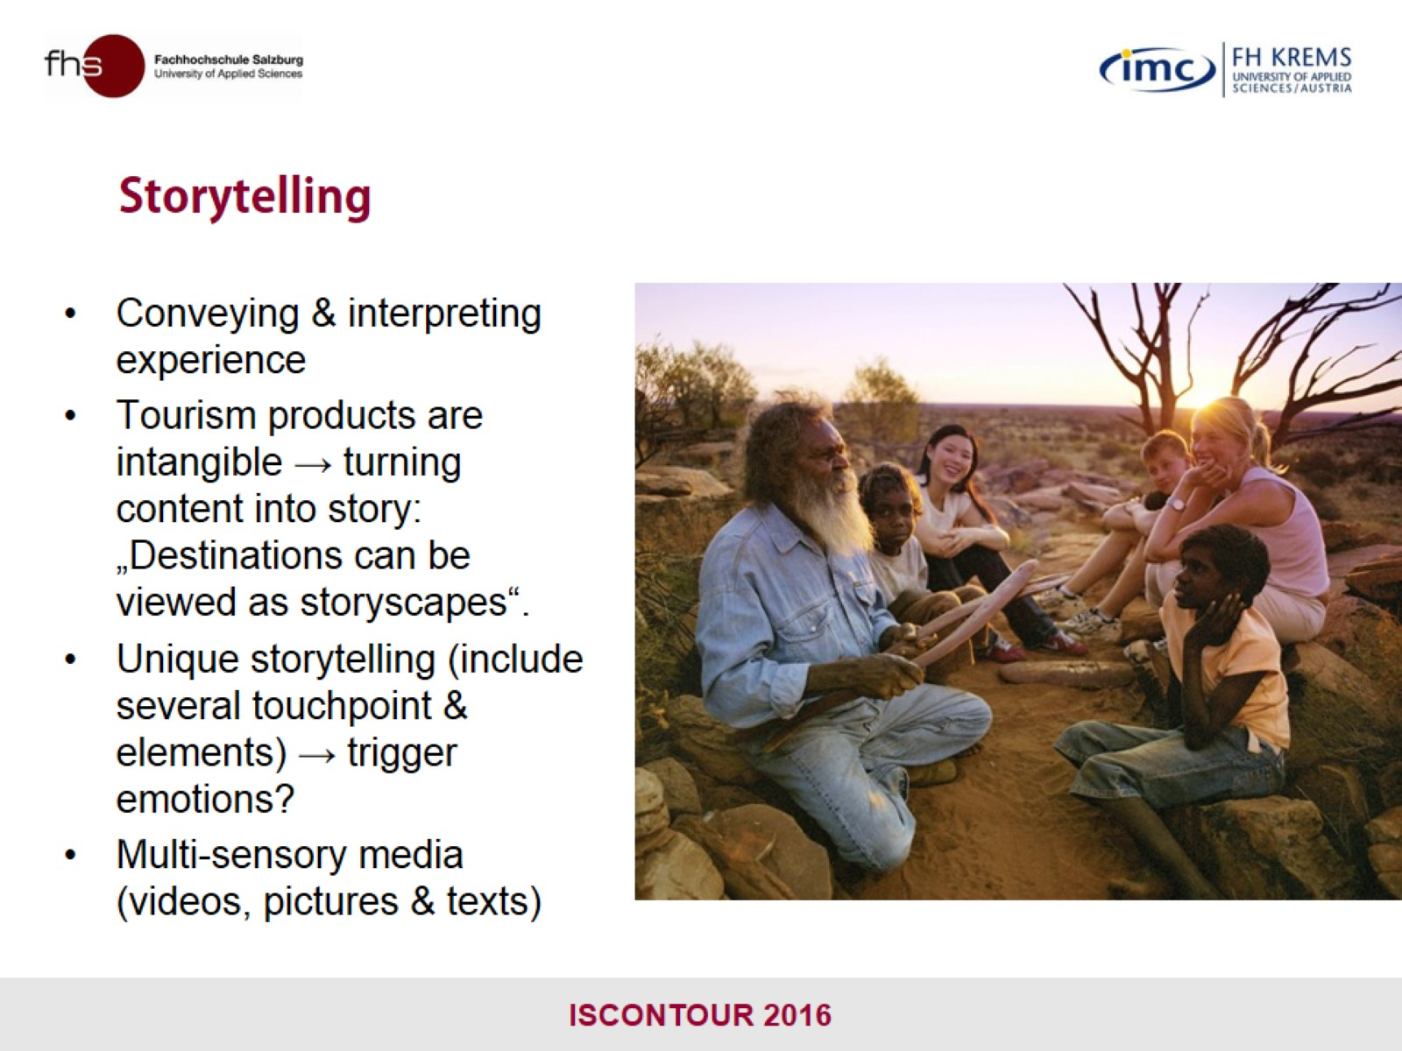
Storytelling

Slide 7

EMOTIONS

Slide 8
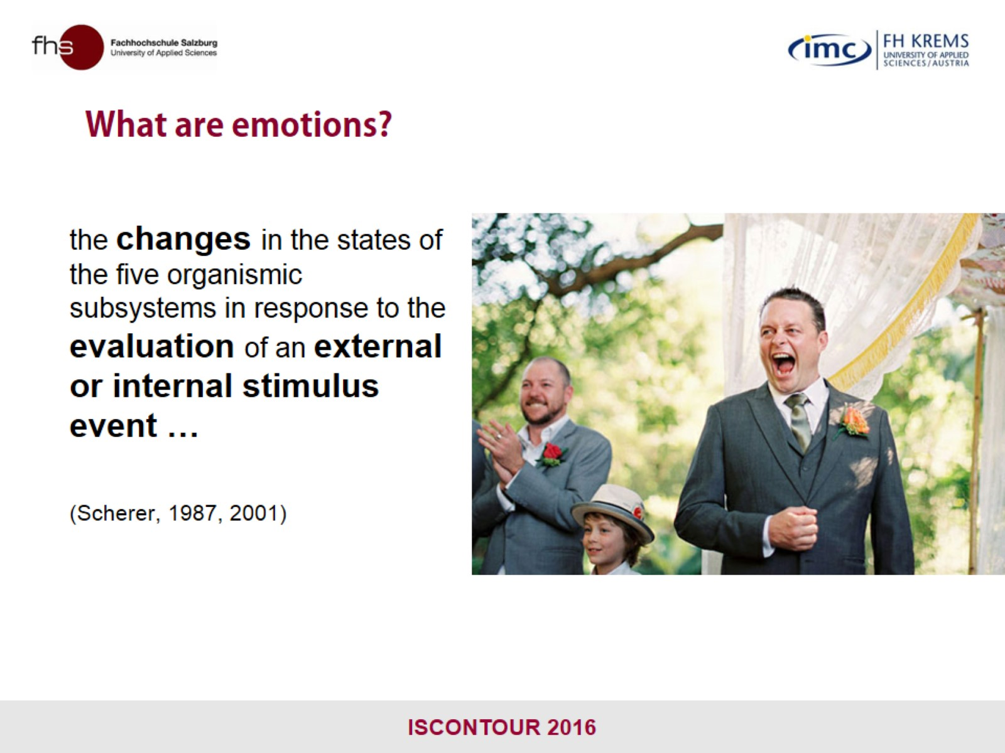
What are emotions?

Slide 9
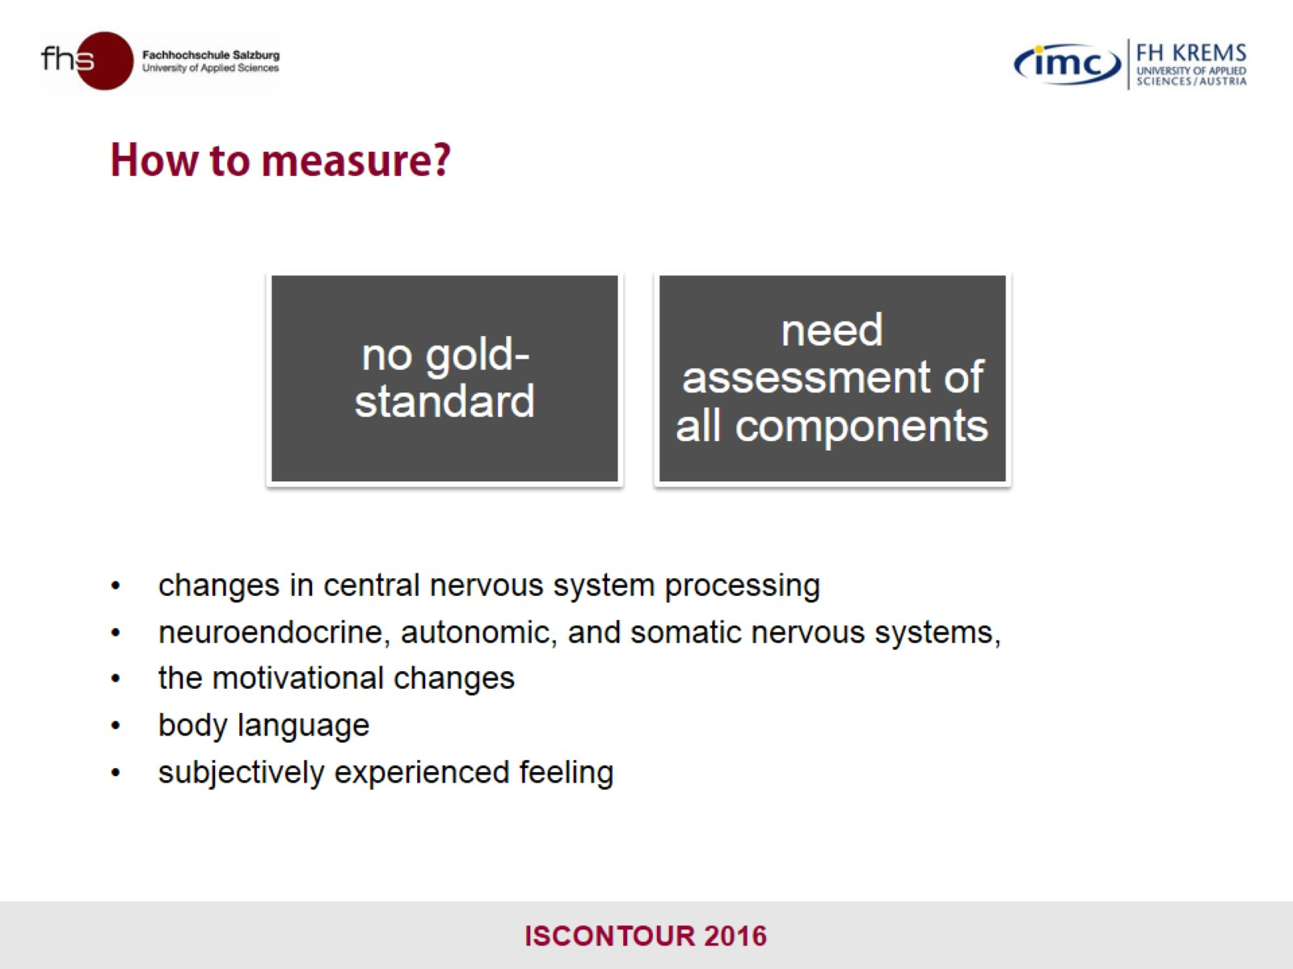
How to measure?

Slide 10
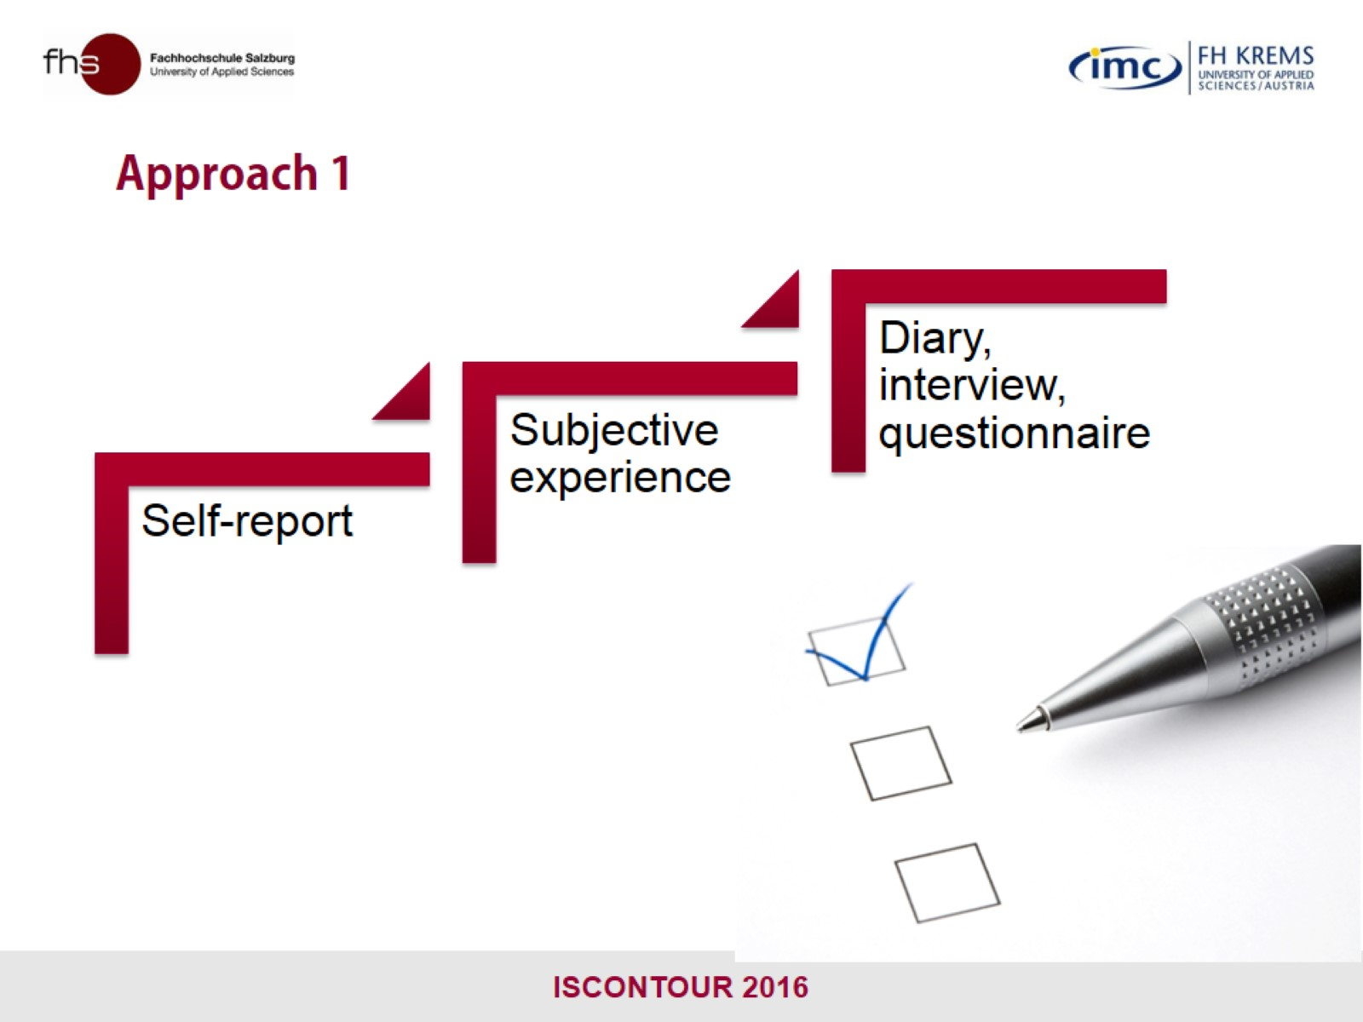
Approach 1

Slide 11
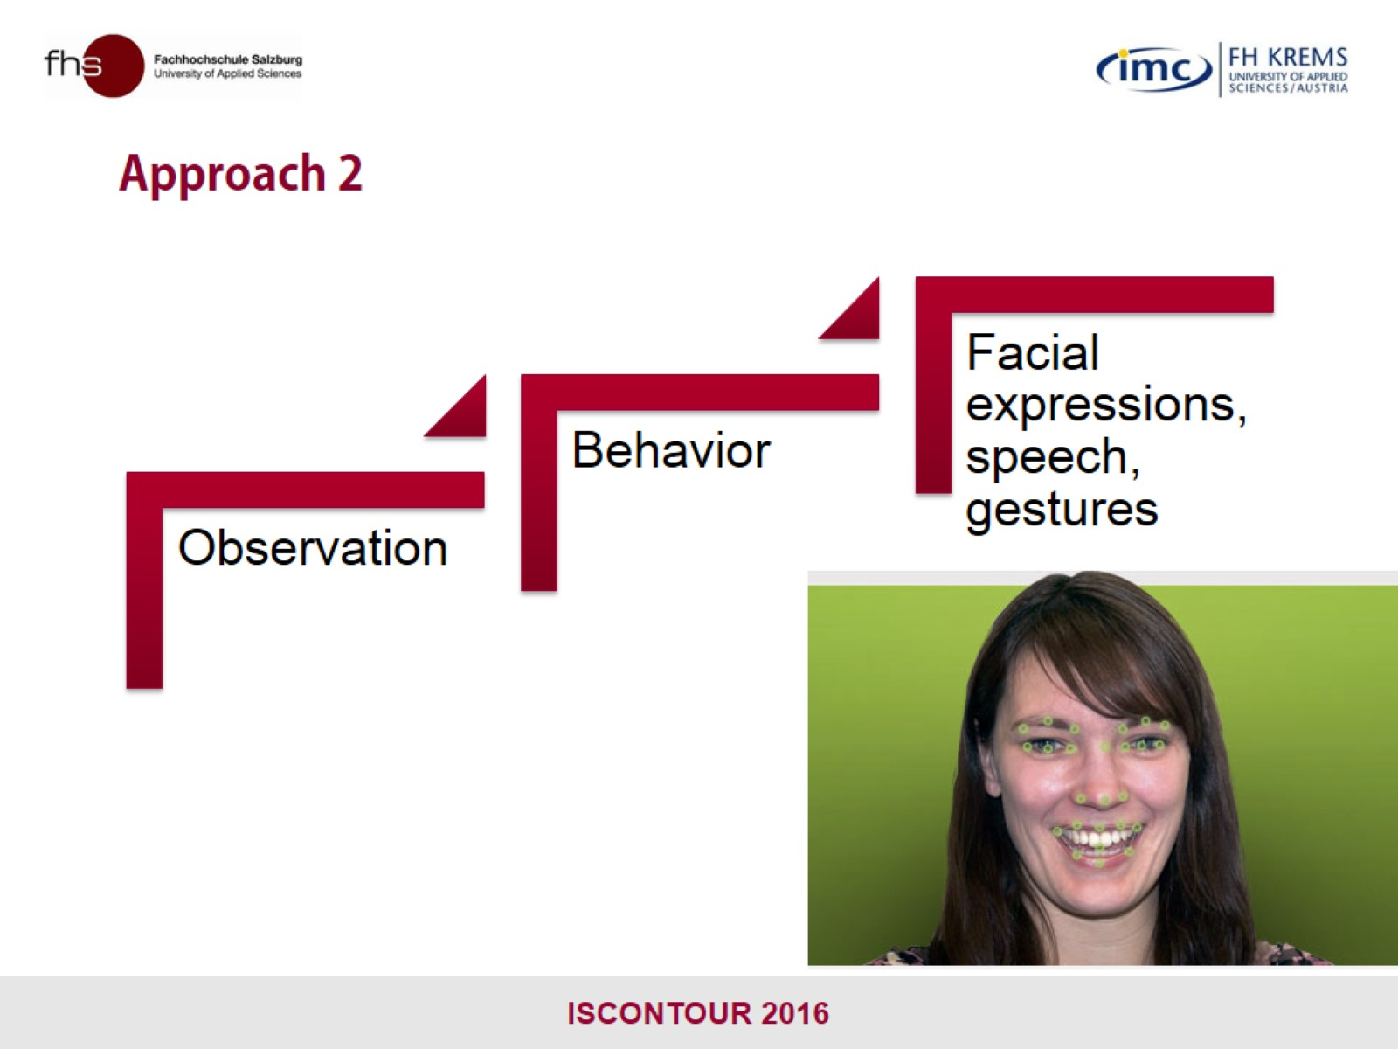
Approach 2

Slide 12
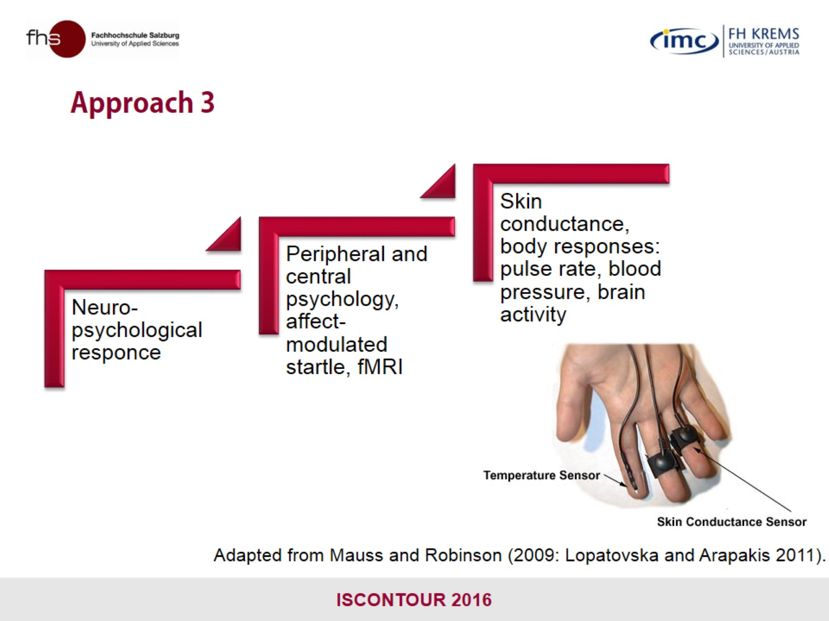
Approach 3

Slide 13

HYPOTHESES

Slide 14
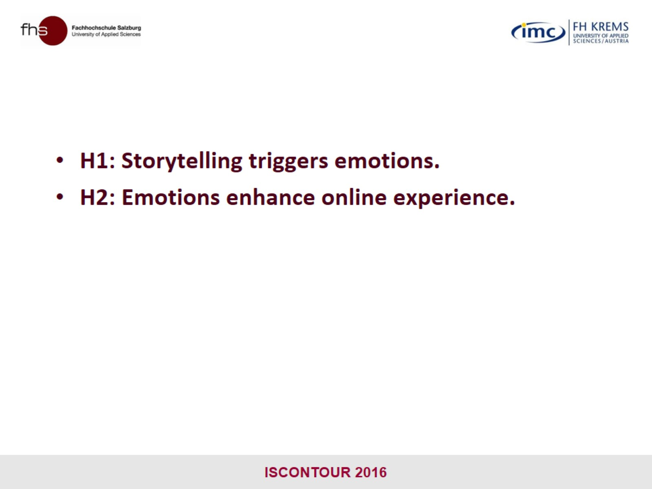

Slide 15

METHODOLOGY

Slide 16
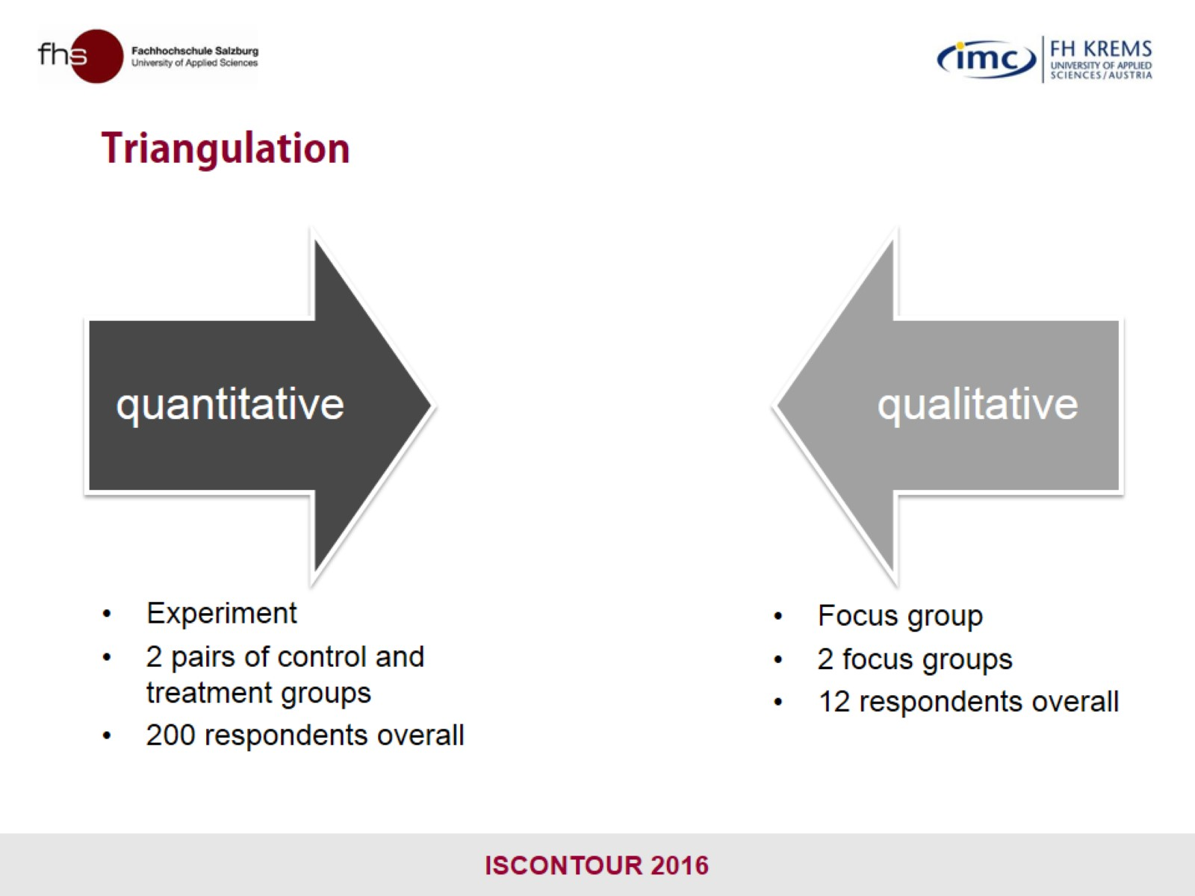
Triangulation

Slide 17
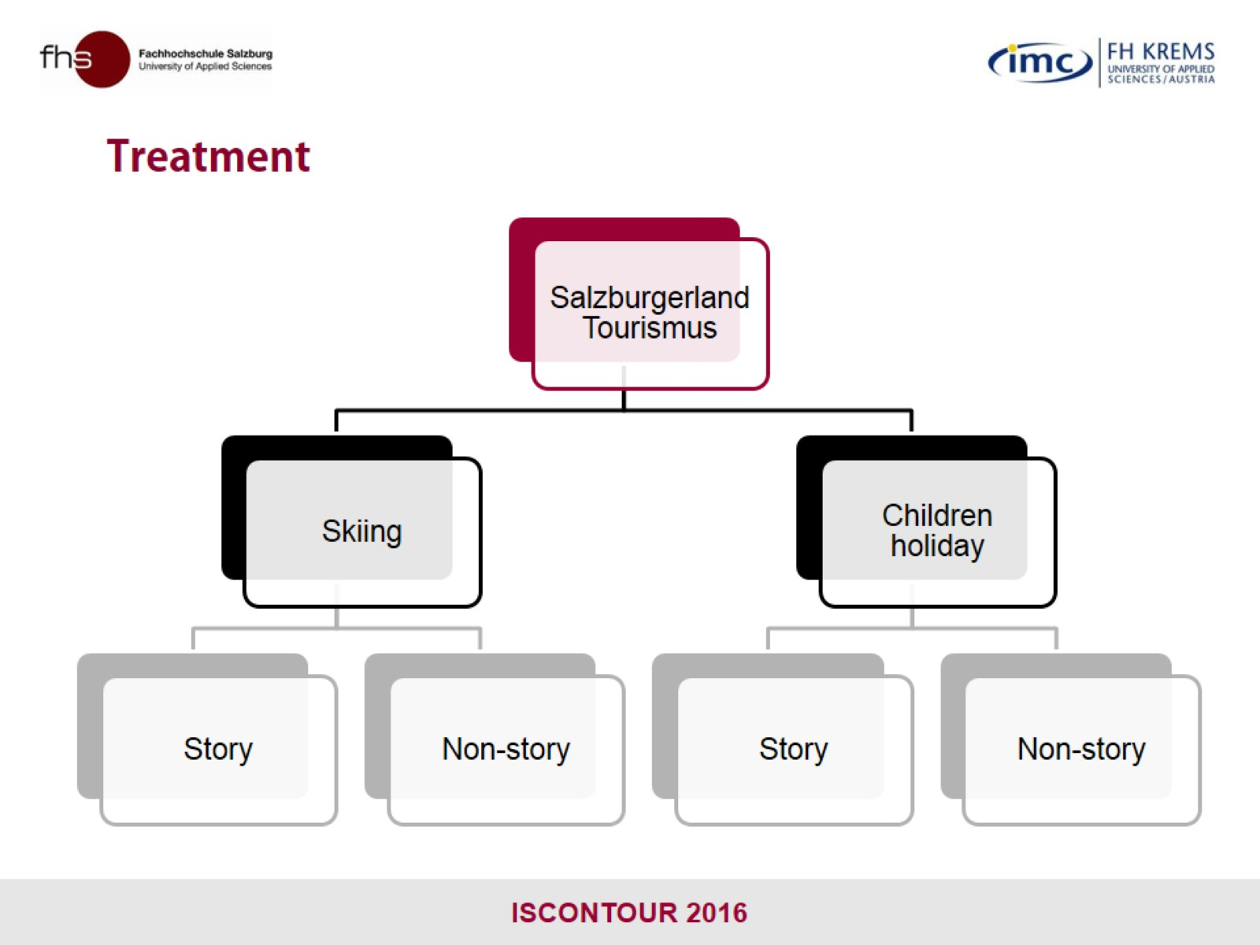

Slide 18
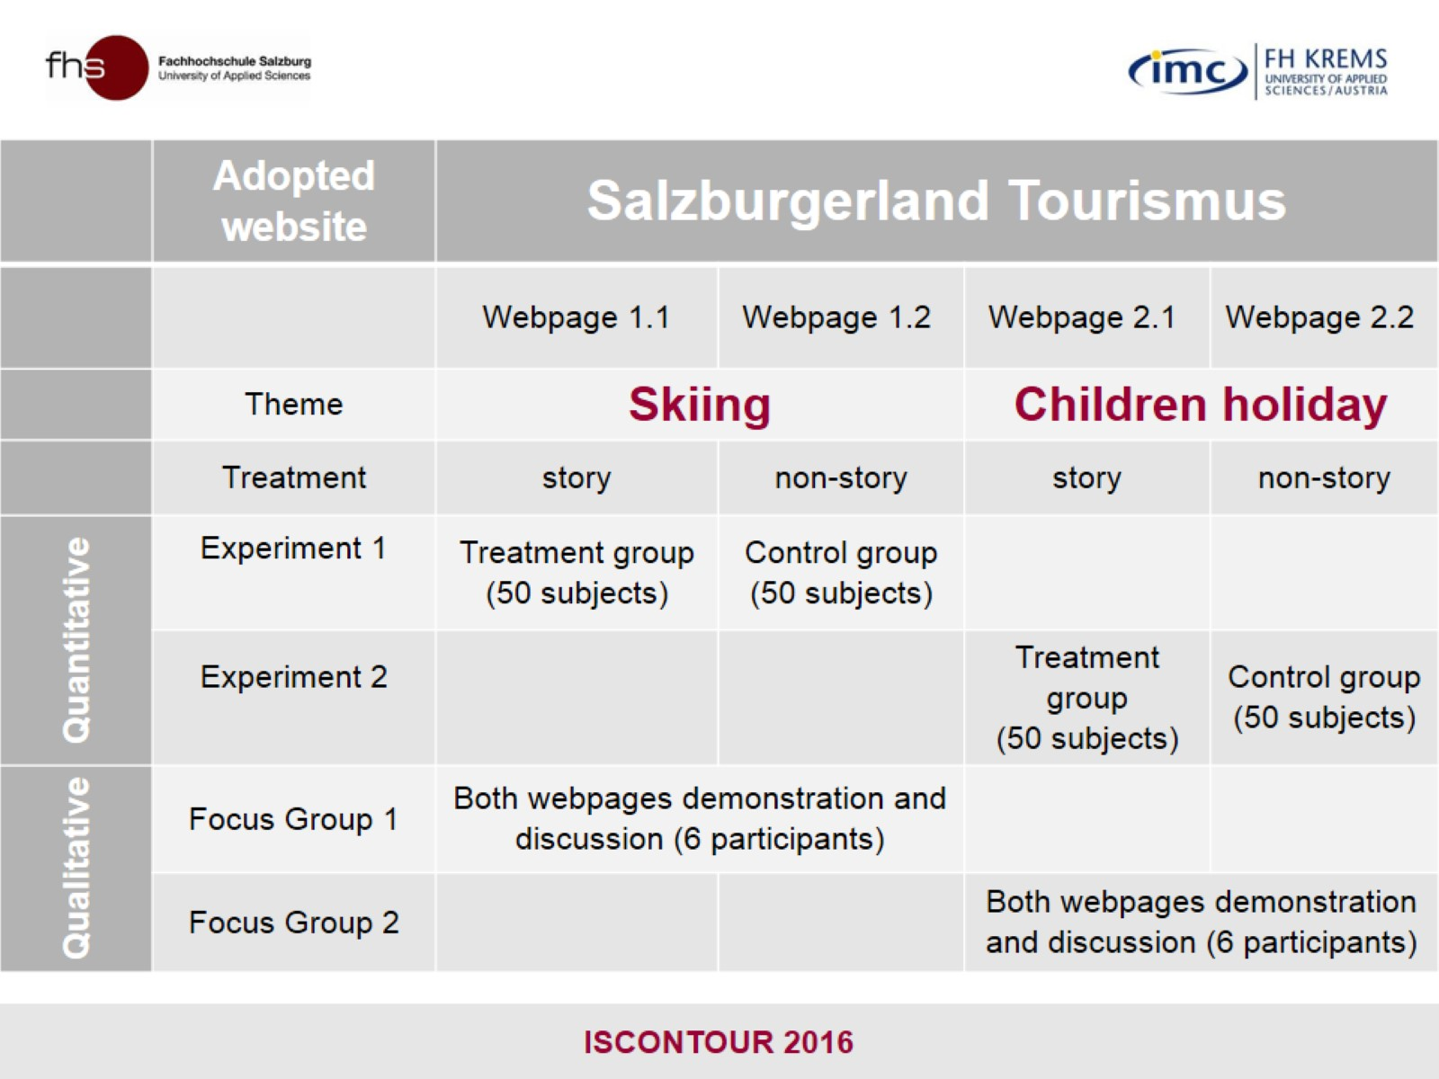

Slide 19
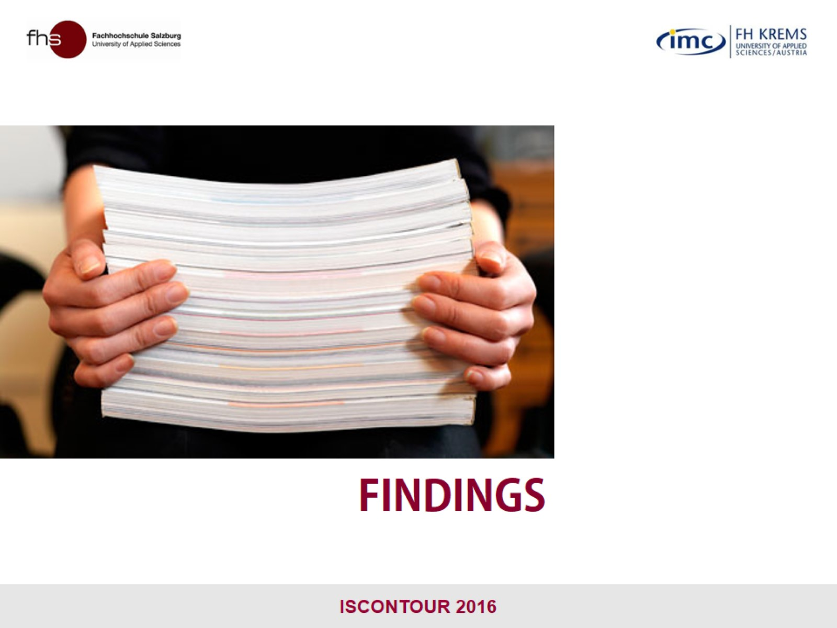
FINDINGS

Slide 20
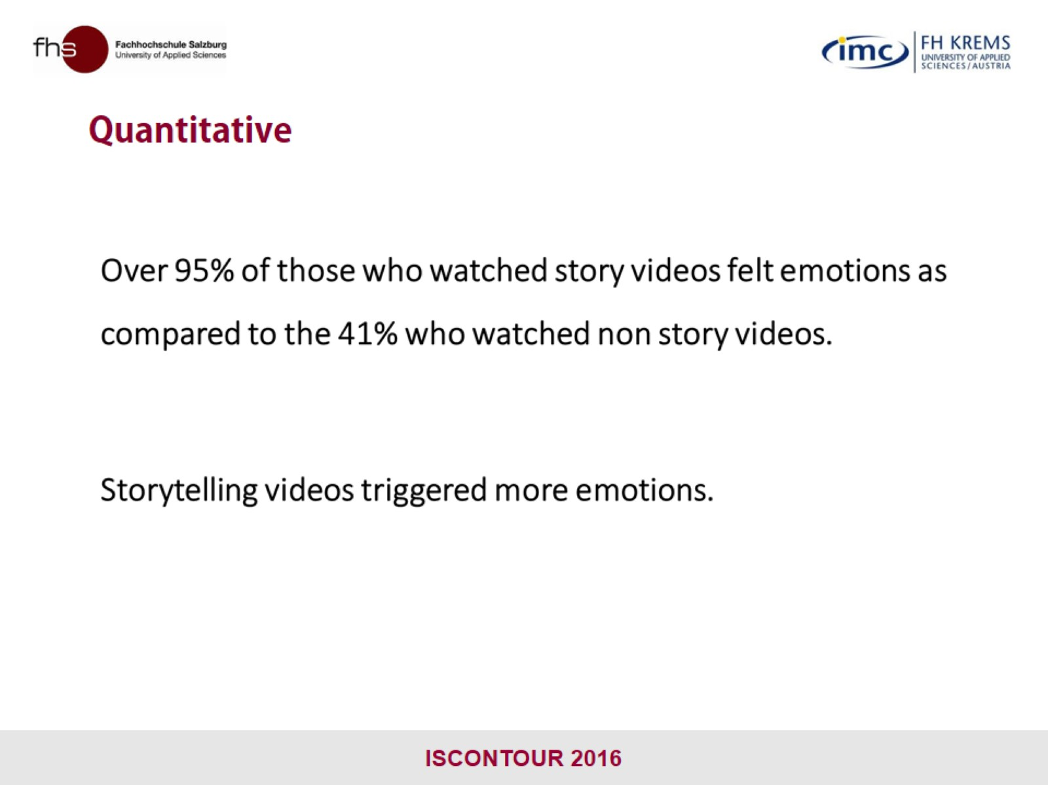
Quantitative

Slide 21
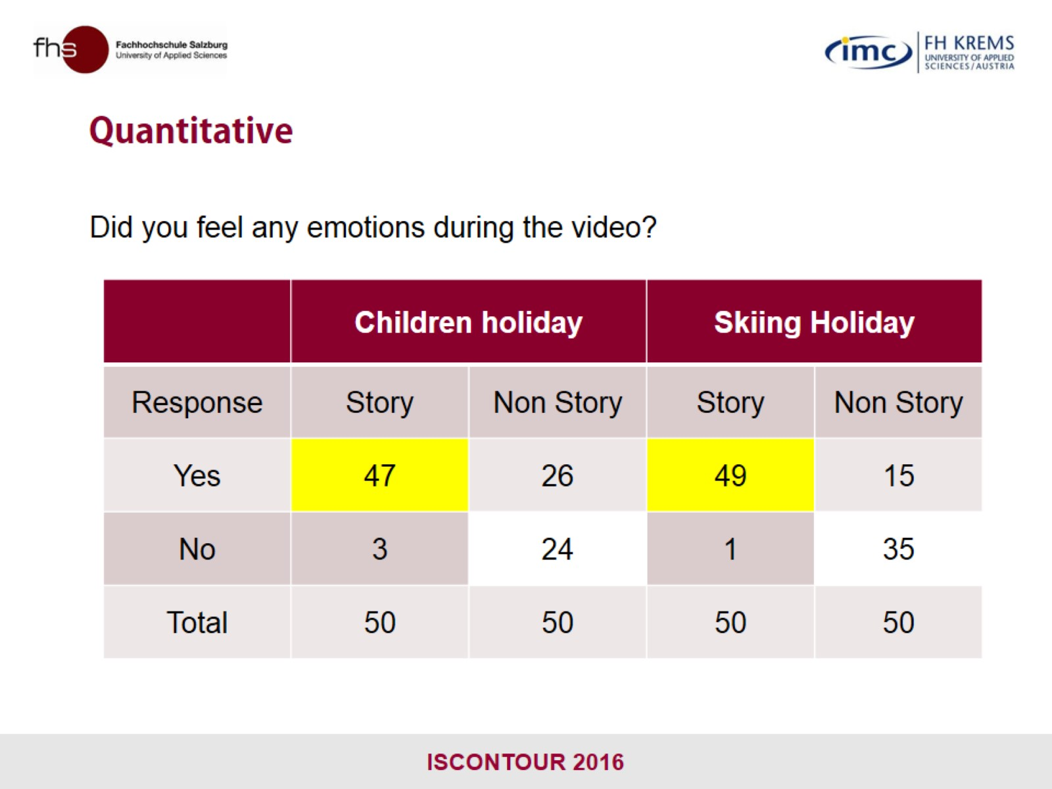
Quantitative

Slide 22
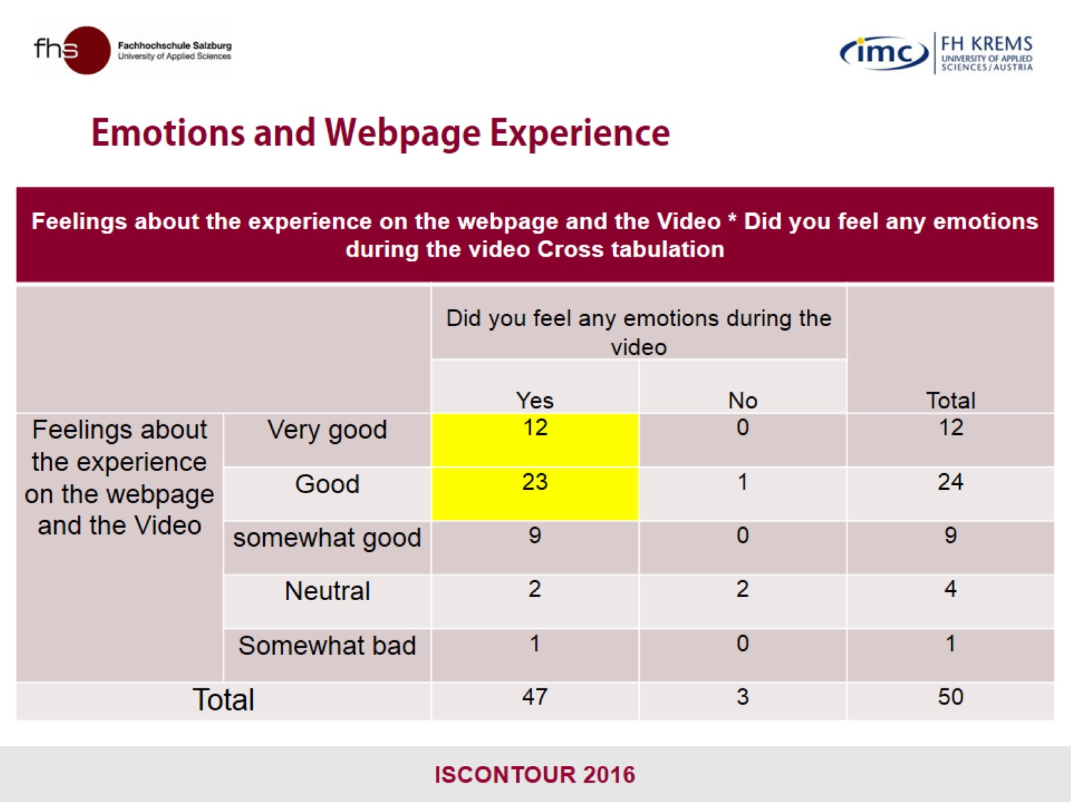
Emotions and Webpage Experience

Slide 23
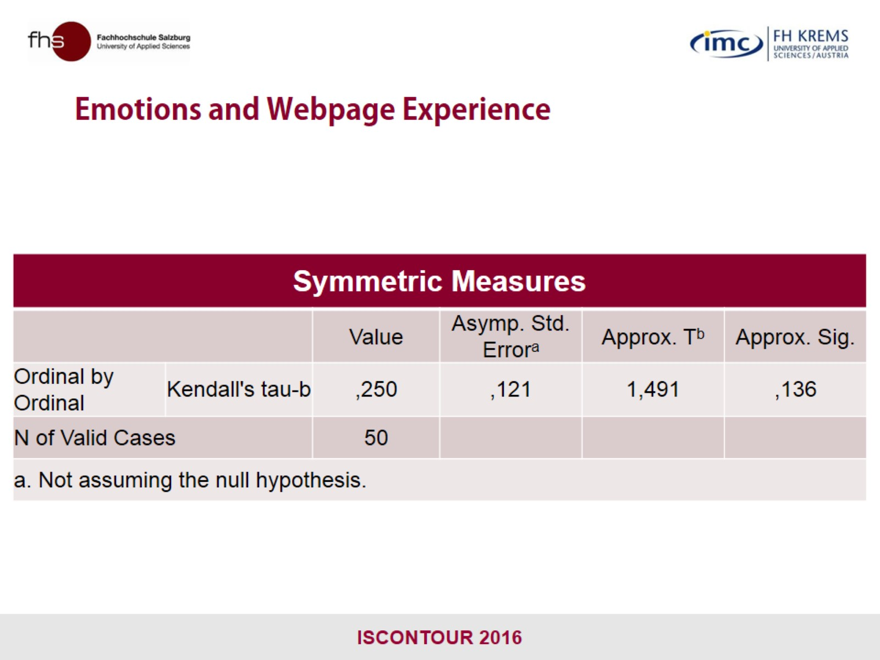
Emotions and Webpage Experience

Slide 24
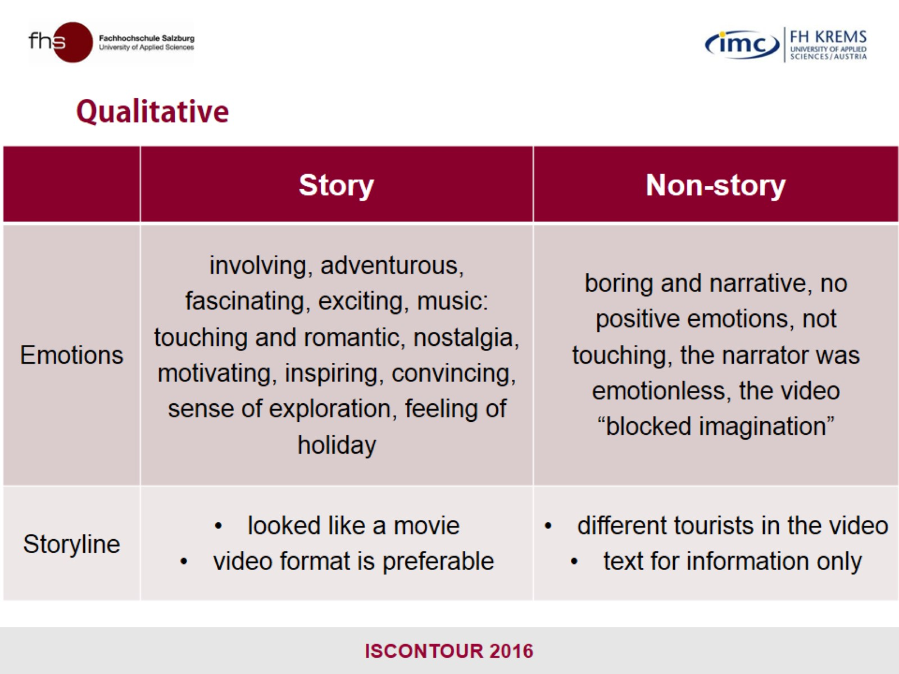
Qualitative

Slide 25
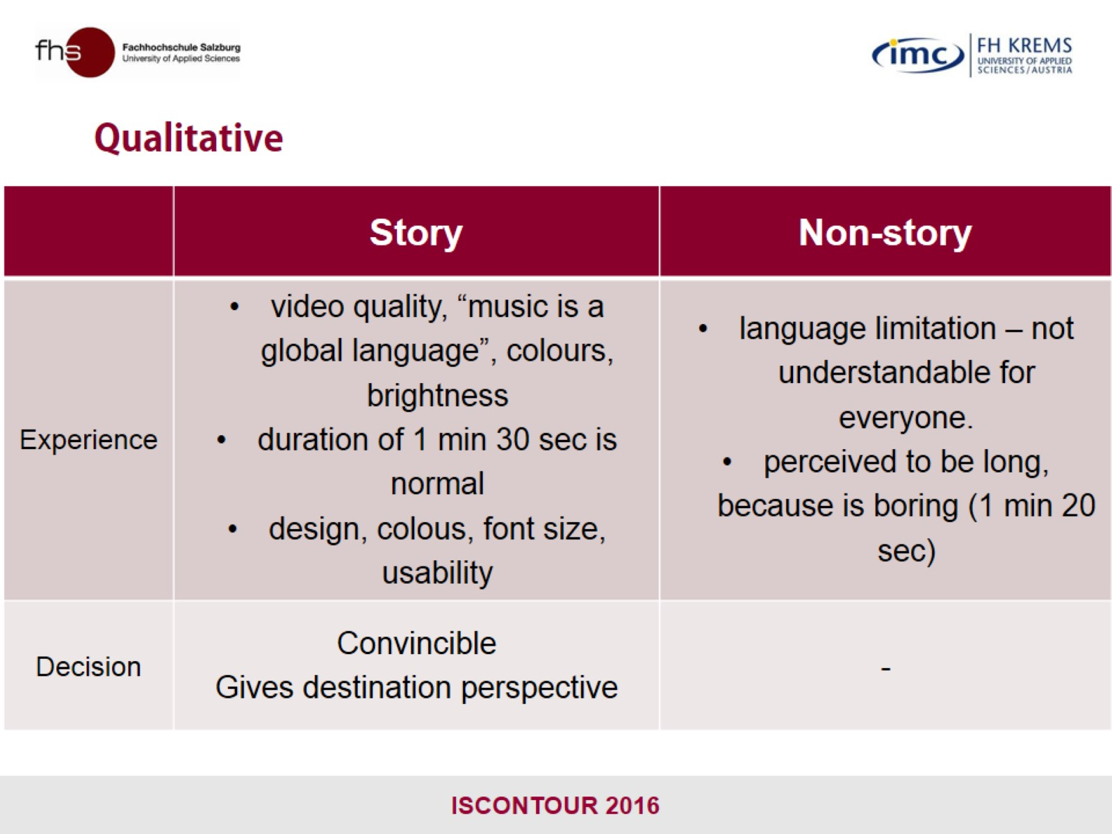
Qualitative

Slide 26


Slide 27
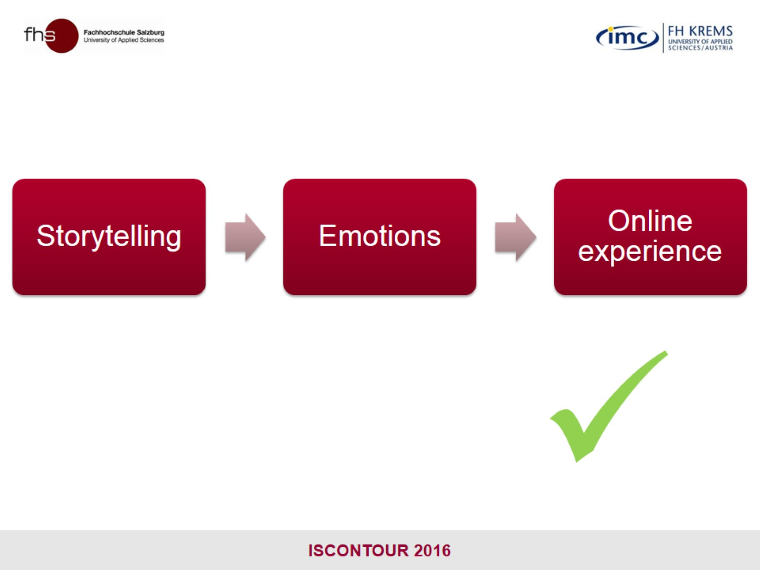

Slide 28
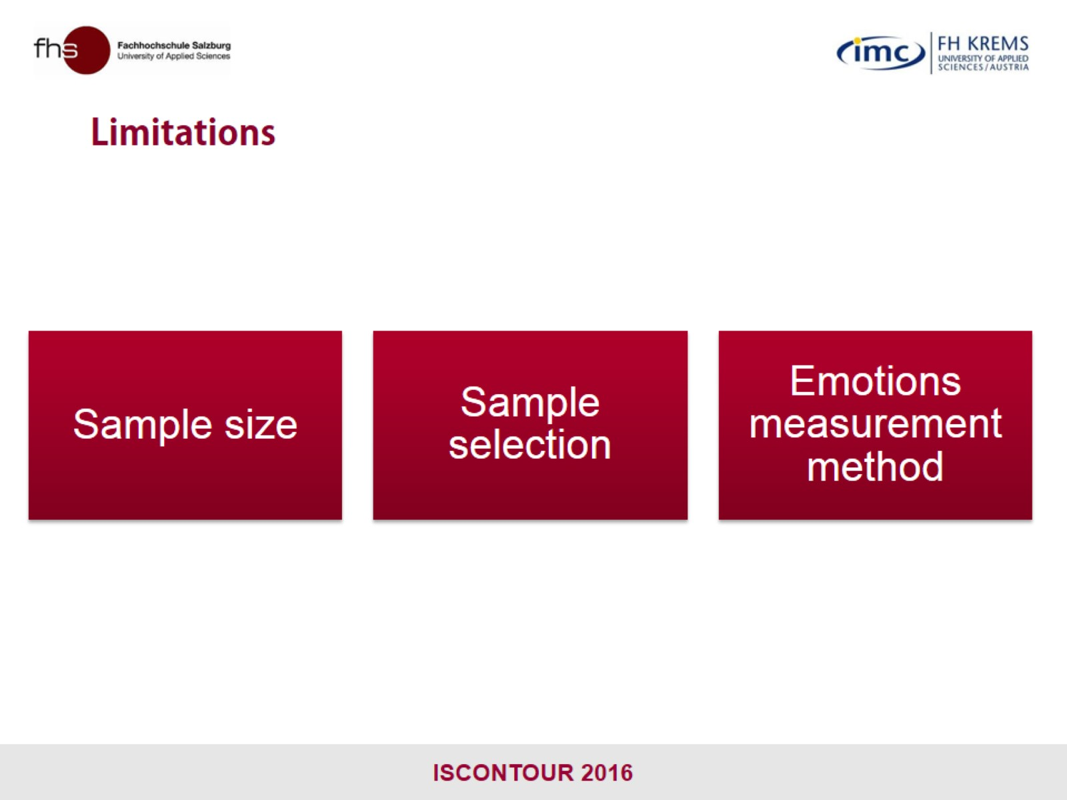
Limitations

Slide 29
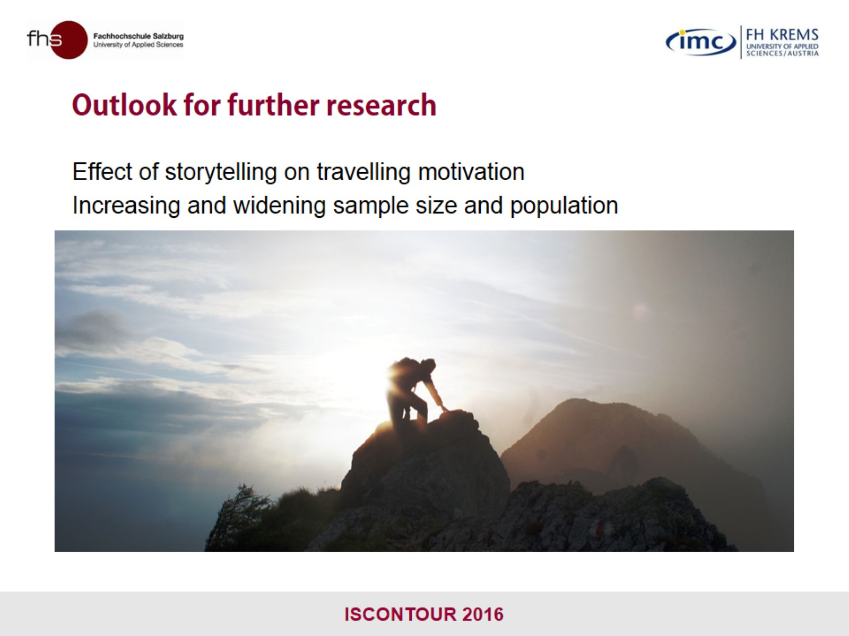
Outlook for further research

Slide 30

Thank you for your attention!

